Slide 1
GIS
(Geographic Information Systems)
Applications in marketing
Austin College
April 2014
Dr. Ronald Briggs
Professor Emeritus
The University of Texas at Dallas
Program in Geospatial Information Sciences
briggs@utdallas.edu

Slide 2
Overview
Geographic Information technologies
GIS data concepts
Applications
  In marketing
  In environmental studies (at noon)

Slide 3
Geographic Information Technologies
GIS: one of three technologies which have revolutionized the handling of spatial or locational data, which is critical for marketing
Global Positioning Systems (GPS)
Remote Sensing (RS)
Geographic Information Systems (GIS)
Made it easy to do things which in the past had been time consuming, expensive, or even impossible
.

Slide 4

Geographic Information Technologies
1. Global Positioning Systems (GPS)
  a system of earth-orbiting satellites which provide precise location on the earth’s surface
  GPS gave us exact locations inexpensively
  didn’t need an expensive surveyor

Slide 5
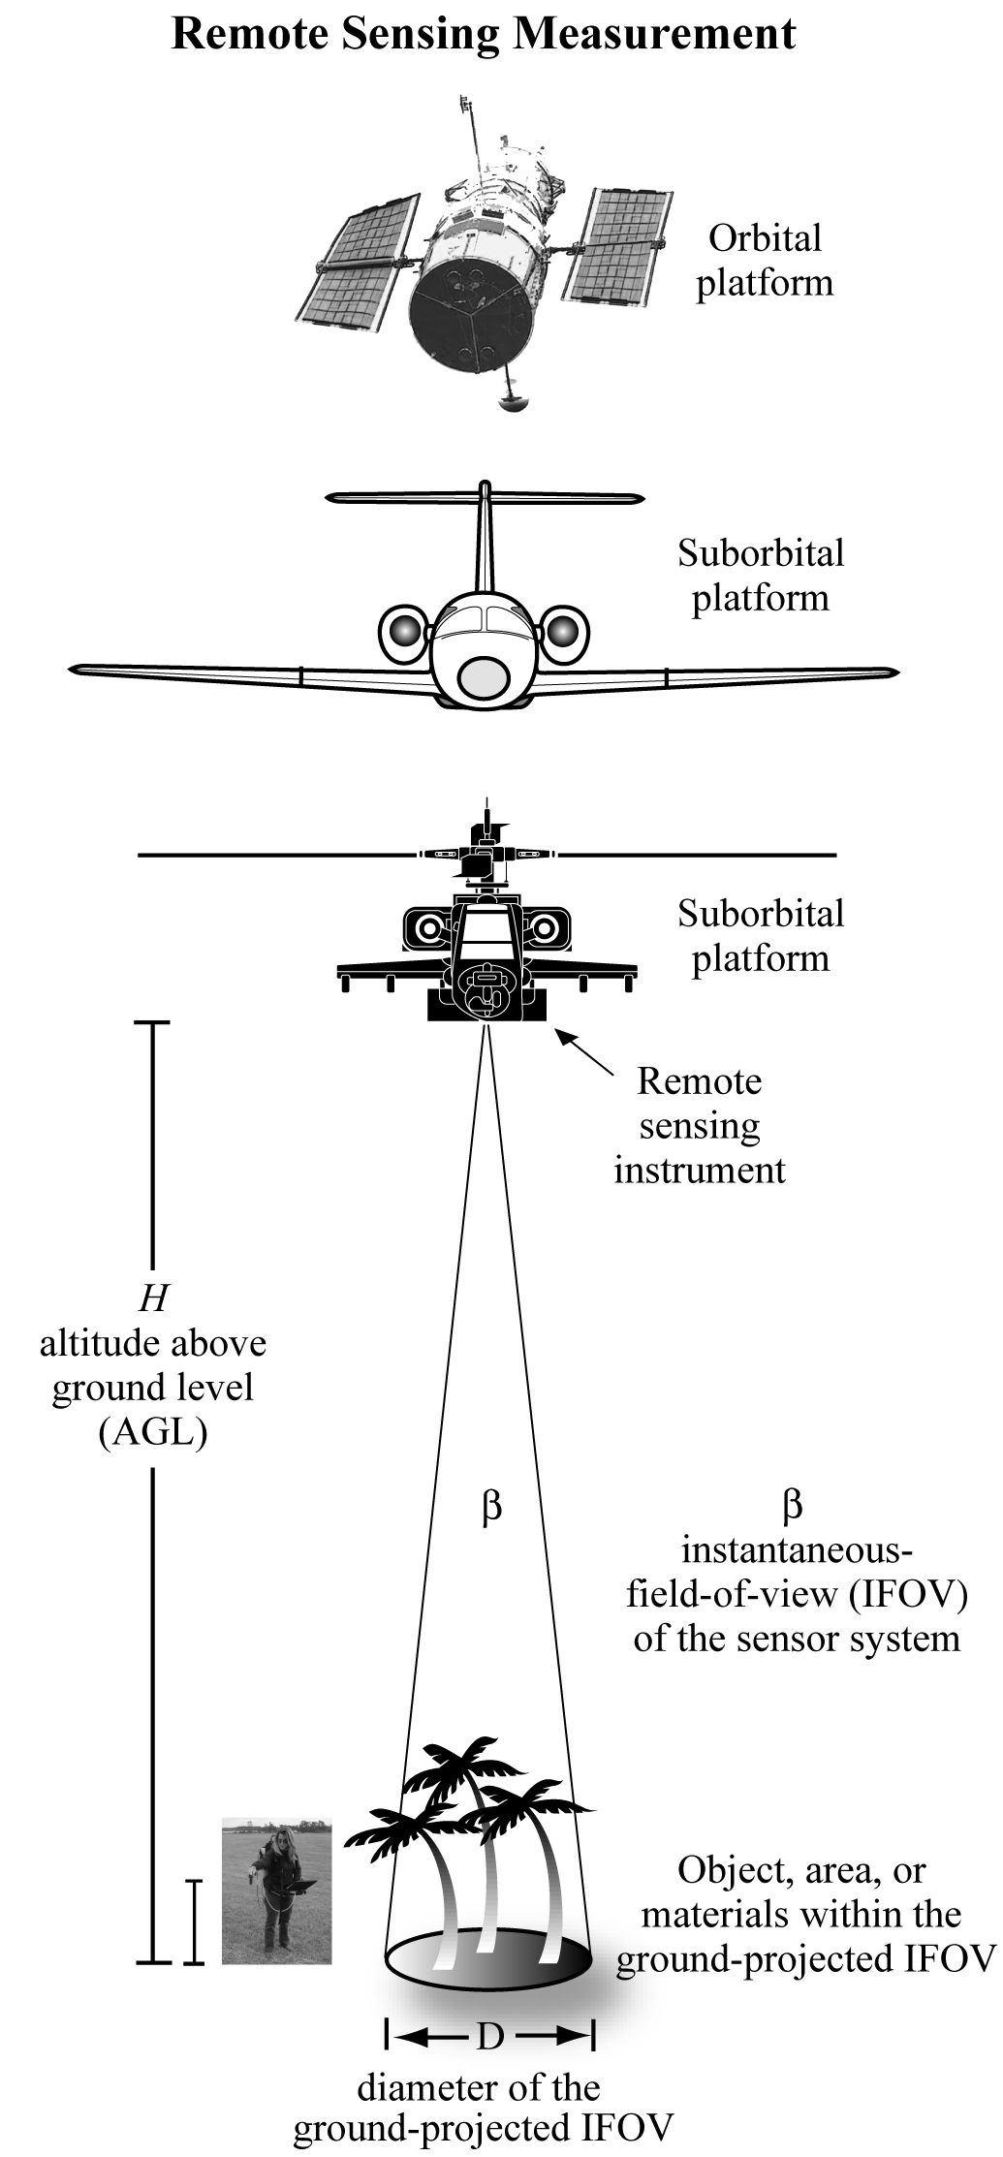

Geographic Information Technologies
2. Remote Sensing (RS)
  collecting data without direct contact with the object being measured
  use of satellites or aircraft to capture information about the earth’s surface
  Expensive field surveys far less necessary
  Especially important for environmental applications

Slide 6
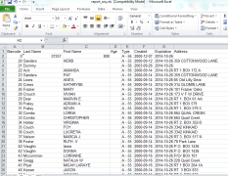

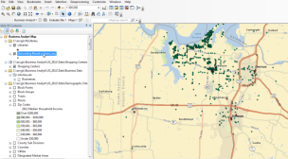
Geographic Information Technologies
3. Geographic Information Systems (GIS)
  Software systems for input, storage, retrieval, analysis and display of geographic (spatial) information
gave us inexpensive map production/display and easier analysis
  don’t need a professional cartographer
  But still need analysts!
Input
Analysis
Display

Slide 7
The Synergism of Three Technologies
  GPS and Remote Sensing provide data for GI Systems.
  GI Systems allow the effective use of GPS and RS data.
GPS data
RS data
GI Systems

Slide 8
GIS data concepts

Slide 9
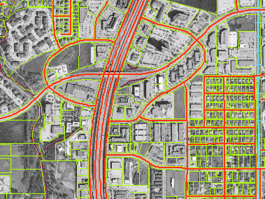
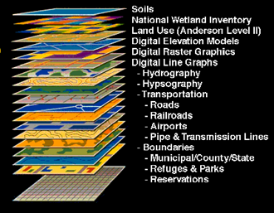
Geographic Information System: intuitive description
A map with a database behind it
Which you can use:
to support on-going operations
  Where are my delivery vehicles now?
to make strategic decisions
  Where shall I locate my new store
to conduct scientific inquiry
  Are grocery prices higher in low income neighborhoods?

Slide 10
Management Information Systems
and
Geographic Information Systems
What’s the difference?
In practice, they are becoming more and more the same, but lets look at the classic differnece

Slide 11
The Uniqueness of GIS uses explicit location on earth’s surface to relate data
SS #
But I don’t have a SS # !!
We all have Latitude and Longtitude !!
Everything happens someplace. Is there anything more in common?
“Allows the integration of disparate data hitherto confined to separate domains”
--allows you to bring stuff together that you couldn’t before
--customer’s homes and store locations
--polluted rivers and factory locations

Slide 12
The GIS Data Model:
A layer-cake of information
Each layer is a different phenomena
  elevation, streets, ownership parcels, land use
Layer are related based on common geographic coordinates
  Latitude & longitude or projected X,Y coordinates

Slide 13
Two data types:
Vector and Raster
“raster is faster but vector is corrector”
Real World
Raster Representation
Vector Representation
point
line
polygon

Slide 14
Representing Data with Raster and Vector Models
1. Raster Model
area is covered by grid of equal-sized, square cells (usually)
each cell given a single value based on the majority feature in the cell, such as land use type.
0
1
2
3
4
5
6
7
8
9
0
1
1
1
1
1
4
4
5
5
5
Multi-family
retail
1
1
1
1
1
1
4
4
5
5
5
2
1
1
1
1
1
4
4
5
5
5
3
1
1
1
1
1
4
4
5
5
5
4
1
1
1
1
1
4
4
5
5
5
Single family
5
2
2
2
2
2
2
2
3
3
3
industry
6
2
2
2
2
2
2
2
3
3
3
7
2
2
2
2
2
2
2
3
3
3
retail
8
2
2
4
4
2
2
2
3
3
3
9
2
2
4
4
2
2
2
3
3
3

Slide 15
Representing Data with Raster and Vector Models
Raster Model
Great for some data such as elevation, rainfall, land use
  environmental data in general
Doesn’t work so well for others such as land ownership, streets,
  human data in general
0
1
2
3
4
5
6
7
8
9
0
1
1
1
1
1
4
4
5
5
5
Brown
Lee
1
1
1
1
1
1
4
4
5
5
5
2
1
1
1
1
1
4
4
5
5
5
3
1
1
1
1
1
4
4
5
5
5
4
1
1
1
1
1
4
4
5
5
5
Smith
5
2
2
2
2
2
2
2
3
3
3
Santos
6
2
2
2
2
2
2
2
3
3
3
7
2
2
2
2
2
2
2
3
3
3
Lee
8
2
2
4
4
2
2
2
3
3
3
9
2
2
4
4
2
2
2
3
3
3

Slide 16
Representing Data with Raster and Vector Models
Vector Model
Features in the real work can be represented either as:
points (nodes): intersections, stores, homes, trees, poles, fire plugs, airports, cities
lines (arcs): streets, sewers, streams
areas (polygons): land parcels, voting precincts, cities, counties, forest, rock type
1
II
2
Birch
5
I
Smith
Estate
A34
III
A35
6
4
IV
3
Cherry
More complex, but more accurate and flexible

Slide 17
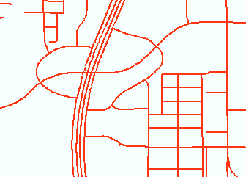
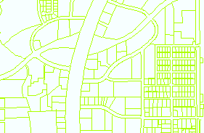
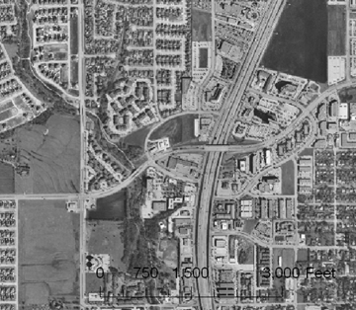
Example
2 vector
Layers
Street Network layer: lines
Land Parcels layer: polygons
Raster layer (image)
Digital Ortho Photograph
Digital Ortho photo:
visual properties of a photograph with the positional accuracy of a map, in computer readable form.

Slide 18
Overlay based on Common Geographic Location

Slide 19
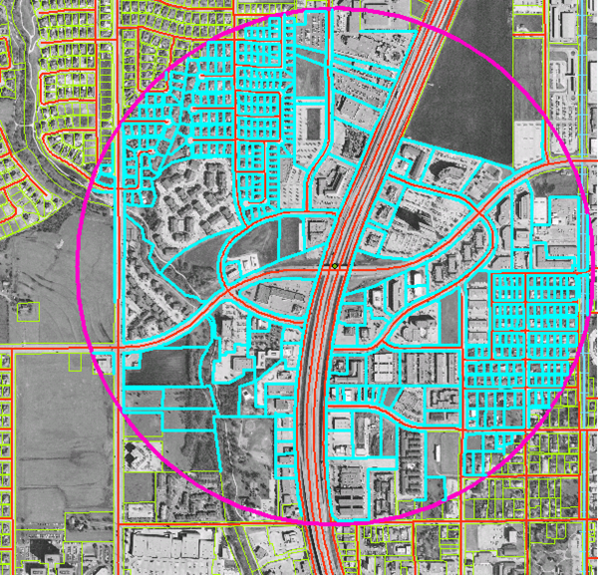
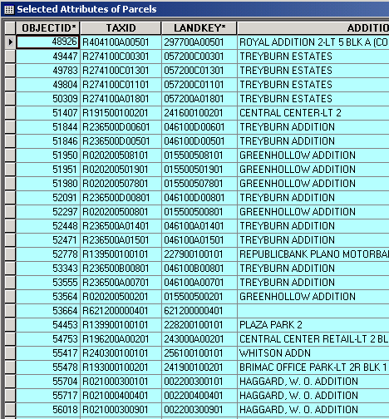
Analysis
Parcels within a half mile buffer of Park and Central
Data Table

Slide 20
GIS in practice
Marketing examples

Slide 21
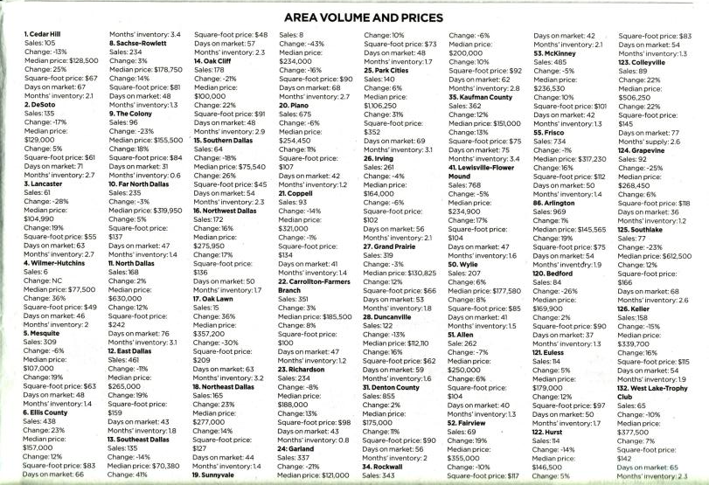
Real estate sales and prices
Dallas area, year on year 1st Q 2014
Source: Dallas Morning News Friday April 18, 2014, p. 7D

Slide 22
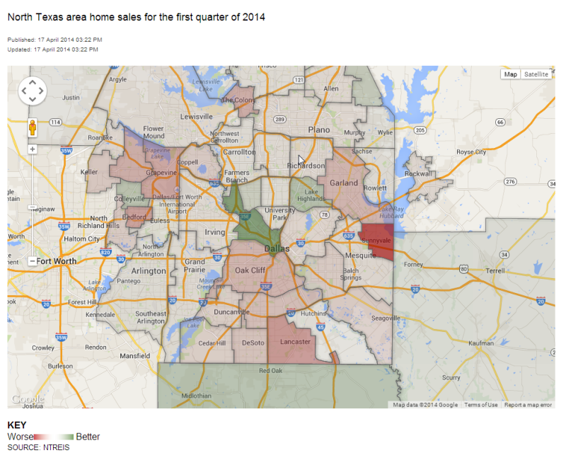
Interactive database—click on Richardson
http://www.dallasnews.com/business/databases/20140417-area-home-sales.ece

Slide 23
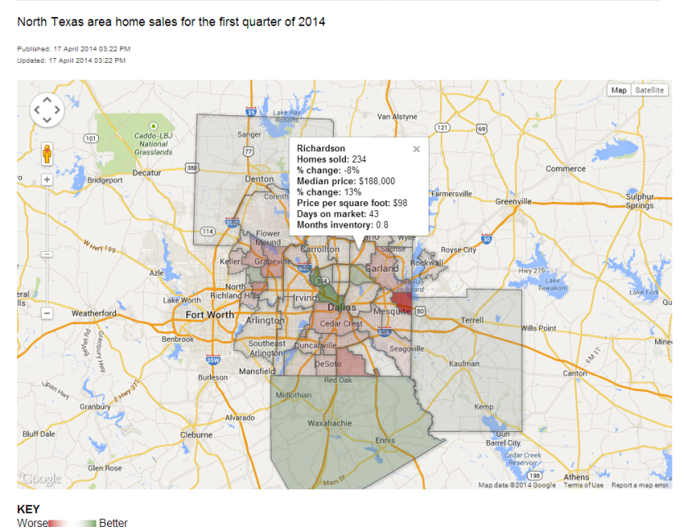
MGIS: map with a database behind it

Slide 24
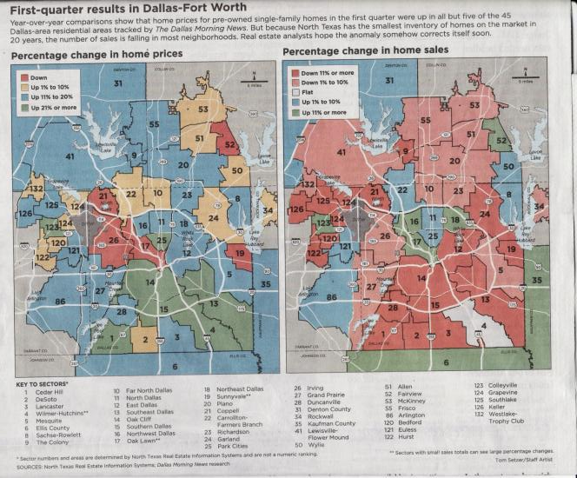
Real estate sales and prices
Dallas area, year on year 1st Q 2014
Color-coded or Choropleth map
Source: Dallas Morning News Friday April 18, 2014, p. 1D

Slide 25
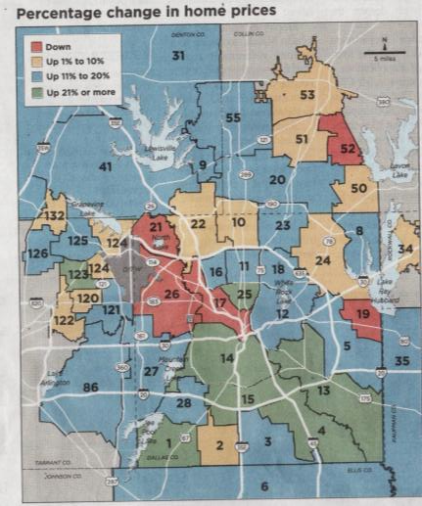
Real estate sales prices
Analysis
Prices down cluster
21 Coppell
26 Irving
17 Oak Lawn
Prices up cluster
14 Oak Cliff
15 Southern Dallas
13 Southeast Dallas
4 Wilmer-Hutchins
Analysis: Why?
Source: Dallas Morning News Friday April 18, 2014, p. 1D

Slide 26
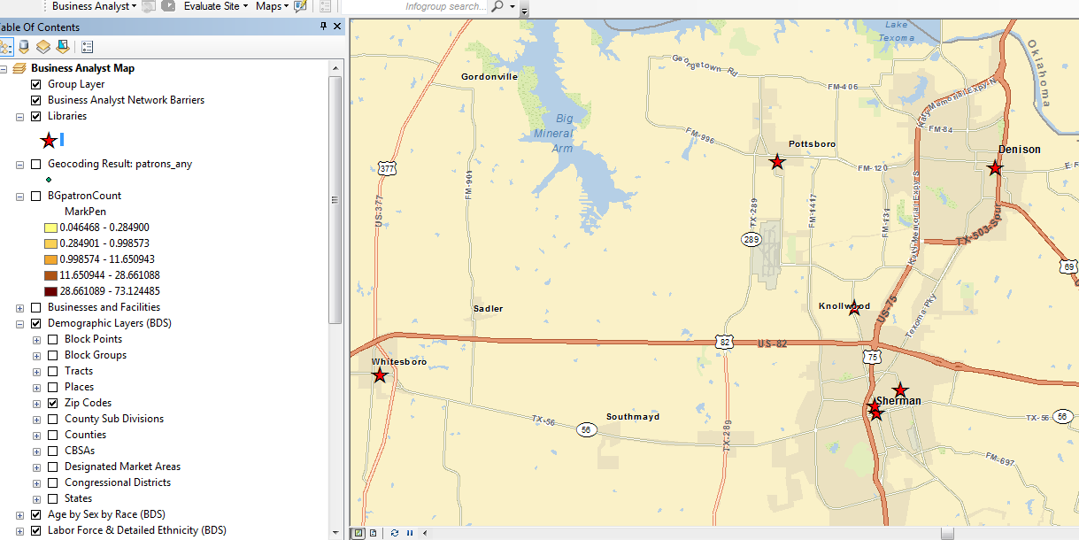
Market Area Analysis using GIS for
Pottsboro Regional Library
Competitors
(other libraries)
Demographic Data
(potential market)
Data from ESRI, Inc. ArcGIS Business Analyst

Slide 27
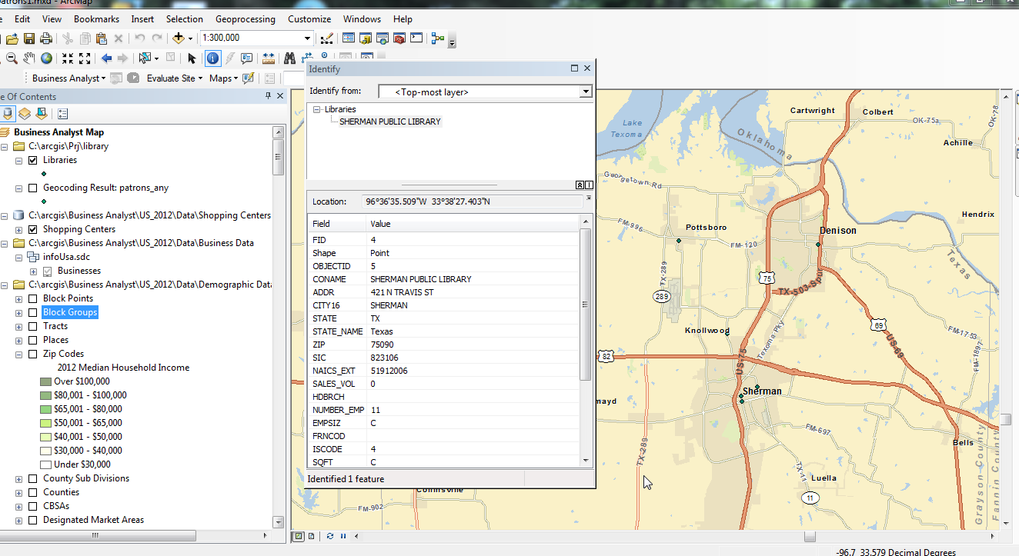
Information on competitors
GIS: map with a database behind it.

Slide 28
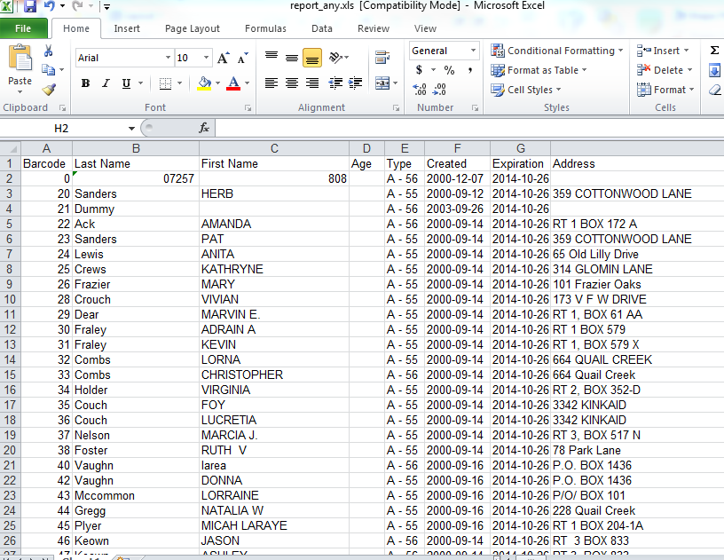
Current customers: list derived from operational records

Slide 29
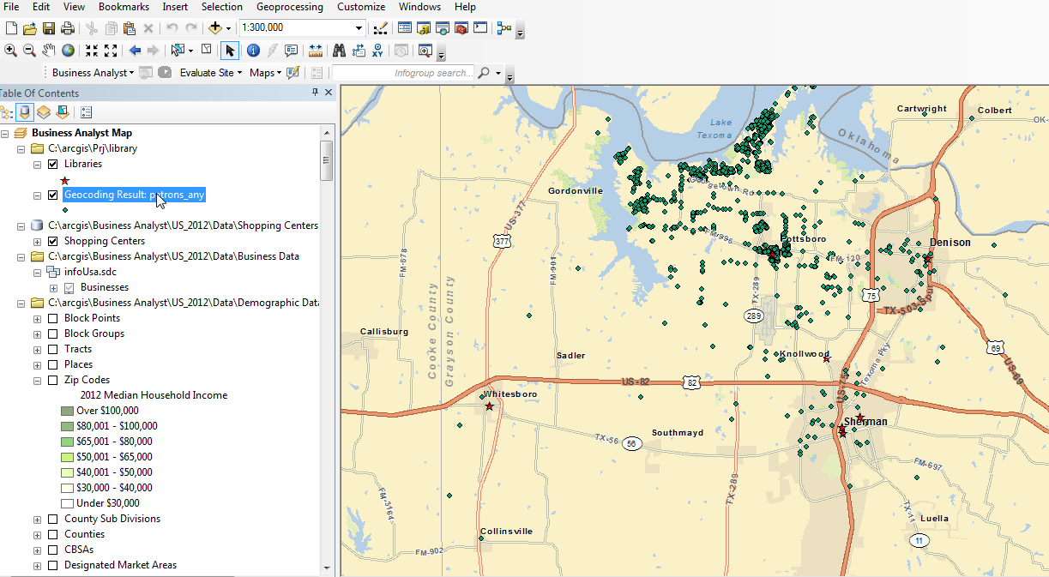
Customers geocoded to their home address

Slide 30
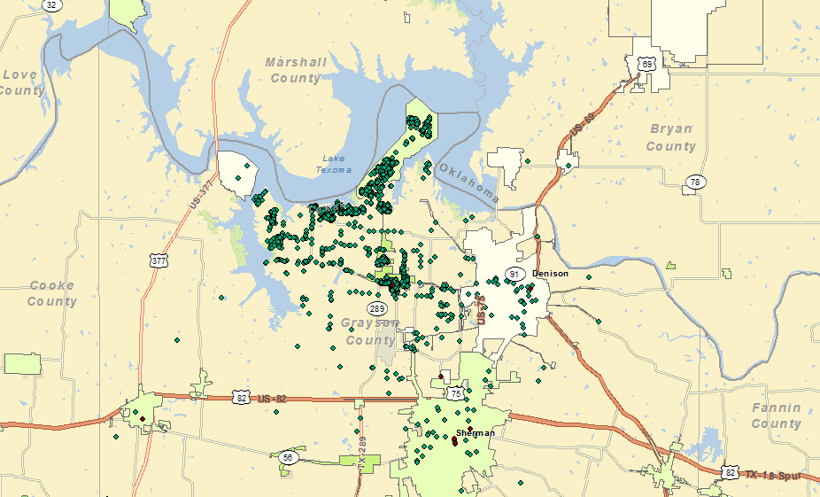
Location of library card holders, Pottsboro Area Public Library,
Overlay of city boundaries
November, 2013

Slide 31
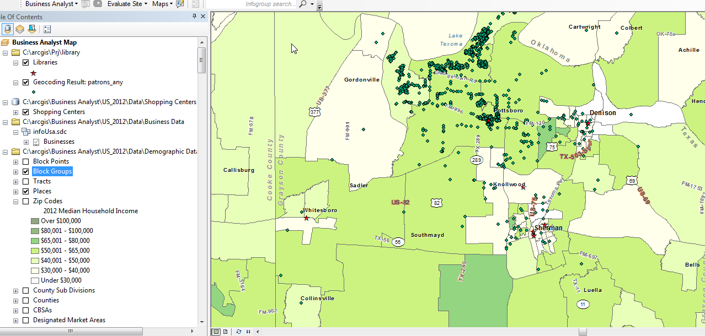
Demographic data on our market area:
--data by census block
--use to calculate market penetration

Slide 32
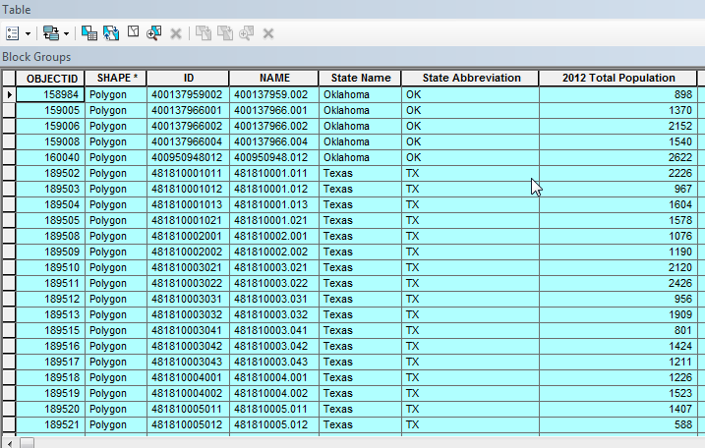
Population in each census block group:
--need to add count of our customers

Slide 33
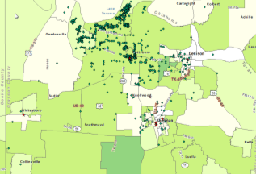
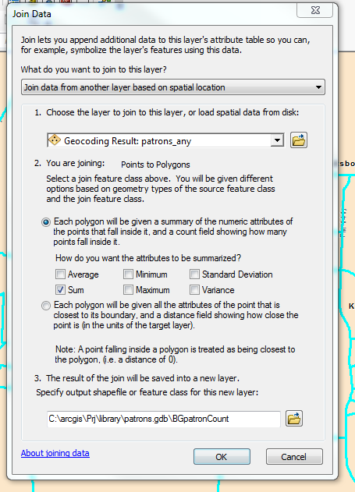
Points in polygon operation
--counts the number of points falling in each polygon
--the number of customers in each block group
Achieved with a spatial join
--join points file to polygon file
Calculate market penetration
--now have population and count of customers for each block group we can calculate market penetration as:
Customer Count / Total Population*100

Slide 34
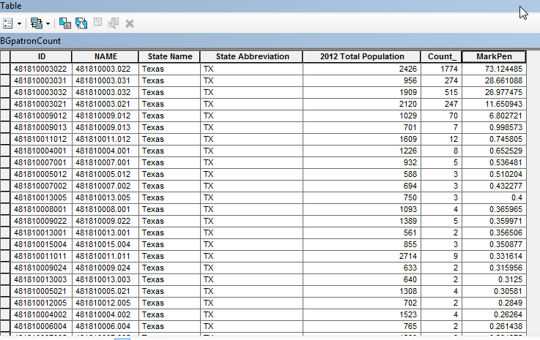
Spatial join adds Count of customers for each polygon
Market Penetration calculated as:
MarkPen = Count (of customers)/2012 Total Population*100

Slide 35
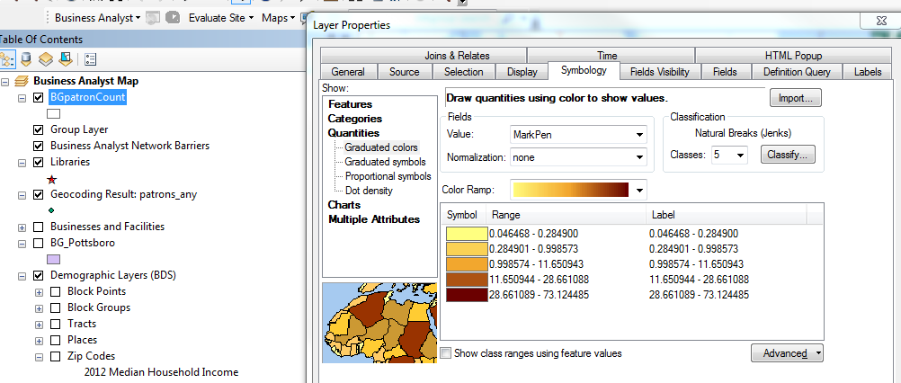
Creating a color coded (choropleth) map
for market penetration

Slide 36
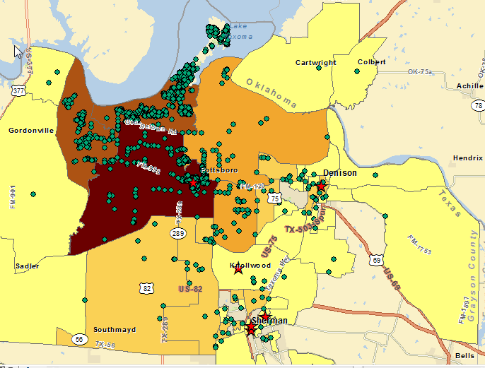
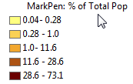
Market Penetration map

Slide 37
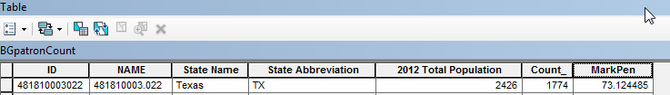
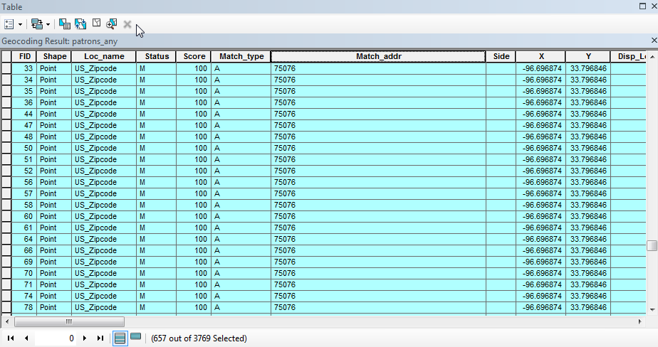
73% is a remarkably successful market penetration!
Data problem! 657 patrons have only zip code for address
--all geocoded to same location
96.697 33.797

Slide 38
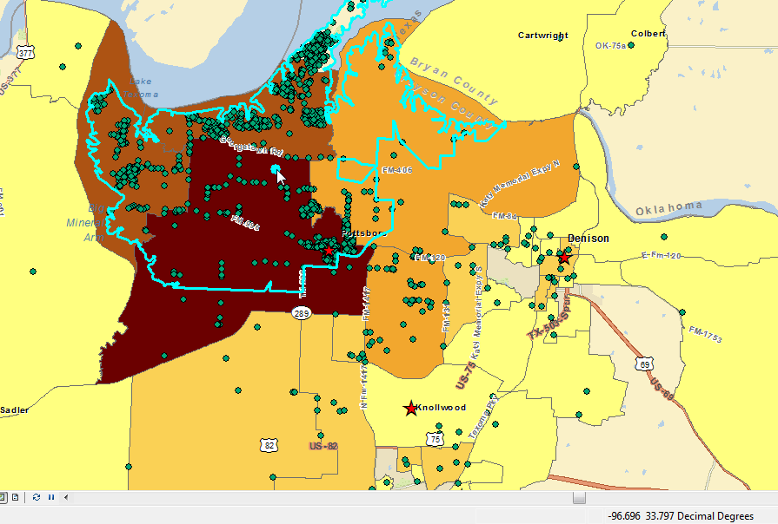
657 patrons geocoded to here
(center point for 75076)
But could live anywhere in here (75076 zip code area)

Slide 39
In God we trust, all others bring data.
Michael Bloomberg
In God we trust, all others bring good data.

Slide 40
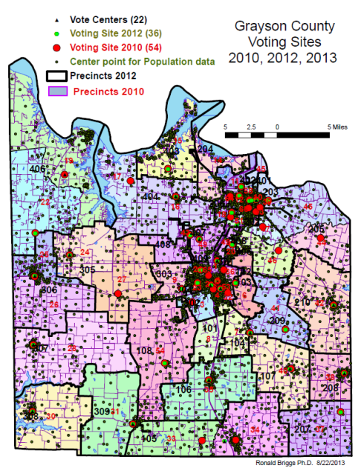
Voting sites reduced from 54 in 2010 to 36 in 2012 to 22 in 2013
  but could vote at any site in 2013
No analysis done
  Would this increase distances voters had to travel?
  Would it differentially impact minorities?

Slide 41
Data for all census blocks in Grayson County (6,705) for total population, voting age population, and four racial/ethnic groups
Use GIS to calculate average travel distance to
  54 local precinct voting sites in 2010
  36 local precinct voting sites in 2012
  22 closest voting site (irrespective of precinct) in 2013

Slide 42
Grayson County Texas | Average Travel Distance to Poling Sites
PANEL A Distance in miles | Total | 18 and Over
 | Population | Population | Hispanic | Anglo | AfAm | Mix & Other
Voting Sites 2012 (36) | 2.27 | 2.33 | 1.54 | 2.50 | 1.17 | 2.08
Voting Centers 2013 (22) | 2.20 | 2.24 | 1.51 | 2.39 | 1.26 | 2.06
PANEL B Change in miles
 | -0.07 | -0.08 | -0.03 | -0.10 | 0.09 | -0.02
PANEL C % Change
 | -3.2 | -3.6 | -2.1 | -4.2 | 7.8 | -1.1
Comparing results for 2012 (36 sites) when had to vote at your site,
to 2013 (22 sites) when vote at any site
  average travel distances went down (negative values for change)
  flexbility of going to any site offset the smaller number of sites (22 rather than 36)
African Americans the sole exception
  Travel distance increased by 7.8%
  But only 484 feet in absolute terms

Slide 43
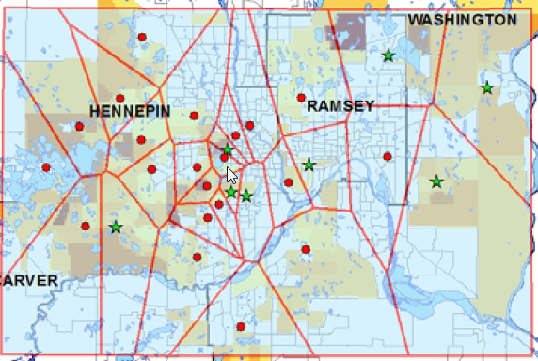
Thiessen (Voroni) polygons:
--the area closer to a point than to any other point
--a store’s “natural” trade area
Source: Jesse K. Pearson A Comparative Business Site-Location Feasibility Analysis using GIS Systems and the Gravity Model
Department of Resource Analysis, Saint Mary’s University of Minnesota, Minneapolis, MN

Slide 44
Thiessen polygons: applications
Calculate customer potential in each area polygon
Do each of your stores have similar penetration
  Are there laggards?
consider new stores at intersection of polygons with large customer potential

Slide 45
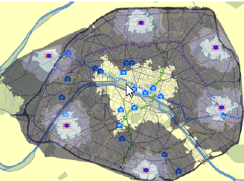
Drive-time analysis for store locations: commonly used to assess the potential of different possible sites

Slide 46
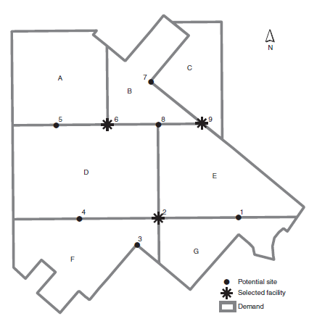
Maximal coverage models
Given
A set of demand polygons (7)
A set of potential sites (9)
Where locate three facilities
to maximize sales (stores)
to minimize travel distance
(fire stations)
Source: Church and Murray 2008

Slide 47
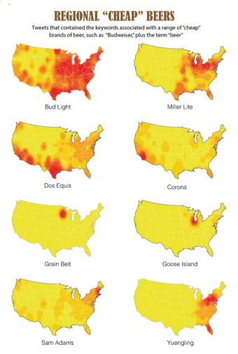
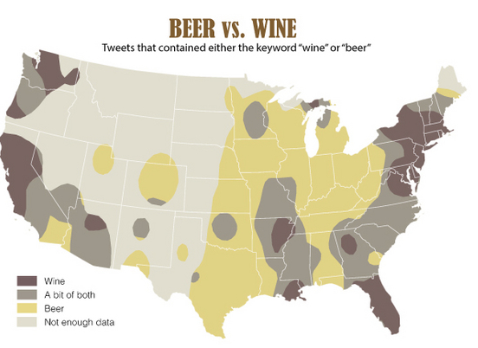
GIS and Social Media
Matthew Zook , et. al. "The Geography of Beer.” Department of Geography, University of Kentucky
Tweets sent between June 2012 and May 2013 were searched for keywords pertaining to beer. Geotagging allowed the tweets to be located on a map
http://www.livescience.com/44622-beer-on-twitter-finding-drinking-patterns-in-tweet-data-infographic.html

Slide 48
Thank you for inviting me
Questions?
briggs@utdallas.edu
www.utdallas.edu/~briggs
(under Presentations)

Slide 49
Resources: books and papers
Richard L. Church, Alan T. Murray Business Site Selection, Location Analysis and GIS
Wiley InterScience On-line, ISBN: 9780470432761, 2008
Miller, F. GIS tutorial for marketing. Redlands, CA: ESRI Press, 2007
Miller, F. Getting to Know ESRI Business Analyst. Redlands, CA: ESRI Press, 2010
Pick, James B. Geo-Business: GIS in the Digital Organization. Wiley, 2008
Boyles, David. GIS means business, Redlands, CA: ESRI Press, 2002
Grant Thrall, Business Geography and New Real Estate Market Analysis (Oxford: Oxford University Press, 2002)
Shepherd, Ian D. H. From Geography Department to Business School: Strategies for Transplanting GIS Courses between Disciplines Journal of Geography in Higher Education, 2009, Vol.33(1), p.28-45
http://www.gis.smumn.edu/GradProjects/RingoL.pdf
Linder G. Ringo Utilizing GIS-Based Site Selection Analysis for Potential Customer Segmentation and Location Suitability Modeling to Determine a Suitable Location to Establish a Dunn Bros Coffee Franchise in the Twin Cities Metro, Minnesota
Department of Resource Analysis, Saint Mary’s University of Minnesota, Minneapolis MN

Slide 50
Resources: on-line examples
http://www.gis.smumn.edu/GradProjects/RingoL.pdf
Linder G. Ringo Utilizing GIS-Based Site Selection Analysis for Potential Customer Segmentation and Location Suitability Modeling to Determine a Suitable Location to Establish a Dunn Bros Coffee Franchise in the Twin Cities Metro, Minnesota
Department of Resource Analysis, Saint Mary’s University of Minnesota, Minneapolis MN
http://www.gis.smumn.edu/GradProjects/PearsonJ.pdf
Jesse K. Pearson A Comparative Business Site-Location Feasibility Analysis using GIS Systems and the Gravity Model
Department of Resource Analysis, Saint Mary’s University of Minnesota, Minneapolis, MN

