Slide 1
Skin Lesion Analysis Toward Melanoma Detection: 2017 ISIC Challenge
Anupa Desai
MATH 4v91
Prof. Baris Coskunuzer

Slide 2
Motivation
Most prevalent form of cancer in the US is skin cancer
Melanoma- the most dangerous type - 9000 deaths/year[1]
Diagnostic accuracy of unaided expert inspection is ~ 60%[2]
With dermoscopy, diagnostic accuracy is 75% - 84%[2 3]
Reports indicate a growing shortage of dermatologists per capita[4]
⇒ Increased need and interest in techniques for automated inspection of dermoscopic images

Slide 3
What is ISIC challenge?
A challenge at the International Symposium for Biomedical Imaging (ISBI), hosted by International Skin Imaging Collaboration (ISIC)
The 2017 challenge has 3 parts and participants could choose to participate in any/all of the 3 parts:
1. Skin Lesion Segmentation - prediction of lesion segmentation boundaries
2. Detection and Localization of Visual Dermoscopic features - prediction of dermoscopic features - used by expert dermatologists to evaluate skin lesions
3. Disease Classification - binary classification of (i) melanoma and (ii) nevus and Seborrheic Keratosis & (i) Seborrheic Keratosis and (ii) nevus and Melanoma

Slide 4
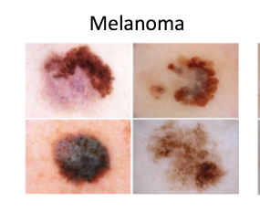
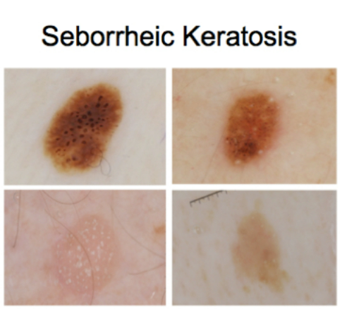
My Dataset
2017 challenge
2000 Images - training set:
1371 Normal Images
374 Melanoma
255 Seborrheic Keratosis
My task: trying 2 classification techniques:
100 Normal and 100 Melanoma (Binary classification)
100 Normal, 100 Melanoma and 100 Seborrheic Keratosis (3-label classification)
Image size: Variable, ranging from 767 x 767 to 4400 x 6700

Slide 5
Methods
Preprocessing:
→ loading data into my code
⇒ 3 kind of files: csv, png and jpg - kept jpg and deleted the rest
→ Sorting them into their respective folders using the excel sheet provided
Grayscaling:
→ After resizing images to 750 by 750, I converted each image to grayscale using imread
→ imread - float values of image in [-1,1]
→ Normalized it to the range [0, 255]

Slide 6
3. Persistence diagram:
→ Supplied each image grayscale value to the cubical persistence function from giotto tda, for homology dimension 0
4. Vectorization:
→ Betti functions with n_bins = 150
→ Silhouette with p = 1
5. Training the model using Random Forest Classifier

Slide 7
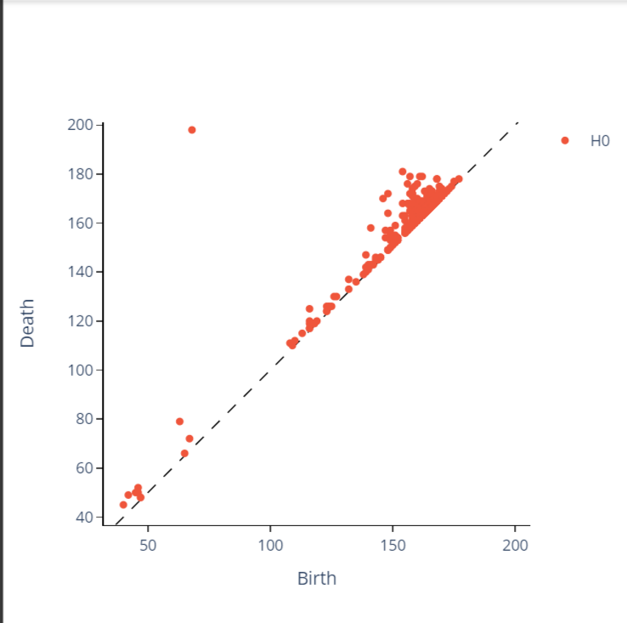
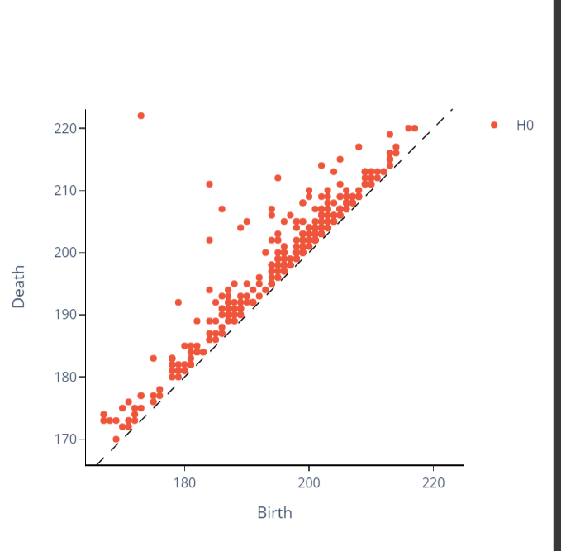
Melanoma Images
Normal Images

Slide 8
Results
Binary Classification (100 Melanoma and 100 Normal)
3-label Classification (100 Normal, 100 Melanoma and 100 Seborrheic Keratosis)
Vectorization | AUC | Accuracy
Betti_0 | 0.675 | 0.648
Silhouette for p = 1 | 0.603 | 0.575
Vectorization | AUC | Accuracy
Betti_0 | 0.52 | 0.498

Slide 9
Team | Approach | AUC | Accuracy
Casio and Shinshu University Joint | ResNet ensemble with with normalized images | 0.911 | 0.816
Multimedia Processing group - Universidad Carlos III de Madrid | Gpm - LSSSD | 0.910 | 0.883
RECOD Titans/ UNICAMP | release (rc36xtrm) "alea jacta est" | 0.908 | 0.883
USYD - BMIT | EResNet(single scale w/o attributes | 0.896 | 0.888
Yale | MyBrainAl | 0.705 | 0.803
Recod titans: 10% horizontal and vertical shifts, 20% zoom and 270 degrees rotation of images, with 128 x 128 image size
All of the competitors listed used 2000 images for training
ISIC 2017 Challenge leaderboard

Slide 10
What could have been done better
Decrease the size of each image by the same amount
Remove outliers
Instead of directly converting grayscale images to persistence diagrams, could have first converted grayscale to a binary image → radial filtration → cubical persistence
Increase the number of images I have

Slide 11
References
[1]“Cancer Facts & Figures 2017”. American Cancer Society, 2017. Available: https://www.cancer.org/research/cancer-factsstatistics/all-cancer-facts-figures/cancer-facts-figures2017.html
[2] Siegel, R.L., Miller, K.D., and Jemal, A.: “Cancer statistics, 2017,” CA: A Cancer Journal for Clinicians, vol. 67, no. 1, pp. 7-30. 2017.
[3] Kittler, H., Pehamberger, H., Wolff, K., Binder, M.: “Diagnostic accuracy of dermoscopy”. The Lancet Oncology. vol. 3, no. 3, pp. 159-165. 2002.
[4] Kimball, A.B., Resneck, J.S. Jr.: “The US dermatology workforce: a specialty remains in shortage.” J Am Acad Dermatol. vol. 59, no. 5, pp. 741-5. 2008.

