Slide 1
Pneumonia Classification of Chest-Xrays
Prachi Patel
12/6/2022
Professor Baris Coskunuzer

Slide 2
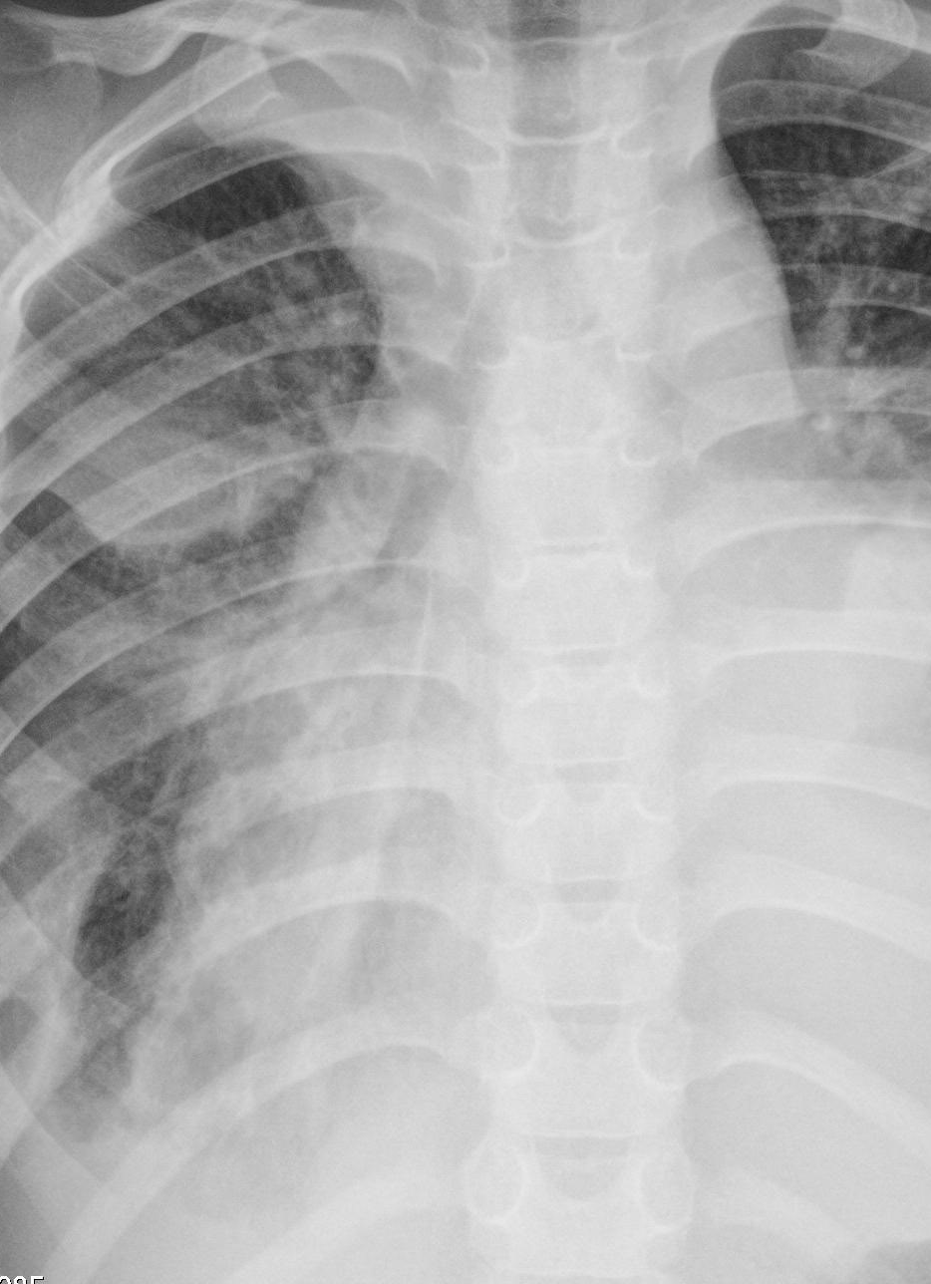
Agenda
Introduction to Problem
Methodology
Results
Comparison
References

Slide 3
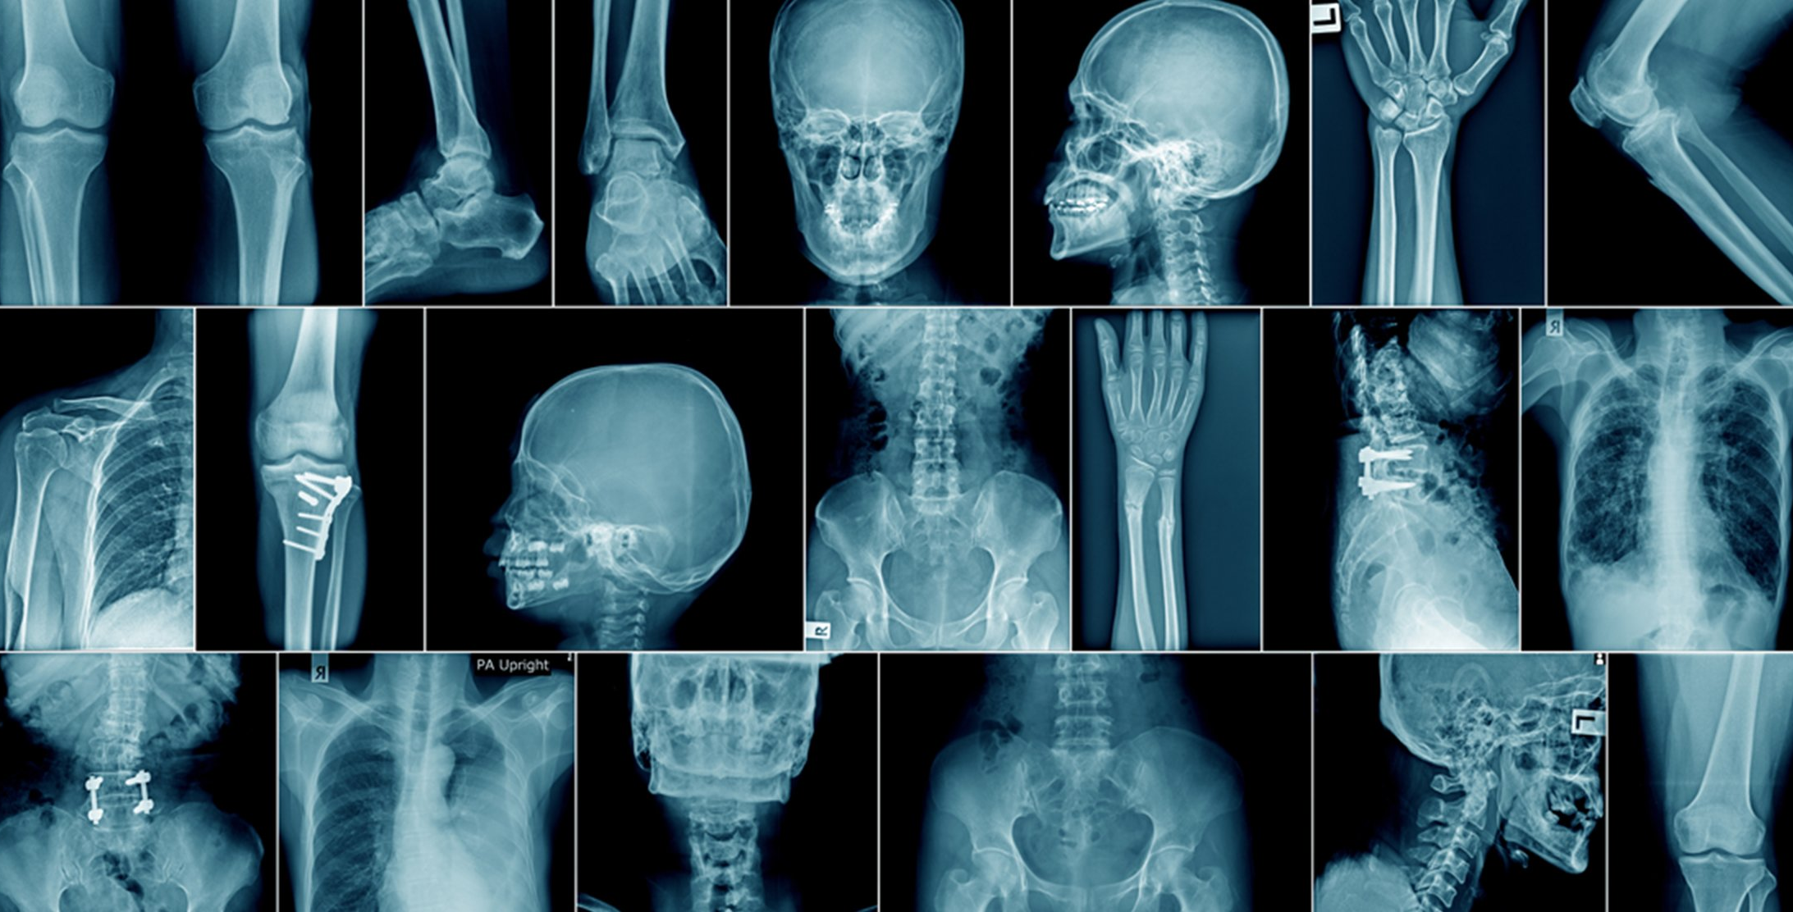
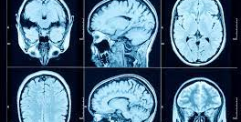
Medical Imaging and X-rays
Allow doctors and medical professionals to better understand body functions
Can detect a multitude of problems, but can be time consuming when dealing with large dataset

Slide 4
Pneumonia Detection in Chest X-rays
Important that detection and treatment of pneumonia happens before it becomes dangerous
Pneumonia is a leading cause of hospitalization in both children and adults
Most cases treated successfully but long recovery time

Slide 5
Methodology
Import images in
Convert to grayscale
Get persistence diagrams
Get Betti 0 vectors
Put into Random Forest and XG Boost Classifier

Slide 6
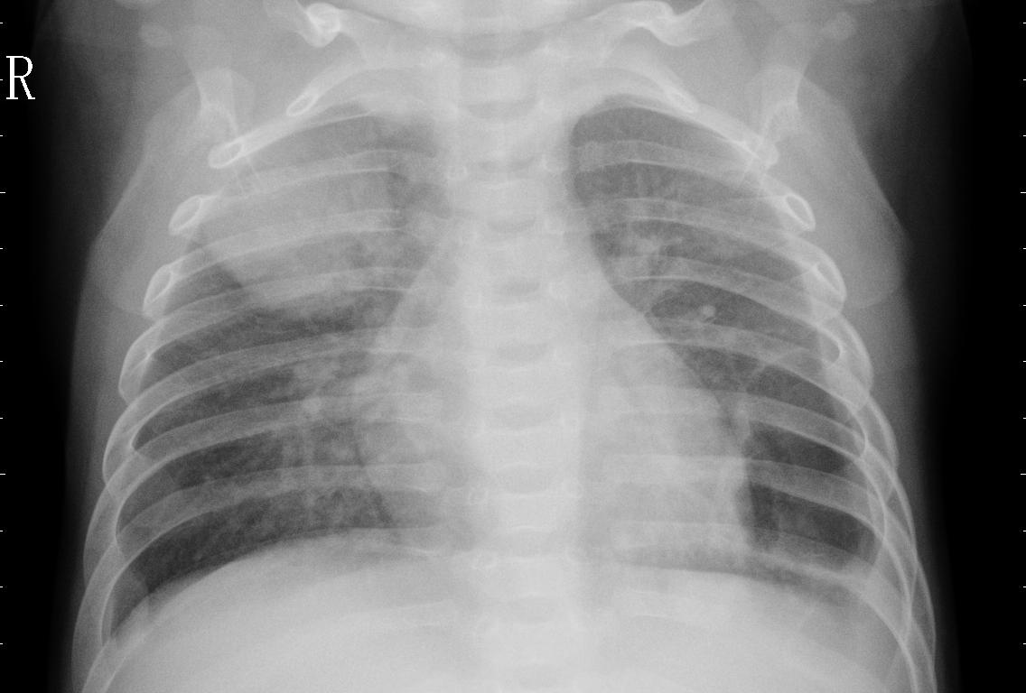
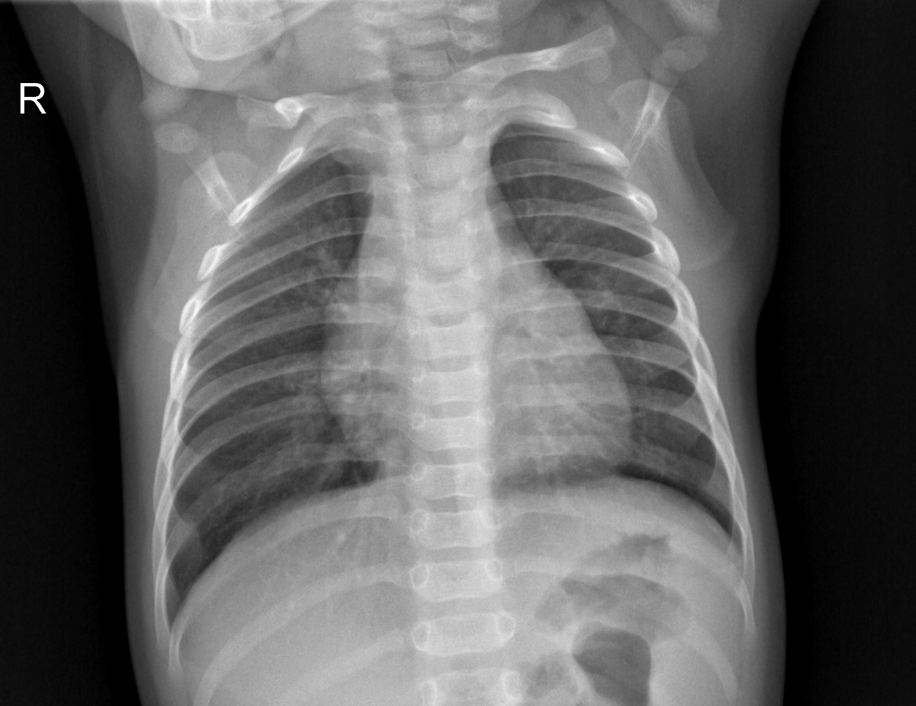
Chest X-ray Dataset
PNEUMONIA
100 Normal Images vs 100 Pneumonia Images
Looking to detect infection in pneumonia
Images have different dimensions
Randomly chosen
NORMAL

Slide 7
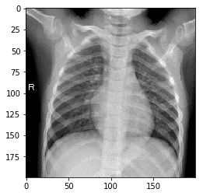
Alterations
Converted to grayscale
Resized images to 200,200
Image sizes were above 2000,2000 in some cases, other pictures rectangular so their sizes were not the same square shape
Images were already gray so the change was not huge

Slide 8
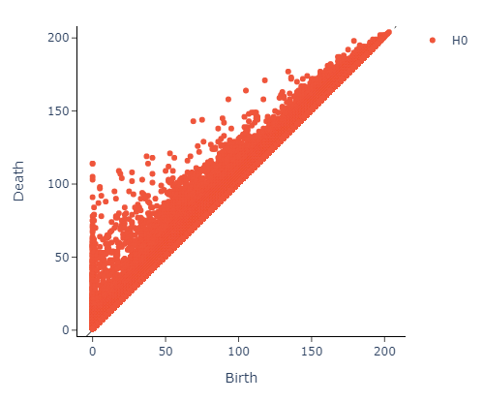
Persistence Diagrams
NORMAL
PNEUMONIA

Slide 9
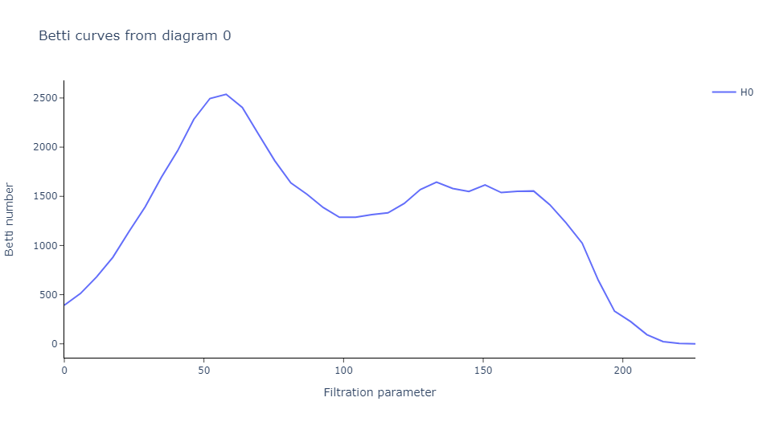
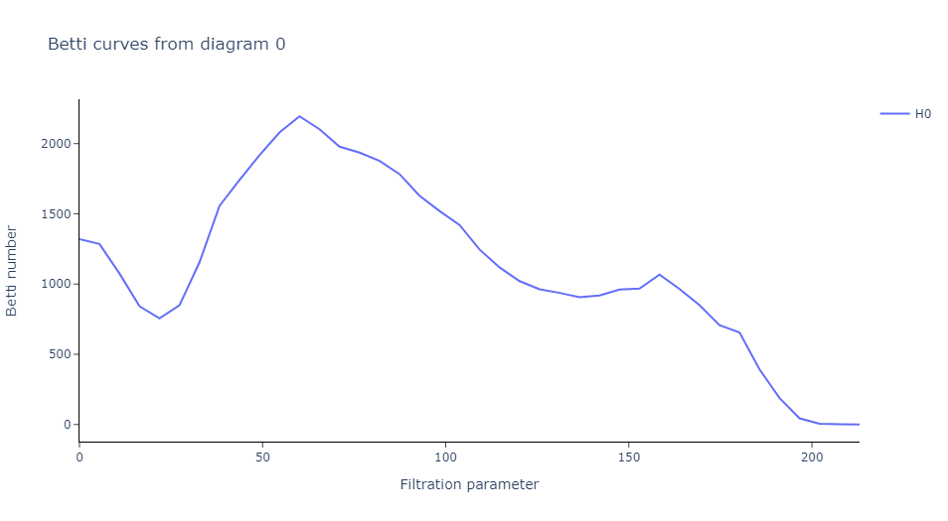
Betti Functions & ML Models
Got Betti 0 Function from Persistence Diagrams that had homology dimension of 0
Used Random Forest Classifier, and XGBoost Classifier
Got exact same results
NORMAL PNEUMONIA

Slide 10
Results
 | Train Accuracy | Test Accuracy | AUC
Pneumonia detection in chest X-ray images using an ensemble of deep learning models | -- | -- | 0.9835/ 0.8685
RandomForest/XGBoost Classifier(Mine) | 0.99375 | 0.975 | 0.9792
Multi-Objective Evolutionary Design of Deep Convolutional Neural Networks for Image Classification |  |  | 0.847
CheXNet: Radiologist-Level Pneumonia Detection on Chest X-Rays with Deep Learning |  |  | 0.844
Pneumonia Detection Using CNN based Feature Extraction Publisher: IEEE Explore | -- | -- | 0.8002

Slide 11
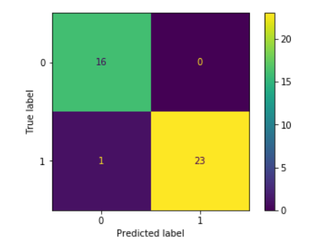
Confusion Matrix Analysis and Deliberation
0 = Normal, 1 = Pneumonia
Have 1 False Negative( not desirable)
Most were correctly classified
Potential Reasons for high training and test accuracy:
Small dataset
Model actually performed well for this dataset

Slide 12
Overall Difficulties and Future Work
Originally was trying to run for 1000,1000 (ran forever)
Resizing images to 200,200 pixels helped process a lot
Apply model to a larger dataset and see if accuracy remains
See how adding another homology dimension affects model

Slide 13
References
Learn About Pneumonia | American Lung Association
Pneumonia Detection Using CNN based Feature Extraction | IEEE Conference Publication | IEEE Xplore
Pneumonia detection in chest X-ray images using an ensemble of deep learning models | PLOS ONE
ChestX-ray14 Benchmark (Pneumonia Detection) | Papers With Code

