Slide 1
Reddit Graph Classification using TDA
Varin Sikand

Slide 2
Background
Information mining from Social media
Unique structure of Reddit
Subreddits act as separate entities
Interaction via posts and replies
Modeling as a Graph
Multiple definitions of nodes and edges.
Two distinct tasks
Binary classification
Multi-class
Classification leads to understanding of structure

Slide 3
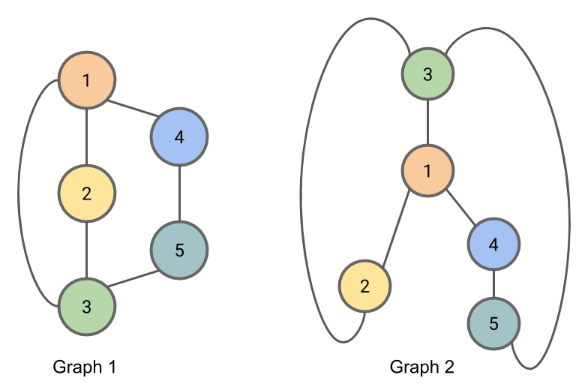
Previous work
Mostly Deep Learning models
Still uses feature extraction
Graph Kernels paired with neural nets
SVM models
GIN is the best performing on both datasets
Little to no explainable models
Persistent homology offers insight into clique structures of these graphs
Could potentially identify structures that hold high correlation with classification
Accuracies differ greatly between datasets
Multi-class: ~45-50%
Binary: ~80-90%

Slide 4
Datasets
Modeling Reddit data as Graphs
Each Graph is a post
Nodes are Users
Establish an edge whenever a user replies to another user within that post
Each Graph belongs to 1 subreddit; establishes label
Binary Classification vs Multi-Classification
Binary: Q&A vs discussion
Multi: 5 distinct subreddits
Validation split
10-Fold Validation score
REDDIT-BINARY: 2,000 datapoints
REDDIT-5K: 5,000 datapoints
Both are balanced between all possible labels

Slide 5
Methods
Sub-level filtration using Degree Function
Extract features
Betti Curves
Concatenate 0th and 1st homology vectors
Input into Machine Learning model
Random Forest
Gradient Boosting
Neural Net

Slide 6
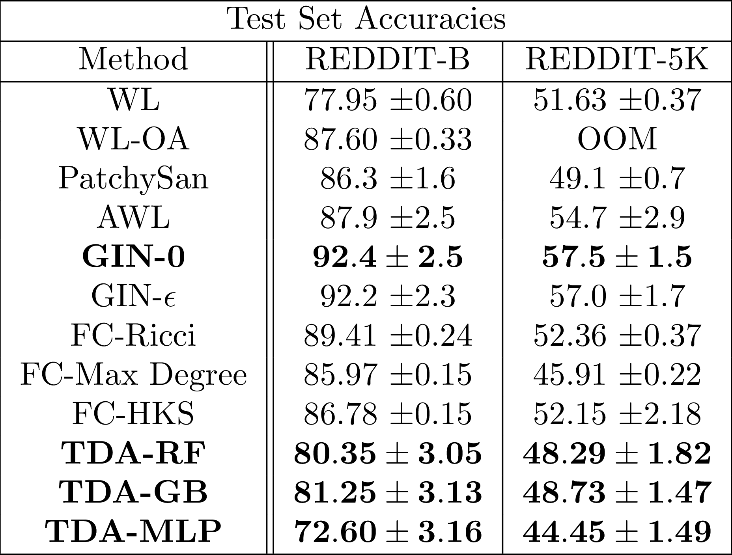
Results
GB proves best classifier for TDA features
Why didn’t MLP perform better?
Simple models are better post-feature extraction
Graph Neural Nets still perform better
Curiously, better than Max Degree Filtration curve for Multi-label
Notes:
Weisfeiler–Lehman Isomorphism Test - Optimal Assignment
PatchySan, AWL (Anonymous Walk Embeddings) - Deep Learning
GIN - Graph Isomorphism Network (Maps graphs that aren’t isomorphic to different embeddings)

Slide 7
Further Improvements
Further fine tuning
Gradient Boosting method contains many possible parameters
Each parameter (including learning rate + num estimators) has a wide range of valid values
Using other methods of representing Persistent Homology
Persistence Images
Heat Kernels
Different method of sublevel filtration
Vietoris-Rips with computed edge weights
Assuming all vertices are born at weight 0

Slide 8
Works Cited
O'Bray, L., Rieck, B., & Borgwardt, K. (2021, August). Filtration Curves for Graph Representation. In Proceedings of the 27th ACM SIGKDD Conference on Knowledge Discovery & Data Mining (pp. 1267-1275).
Xu, K., Hu, W., Leskovec, J., & Jegelka, S. (2018). How powerful are graph neural networks?. arXiv preprint arXiv:1810.00826.

