Slide 1
TERASOFT DISTRIBUTED MEETING SCHEDULER SYSTEM Project Phase I (Interim)- - THE PIONEER October 6th 2009
Presented by
Vinit Patwa
Prasanna Kumar Thiagarajan
Shiva Sangam
Meghana Satpute
Azharuddin Mohammed
Ritesh Patel
Tarun Chandra Samireddy
Rutvij Desai
Sirisha Balantrapu
Shubhada Deshmukh
Preethi Varambally
Swaroop Govindappa

Slide 2
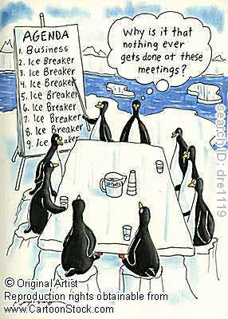
A Healthy start!!!!!

Slide 3
Secure, interactive and easy to use online meetings are waiting for you !!!
Communicate as if you are "face-to-face" with people across town, or across the world
Share documents, make presentations, demonstrate products and services, and collaborate like never before
Start a secure web meeting from the comfort of your desktop instantly, with just a click of the mouse
The possibilities are infinite. And with Terasoft Distributed meeting Schedular System, there's no software to install and no hardware to purchase

Slide 4
Agenda
What, Why and How
RE process
Preliminary Requirements
Domain Functional and Non-Functional Issues
Improved Understandings
Traceability
Prototype
Changability

Slide 5
WHY :The need for such a system?
Scheduling Meetings
Making scheduling of meetings easy and fast
Making Changes
Everyone is often operating on different schedules and finding a common time can be a tough task.
Reducing Stress for Schedulers
A lot of emails and phone calls are required to make a schedule, this system reduces stress and makes scheduling stress free.

Slide 6
WHAT – The system is? The Software System addresses the issues based on the functional Requirements of the specification For Example: 1- Plan Meetings 2-Replan Meetings 3-Conflict Resolutions

Slide 7
How – The system is a Success? The Software System is considered complete, if it covers the Non Functional Requirements. For Example: 1- A meeting should be accurately monitored especially when it is held in a virtual place. 2- Re-planning of a meeting should be done as dynamically and Flexible as possible 3-The meeting date and location should be as convenient as possible.

Slide 8
GOAL
GO-1. Initiate a new meeting & invite the participants to join it.
GO-2. Participate in the meeting
GO-3. Location and equipments for meeting
GO-4. Automatic Rescheduling - important participants cannot join
GO-5. Cancelation by initiator
GO-6. Rescheduling by initiator
GO-7. Invite more participants
GO-8. Concurrency handling
GO-9. Remote meetings
GO-10. Preference to important meeting

Slide 9
STAKEHOLDERS
The following stakeholders were identified in this project: User- Meeting Scheduler / Initiator, Participants
Customer - TeraSoft Inc
Requirements Engineer
Development Team
Testing and Maintenance team

Slide 10
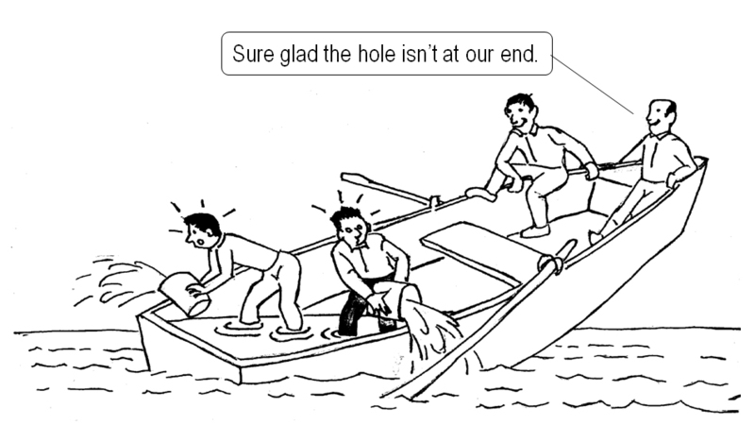
ROLES AND RESPONSIBILITIES
Team Members Role
Rutvij , Preethi, Ritesh User World
Sirisha, Meghana, Shubhada System World
Swaroop, Shiva, Prasanna Subject World
Vinit, Tarun, Azharuddin Developer World

Slide 11
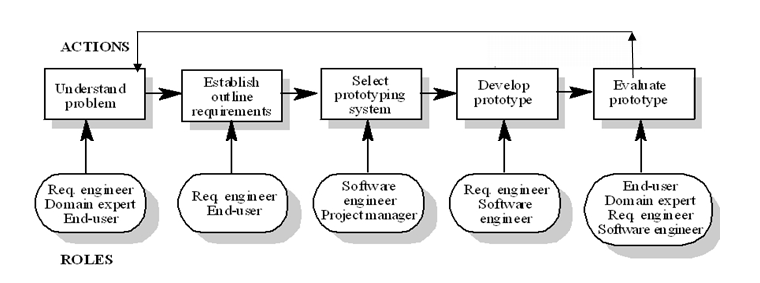
RE PROCESS
Evolutionary Iterative model.

Slide 12
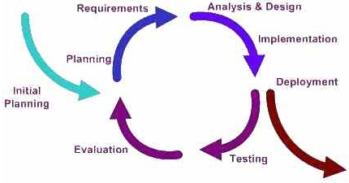
RE PROCESS

Slide 13
RE Process:
Where are we now?
Elicitation: (Early RE)
Determine what is really needed, why is it needed and
whom to talk to acquire as much knowledge as possible.
Specification : (Late RE)
Produce a formal RS model by translating the vague requirements
to Concrete requirements and make decisions on implementing the what and how.
Validation: (Late RE)
Assure that the RS model satisfies the user needs.

Slide 14
PRELIMINARY REQUIREMENTS

Slide 15
SYSTEM FUNCTIONAL REQUIREMENTS
In software engineering, a functional requirement defines a function of a software system or its component. A function is described as a set of inputs, the behavior, and outputs.

Slide 16
SYSTEM FUNCTIONAL REQUIREMENTS
System shall provide functionality that enables initiator to send out the meeting information to all of the potential meeting attendees.
The system should provide functionality for the meeting attendees to select their exclusion set and preference set.
The initiator is going to decide on a date range considering the exclusion and preference sets.
The system shall provide functionality for the attendees to notify the initiator of any special equipment requirements and preferences about the meeting location.

Slide 17
Contd…
The system shall provide functionality to check for a date conflict and notify all the participants.
The system shall provide functionality for the initiator to extend the date range to facilitate conflict resolution.
The system shall provide functionality for the attendees to remove dates from their exclusion sets to facilitate conflict resolution
The system shall provide functionality for the attendees to withdraw from the meeting to facilitate conflict resolution.

Slide 18
Contd…
The system shall provide functionality for the attendees to add new dates into their preference sets to facilitate conflict resolution.
The system shall provide options for the meeting initiator to select a real or a virtual meeting location.
The system shall provide functionality to re-plan a meeting.
The system shall notify all participants after the meeting initiator inserts the final decision (about meeting date and location) in the system.

Slide 19
SYSTEM NON-FUNCTIONAL REQUIREMENTS
In requirements engineering, a non-functional requirement is a requirement that specifies criteria that can be used to judge the operation of a system, rather than specific behaviors.

Slide 20
SYSTEM NON-FUNCTIONAL REQUIREMENTS
A meeting should be accurately monitored, especially when it is held in a virtual place.
Re-planning of a meeting should be done as dynamically and with as much flexibility as possible.
The amount of interaction among should be kept minimal.
The meeting date and location should be as convenient as possible, and available as early as possible, to all (potential) participants

Slide 21
Contd…
Physical constraints shall be considered.
The system shall handle appropriate number of concurrent users.
The system shall have an appropriate level of performance.
The system shall be easily usable by non-experts

Slide 22
Contd…
The system shall be configurable.
The system should be scalable .
The system shall be customizable to professional as well as private meetings.
Privacy rules should be enforced.

Slide 23
ISSUES
Issues are classified as
Ambiguous
Incomplete
Inconsistent
And thus we get the--
Domain issues
Functional issues
Non-Functional issues

Slide 24
DOMAIN ISSUE 1
Requirement – “The initiator could also ask, in a friendly
manner, active participants to provide any special equipment
requirements on the meeting location”
Description – The requirement is ambiguous. There is no assertive
proposal made by the initiator so this could also mean that the initiator
will ask about the equipment requirements at the meeting location instead
of asking about the requirements at the time of sending out the request.
Option1:
Rephrase the sentence such that it clearly conveys what it is exactly
supposed to mean.
Decision and rationale :
The initiator shall ask active participants to provide any special equipment
requirements on the meeting location prior to the meeting date.

Slide 25
DOMAIN ISSUE 2
Requirement – The initiator may ask important participants to state preference
about the meeting location
Description - The requirement is ambiguous. The requirement doesn’t specify
the case of preference confliction among important participants.
Option 1: The system shall give more priority to the important participants who
submit the location preference earlier.
Option 2: The decision is solely based on the meeting initiator.
Decision and Rationale: The solution would be option 2 because it specifies
the case of preference confliction among important participants in more detail.

Slide 26
DOMAIN ISSUE 3
Requirement – The meaning of the terms ” potential attendees”, “active
participants”, “important participants” is not specified
Description - The requirement is ambiguous. The potential attendees can be
important or active participants for other meeting. Similarly they can be active
and important participants.
Decision and Rationale: The meeting initiator should have the responsibility
of specifying the role for each of the participants (potential, active and important)
for the meeting.

Slide 27
Functional Issues
Functional Issue 1
Overlapping can occur when there are competing meeting requests.
Criteria for Overlapping : Time or space
Description: Incomplete Issue
Resolution:
Option 1: Initiator initiated meeting priority
Option2: Rank of the initiator is given the preference
Option3: A Random Selection is made
Rationale:
Option 1 – It will result in conflict if ranks are same. So FCFS is given priority Random selection can result in cancellation of previously organized well planned meeting

Slide 28
Functional Issue 2
Some bound on re-planning should be set up in all cases
Description of the issue: Incompleteness
It does not tell what the system should do when it needs to re plan the meeting
Resolution:
Option 1:Message is sent to the initiator to replan with new dates
Option2: Other available dates are sent to the initiator. If the other available meeting dates are not available then reinitialize message is sent to the initiator
Option3:System will select the meeting to be held by random selection
Rationale:
Option 2 – Rescheduling will be faster in case of available dates. It will begin scheduling immediately after cancellation

Slide 29
Functional Issue 3
Original meeting date or location may need to be changed, sometimes even cancelled
Description of the issue: Incomplete issue
It does not tell who will cancel or reschedule the meeting
Resolution:
Option 1:Initiator or Active participant can cancel or reschedule the meeting
Option2: The system can cancel or reschedule the meeting depending on participant response changes or conflicts with other more important meeting.
Rationale:
Option 1&2 – Both options seem appropriate as authority of cancellation or rescheduling with initiator or active participants makes system more flexible. Unauthorized changes to the meeting schedule is prevented
Allowing system to cancel and reschedule meeting saves time overhead needed for manual rescheduling of meeting.

Slide 30
Issues with non functional requirements
Ambiguous
Incomplete
Ambiguous issue example:
Requirement: “system should considerably reduce the amount of overhead.”
Solution: The meeting will be held at location which is preferred by most of the participants that will reduce the time they need to reach the meeting location.
Incomplete issue example:
Requirement: “Meeting date should be as convenient as possible.”
Solution: Date on which 100% of important members and 70% of regular members can attend.

Slide 31
Improved understanding
“ Meeting requests can be competing when they overlap in time or space.”
Improved Understandings
The meeting scheduler system should cancel the meeting to resolve the conflict with more important meeting.
The meeting scheduler system should request the ‘importance level’ of the meeting to initiator when he initiates the meeting. If it has the same level of importance, the meeting which is initiated first by the initiator will be held.
An initiator should select the ‘room location’ from given list. The availability of room should be checked and if it is not available then initiator has to choose other meeting room.

Slide 32
Improved understanding (contd..)
“The original meeting date or location may need to be changed, sometimes the meeting may even be cancelled”
Improved Understandings
The meeting scheduler system should allow initiator to cancel or reschedule the meeting.
The meeting scheduler system should cancel the meeting to resolve the conflict with more important meeting.
If the meeting is canceled by meeting scheduler then it should send the other acceptable schedules to initiator depending on already done voting.
The meeting scheduler shall send a cancellation email to all the participants in case the meeting gets canceled.
If the acceptable schedules cannot be found to reschedule the meeting an email shall be sent to initiator to reschedule the meeting with new date range.

Slide 33
Improved understanding (contd..)
“Meeting date should be as convenient as possible”
Improved Understandings
The meeting date and location should be as convenient as possible, and available as early as possible, to all (potential) participants. It should be a convenient date for 100 % of important members and 70% of regular members.
Physical constraints should not be broken
e.g., A person may not be at two different places at the same time; a meeting room may not be allocated to more than one meeting at the same time.

Slide 34
Improved understanding (contd..)
“The system should considerably reduce the amount of overhead.”
Improved Understandings
The amount of interaction among participants(e.g., number and length of messages, amount of negotiation required) should be kept minimal
The intended system should considerably reduce the amount of overhead usually incurred in organizing meetings where potential attendees are distributed over many different places and communicate with each other, for example, via Internet.
The meeting will be held at location which is preferred by most of the participants that will reduce the time they need to reach the meeting location.

Slide 35
Traceability
Forward Traceability
Backward Traceability
Importance –
1. Verify and validate system specifications
2. One high-level requirement may be broken into a number of detailed requirements.
3. When a high-level requirement is changed it will be necessary to find all of the derived requirements and make sure that they are still valid.

Slide 36
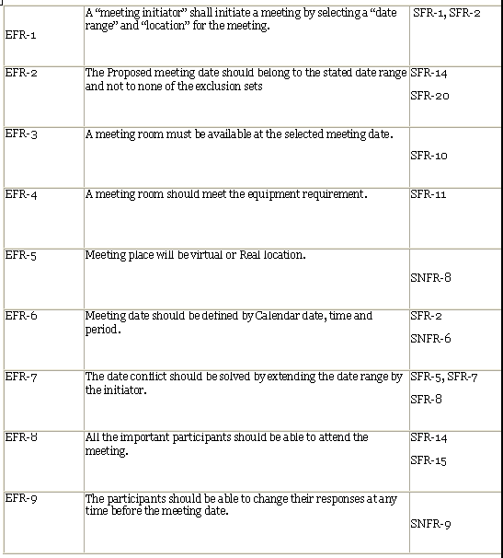
TRACEABILITY MATRIX

Slide 37
Traceability
EFR-1 -> SFR-1, SFR-2
EFR-1 A “meeting initiator” shall initiate a meeting by selecting a “date range” and “location” for the meeting.
SFR-1 The user who has login privileges can initiate a meeting.
SFR-2 The meeting scheduler should request the meeting date range, location and equipment needed to the initiator.
EFR-8 -> SFR-14,SFR-21
EFR-8 All the important participants should attend the meeting.
SFR-14 As soon as the active or important member declines the meeting invitation the system shall send an email to initiator regarding rescheduling of the meeting.
SFR-21 The meeting scheduler shall send a cancellation email to all the participants in case the meeting gets cancelled.

Slide 38
PROTOTYPE
http://www.utdallas.edu/~axm084000/ARE_prototypes/welcome.html

Slide 39
Changability
Change in Requirements specification is inevitable.
% of change ----- 30
Reason
1.Early stage of requirement.
2.Implementation not done.

Slide 40
THANK YOU
Questions???

