Slide 1

TERASOFT DISTRIBUTED
MEETING SCHEDULER
SYSTEM
Project Phase 2.2
DeCEMBER 3 , 2009
Presented by
Vinit Patwa
Prasanna Kumar Thiagarajan
Shiva Sangam
Azharuddin Mohammed
Ritesh Patel
Tarun Chandra Samireddy
Rutvij Desai
Sirisha Balantrapu
Shubhada Deshmukh
Preethi Varambally
Swaroop Govindappa

Slide 2

Secure, interactive and easy to use online meetings are waiting for you !!!
Communicate as if you are "face-to-face" with people across town, or across the world
Share documents, make presentations, demonstrate products and services, and collaborate like never before
Start a secure web meeting from the comfort of your desktop instantly, with just a click of the mouse
The possibilities are infinite. And with Terasoft Distributed meeting Schedular System, there's no software to install and no hardware to purchase

Slide 3
Presentation summary
New Requirements
Process Specification
Vision Document and SRS-Analysis Models
Functional Prototype Demo

Slide 4
NEW Requirements!!!

Slide 5
enterprise functional requirements
Meetings can belong to a special category that can be held in chunks.
Attendees of chunk meetings qualify for partial attendance. (i.e. they can participate in multiple meetings in the chunk partially).
The meeting locations for the meetings that are held in chunks should be as convenient as possible for attendees who are involved in more than one meeting.
The initiator can cancel a meeting request and delete it form the calendar. Then notify all the participants about the cancellation.

Slide 6
System Functional Requirements
System should provide functionality to organize meetings that are held at the same time as chunks.
System should provide functionality that will allow partial attendance.
The system should provide functionality to suggest convenient locations for meetings that are held in chunk.
System should provide functionality to cancel or update a meeting.
System should provide functionality to schedule recurring meetings.

Slide 7
ISSUES
Requirement - The meeting location should be as convenient as possible for attendees who are involved in more than one meeting.
Description – This requirement is incomplete. It does not specify what convenient location means.
Option 1: Location at which maximum number of participants of meetings that are held as chunk can attend.
Option 2: Location at which 100% of participants who are attending more than one meeting of a chunk can attend.
Option 3: Location at which 100% of the participants who are attending more than one meeting of a chunk can attend and 70% of the single meeting participants can attend.
Decision and rationale:- Options 3 is a better one because people who are attending more than one meeting in a chunk can benefit. More over if a participant is attending more than one meeting he can be considered as an important attendee.

Slide 8
Issues (contd)
Requirement - Attendees of chunk meetings qualify for partial attendance.
Description- This requirement is incomplete. There may be a situation where a person may be needed at two meetings at the same time.
Option 1: This requirement can be extended to mention which part of the meeting the partial attendee is going to attend.
Decision and rationale: - When accepting the meeting request the attendee with partial attendance has to mention which part of the meeting he/she is going to attend.

Slide 9
Process Specification

Slide 10
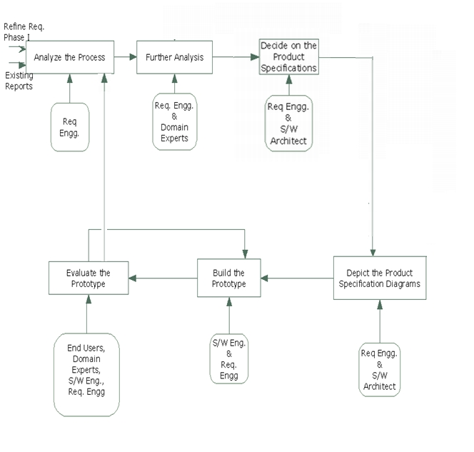
prOCESS mODEL

Slide 11
SADT: Top Level Diagram
UML Specifications
SADT Specifications
Requirements validation
Software Requirements Specification
Preliminary Document
Process Requirements
Process Specification
A0
Requirements Engineer

Slide 12
SADt: MEEting Schedular!!!

Slide 16
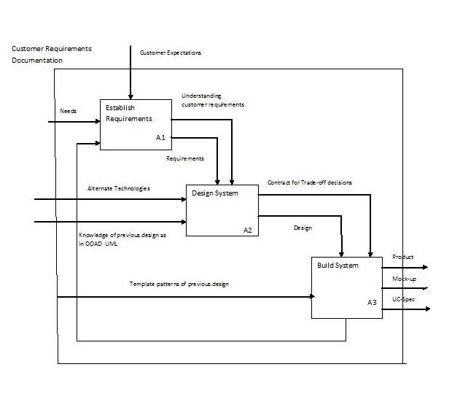
IDEF level0

Slide 17
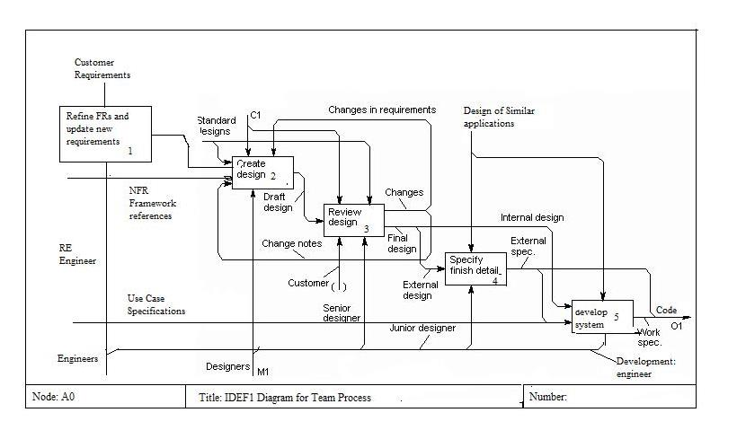
Idef level1

Slide 18
Vision Document and SRS-Analysis Models

Slide 19
The vision !!!
The problem of | scheduling meetings with minimal interactions and resolution of conflicts regarding date and time
Affects | employees of organizations
the impact of which is | Delay and ultimately improper resource utilization
a successful solution would be | An accessible, cost-effective meeting scheduler which can be used by the employees to initiate and schedule meetings. The product would also address issues related to conflict in dates and provide an efficient method to solve any such problems

Slide 20
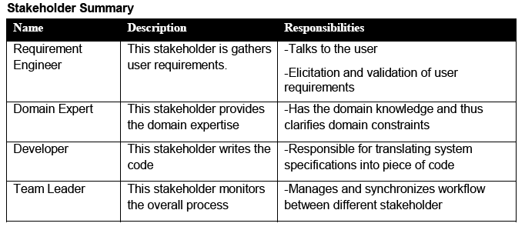
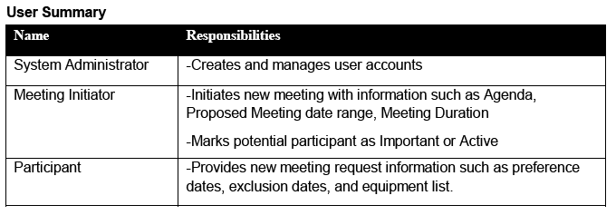
The vision!!

Slide 21
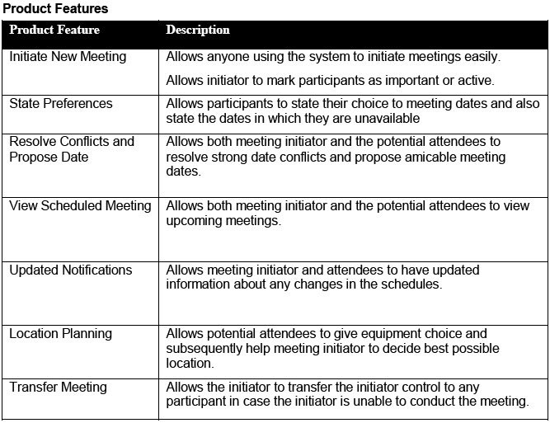
The Vision(contd)

Slide 22
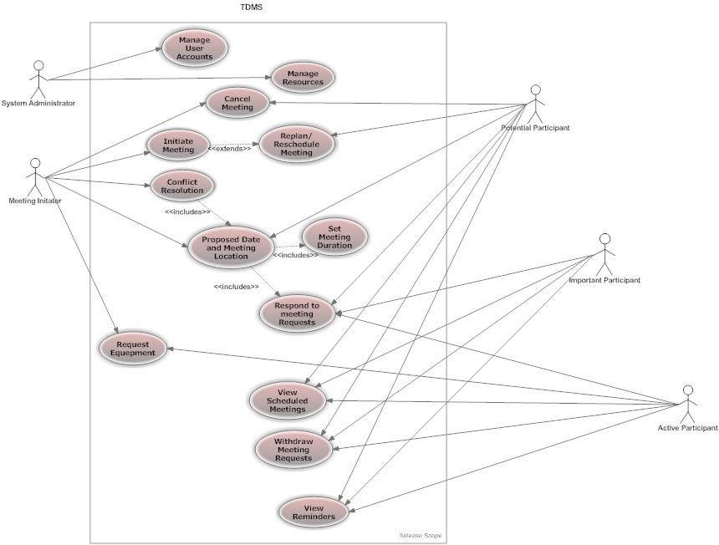
Use case diagram

Slide 23
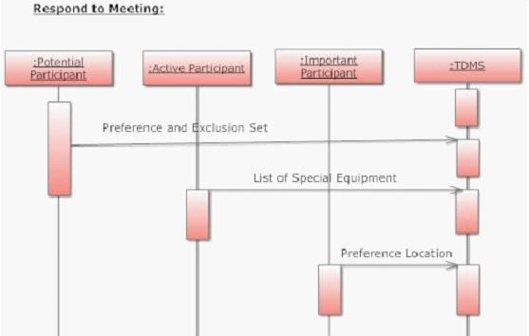
Sequence diagram

Slide 24
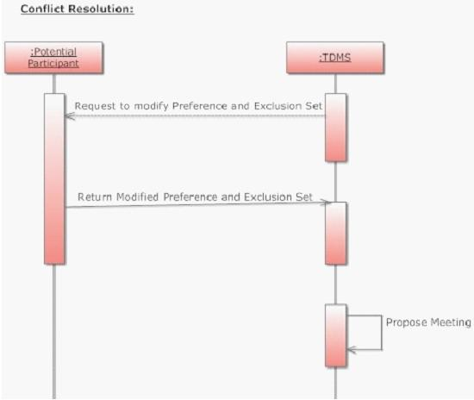
Sequence diagram

Slide 25
Fish-bone diag
Unexpected change in meeting schedules / cancelation by attendees
Date
Attendees Location
Attendees not available at a given date
Attendees are in different places/ Geometric locations
Attendees are in different places/ Geometric locations have different holidays
Attendees are in different time zones
Scheduling meetings is Difficult and Time Consuming
Equipment taken by other meetings
Attendees have already committed to other meetings
Equipment malfunction
Attendees have work or assignments on a given meeting date
Availability of Free Timeslots
Availability of Equipment
Availability of Attendees

Slide 26
Activity diagram

Slide 27
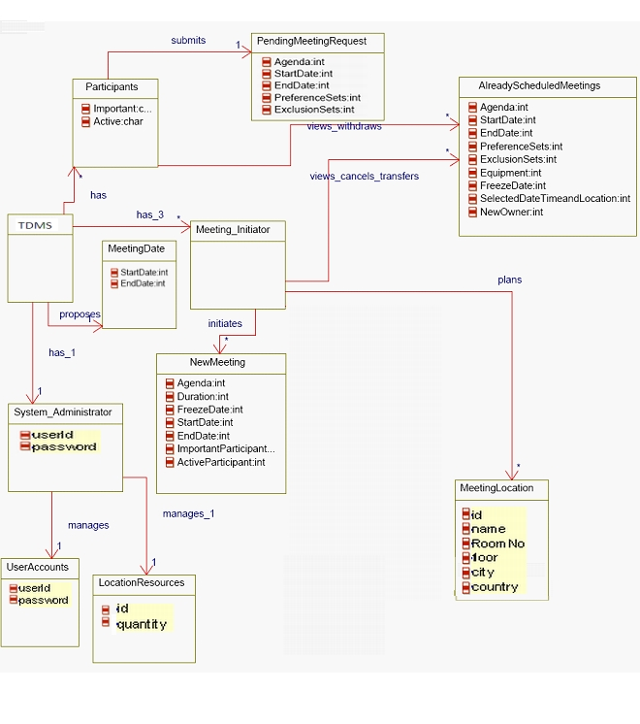
Class Diagram

Slide 28
KAOS
Schedule Chunk Meetings
Reduce the overhead in organizing meetings
Choose convenient meeting locations
Reduce the number of interactions between attendees and the initiator
Allow partial attendance
Convenient for 100% of the multiple meeting attendees
Convenient for 70% of the single meeting attendees
Maintain
[Partial attendance timing]
Maintain
[Interactions for backtracking]
Avoid
[Redundant interactions]

Slide 29
Sig:SEcurity

Slide 30
SIG: performance

Slide 31
SIG:usability
Convenience Convenient to use due to some convenience features
Understandability Learning to use the system takes few hours. It is very easy to use as the system as the interface is user friendly.

Slide 32
Sig:reliability
Accuracy – System should monitor the status of the meeting accurately by monitoring location, participants and time schedule of meeting.
Availability – System shold be available from anywhere in the world on web. It should be available 24 hours a day 7 days a week.
Consistency - System should not schedule avoid the conflict of scheduling multiple meetings on one schedule and location.

Slide 33
Sig:maintainability

Slide 34
Use case to requirements mapping

Slide 35
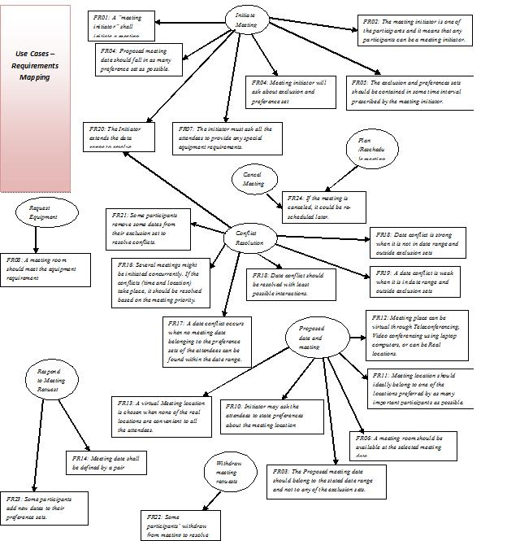

Slide 36
TRaceability

Slide 37
Traceability
SCREEN – 1 | Login Page
SCREEN –2 | Registration Page
SCREEN –3 | Invalid User Page
SCREEN –4 | Welcome Page
SCREEN –5 | Initiate Meeting Page
SCREEN –6 | View Meet Page
SCREEN –7 | Response Page
SCREEN –8 | Update Meeting Page
SCREEN –9 | Confirm Meeting Page
SCREEN –10 | Cancel Meeting Page
SCREEN –11 | Logout Page

Slide 38
Traceability (contd)
SFR 1 | SCREEN - 1
SFR 2 | SCREEN - 5
SFR 3 | SCREEN - 7
SFR 4 | SCREEN - 7
SFR 5 | SCREEN - 5
SFR 10 | SCREEN - 8
SFR 11 | SCREEN - 8
SFR 12 | SCREEN - 8
SFR 14 | SCREEN - 7
SFR 15 | SCREEN - 7
SFR 16 | SCREEN - 7
SFR 17 | SCREEN - 5
SFR 21 | SCREEN - 8
SFR 23 | SCREEN - 9

Slide 39
THE prototype!!
Screen shots

Slide 40
Thank you!!
Queries????

