Slide 1
Team Crutch
Final Presentation

Slide 2
Agenda
Process – Justin
Vision Document
Issues
Use Case Diagram
Domain Diagram
SIG
Prototype
Why Team Crutch?

Slide 3
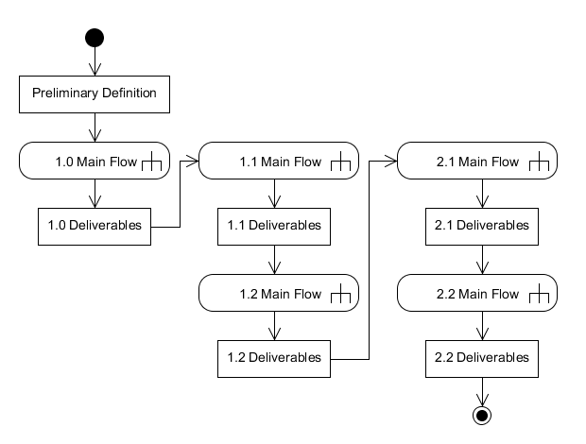
Process Model Activity Diagram

Slide 4
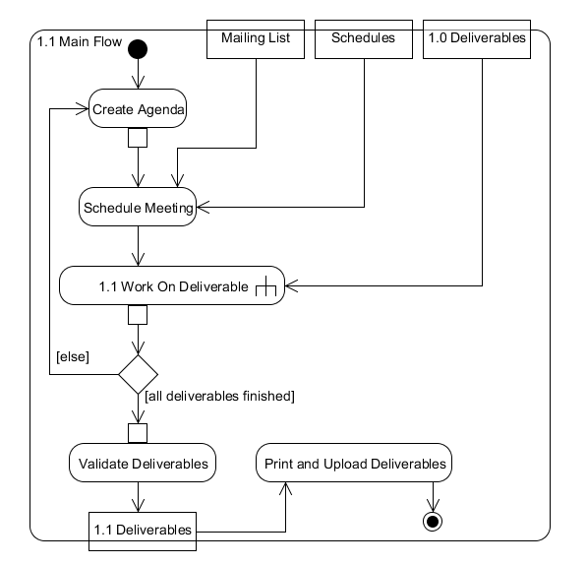
1.1 Main Flow

Slide 5
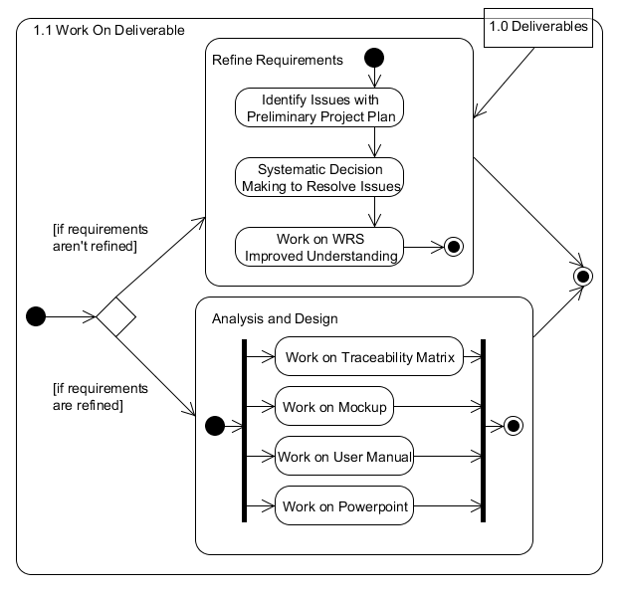
1.1 Work On Deliverable

Slide 6
Agenda
Process
Vision Document – Julie
Issues
Use Case Diagram
Domain Diagram
SIG
Prototype
Why Team Crutch?

Slide 7
Vision Document
HOPE
Team Crutch aims to develop portable, inexpensive, user-friendly software for the Android platform that mitigates communication barriers for the communication disabled.

Slide 8
Vision Document
Helping Elderly Communicate with Others
Stakeholders and Users
Our Product and how it gives HOPE
Features and Constraints

Slide 9
Agenda
Process
Vision Document
Issues – Ashley
Use Case Diagram
Domain Diagram
SIG
Prototype
Why Team Crutch?

Slide 10
Issues
Customizability
Issue: The Preliminary Definition does not address any forms of customization available to the user
Decision: Users will be able to customize the size of icons, label used to describe an icon, and enable/disable“Hold to Speak”

Slide 11
Issues
1a. Customize Icon Size
Issue: The preliminary definition does not mention any icon size customizability.
Decision: Icons automatically set to “Standard” size by default. Icon sizes customizable through “Resize Icons” option under “Menu”

Slide 12
Issues
1b. Customize Icon Label
Issue: preliminary definition does not mention any icon label customizability
Decision: Icon labels customizable through “Re-label Icons” option under “Menu” . Users are able to manually input icon labels through text input from keyboard.

Slide 13
Issues
1c. Enable/Disable “Hold to Speak”
Issue: preliminary definition does not address customization of “Hold to Speak” feature
Decision: Users are able to enable/disable “Hold to Speak feature under “Menu” section

Slide 14
Issues
2. Sign Language Setting
Issue: Sign Language accomodations are not mentioned in the preliminary definition.
Decision: Sign Language feature will not be implemented.

Slide 15
Issues
3. Home Screen
Issue: Contents of the Home Screen are not defined
Decision: “Speak”, “Emergency”, “Favorites”, “Contacts”, “Recents”, and “Me” are available from the Home Screen. The day of the week is also displayed at the top of the screen

Slide 16
Issues
4. Recents Category
Issue: Contents of the “Recents” section are not defined
Decision:Recents Category contains the last 25 sentences generated by the user.

Slide 17
Agenda
Process
Vision Document
Issues
Use Case Diagram - Frank
Domain Diagram
SIG
Prototype
Why Team Crutch?

Slide 18
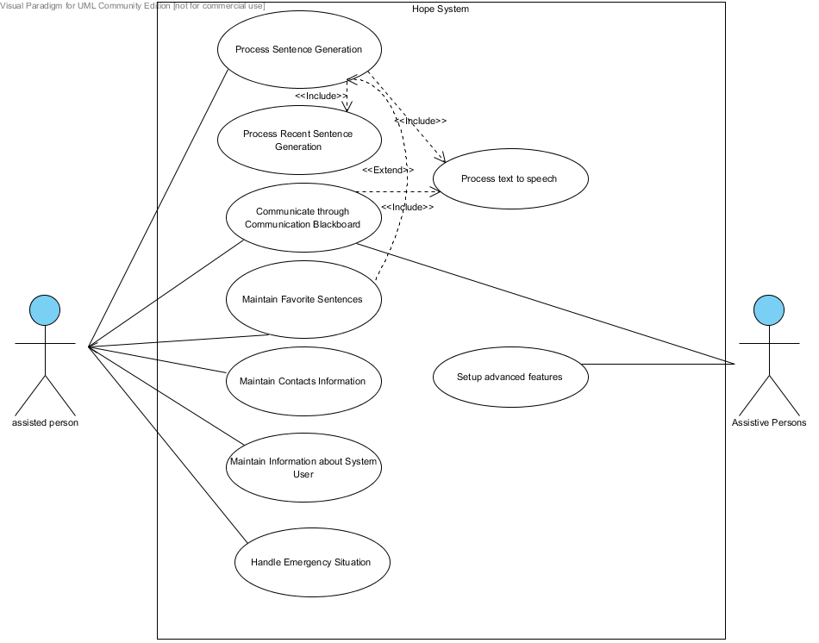
Use Case Diagram

Slide 19
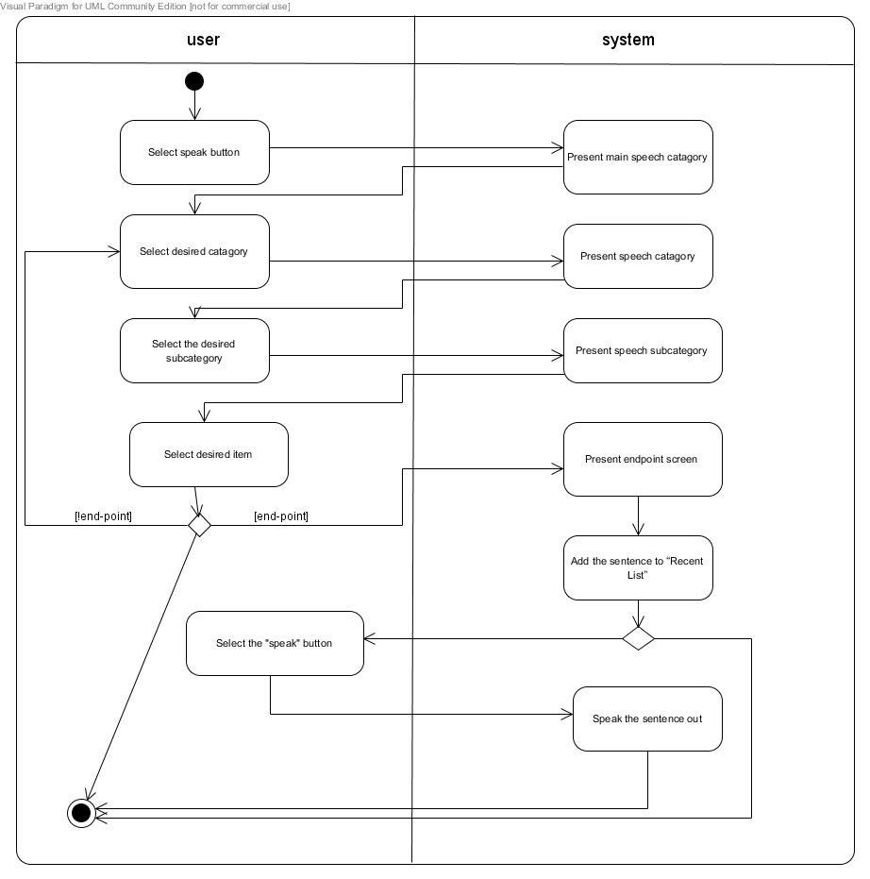
Activity

Slide 20
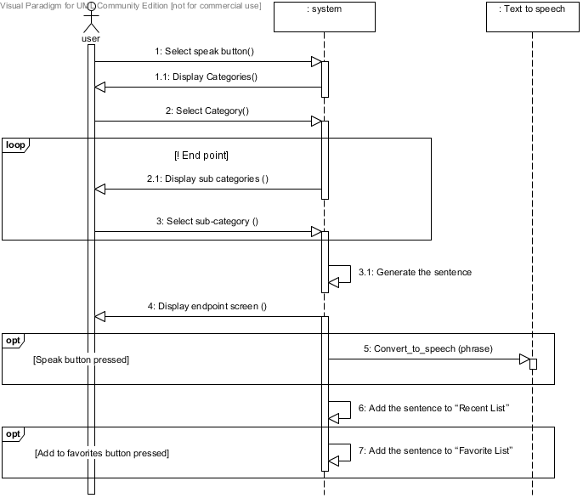
Sequence

Slide 21
Agenda
Process
Vision Document
Issues
Use Case Diagram
Domain Diagram - Don
SIG
Prototype
Why Team Crutch?

Slide 22
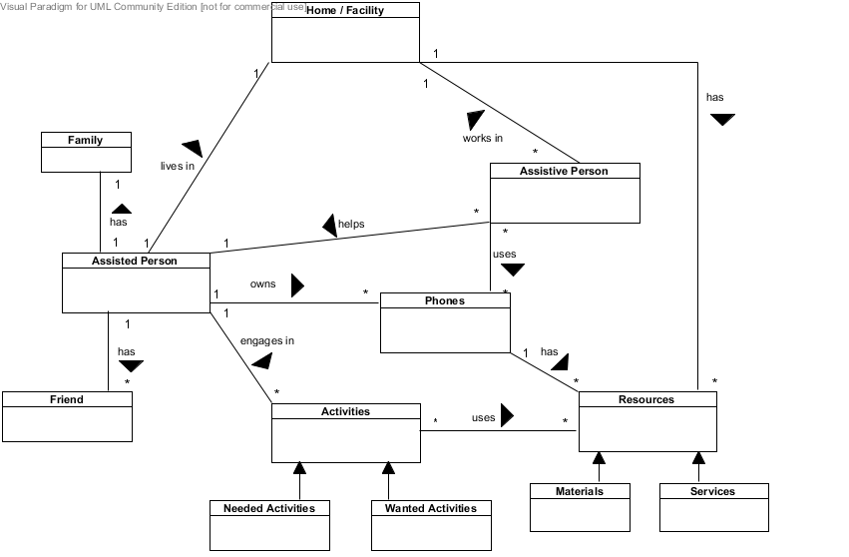
Domain Class Diagram

Slide 23
Agenda
Process
Vision Document
Issues
Use Case Diagram
Domain Diagram
SIG – Blake, Mohammad
Prototype
Why Team Crutch?

Slide 24
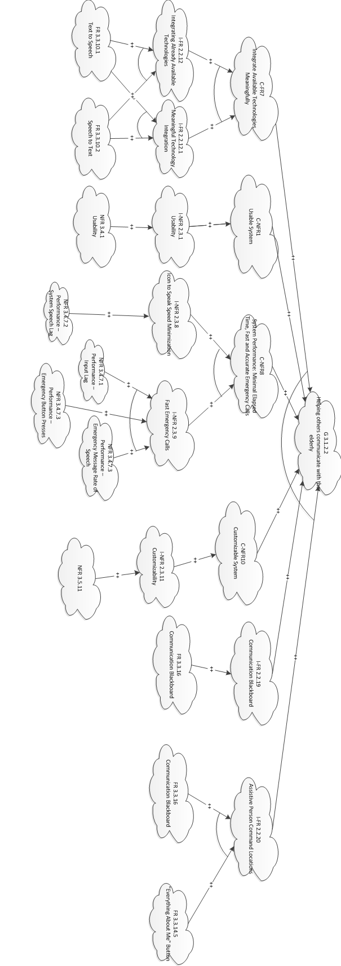
Helping Others Communicate with the Elderly

Slide 25
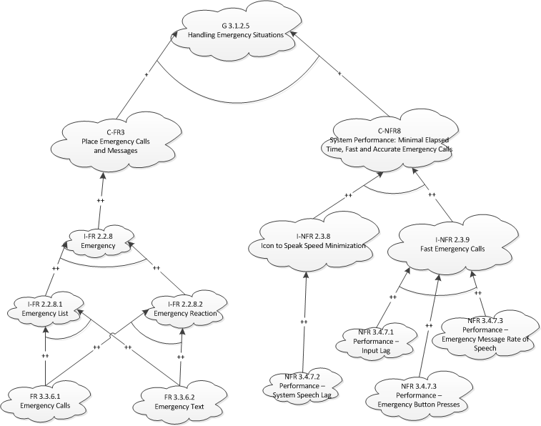
Handling Emergency Situations

Slide 26
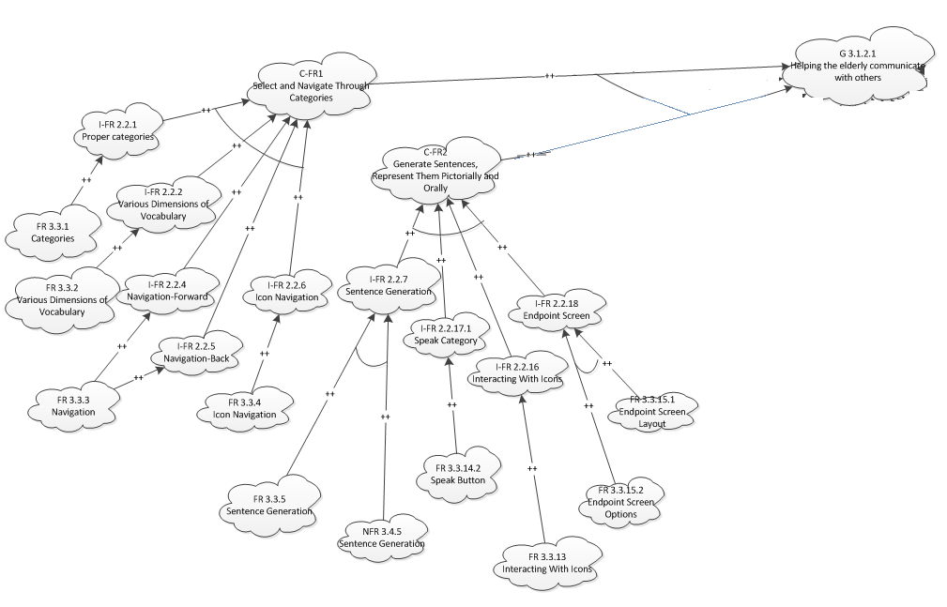
Helping Elderly Communicate with Others (Partial)

Slide 27
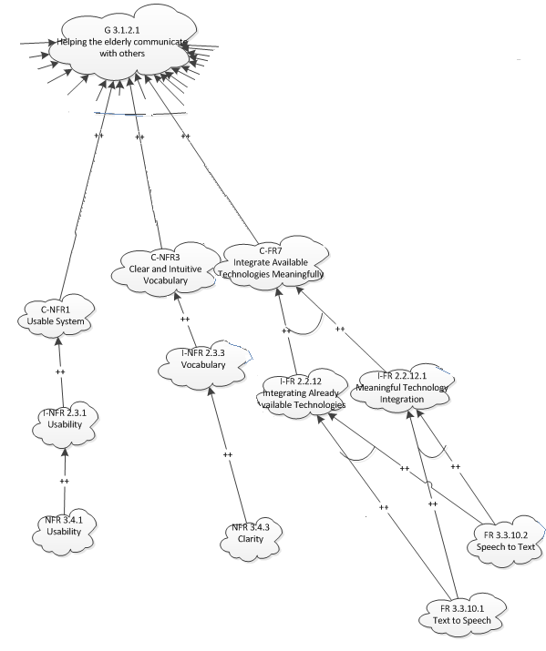
Helping Elderly Communicate with Others (Partial)

Slide 28
Agenda
Process
Vision Document
Issues
Use Case Diagram
Domain Diagram
SIG
Prototype - Zac
Why Team Crutch?

Slide 29
Prototype

Slide 30
Agenda
Process
Vision Document
Issues
Use Case Diagram
Domain Diagram
SIG
Prototype
Why Team Crutch? - Eric

Slide 31
Why Team Crutch?
Target Customer
Simplicity
Low Price
Aesthetic Appeal
Feasibility
Validation + Requirements + Traceability
Hope only gets better

