Slide 1
Failures And causes nasa missions
Muhammad Ayaz Shaikh
05/19/2012
Dr. Chung
SYSM 6309 - Advance Requirements Engineering

Slide 2
Overview
Introduction of the situation
Issue Definition
Solutions and Advancements

Slide 3
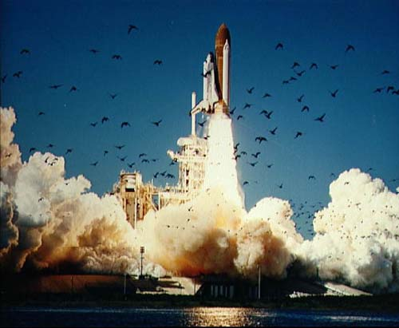
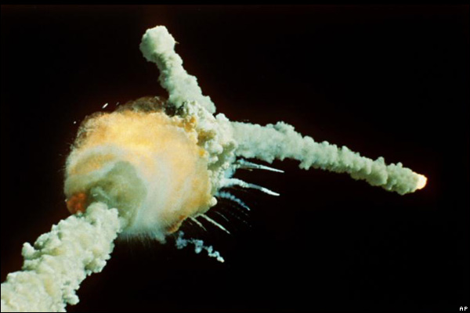
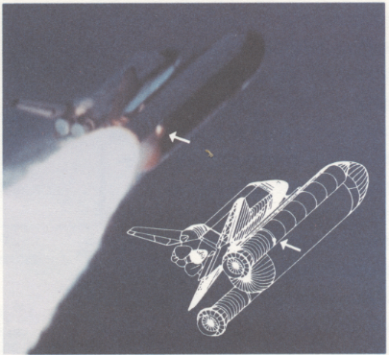
Introduction
In my last presentation I discussed about one of the NASA’s mission failure. The name of the shuttle was The Challenger which exploded just after 80 seconds of its launch due to cold weather i.e.;
O-rings which are the part of fuel tank are not efficient in cold weather.

Slide 4
NASA’s Goal
To reach for new heights and reveal the unknown so that what we do and learn will benefit all humankind.
To enrich our Nation's society and economy
To achieve a better life on the Earth for this and future generations
Through a permanent human
presence in space

Slide 5
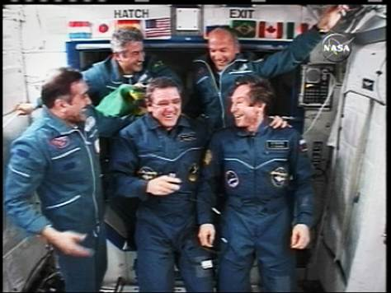
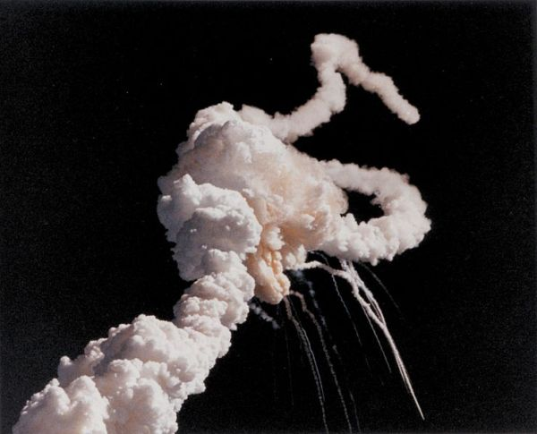
NASA Missions Statistics
More than 6000 missions
Nearly 95% success rate
422 missions failed
123 manned missions
Nearly 98% success rate
3 failures

Slide 6
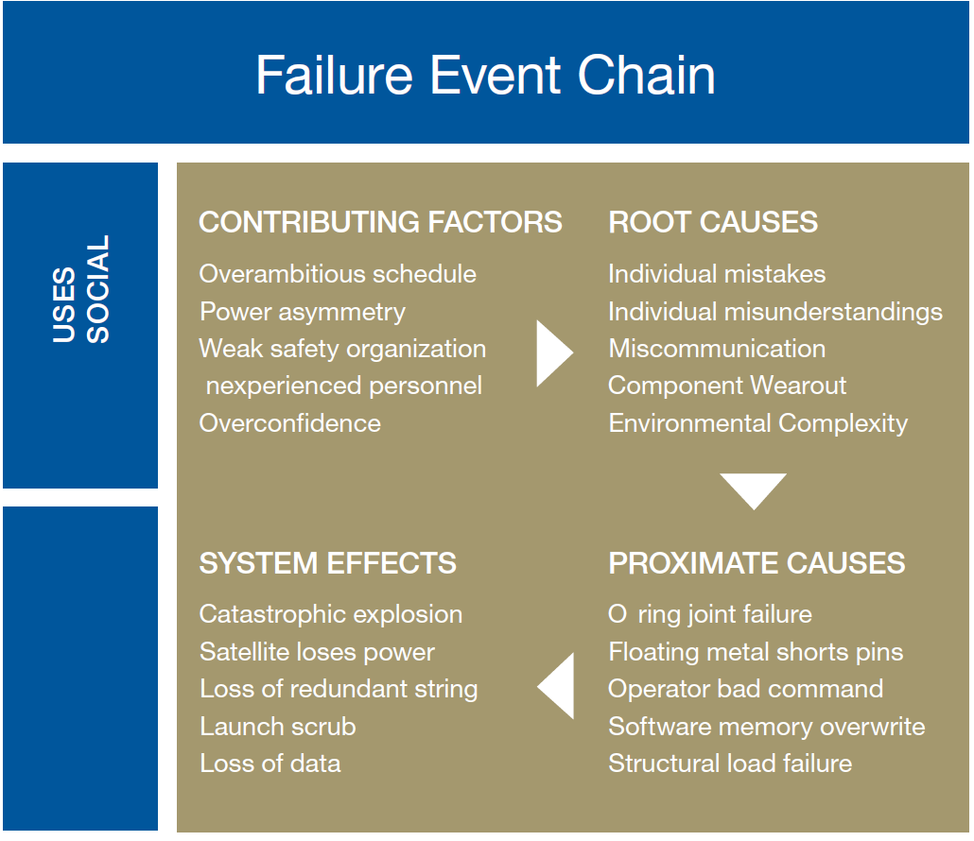
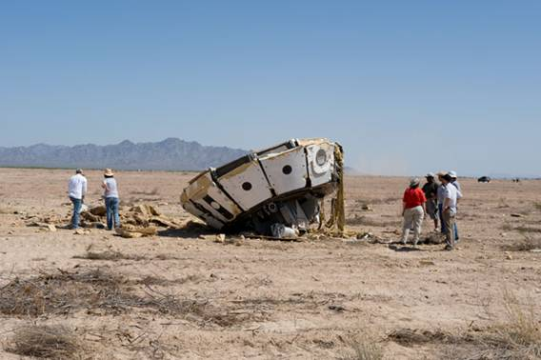
Issue Definition
Orion Crew Module Crash Site
Normal accident theory explains that in complex, tightly coupled systems, accidents are predictable.

Slide 7
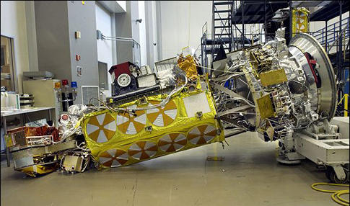
Issue Definition
Frequently, we find that the failure effects and the proximate causes are technical, but the root causes and contributing factors are social or psychological.
Stephen B. Johnson
University of Colorado
Institute of Space
NOAA-19
Engineers failed to check if the satellite was bolted down before moving it.

Slide 8
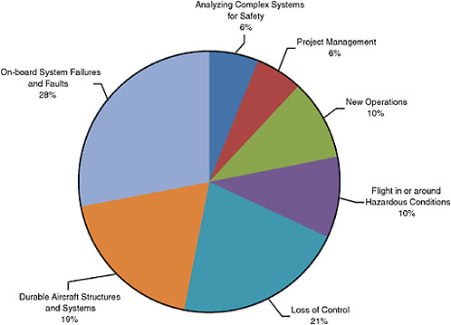
Solutions and Advancements
Systems management & engineering can reduce failure rates by providing formal cross-checks that find and fix most potential mission-ending faults.
Tackle individual and
social causes of failure.
Analysis of difficult
decisions provides
Insight of future disaster.

Slide 9
Approach from Human Elements
NASA technically works with the theory that accidents can be prevented through good organizational design and management.
Eliminate communication gaps between members of the team and teams of a team.
Develop corrective actions against the identified root causes byapplying human factors engineering.
Implement a system to provide human performance audits of critical processes.
Organizational surveys for operator feedback.
Emphasis on designs that limit system complexity and coupling.

Slide 10
References
http://askmagazine.nasa.gov/pdf/pdf32/NASA_APPEL_ASK_32i_success_failure_nasa_culture.pdf
http://www.msnbc.msn.com/id/12102538/ns/technology_and_science-space/t/new-crew-arrives-space-station/#.T7YGGtzO3oQ
http://www.hq.nasa.gov/office/codez/stratplans/1996/vision.html
http://www.popsci.com/military-aviation-amp-space/gallery/2009-03/top-10-nasa-probe-failures
http://answers.yahoo.com/question/index?qid=20080104115202AAHbQuF
http://www.hq.nasa.gov/office/codeq/accident/accident.pdf
http://www.nap.edu/openbook.php?record_id=12950&page=22

