Slide 1
Challenges and Lessons Learned: Micro Air Vehicle Requirements Development
Gilbert Islas
May 5, 2012
Professor Lawrence Chung
Advanced Requirements Engineering
SYSM 6309

Slide 2
Outline
Motivation and Context
Problem Statement
Solution and Approach
Validation and Illustration
Recommendations and Future Work

Slide 3
Motivation and Context

Slide 4
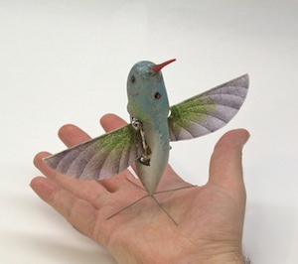
What are MAVs?
A Micro Air Vehicle (MAV) is a class of unmanned aerial vehicle (UAV)
Must be smaller than 15 cm
May be autonomous
Developed for military ISR applications
Intelligence, Surveillance, and Reconnaissance
Allows remote observation of hazardous environments.
Keeps humans out of harm’s way.
Other development driven by:
Commercial applications:
Hobby, real estate, entrepreneurs
Local government
Research and Development (Agriculture)

Slide 5
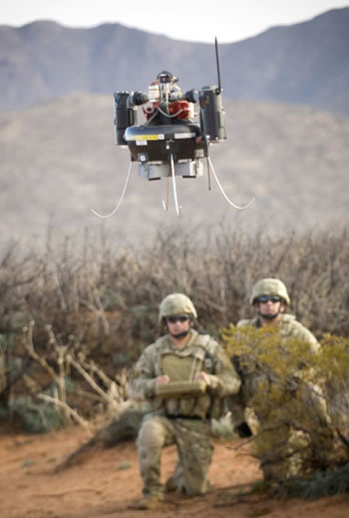
History and Concept Genesis
Early 1990s: MIT Lincoln Labs
Creates concept model of tiny EO reconnaissance system.
CIA is interested in an insect-like platform for covert ops.
1993: RAND Corporation studies sensor-carrying insects.
1995: DARPA holds micro air vehicle technology workshop. Leads to $35M contract.
Loose requirement definitions.
What are the stakeholder objectives?
1997: DARPA narrows vision for MAVs to be used by the individual soldier.
Reconnaissance, surveillance, battle damage assessment, targeting, nuclear, or biological substances.

Slide 6
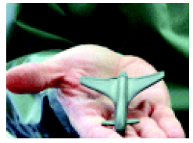
Original Problem Definition
Micro Air Vehicles are “less than 15 cm”.
What does this mean?
Can it be a sphere, cylinder, or cube?
Can an MAV have moving parts (propellers and rotors) that extend beyond 15 cm?
Conduct real-time imaging.
Ranges up to 10 km.
Speeds of up to 30 mph.
Missions are 20 minutes long.

Slide 7
Redefine the Mission
Original vision was for outdoor use.
Environmental flight limitations (i.e. High Winds).
Is this system tactically practical?
A 15 cm MAV can support a maximum 15 cm antenna = 2 GHz frequency range.
Requires Line-of-Sight transmission.
Implies “look over the hill” Scenario
Distance of 1 km to look over 30 m tall hill and at a distance of 60 m from MAV.
Requires altitude of more than 500 meters (1640 FT) to maintain line-of-sight.
Far out of sight and earshot of observers, even for UAVs.
Why are MAVs needed for outdoor ISR missions???

Slide 8
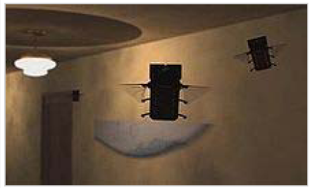
New Use Case for Indoor Operation
After 2 decades of UAV development, no assets exist to covertly penetrate:
Buildings
Tunnels/Caves
Bunkers
Size is important in indoor and confined spaces.
Unfamiliar enclosures are dangerous for soldiers to enter.
Ground vehicles have difficulty penetrating.
No need to operate in high winds.
No need for long stand-off capability.

Slide 9
Problem Statement

Slide 10
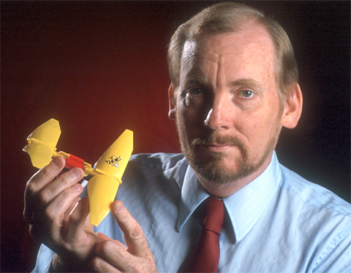
Problem Statement
“No other air vehicle design space has presented the mix of challenges as that of miniature flight platforms. The creators of these aerial robots must address the same physical design constraints which have already been mastered by the world of airborne biology”
Robert C. Michelson
Georgia Tech Research Institute
Designer of Entomopter MAV

Slide 11
Requirements Challenges
“Must be able to fly, be controllable, and have useful endurance”
Low Reynold’s number aerodynamics.
Air is more viscous for small flight vehicles.
Technology is not scalable (materials, electronics, motors, airfoils).
Complex issues with bio-mimicry.
Small size, slow flight, ability to navigate without GPS.
Critical implications for efficient aerodynamic structure and weight.
Surface area is limited.
Focus on propulsive power and energy density of fuel.
Autonomous flight controls
Navigation and decision making in obstacle-rich enclosures.

Slide 12
Solution and Approach

Slide 13
Top-Level Requirements
High Lift-to-drag ratio
Airfoil Shape
High Propulsive Power
Fuel energy density
Flight Endurance
Power consumption
Total Weight
Strength of Materials
Controls and Controllability
Inner-loop and Outer Loop
Autonomy
Decision making, target acquisition, tracking, vision, network communication.

Slide 14
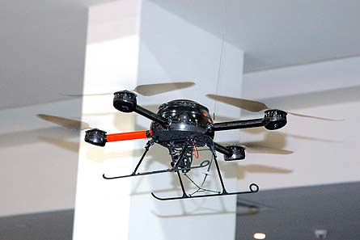
Design Solutions
Fixed Wing
High speeds (up to 40 mph)
Not suitable indoors
Rotary Wing
Like mini helicopters
Fly slowly and hover
Multiple propellers are popular but can be inefficient. (i.e. Quadrotor design)
Flapping Wing
Best for indoor use
Slower flight
Robustness and survivability
Biological Inspiration

Slide 15
Validation and Illustration

Slide 16
Biological Inspiration is used to Validate Requirements
Insect-like Flapping-Wing architecture
U.S. Air Force “Bumble-Bee”
Honey Bee-like energy storage and consumption goals.
Sugars (fuel) is chemically stored in nectar
Immediate access to energy
Honey Bee-like flight controls
Observe bilateral flow of objects to assess speed and trajectory.
Insect-like pheromone tracking
Autonomous tracking

Slide 17
Future Development

Slide 18
Future Development Considerations
Do not develop requirements until a useful use case scenario is identified.
Do not let the technology define the need.
Start with a problem and goals and find the solution later.
Not all technology is scalable or makes sense.
Classical aerodynamics break down at small scales.
Reynold’s number takes effect (air is more viscous).
Strength of materials, propulsions systems and motors, electronics, GPS capability, LOS communication.
Continued bio-inspiration
More autonomous systems and networked communication.
Smaller, lighter, and higher strength.
Higher endurance.
MEMS technology and chemically fueled motors.
Insect-sized aircraft expected in the future.

Slide 19
Questions?

Slide 20
References
“Micro Air Vehicle” http://en.wikipedia.org/wiki/Micro_air_vehicle
“RQ-4B Global Hawk Block 30, Operational Test and Evaluation Report” J. Michael Gilmore, Director, Operational Test and Evaluation, May 2011.
B. Christensen, “Micro Air Vehicle in-use in Iraq” http://www.technovelgy.com/ct/Science-Fiction-News.asp?NewsNum=1111
M. Wohlsen, “Drones coming to a sky near you as interest surges” http://news.yahoo.com/drones-coming-sky-near-interest-surges-150302837.html
M. Masnick, “Why You Can't Have A Tacocopter Drone Deliver You A Taco For Lunch Today”, 27 MAR, 2012, http://www.techdirt.com/articles/20120327/04431918256/why-you-cant-have-tacocopter-d...
Michelson, R. C. 2010 “Overview of Micro Air Vehicle System Design and Integration Issues”, Encyclopedia of Aerospace Engineering.

