Slide 1
HELPeople
Assistive Technologies
for the Mobile Market
Team T-MIP
UTD Spring 2012

Slide 2
HELPeope – your smart friend
Contents
Mission
Scenario
Product Overview
Stakeholders / Problem / Goal
Domain Requirements
Functional Requirements
Non-Functional Requirements
Designing Mockups
Why HELPeople is better?

Slide 3
HELPeope – your smart friend
mission
Enhance quality of life for the elderly, or those with communicative disabilities, using intelligent assistive technologies implanted in mobile communication devices.

Slide 4
HELPeope – your smart friend
scenario
WATCH HERE
http://youtu.be/V6RiacgnetY

Slide 5
product overview
HELPeope – your smart friend
A mobile application that serves as a unified interface for other mobile apps
Integrates multiple input and output methods, e.g. voice, text, visual, audio etc.
Customizable based on different user profiles and needs
Makes better use of existing apps as well as those yet to be developed.
Has a set of native apps of its own

Slide 6
HELPeope – your smart friend
stakeholders
Primary user group: Baby Boomers
Secondary user group: those with communication handicaps
Caretakers – family members, healthcare professionals, etc.
Emergency Personnel – ambulance, police, hospital, etc.
Product Development – Management, Sales/Marketing,
Engineering, Support
Other mobile app makers on market

Slide 7
HELPeope – your smart friend
problem
Many Baby Boomers are moving from personal computers to mobile devices for their daily activities and needs
Mobile apps have diverse and non-standardized interfaces, difficult for aging Boomers to navigate
Most mobile apps are visual- and touch-based, not designed for people with physical impairments
Mobile web browsers marginalize those with poor or no eyesight

Slide 8
HELPeope – your smart friend
goal
Make existing “smart” devices even “smarter”
Maximize re-use and minimize re-invention
Make mobile apps more useful to more people
Make the Internet more accessible to people with communicative impairments
Expand the market for mobile devices and mobile apps
Support

Slide 9
HELPeope – your smart friend
domain requirements
Support iOS and Android (initially)
Multiple input/output modes that are customizable
Screen-Reader and Text-to-Speech capabilities
Support GPS and Bluetooth functions
An API so other apps can integrate with HELPeople

Slide 10
HELPeope – your smart friend
functional requirements
Quick and easy access to favorite apps
Different options to handle emergency cases
Health Center application to remind medication and store medical information
Web surf capability for visually impaired users
Family Tree
Backtrack
Image recognition
Text to Speech and Speech to Text capability
Customizable user profiles according to user’s need
Customizable settings for different parts of product

Slide 11
HELPeope – your smart friend
non-functional requirements
Installation time should be quick
Product should consume less battery power
Product should occupy less capacity
Product should be easy to use
Application should be properly categorized
Application icon picture should be meaningful
Product should be extensible
While running, product should respond quickly to command
Essential icons should be reachable all time.

Slide 12
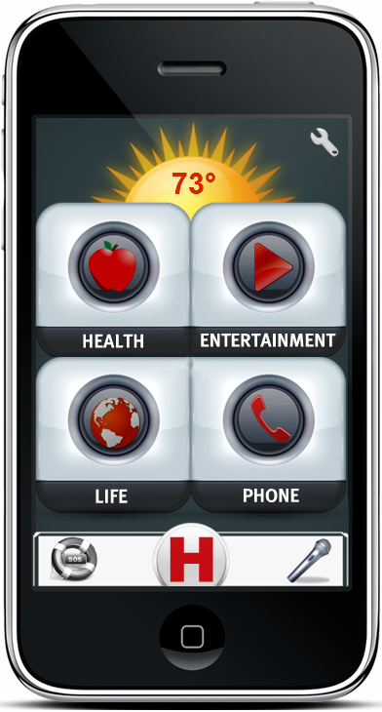
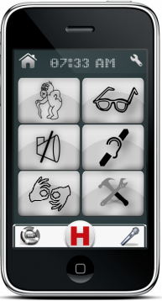
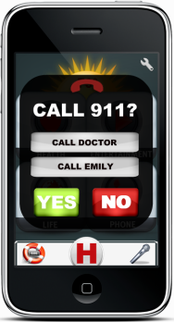
HELPeope – your smart friend
designing mockups
…isn’t all that different across the competitive mobile platforms.
great apps:
don’t make us think about their interfaces
deal with complex tasks, but insulate us from
that complexity
make accomplishing our goals easier
help users be awesome in the moment

Slide 13
HELPeope – your smart friend
product mockups demo
WATCH HERE
http://www.youtube.com/watch?v=4aFOWkZmX_U

Slide 14
HELPeope – your smart friend
why HELPeople is better?
Utilizes ALL of a mobile device’s built-in Input and Output
hardware capabilities
Leverages the power and functionality of other apps instead
of re-inventing the wheel
Increases the usefulness of existing apps
Opens up the World Wide Web to the handicapped
Other app makers will want to integrate with HELPeople in order
to reach a larger and heretofore untapped market
One common UI that ties everything together
Future-proof: API ensures that HELPeople can handle yet-to
be-invented apps with little or no change required to system

Slide 15
HELPeope – your smart friend
thank you
Taraneh parvaresh
Mairon toci
Ian bui
Pooria kamran rashami
We appreciate your feedback!
contact@tmip-helpeople.com
www.tmip-helpeople.com

