Slide 1
Case Study
The Root Cause Behind ERP Implementation Failure:
A Requirement Engineering Perspective
Obi Ogbanufe
SYSM 6309

Slide 2
Overview
Motivation
Problem(s)
Solution
Conclusion
Notes:
How many here have tried cooking before? How many have seen a dish in a restaurant and tried to make it?

Slide 3
Motivation
Requirements engineering
..how could it have saved Ingram Micro from a $20 million loss incurred from a failed ERP implementation

Slide 4
Ingram Micro
Background
Fortune 100, founded 1979, wholesale provider of technology products and supply chain services
World’s largest IT distributor, based in Santa Ana, California.
Locations in the US, New Zealand, Singapore, Belgium, Chile, Indonesia, Australia etc.

Slide 5
Ingram Micro ERP Implementation
Replace old legacy 1980’s enterprise system and transition to an SAP ERP
Started three (3) years prior
Singapore, New Zealand, Chile, and Belgium
…Australia
but Australia, which hosts one of Ingram's largest operations, has presented some difficulties due to increased complexity in the existing IT landscape there

Slide 6
Enterprise Resources Planning (ERP)
Enterprise Resource Planning system is a software system designed to support automate and integrate the business processes of medium to large organizations
Manufacturing, distribution, human resources, project management, payroll, and financials

Slide 7
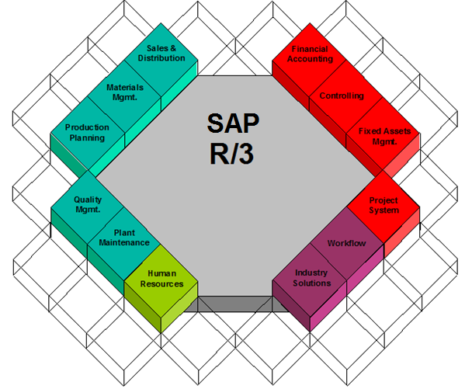
ERP Processes Integration

Slide 8
ERP Failures
40% of ERP projects failed- from survey of 117 orgs - Source Conference Board
51% of companies across a wide range of industries stated that their ERP implementations were unsuccessful - Source Robbins-Gioia LLC
FoxMeyer
Pharmaceutical
American LaFrance
Emergency Vehicles
Shane Co
Jewelry Retailer
ERP Failures Surveys
ERP Related Bankruptcy

Slide 9
Cause
Ingram …due to increased complexity in the existing IT landscape

Slide 10
Landscape

Slide 11
Increased Complexity in IT Landscape
Requirements Engineering [RE]
User Involvement [UI]
Project Management [PM]
Implementation Teams [IT]
Customization [CZ]
Project
Stakeholder Analysis
Requirements (Scope)
Time
Cost
Human Resources
Risk
Communication
Quality

Slide 12
Identified Problems – [RE]
Requirements Engineering is capturing, structuring, and accurately representing the user's requirements so that they can be correctly embodied in systems which meet those requirements (Computing Dictionary)
No other part of the conceptual work is as difficult as establishing the detailed technical requirements, including all the interfaces to people, to machines, and to other software systems. No other part of the work so cripples the resulting system if done wrong (Fredericks Brooks, 1987)
Poor requirements management results in inconsistent project outcomes (IBM)
Notes:
RE formerlly thought to be restricted to software:

Slide 13
Identified Problem – [UI]
User Involvement
Critical for project success to identify stakeholders early in the project, and to analyze their levels of interest, expectations, importance and influence (PMBOK, 2010)
Stakeholder | Stakeholder Interest | Assessment of Impact | Strategies for supporting or reducing obstacles
Steve Fordyce | Wants to see the project succeed, but will not hesitate to criticize its inadequacies | Power | Manage closely, keep Satisfied
Gilbert Islander | Wants project to succeed and wants to be in all meetings | Interest | Keep Satisfied, Keep Informed
Stakeholder Matrix (PMBOK 2004)
Notes:
Users can also be referred to as stakeholders and as such their influence and expectations must be taken seriously

Slide 14
Identified Problem – [IT]
Initiating
Planning
Implementing
Monitoring
Implementation Teams
Implementation Engineers lack an understanding of the complexity of the business system
Lack of Staff Management Plan - Attrition

Slide 15
Identified Problem – [CZ]
Customization
Vanilla vs. Fully Customized Solutions
Based on Maturity of ERP Software Market and Vertical Segment
Identified as one of the major causes of ERP implementation failures
…modify the code as a last resort… it hurts performance. Kevin McKay – a former SAP America’s CEO
Vanilla implementations have become the de facto standard for ERP implementations (Sarkera, Lee 2002).

Slide 16
Identified Problem – [PM]
Project Management
…the application of knowledge skill, tools and techniques to project activities to meet project requirements (PMBOK 2010)
…lack of a mature project management- Robbins-Gioia found that only 56% of survey respondents have a formal program management office (PMO) in place
This may correlate with the percentage of failure ERP implementation projects –
More study in this area may identify the exact correlation.

Slide 17
Solutions
Requirements Engineering
Unambiguous, Complete, Verifiable, Consistent , Modifiable, Traceability, Usable
Coordinate Requirements between business units
User Involvement
Continuously Identify and Analyze, Stakeholder expectation management, Communicate effectively and Frequently

Slide 18
Solution
Customization
Less is more
Project Management
Plan
Implementation Team
Give customers a realistic set of project timelines
Deliver on agreed milestones
Staff the job with well-qualified technicians

Slide 19
Conclusion
.. knowing that requirements engineering and project management practices have limitations
.. no matter how much we use requirements to address all the known constraints, projects are still constrained with resource limitations in time, money, resources
..could RE prevent the failure and save Ingram $20million?

Slide 20
Companies Bankrupt by ERP
Shane Co. (2009)
Denver, Colorado-based jewelry retailer
FoxMeyer Corp (1998)
4th largest pharmaceutical company
America LaFrance (2008)
Maker of emergency vehicles such as fire trucks and ambulances. Claims IBM’s work on installing and transitioning to a new ERP system contributed to inventory and production problems.

Slide 21
Solution to 2
Solution (coordination)
Goal Oriented Mechanism
Partners, BUs agreeing to goal of coordination
Process Orient Mechanism
Establishing end-to-end inter-organizational process

