Slide 1
Learning from Failure: Managing Changing Requirements on the Apollo 13 Mission
SYSM 6309 Advanced Requirements Engineering
By: Paul Wasilewski

Slide 2
Context
Background and problem
Why requirements change
Avoiding requirements creep
Discovering discordances in requirements
Managing Changing Requirements
Application and Conclusion

Slide 3
Apollo 13 Mission - Background
“Successful Failure”
Mission failed to land on moon, but succeeded to return astronauts safely
Engineers/Mission Controllers able to work together to create a safe return for Apollo 13 crew
“Failure is not an Option” – Flight Director Gene Krantz
Failure may be an option at every step except the final goal
Intermediate failures contribute to success

Slide 4
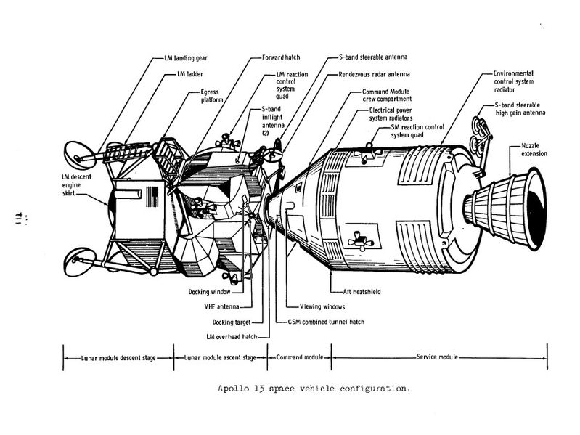
Apollo 13 Space Vehicle Configuration

Slide 5
Apollo 13 Voltage Requirements
Original requirement for Command and Service Module (CSM)- 28V
Requirement changed to be compatible with ground-support equipment - 65V external power
Thermostat safety switches were not changed
All Apollo spacecraft up to 13 had wrong switches
Underrated switches may not have been a problem
Prior removal from Apollo 10 damaged ability to drain tanks
Following a test ground crew was unable to drain LOX
Tank heaters activated – boil off oxygen
65V applied to 28 V rated thermostatic switch
Switch fused shut

Slide 6
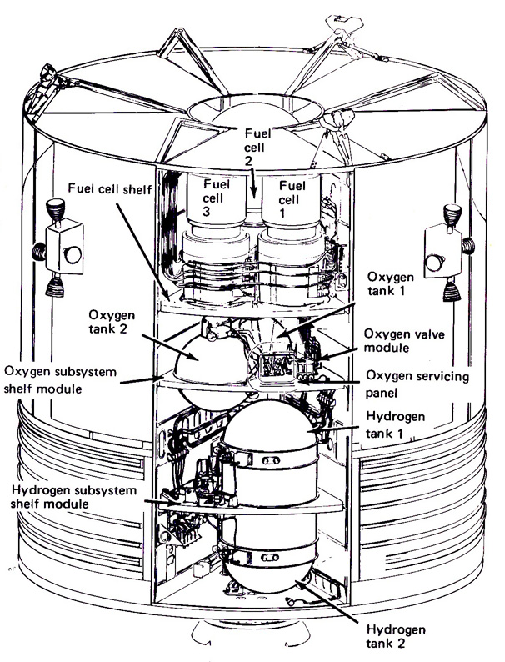
Apollo 13 Voltage Requirements (cont.)
Thermostat required to keep temperature <27°C
Heaters stuck on for 8 hours – Temps>500°C
Teflon insulation melted exposing wires
Thermometer only calibrated to 29°C
Prevent overheat requirement missed
LOX in tank prevent arcing until depleted
Request to stir tanks resulted in explosion of oxygen tank 2

Slide 7
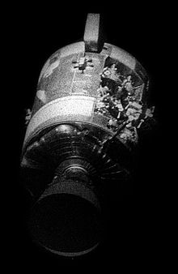
Why Requirements Change
Changing Requirements
Government Regulations
Business Priorities
Technology
New Stakeholders
60% of changes due to functional enhancements

Slide 8
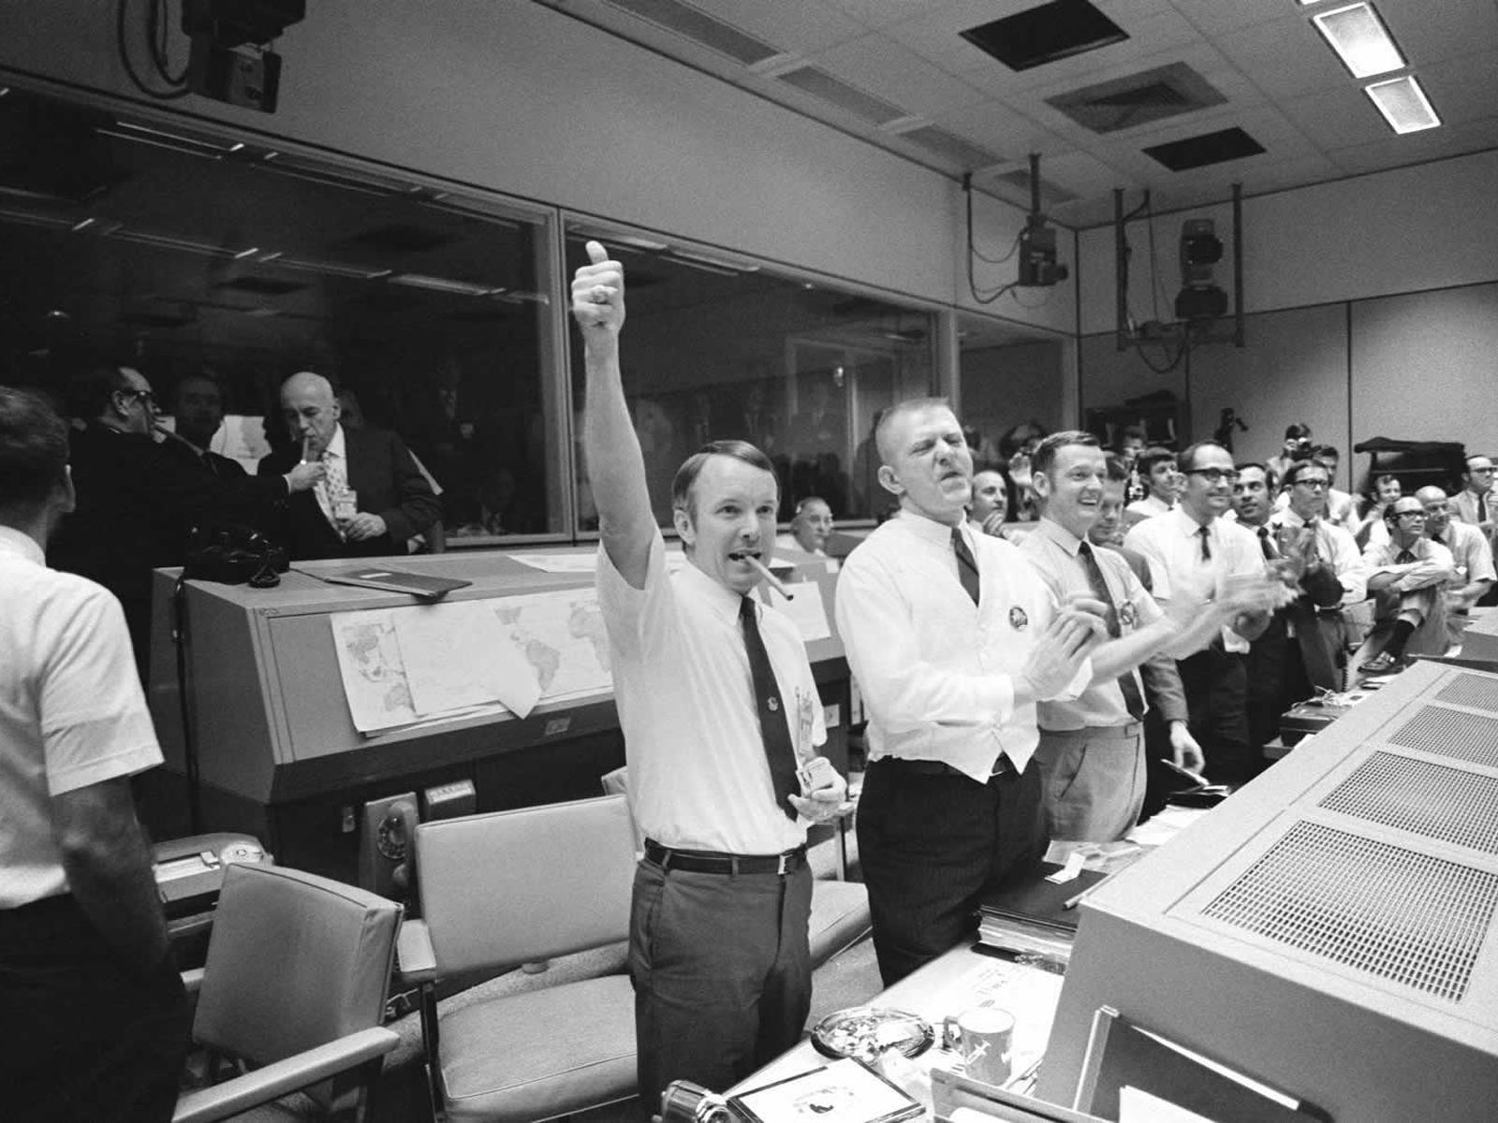
Guidelines for Changing Requirements (IBM Corporation)
Expect and plan for requirements that change throughout the develop­ment process.
Continually reprioritize requirements based on changing circumstances
Have a plan and adjust it at regular intervals.
Keep your stakeholders informed as changes occur—get their input for prioriti­zation and the rationale behind it.

Slide 9
Avoiding Requirements Creep
Reduce Rate of Change
Measure functional points and quantify rate
Functional Points - units of measure used to quantify functional requirements based on user’s point of view
Compare initial requirements with final requirements
Analyze data between phases to determine rate
Develop processes and procedures to reduce the rate of change
Increased rate of changes = need for better procedures for requirements elicitation
Use tools to lessen the impact of change

Slide 10
Detecting Discordances in Requirements
Better requirements at elicitation = less changes to manage
Problems with differing views of requirements
Missing Requirements
Inconsistent Requirements – differing outcomes expected
Discordant Requirements
Difference in interpretation – results from knowledge gap
Differing evaluation
Apollo 13 examples of discordance
Voltage requirements
28 volts vs. 65 volts
Thermometer requirements
Over temperature vs. system operation monitoring

Slide 11
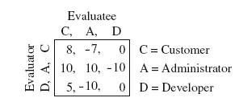
Detecting Discordances (cont.)
Important to correct during elicitation of requirements
Attributed Goal Oriented Requirements Analysis (AGORA)
Generate “goal graph” to prioritize importance
Allows for analysis of interpretation and evaluation of requirements
Preference matrices

Slide 12
Managing Changing Requirements
Joint Application Design
Users and developers jointly develop requirements specification
Prototypes
Allows changes to occur prior to development
Rapid Application Development
Small applications, developed faster to avoid change
Requirements inspection
Formal inspections of requirements for errors and inconsistencies
Cost-Per-Function-Point Contracts
Sliding scale discourages late changes in requirements
Quality Function Deployment
Used in hardware development, evaluates requirements based on user quality
Change Control Boards
Large projects, board made up of various stakeholders
Change and Configuration Management Systems

Slide 13
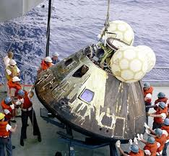
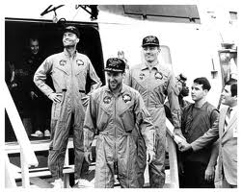
Application to Apollo 13
Issues with Requirements
Not passed down to all stakeholders
Poor traceability
Insufficient testing to validate changes
Poor process for change management
Poor process for requirements elicitation
Interpretation and evaluation of requirements
Illustrates importance of proper requirements elicitation and change management

Slide 14
References
[1] S. Cass, "Apollo 13, We Have a Solution," IEEE Spectrum, 2005.
[2] M. Williamson, "Aiming for the Moon: The engineering challenge of Apollo," Engineering Science and Education Journal, vol. 11, pp. 164, 2002.
[3] IBM Corporation, "Getting requirements right: Avoiding the top 10 traps." 2009.
[4] I. Nonaka, "The Knowledge-Creating Company," HBR, July 2007.
[5] A. Kelly, "Why Do Requirements Change?" 2004.
[6] C. Jones, "Strategies for managing requirements creep," Computer, pp. 92, June 1996.
[7] H. Kaiya, D. Shinbara, J. Kawano and M. Saeki, "Improving the detection of requirements discordances among stakeholders," Requirements Engineering, pp. 289-303, October 2004.
[8] N. J. Slegers, R. T. Kadish, G. E. Payton, J. Thomas, M. D. Griffin and D. Dumbacher, "Learning from Failure in Systems Engineering: A Panel Discussion," Systems Engineering, vol. 15, pp. 74, 2011.

