Slide 1
Pooria Kamran Rashani
Advanced Requirements Engineering Spring 2012
Notes:
Hi guys, before I want to give my final presentation about liquid net reuquirments.. I would like to show you a short video clip about Liquid net so the concept will be more vivid and tangible Well Now , in order to find the requirment First I would like to say the first main requirments of Liquid net 1.Evoloutionary 2.Self adaptive, Self

Slide 2
Liquid Net solution Requirements
Enablers
End-to-end network capabilities
Self-aware and
Self-adapting
Liquid content and traffic management for superior subscriber experience and new revenues
Software defined apps on multi-purpose hardware
Liquid
Net
Liquid resource allocation for flexibility and enhanced efficiency
Inter-linked architecture
Evolutionary

Slide 3
Liquid Net functional requirement in main three domains
Liquid Net
Radio domain & Core domain are main concern in terms of functional Requirements
Intelligent Broadband Management Integrated QoS and Content Delivery Network
Liquid Radio
Baseband
Pooling
Active Antenna System
Unified Heterogeneous
Networks
Liquid Core
Core Virtualization
One Common
Hardware
Liquid Transport
Flexible Optics
Multi Layer Optimization
Intelligent Control
Transport domain mostly act as a non-functional Requirement

Slide 4
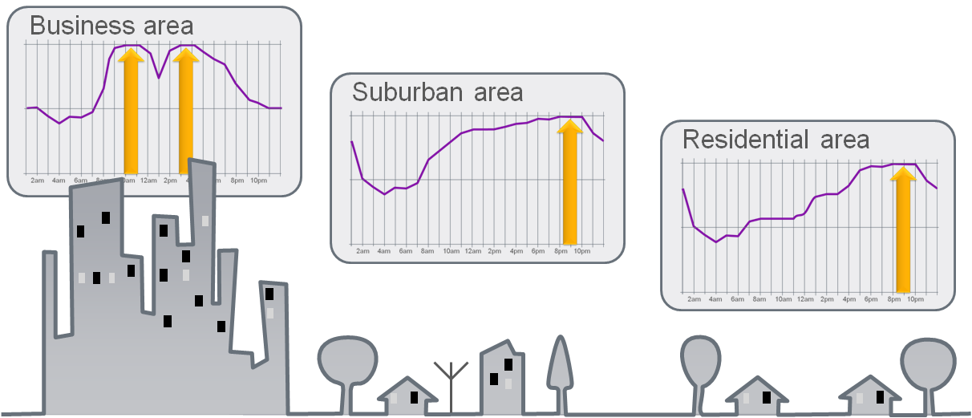
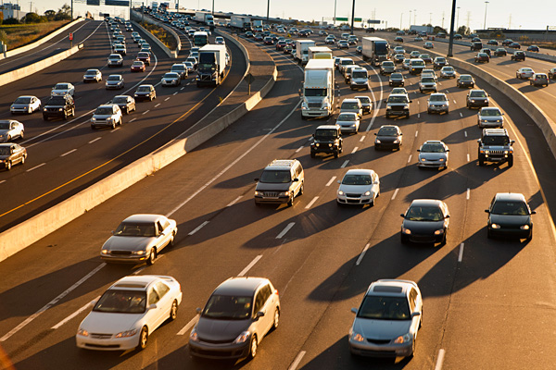
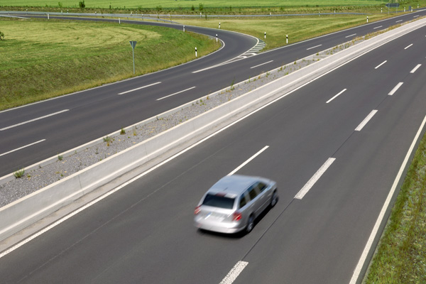
Unpredictable use, but dependent on time and place
Up to 80% idle capacity
Up to 50% idle capacity
Users
Radio
Core
Content

Slide 5
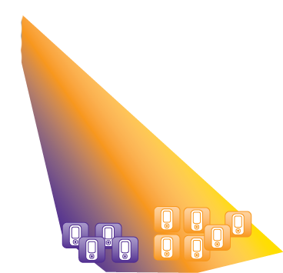
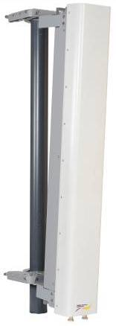
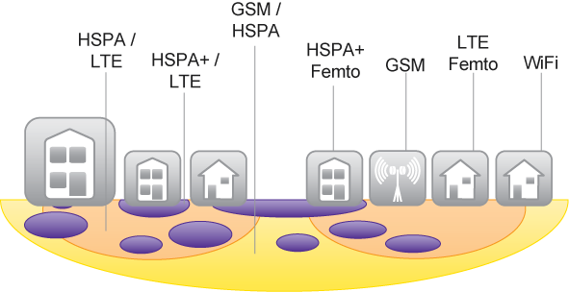
Liquid Radio “functional requirements”
Single RAN -
Active Antenna Systems
Baseband pooling
Unified Heterogeneous
Networks
Small Cells
Macro Cells
automated beam forming for dynamic cells based on time of day or demand
Baseband pool

Slide 6
Smart Lab finding example: Signaling generated by playing Angry Birds
Signaling traffic generated by one hour of Angry Birds play
40000
352% increase
3996
3600
2400
2422
Number of signals sent
Overall, the Angry Birds application itself creates manageable amounts of network and data traffic
1600
8% increase
800
688
742
0
But ads delivered with each new Angry Birds level achieved more than triples signaling traffic on Android phones
Smartphone baseline–
Weather and email updates
No Advertising
Angry Birds on iPhone
No Advertising
Angry Birds on Samsung Galaxy (Android)
Advertising with each new game level
Smartphone online poker
No Advertising

Slide 7
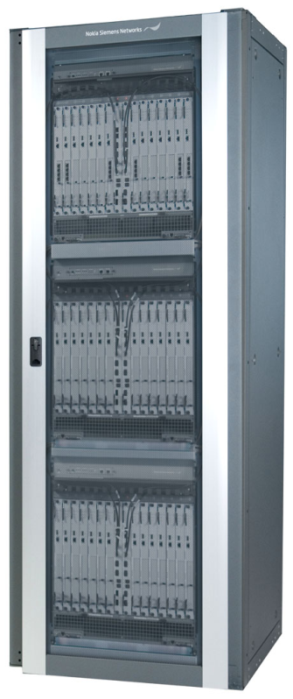
Liquid Core “functional requirements”
Network element with different SW
Automated load and transmission balancing -Efficiently
+
TCO reduced Significantly
Virtualization layer
Core network elements
One Common Hardware-ATCA
1
Voice Mail Server
Simplification
and consolidation
of core network
VMS
SMS Server
Up to 80% lesser footprint
SMS
Signal Transfer Point
Long life cycle for hardware Durability
MSS
Mobile Switching Server
n

Slide 8
Liquid Transport “Non functional requirements”
Intelligent Control
A multi-layer intelligent control plane is introduced to the network to enable more flexibility , rapidly and easy network operation and service provisioning, what is called ‘services in seconds’.
Flexible Optics
By making the optical transport layer, the lowest layer with the least total cost of ownership (TCO), more flexible and software-configurable, more traffic can be carried more cheaply than on the IP layer, removing many of today’s network scalability and cost constraints, and supporting rapid service provisioning and low latency: what is called ‘zero-constraint networking’
Multilayer Optimization
For maximum efficiency between the optical and the IP layer (360’ network design), transport networks must be planned and implemented holistically across all networking technologies, including in particular radio and core – and across different vendors

Slide 9
Reference
NSN white papers Wikipedia

Slide 10
Thank You

