Slide 1
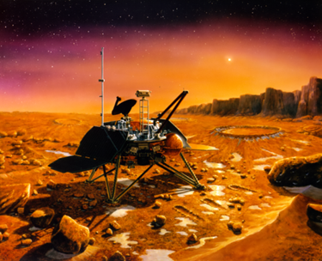
System Software Integration Testing Mars Polar Lander
Steven Ford
SYSM 6309
05/05/12

Slide 2
Problem Statement
Most modern hardware and software systems are what we call a System of Systems (SoS)
A SoS is a group of interacting, interrelated, or interdependent elements forming a more complex whole that is to produce a desired output
Often subsystems, which function as desired at the unit level do not interact as desired with other subsystems when integrated
The earlier these incompatibilities are discovered the less of an impact it will have to the project schedule and cost

Slide 3
Mars Polar Lander Mission
Launched: January 1999
Cost: $165,000,000
Objectives:
1) record local meteorological conditions near the Martian south pole
2) Analyze samples of the polar deposits for volatiles, particularly water and carbon dioxide
3) Dig trenches and image the interior to look for seasonal layers and analyze soil samples
4) Image the regional and immediate landing site surroundings for evidence of climate changes and seasonal cycles
5) Obtain multi-spectral images of local regolith to determine soil types and composition.

Slide 4
Mars Polar Lander Destruction
Mars Arrival: December 1999
Descent Begins: 14:39:00 UTC
Communication Lost: 20:39:00 UTC
Most Probable Cause of Failure – Software Error:
A magnetic sensor is provided in each of the three landing legs to sense touchdown when the lander contacts the surface, initiating the shutdown of the descent engines.
The software logic accepts this transient signal as a valid touchdown event if it persists for two consecutive readings of the sensor.
Testing showed that most of the transient signals at leg deployment are long enough to be accepted as valid events.
The software—intended to ignore touchdown indications prior to the enabling of the touchdown sensing logic—was not properly implemented, and the spurious touchdown indication was retained.
The touchdown sensing logic is enabled at 40 meters altitude, and the software would have issued a descent engine thrust termination at this time in response to a (spurious) touchdown indication.
Lander Destruction:
At 40 meters altitude, the lander has a velocity of approximately 13 meters per second, which, in the absence of thrust, is accelerated by Mars gravity to a surface impact velocity of approximately 22 meters per second (the nominal touchdown velocity is 2.4 meters per second).

Slide 5
Requirements
Potential Requirements Engineering Issues
SW Scope Creep
Software logic satisfied initial requirements then testing showed hardware limitations which could be accounted for through software change, no official requirement change, no official requirement verification – system failure
Inadequate Requirements Verification
Inadequate Integration Testing Requirements
System Level Test Requirements
Inadequate System Level Testing
Inadequate System Modeling

Slide 6
System Integration Testing
Four Levels of Software/Hardware Testing:
Unit Test - Lowest level of testing where each individual software or hardware piece is tested to ensure it functions as desired
Integration Testing – Intermediate level of testing where the individual subsystems are tested to ensure they interact with one another as desired
System Level Testing - Highest level of testing, the system as a whole is tested against requirements
Acceptance Testing - This is demonstration of system functionality to the end user

Slide 7
System Integration Testing
Systems Integration Testing:
The process of combining and testing multiple components together
It is a systematic approach to build the complete software structure specified in the design from unit tested modules
It assures that the software units are operating properly when they are combined together
The aim of integration testing is to discover errors in the interface between the components
The interface errors and the communication between different modules are also unearthed in this testing

Slide 8
Software Integration Testing
Integration and Test Milestones
Integration and test milestones identify a period during which time a set of software units are verified by exercising one or more threads.
Thread verification during software integration deals typically with the interfaces between software units, while thread verification during software testing deals with functional capabilities.
A milestone may consist of one or more capabilities that can be demonstrated by executing the instructions in the software integration and test procedures.
Intermediate Integration and Test Builds
Intermediate integration and test builds may be identified, which consist of informal builds to allow for smaller increments of software to be integrated and tested.
Smaller increments are encouraged, to promote faster problem identification.

Slide 9
Software Integration Testing
Target Hardware/Software Configuration
Software integration and testing should be performed in an environment that represents the target hardware and software environment as closely as possible.
Software Configuration Control
A configuration control management system to control the software and software documentation configuration, storage and retrieval during the integration and testing effort should be implemented
Version Description Document
Used to identify the different versions of the different software linked together for a master release should be used.

Slide 10
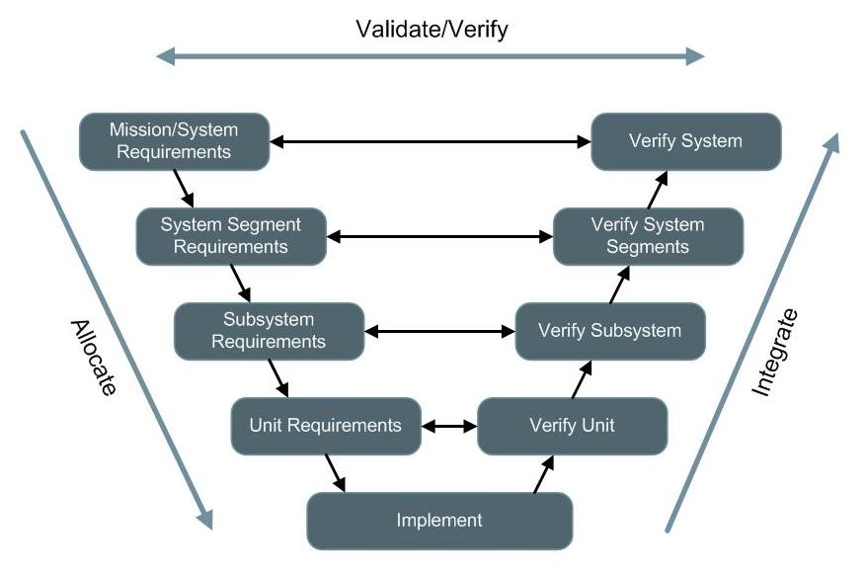
Incremental Design Approach

Slide 11
Mars Polar Lander
The Mars Polar Lander failure was the result of many individual shortfalls in the design and test process which aligned properly to cause the complete loss of the system.
For projects such as the lander where the equipment is designed for a one time use and the environment cannot be duplicated in a cost effective manner iterative integration testing is paramount because the ability to perform system level testing is limited.

Slide 12
Resources
[1] Barry Shore. Mars Climate Orbiter and Mars Polar Lander. Global Project Strategy. http://globalprojectstrategy.com/lessons/case.php?id=10 Retrieved 2012-02-07.
[2] Babu Suresh. Scope Creep Management. 2005-01-01. http://www.projectperfect.com.au/info_scope_creep_mgmt.php Retrieved 2012-05-01.
[3] Bhakti Satalkar. Integration Testing vs. System Testing. 2011-06-14. http://www.buzzle.com/articles/integration-testing-vs-system-testing.html Retrieved 2012-02-09.
[4] Raytheon. Software Integration and Testing Guidelines. EN-04-01-02 Rev. A. 2003-06-06. Revised 2011-02-11. Raytheon Space & Airborne Systems.
[5] Thomas Young. Mars Program Independent Assessment Team Summary Report. Draft #7 2000-03-13. House Science and Technology Committee. http://www.spaceref.com/news/viewpr.html?pid=1444. Retrieved 2012-02-07.

Slide 13
Questions?

