Slide 1
Who wants to be reengineered?
Taraneh Parvaresh
Advanced Requirements Engineering
SYSM 6309
Spring 2012

Slide 2
Topics
Overview of BPR
What is not BPR
Problem
Proposed life cycle of BPR
Functional Objectives
Non-functional Objectives
Illustration
References

Slide 3
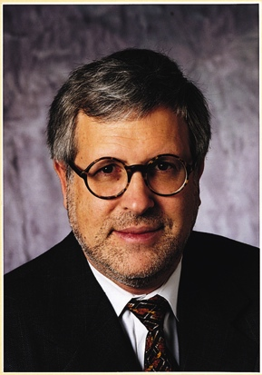
Overview of BPR
Michael Hammer (1948 - 2008)
Founder of Business process reengineering
A professor at the Massachusetts Institute of Technology
Published paper in HBR :
“Reengineering Work; Don’t Automate Obliterate”
Published a book:
“Reengineering the Corporation”
Notes:
known as one of the founders of the management theory of Business process reengineering (BPR)
Reengineering the Corporation was ranked among the "three most important business

Slide 4
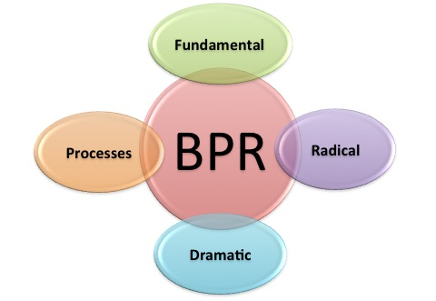
Overview of BPR (Cont.'s)
“Reengineering is the fundamental rethinking and radical redesign of business processes to achieve dramatic improvements in critical, contemporary measures of performance, such as cost, quality, service, and speed.” (Hammer)
fundamental
radical
processes
dramatic

Slide 5
What is not BPR
Is not “Automation”
Is not “Downsizing”
Is not “Restructuring”
Is not “Incremental change”
Is not TQM (Total Quality Management)

Slide 6
Problem
Huge layoffs in the name of reengineering
In an effort to increase productivity by sacrificing the personnel
IBM Corporation cut 154,000
Pacific Bell reduced 10,000 employees
AT&T laid off 18,000 workforces
Compaq and Motorola cut 15,000
Raytheon with 14,000
Notes:
Reengineering concept implemented poorly by many companies in the beginning. Many companies used this term to downsizing the company and reducing cost by streamlining jobs.
Hammer also later admitted to paying little attention to human resource while developing the method.
He said that, “In reengineering, we carry the wounded and shoot the stragglers", and "It's basically taking an ax and a machine gun to your existing organization." The result of using this terminology was huge layoffs which some of the companies carried out

Slide 7
Life cycle of BPR
Proposed Life cycle of BPR
Create Vision
Analyze
Implement
Project Initiation
General Business Analysis
Develop Proposed general business system design
Redesign
Implement procedural solutions
Detailed Business Analysis
Develop Proposed detail business system design
Test procedural solutions
Problem identification and evaluation
Develop procedural solution specification
Implement procedural solutions into production
Post implementation review

Slide 8
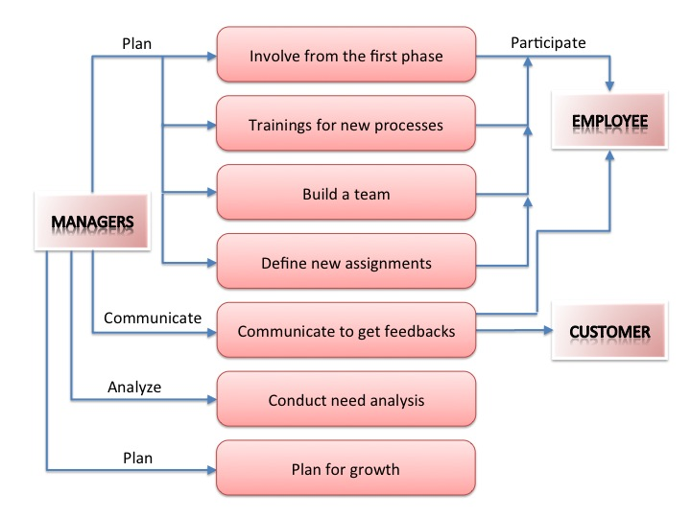
Functional Objectives

Slide 9
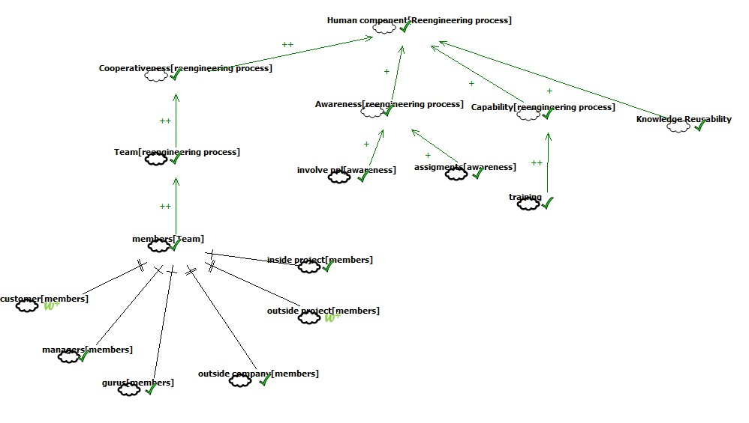
Non-Functional Objectives

Slide 10
Illustration: GTO case study
GTO Inc. small company manufacturing automatic gate openers based in Florida
Losing money on a monthly basis after the death of the founder, it lacked a line of credit
Employees were required to work twenty-four hour shifts to fill important orders
New CEO adopted a new strategy: consist of creating an atmosphere of trust and optimism among GTO's employees
Listening to and adopting their suggestions and improving their health and disability insurance
Pay was increased and bonuses distributed from a profit sharing plan
Net profits moved from the red to nearly $500,000
Employee turnover decreased equally dramatically
Focused on human resources rather than on processes

Slide 11
BPR
What they want to do
What they think they do
What they really do

Slide 12
References
“A Study of Business Process Reengineering” by Kevin Lam
Business Process Reengineering, Dr.Lotfi K.Gaafar
http://freedownload.is/ppt/business-process-reengineering-1065598.html
Video: http://www.referenceforbusiness.com/management/Bun-Comp/Business-Process-Reengineering.html
BIG CHANGE VIA BUSINESS PROCESS REENGINEERING, Daniel F. Duran Whittier College - Operations 342
Encyclopedia for business – Layoffs
“Introduction to Process Reengineering” By Teresa Chiapputo
“Successfully Performing BPR”, By Michael Covert
A six-step guide to process reengineering - Timothy R. Furey
http://www.prosci.com/factors.htm
“Quantitative risk level estimation of business process reengineering efforts”, Thomas J. Crowe
http://www.martymodell.com/pgsa2/pgsa03.html
Reengineering, By Emily Neidhart
Wikipedia
“What Does Reengineering an Organization Mean?” by Kristie Lorette, Demand Media

