Slide 1
HELPeople
Assistive Technologies
for the Mobile Market
Team T-MIP
UTD Spring 2012

Slide 2
HELPeopLe – your smart friend
Content
Product Specifications
Process Specifications
Demonstration
Discussions

Slide 3
HELPeoPLe – your smart friend
I. Product Specifications
Problem Statement
The dearth of mobile apps for people with memory or communicative disabilities means the elderly, the blind, mute, deaf, etc. are not benefiting from the mobile revolution and must depend on whatever PC-based solutions that are available
Solution
A simple, intuitive interface on a smart mobile device (phone, tablet, etc.) that will assist people in important daily tasks and improve their quality of life.
Product Positioning
For | The elderly and disabled
Who | need assistance in daily activities.
HELPeople | is a mobile app running on smart phones or tablets
That | can integrate other apps and provide a common user interface.
Unlike | existing mobile apps which are built mainly for sighted people,
Our product | makes full use of the multiple input and output capabilities of a mobile device, such as microphone, speaker, keyboard, camera, vibration, and so on

Slide 4
HELPeopLe – your smart friend
Market Overview
Business Opportunity
Increasing use of smart mobile devices by the growing elderly population
Untapped segment of users with communicative impairments
No existing apps with easy-to-use integrated interface
Market Demographics
The elderly and those with memory impairments, and their caretakers
The blind or those with poor eyesight
The mute or those with speech disabilities
The deaf or those with poor hearing
Kids
Competition & Alternatives
Google Voice & Apple Siri
Standalone single-function apps
PC-based apps

Slide 5
HELPeopLe – your smart friend
Stakeholders & User Needs
Main Stakeholders
Investors
Management
Development & Support
Sales & Marketing
End Users
Other App Makers on Market
Key User Needs
Emergency situations
Healthcare assistance
Text to speech
Voice command
Facial recognition
Location

Slide 6
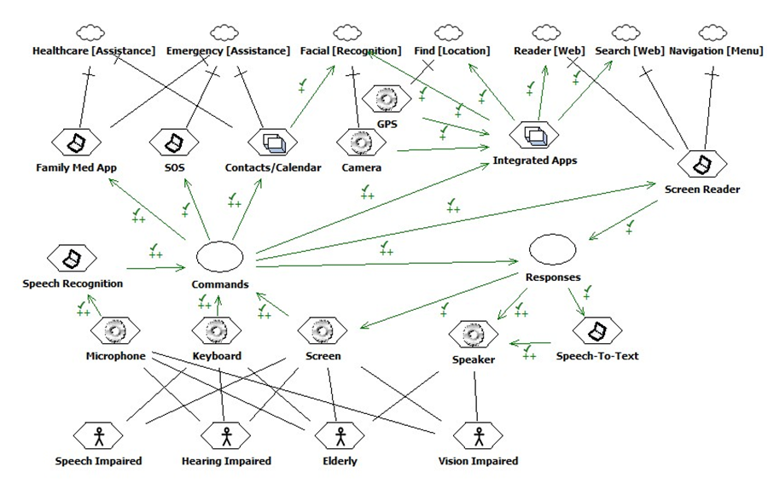
HELPeopLe – your smart friend
Problem Domain – SIG Model

Slide 7
HELPeopLe – your smart friend
System Overview

Slide 8
HELPeopLe – your smart friend
Product Overview
Summary of Capabilities
Easy access to most used applications or favorite ones.
Set the configuration according to their desire.
Add desired applications or remove unwanted apps.
Assumptions and Dependencies
The default language for HELPeople would be US English. It is assumed that the user is able to communicate in English.
It’s assumed that the network would be available on users handset so they can use network-based applications such as SMS and call.
Cost and Pricing
This product would be a “Freemium” application
Native applications: free
Non-native applications: at a cost
Licensing and Installation
Licensing : Shrink-wrapped package
Installation: split to 2 sections: native and non-native applications
Notes:
Which means that the initial software would be free but the users can spend their money on in-app purchases. Native applications would be included in the initial free version of the product, with a limited set of functional features
In this model, “License Agreement” is accepted either by unwrapping the product or by digitally checking the “Accept” checkbox. The customer has unlimited lifetime usage of the software under the terms in the license agreement

Slide 9
HELPeopLe – your smart friend
Constraints and Requirements
Constraints
Responsiveness
User Interface Usability
Security
Other Product Requirements
Application Requirements
System Requirements
Performance Requirements
Documentation Requirements
User Manual
Online Help
Quality Ranges
All output responses should be no more than 1000 ms
The icons representing categories should be large enough so that elderly users can recognize and understand them easily

Slide 10
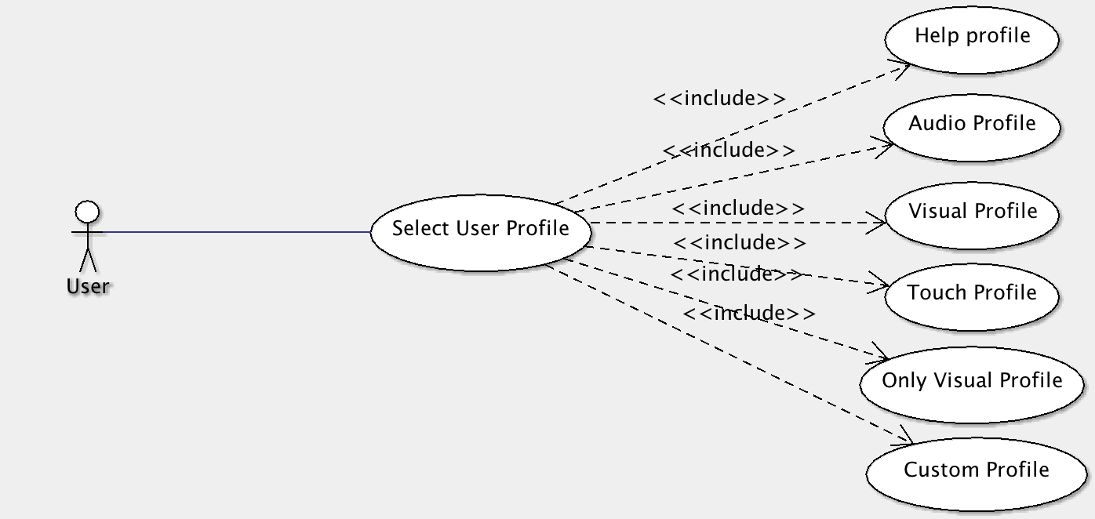
HELPeopLe – your smart friend
Use Cases
User Profiles use case

Slide 11
HELPeopLe – your smart friend
User Profile Use Case
Description
There are 5 categories of predefined user profiles in the product, which users can choose according to their need. And also there is a profile name “Customize Profile” in which the user can customized the settings according to his/her need. Each of them has default settings, which it will define how the user can interact with the system.
The profiles are as below
Help Profile
Audio Profile
Visual Profile
Touch Profile
Only visual Profile
Customize profile

Slide 12
HELPeopLe – your smart friend
User Profile Use Case (cont’)
Actors
User
Prerequisite
HELPeople is installed in user’s phone and is running.
Case Flow
User select “Setting” from main menu
User selects one of the profiles, e.g. “Audio Profile”
Voice commander would be available for this user in all screens of the application and user can interact with the system via voice instead of touch
Web reader and screen reader would be available for the user

Slide 13
HELPeoPLe – your smart friend
II. Process Specifications
Vision
Develop a simple but effective process to produce the required Deliverables as specified in the Course Syllabus without sacrificing accuracy, functionality or quality.
Goals
Optimize efforts
Maximize re-use
Minimize errors
On-time delivery

Slide 14
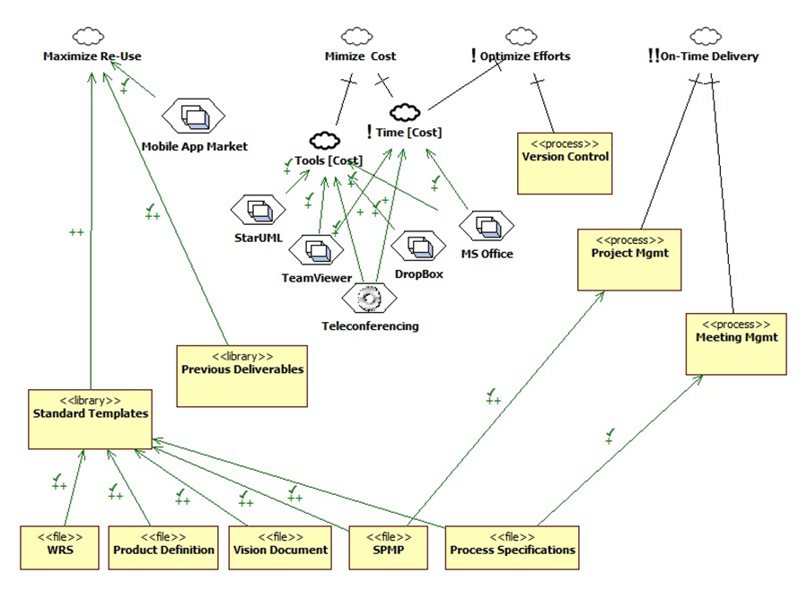
Process Non-Functional Requirements
HELPeopLe – your smart friend

Slide 15
HELPeopLe – your smart friend
Meeting Process Workflow

Slide 16
HELPeopLe – your smart friend
Process Functional Requirements

Slide 17
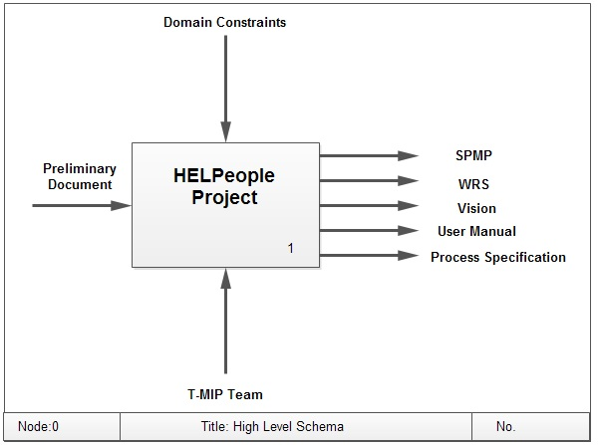
HELPeopLe – your smart friend
Traceability
IDEF Level 0

Slide 18
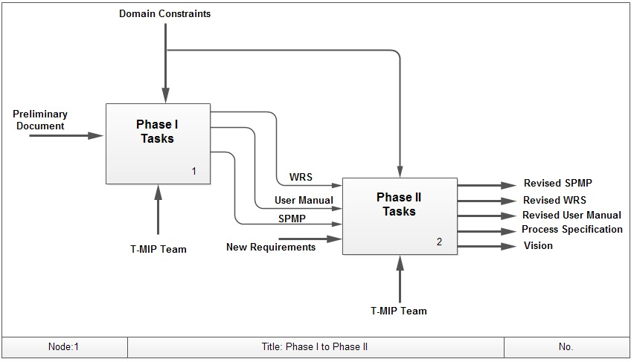
HELPeopLe – your smart friend
Traceability
IDEF Level 1

Slide 19
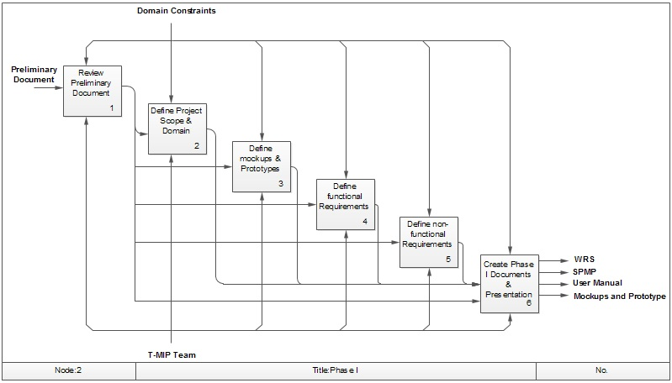
HELPeopLe – your smart friend
Traceability
IDEF Level 2

Slide 20
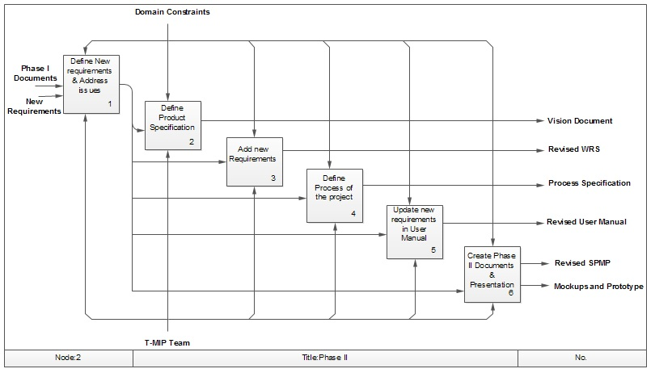
HELPeopLe – your smart friend
Traceability
IDEF Level 2

Slide 21
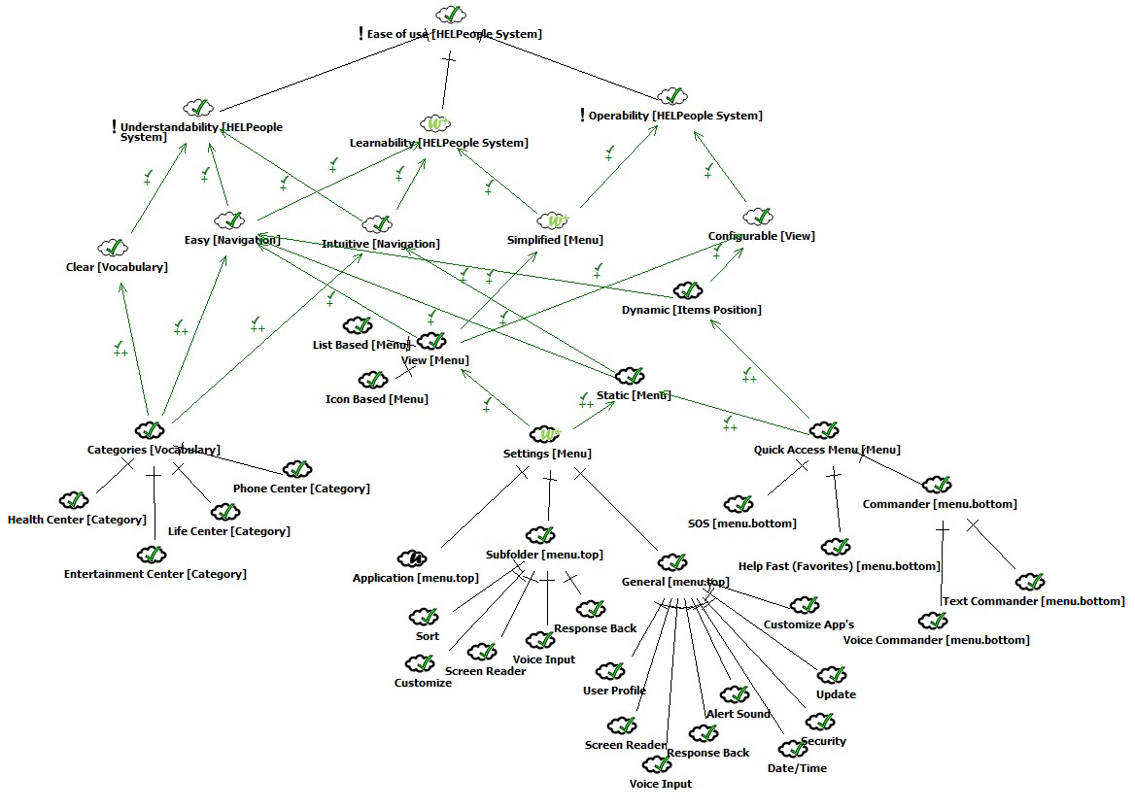
HELPeople – your smart friend
III. Product Demonstration
SIG – Ease of Use

Slide 22
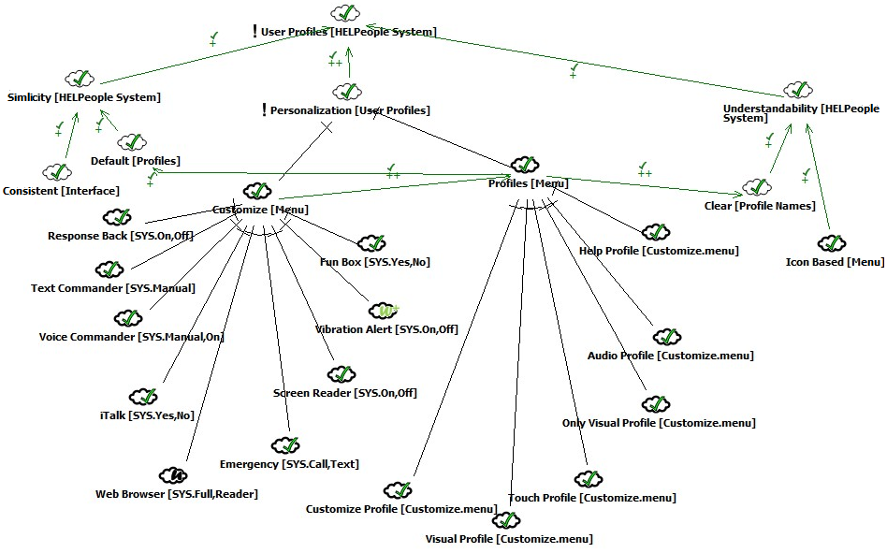
HELPeople – your smart friend
Product Demonstration
SIG – User Profiles

Slide 23
HELPeople – your smart friend
Product Demonstration
Demo
WATCH HERE
http://youtu.be/ydtiQbAtLLQ

Slide 24
HELPeople – your smart friend
Why HELPeople is better?
Utilizes ALL of a mobile device’s built-in Input and Output
hardware capabilities
Leverages the power and functionality of other apps instead
of re-inventing the wheel
Increases the usefulness of existing apps
Opens up the World Wide Web to the handicapped
Other app makers will want to integrate with HELPeople in order
to reach a larger and heretofore untapped market
One common UI that ties everything together
Future-proof: API ensures that HELPeople can handle yet-to
be-invented apps with little or no change required to system

Slide 25
HELPeople – your smart friend
thank you
Taraneh parvaresh
Mairon toci
Ian bui
Pooria kamran rashami
We appreciate your feedback!
contact@tmip-helpeople.com
www.tmip-helpeople.com

