Slide 1
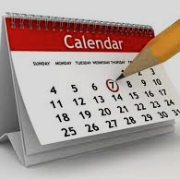
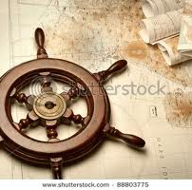
SYSM 6309
ADVANCED REQUIREMENTS ENGINEERING
intelliTrac
http://www.wix.com/ayazhayder/intellitrac
By
Benji Boban
Aagbara Kpea
Muhammad Ayaz Shaikh
Shilpa Siddavvanahally

Slide 2

Table of Contents
Introduction
Overall Use Case & Sample Test Case
Functional requirements
Enterprise domain model
Non-functional requirements
Functional goal model
Scenario
Prototype
Justification

Slide 3
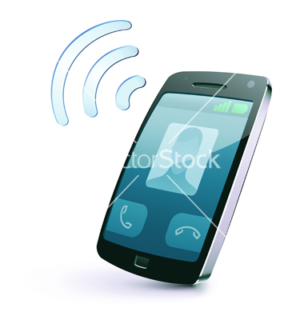




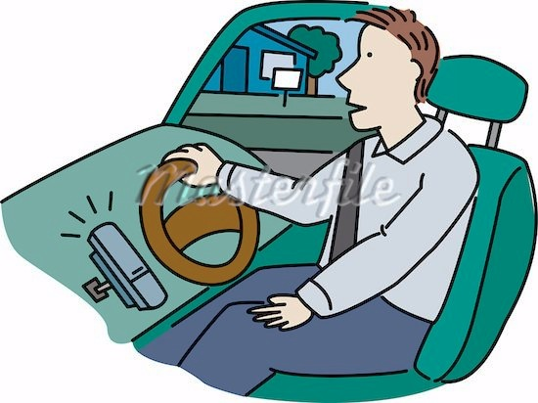
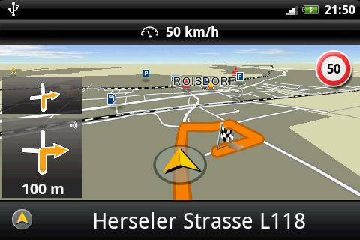
Introduction
intelliTrac is a Smartphone application, whose purpose is to help technicians store the information generally contained in a service ticket.
This app schedules a ticket, then guides you to reach the customer, stores the relevant information for that job, and can even create a report.
  Scheduling
  Location
  Annotation
  Reporting

Slide 4
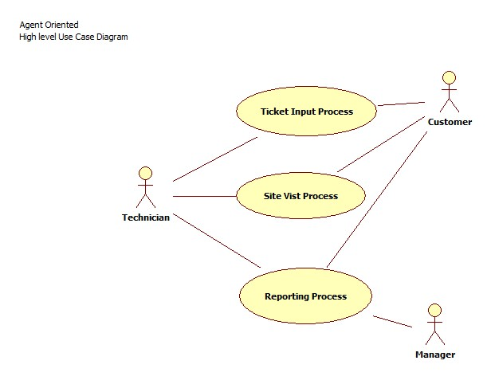
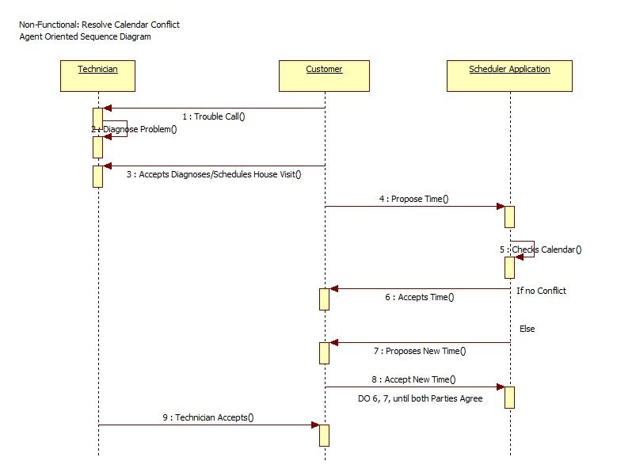
Overall Use case Sample Test Case

Slide 5

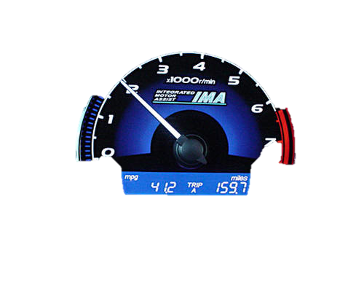
Functional Requirements
The application shall interact with the native phone calendar application for time availability
    There shall be an Application alarm to alert the technician of the coming job.
    The application shall interact with the calendar to offer snooze, reset, reschedule, or initiate travel.
    The application shall calculate the mileage driven via the GPS function of the phone or shall give the technician the ability to enter current location.
    The application shall provide an option to select destination arrived.

Slide 6

Functional Requirements
    The application will allow the user to take notes, record pictures of items purchased, record receipts from hardware/software purchased.
    The application shall pop up with completed ticket summary once the stop work service time soft button is selected
    There shall be an ability to receive a signature from a customer once a service has been completed.
    There shall be an ability to email the completed ticket.

Slide 7
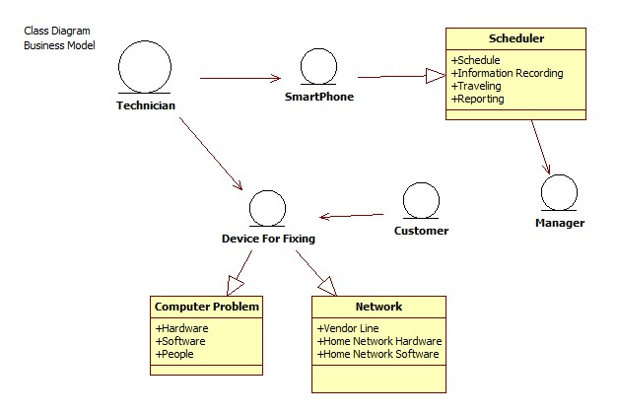
Enterprise domain model

Slide 8
Non- functional Requirements
    Service charges and required hardware/software costs to be purchased will be negotiated with the customer on receipt of ticket.
    Schedule for service shall be negotiated and entered with the customer on receipt of ticket
    It should allow for a calendar view or outline view
    Alarm is set in the calendar of the app
    The information of the GPS functionality of the phone will be used to direct the technician to the site. This information will also send the mileage data back to the application
    There should have an option to calculate from an entered location
    Integrated with a calendar scheduler for a later date and time

Slide 9
Non- functional Requirements
    A menu item shall be provided to edit the customer information, e.g. Name, Address, Phone, Email ID etc.
    An option to create a self tailored alarm with respect to the scheduled time from menu access.
    An option to postpone the scheduled service ticket via snooze mechanism shall be provided.
    Will provide note taking mechanism when the customer site destination is reached.
    An option to attach pictures of receipts, or other work related objects will be provided.
    The Application will provide an option to revisit work areas with respect to the service tickets.
    The Application will provide the option of emailing the completion report to different email ids for e.g. to customer, your manager, yourself, etc.

Slide 10
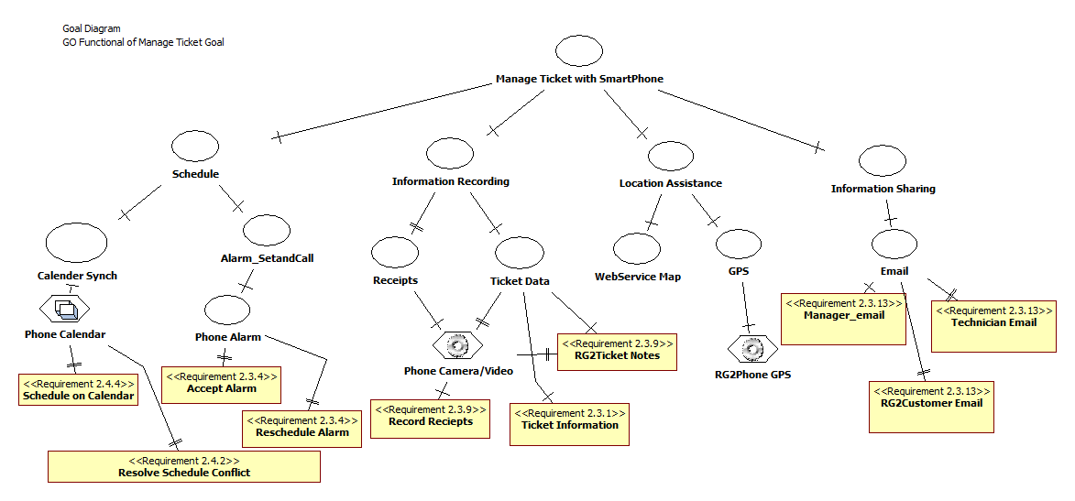
Functional goal model

Slide 11
SCENARIO

Slide 12

Lisa was working on her laptop, to her surprise the laptop hangs and she is forced to reboot her laptop and this is going on for a while.
Lisa decides to get this issue fixed and calls a technician.

Slide 13
The technician who was driving answers the call from Lisa
The technician tries to look up his calendar before he could confirm the appointment with Lisa, as the laptop was not connected to the internet he was not able to get the latest information.

Slide 14

The technician decides to write down the details on a piece of paper so he could call Lisa later to confirm her appointment
The technician forgets to check his schedule and call back Lisa to confirm her appointment.

Slide 15


The technician calls Lisa and asks for apology before scheduling an appointment
Lisa was mad at the technician for his negligence, but agrees for an appointment the following day

Slide 16

The technician forgets his GPS and struggles to find Lisa’s house
Finally the technician reaches Lisa’s house but he was late for his appointment

Slide 17
PROTOTYPE
PROTOTYPE
PROTOTYPE

Slide 18
Justification
1. IntelliTrac is exclusively made for individual technicians / client, while others need a lot of different kind of setups and system specifications.
2. IntelliTrac do not need internet connection to fetch the data, it is stand alone application running from your Smartphone and saving the data in your Smartphone.
3. Big icons within the application are designed that way so you can easily tap them and schedule tickets / tasks even when technician / client is busy in a job.
4. IntelliTrac can be used by any individual even if user doing grocery, mall shopping or any other daily routine work.
5. IntelliTrac has an integrated calendar which has different view for user’s ease.

Slide 19
Justification cont…
6. IntelliTrac can create a follow-up reminder that will prompt be on a specific date and time to get back to a particular ticket.
7. Easily organize, prioritize and engage with others on support requests to ensure your customers get accurate and timely responses.
8. IntelliTrac guides you till customer’s location via GPS functionality of your own Smartphone.
9. This is made specifically to help your business grow.
10. No any Smartphone application in the market has the feature to take the signatures via your Smartphone’s touch screen and email the ticket summary right away to as many persons you want.
11. It can attach real time videos to your ticket summary as a proof for your future references.
12. Last but the greatest that it’s the best and the cheapest to help you in making you and your business big.

Slide 20
Questions

