Slide 1
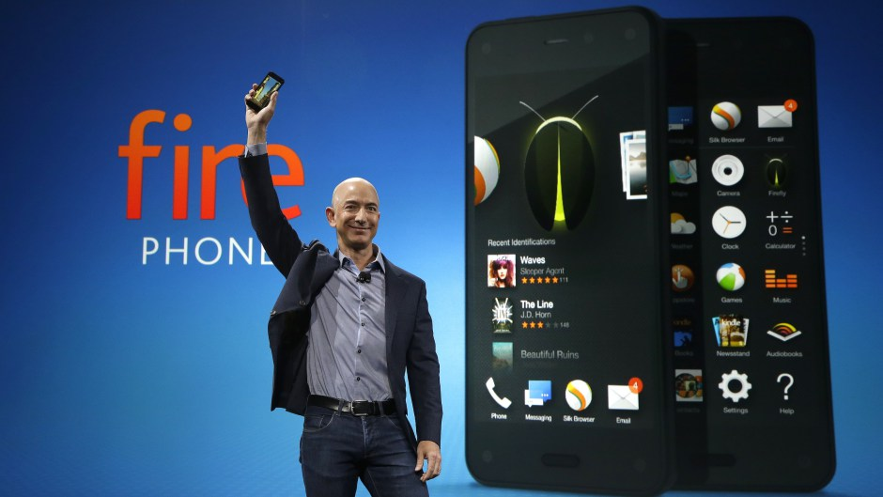
Amazon’s Fire Phone

Slide 2
Features
3D enabled smart phone
4 front-facing cameras and the gyroscope to track the user's movements
OS adjusts the UI so that it gives the impression of depth and 3D
x-ray - used for identifying and finding information
Users can touch a word to launch either a dictionary definition or a more in-depth explanation provided by Wikipedia.
X-Ray accesses pre-loaded files with relevant information, with no internet
Mayday - 24-hour customer service tool
Firefly - tool which lets you point the camera at everyday objects and then view that item in the Amazon online store.

Slide 3
Development
5 years of Development cycle
Started on 2010, released in 2014
Kept Secretive

Slide 4
Features that didn’t make into Final Product
Near-field communication for contactless payments
Hands-free interactions to allow users to navigate the interface through mid-air gestures
Force-sensitive grip that could respond in different ways to various degrees of physical pressure

Slide 5
Micro Management of Leadership
Jeff Bezos – CEO
Obsessively monitored the product
Even the smallest decisions needed to go by him
Employees frustration over Extraneous features Dynamic Perspective
Kept quite due to the respect they held for Jeff Bezos

Slide 7
Release
Introduced in Seattle in Fremont Theatre
As a limited time promotion, buyers are offered a year of Amazon Prime and 1,000 Amazon coins with the purchase of a Fire Phone.
Six weeks after the introduction of the phone to the market, its price was cut to $0.99 from $199 with a two-year contract and from $650 to $449 off contract.

Slide 8
Positive Reception
Firefly and the Dynamic Perspective features to be significant differentiators

Slide 9
Negative Reception
Lack of Bluetooth LE (low energy)
Underdeveloped OS
High price
Exclusivity of the device to
AT&T's network.
Questions on durability of the glass, it’s thickness and weight.
However, the headphones were well received

Slide 10
Other factors
Little incentive to switch carriers
or platforms to buy it.
Its unique features don't provide
enough utility, and come at the
expense of battery life and performance
Lack of frequently used apps available on other platforms.
Confusing interface, bland design, Firefly's poor accuracy
Looked more like a prototype than a finished product

Slide 11
Sales
No more than 35,000 Fire Phones sold in the first 20 days
$170 million hit due to costs
associated with the Fire Phone
Over $83 million worth of Fire Phones in inventory
CTO Tom Szkutak indicated that its pricing strategy being initially too high

Slide 12
Questions?

