Slide 1
Iridium Satellite Failure
University of Texas at Dallas
SYSM 6309 – Advance Requirements Engineering
Simon Ordaz

Slide 2
Iridium Satellite Failure
Iridium is the 77th element in the Periodic table of elements and the original plan was to build a network of 77 satellites
Iridium was a consortium formed by Motorola and other investors
After 11 years of development Iridium launched in November of 1998

Slide 3
Iridium Satellite Failure

Slide 4
Iridium Satellite Failure
1998 Iridium was one of the darlings of Wall Street
With over 1000 patents , the company seemed ready to provide global telephony via network of low-Earth-orbiting satellites
The company screened 200K people, interviewed 23K – Future looked bright

Slide 5
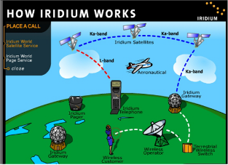
Iridium Satellite Failure
By April of 1998 only 10000 subscribers
Only 20000 subscribers August of
The same month Iridium filed for Chapter 11 bankruptcy

Slide 6
Iridium the idea
Bary Bertiger, a Motorola engineer, first envisioned the idea for Iridium in 1985, after his wife complained she couldn’t reach clients via her cell phone from the Bahamas
Bary’s superiors at Motorola had rejected the Iridium concept but it was Robert Galvin, Motorola’s chairman at the time and his son Christopher Galvin later that approved the 5 billion project
“What it looks like now is a multibillion-dollar science project. There are fundamental problems: The handset is big, the service is expensive, and the customers haven’t really been identified.” – Chris Chaney, Analyst, A.G. Edwards, 1999

Slide 7
Satellite Communication technology
Communications satellites in the 1960s were geo-stationary satellites
Satellites that orbited at altitudes of more than 22000 miles
At this altitude satellite phones were very large and phone signal has a quarter second delay
Iridium’s innovation was to use a large constellation of low-orbiting satellites (~450 miles)
Phones could be much smaller and voice delay was minimum

Slide 8
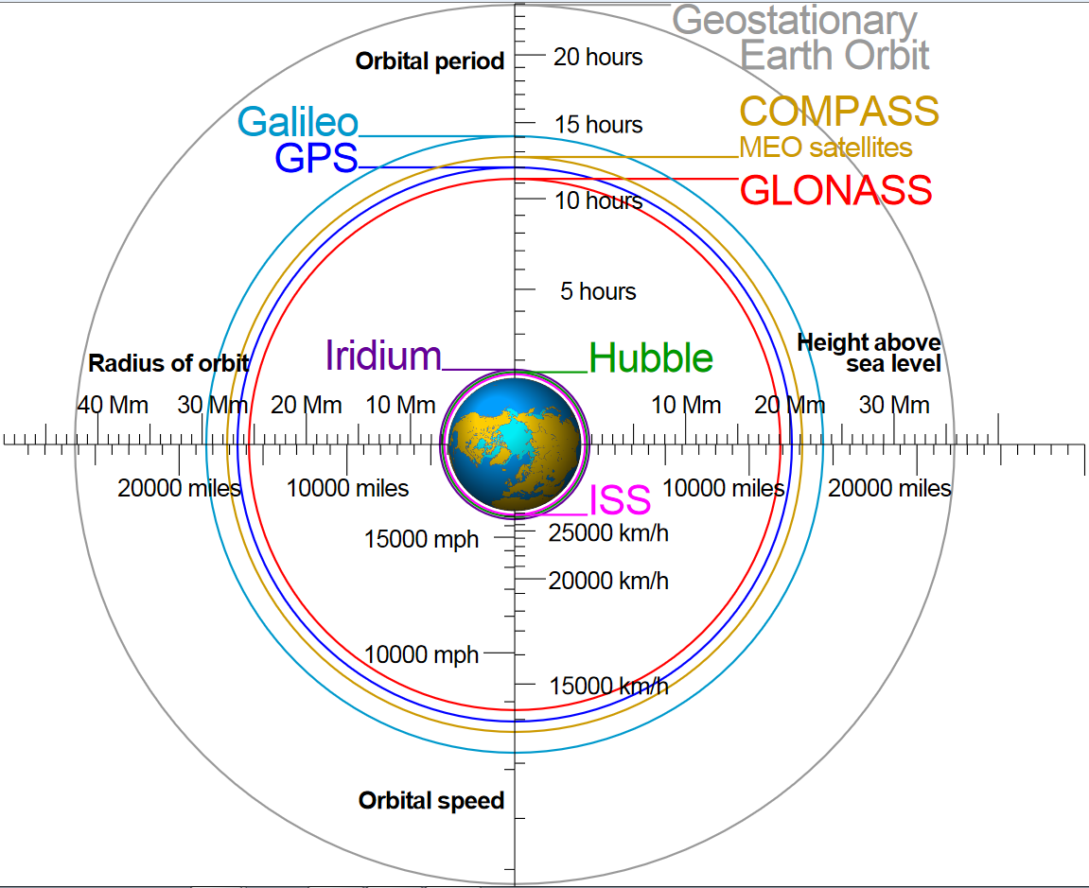
Satellite Communication technology

Slide 9
Iridium Conglomerate
In 1991, Motorola established Iridium Limited Liability Corporation
Moto was partner with more contribution at 400 M
Motorola had difficulty attracting investors for Iridium but 1994 had partnerships with 18 companies including, Sprint, Raytheon, Lockheed Martin and a variety of companies from China, the ME, Africa, India, and Russia
Unfortunately for Iridium, outside partners, delayed setting up marketing teams and distribution channels
Some partners did not have sales teams in place at launch

Slide 10
Motorola Failures
Between 1994 – 1997, Motorola had suffered through slowing sales growth, a decline in net income, and declining margins
Failure to anticipate the cellular industry’s switch to digital cell phones
This failure played a significant role on Motorola’s 50% share price decline in 1998

Slide 11
Top Management Team
Dr. Edward Staiano was Iridium’s CEO in 1996
He had 23 years of working experience with Motorola
He lead the General Systems Sector – In 1995 the division accounted for approximately 40% of Motorola’s total sales of $27 billion dollars

Slide 12
Service Launch
Launch happen on November of 1998 with a 180 M advertising campaign / Al Gore made the first call
$3000 for a handset and $3-$8 minute per calls
The results were devastating
Only 10000 subscribers by April 1999
In April, two days before Iridium was to announce quarterly results CEO Staiano quit
In June 1999, Iridium fired 15% of its staff – including manager’s involved in marketing strategy
By August Iridium’s subscriber base had grown to only 20000 – short of the 52000 necessary to meet loans responsibilities
On August 13 1999 Iridium filed for Chapter 11 bankruptcy – Becoming one of the 20 largest bankruptcies in U.S history

Slide 13
Reasons for Iridium’s Collapse
Iridium knew its phones would be too large and expensive to compete with cellular service
Iridium sought a target market by focusing on international business executive who frequently traveled to remote areas
Even late on 1998 the CEO anticipated 500000 subscribers by the end 1999
Terrestrial cellular had spread faster than the company had originally expected
Iridium had become obsolete even before launch

Slide 14
Iridium’s Technological limitations
Iridium’s technology depended on line-of-sight between the phone antenna and the orbiting satellite
Subscribers were unable to use the phone inside moving cars, inside buildings, and many urban areas
Additionally, Iridium lacked adequate data capabilities – Increasing requirement of business users
Although smaller than competitor Comsat’s phone – Iridium’s phone was the size of a brick

Slide 15
Poor operational execution
Manufacturing problems caused the product to stumble out of the gate
Management launched the service before enough phones were available from Kyocera
Supply difficulties meant there were few phones available in the market
Iridium couldn’t even get phones to the few consumers they got

Slide 16
Main Forces that collapse the project
Motorola executives who pushed the project forward in spite of known and potential fatal technology and marketing problems
Personal and professional reasons for CEO to abandon the project
Iridium’s board was structure in a way that prevented it from performing its role of corporate governance

