Slide 1
Iridium Satellite Failure
University of Texas at Dallas
SYSM 6309 – Advance Requirements Engineering
Simon Ordaz
Final Presentation

Slide 2
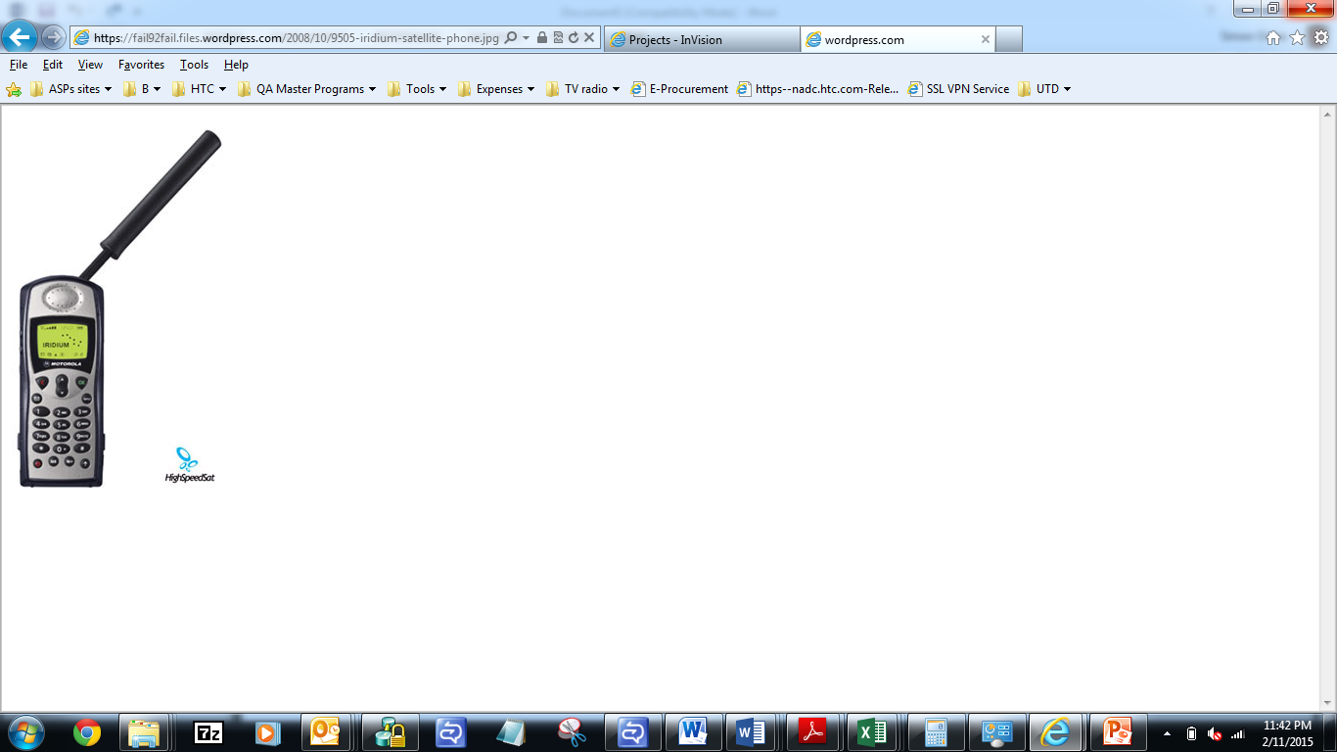
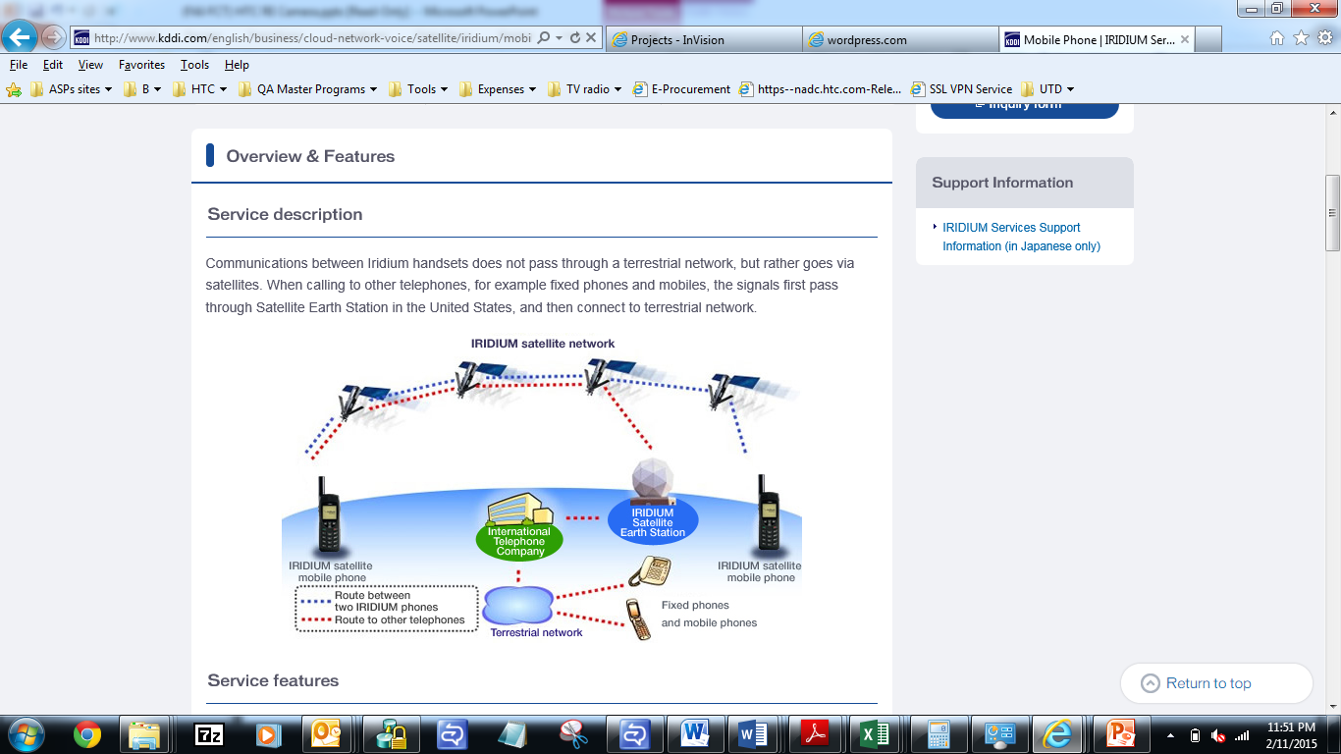
Iridium Satellite

Slide 3
Iridium – Failure reasons
Market was coming out of Analog paradigm
Digital cellular service had spread faster than Motorola had originally expected
Cellular phones were too large and expensive
Unable to stablish a new market
Iridium became obsolete before launch
Iridium had to settle for a small market

Slide 4

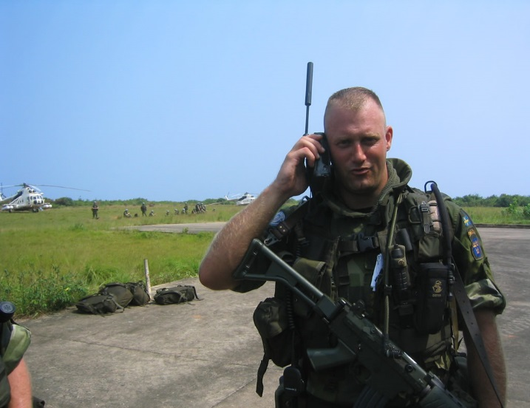
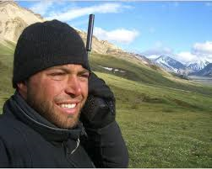
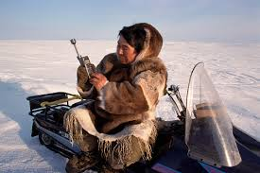
Iridium users

Slide 5
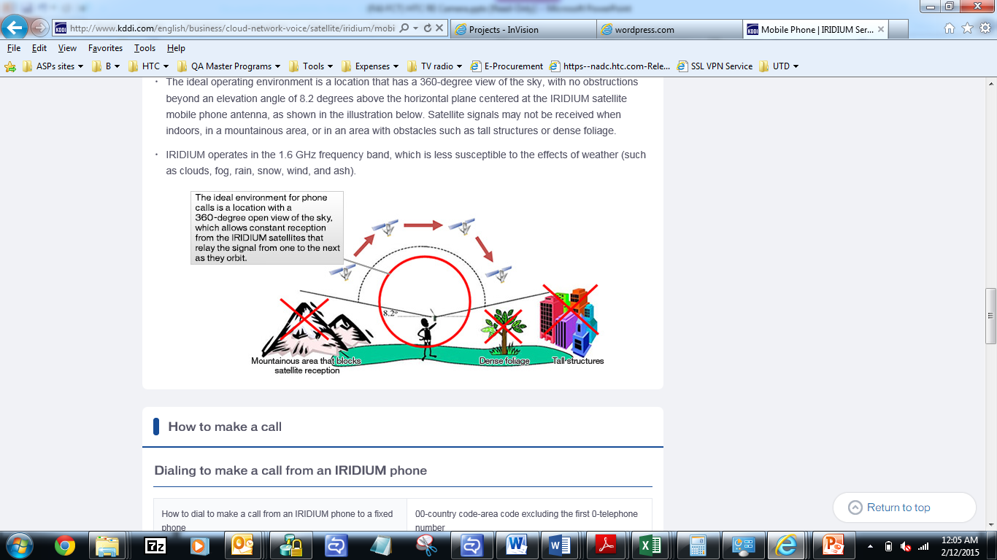
Iridium’s Technological limitations
Iridium’s technology depended on line-of-sight between the phone antenna and the orbiting satellite
Subscribers were unable to use the phone inside moving cars, inside buildings, and many urban areas
Additionally, Iridium lacked adequate data capabilities

Slide 6
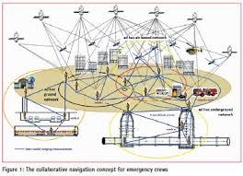
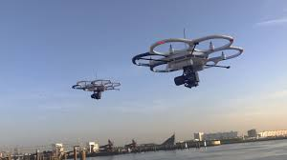
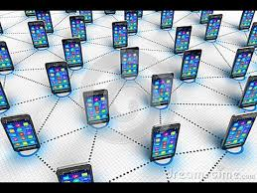
Iridium’s Network Application Solutions
Iridium became a Wireless Service Provider
Found new investors
New infrastructure includes Terrestrial, Satellites and drones

Slide 7
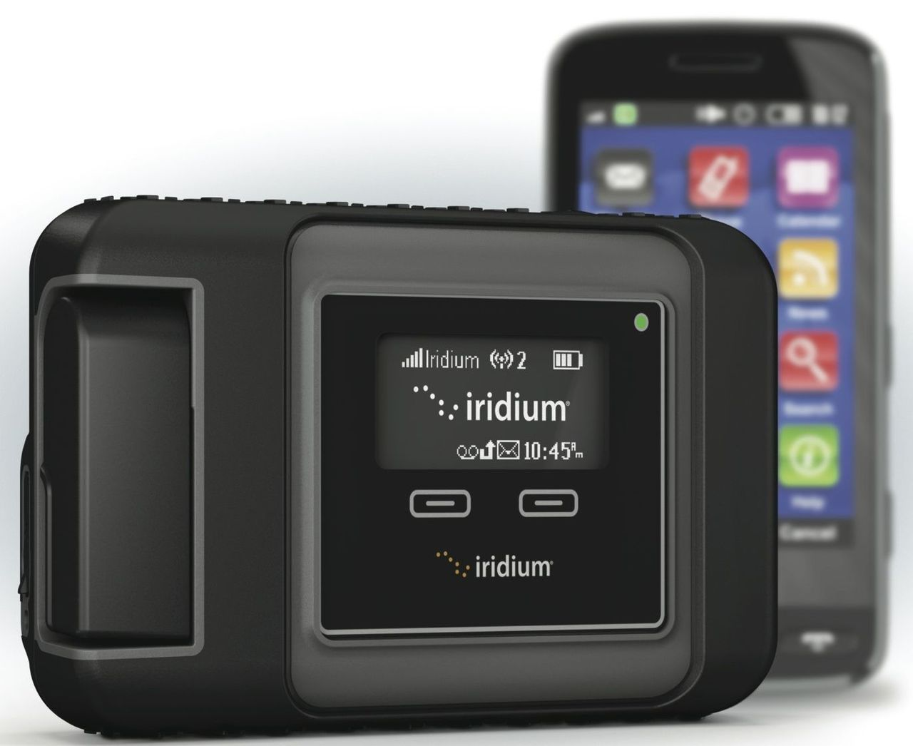
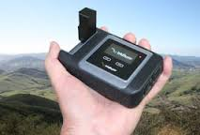
Iridium’s device integration
Iridium would link terrestrial and Satellite systems
Iridium would be available to any customer, just like GPS
Iridium can be available as a docking station on any smart phone (Use in the car and outdoors)
Additional antennas are required for Satellite RX/TX
Would enable data transfer in remote areas
Universal Satellite hot spot

Slide 8
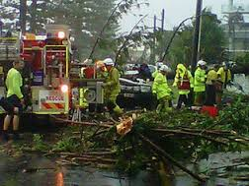
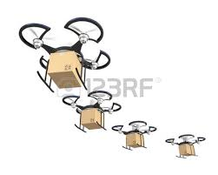
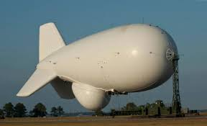
Iridium’s other Application Solutions
Work during bad weather conditions
Deploy resources (Portable communication drones) in natural disaster situations and temporary cities
Control system for delivery drones

Slide 9
Iridium Class Diagram

Slide 10
Iridium PIG - SIG

Slide 11
Reference Model
Environment
System
D1:End user places calls and data
Exchanges
D2:End user travels to
Remote areas with weak
coverage
R1:Iridium shall deliver
Communication services
Without interreption
Iridium
Infrastructure
S1:Terrestrial, Satellite and Drone communication systems shall be fully functional and available to end user everywhere in the continental US

Slide 12
Thank you
Q & A

