Slide 1
Missing Plane Disasters – 2014 part-2
Mitigation through adding - Accountability, Visibility & Responsibility
SYSM 6309 Advanced Requirements Engineering
Faizal A. Khader
Disclaimer : These are my personal views presented for the sake of course term paper.
Notes:
Processes are put in place to add accountability (liability)
Adding visibility using technological advances
People, processes and systems are increased for their responsibility.
These will be the agenda for this presentation.
-----------
Planes are a miracle in the sky. It is the best use of physics that humans have invented since the birth of civilization.

Slide 2
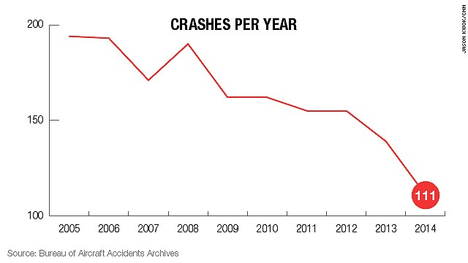
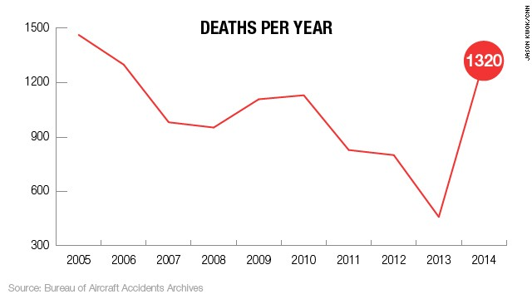
Recap 2014
Lowest
Highest
Notes:
Why is 2014 unique for airline disasters - 2014 has seen the lowest number in more than 80 years.
2014’s number totals at 111.
The last time the world had 111 crashes was in 1927.
Though low in number of crashes, the number of deaths have been the highest in the last 10 years

Slide 3
To-be - Mitigation Approaches – Pertaining to each Incidents

Slide 4

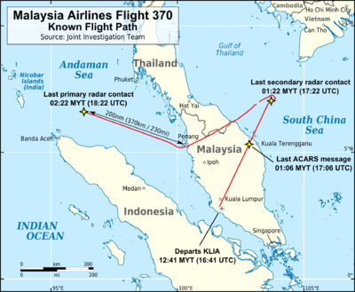
Tamper resistant location transmitters
Backup ACARS transmission, and Inmarsat subscription not optional
Notes:
MH370 - Plane’s location will be transmitted every minute/or-continuous advertising using tamper resistant transmitters through the internet and satellites. This is missing in today’s aircrafts.
Aircraft communications addressing and reporting system (ACARS via Inmarsat) will be mandatory and not be optional. (MH 370 had no active subscription to Inmarsat, though it was transmitting its position and the transmission was getting picked up by Inmarsat satellites. These unattended handshakes happened to be the only clues available later)

Slide 5
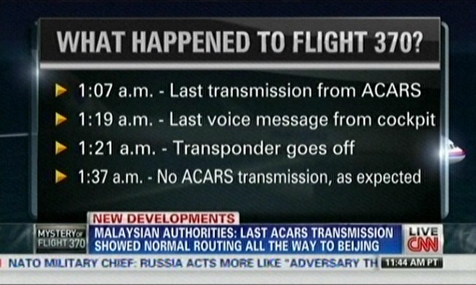
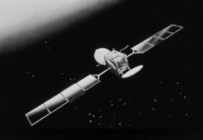
Low-frequency underwater beacons
Beacons (in Blackbox)longer lasting batteries
No inflammable cargo allowed
Notes:
Technology is available for better communication and detection, but regulatory bodies are slow to implement.
Emphasis has to be to implement low frequency underwater beacons – different from the existing 1960’s technology.
Battery life of these beacons will provide a 90 days charge backup.
Commercial flights will not carry any inflammable cargo. (5000 pounds of lithium batteries were found to be stored in MH 370 cargo)

Slide 6
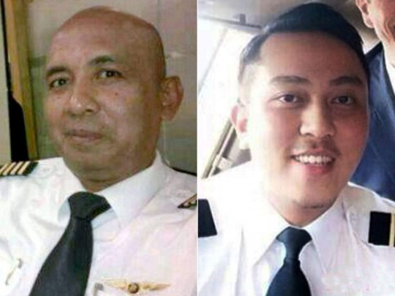
Prevent pilot suicide, ‘OR’ Award noble decisions
Pilots will not be solely in-charge of the plane
Coordinated decisions with ground control
Outside and inside video recorders activated on communication loss
Cockpit always occupied with two people
Notes:
Pilots will not be allowed to make independent decisions without ground control approval/involvement.
Ground control will be handed more responsibility to allow fly by wire auto pilot that will redirect the plan to near-by airport in the flight path, in cases of emergency.
Video recorders will supplement data and voice recorders. These will have auto trigger mechanism, and also manual triggers from ground control.
Cockpit always to be occupied with 2 people. This law is followed in the US aircrafts, but not practiced worldwide.

Slide 7
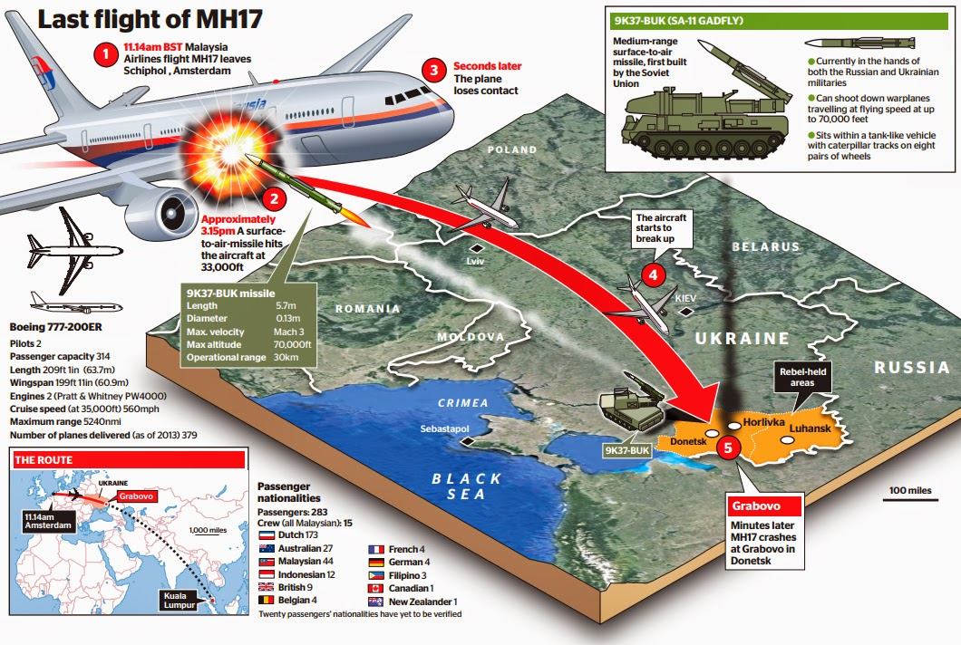
Lateral federated information sharing between airlines
Sensors to detect missile locks on planes flying over dangerous war torn terrains
Air traffic will not authorize short cut flight paths
Encrypted flight location transmissions
Notes:
MH17- There has been evidence found later to this incident that some of the carriers had been avoiding the dangerous route, due to weapons activity in the region. The information though stayed within the siloes of each airlines. Independent decisions also were being made with in each airlines. Information sharing has to be enforced.
Israel’s flag carrier, El Al, equips its planes with sensors to detect when radars lock on to them as targets.
Virtually anyone these days can check the exact location of a particular plane, including its precise height and speed. "Flight details are transmitted to the ground completely decoded”. Encryption will be enforced on all commercial aircraft related transmissions.

Slide 8
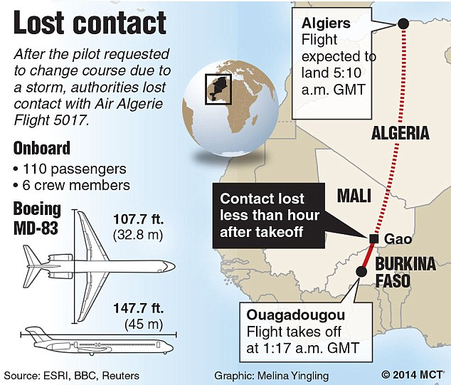
Improved weather simulations from real-time data – Microsoft
Airports augment simulated weather models with internet of flying things
Machine learning and data mining techniques to boosts human expertise at decision making
Notes:
Microsoft Research illustrated that by combining real-time data from nearby flights, it is possible to predict the wind speed to an accuracy 10 times better than the weather simulations by supercomputers.
The internet of flying things refers to the technology that is ready for adoption by agencies on the ground that want to get a bird’s-eye view of weather conditions. The basic technology is already available for less than $800: Equipping a drone or unmanned airborne vehicle with a GoPro quality camera - can equip airports to survey the neighborhood from the air.
Planes are generally flown by computers – pilots manage them. It is surprising though that the computers give up in critical situations, when it is most needed. For example, auto pilots gets disabled when a plane stalls. Computers should be smart enough to start taking preventive actions, as they are sending out alerts.

Slide 9
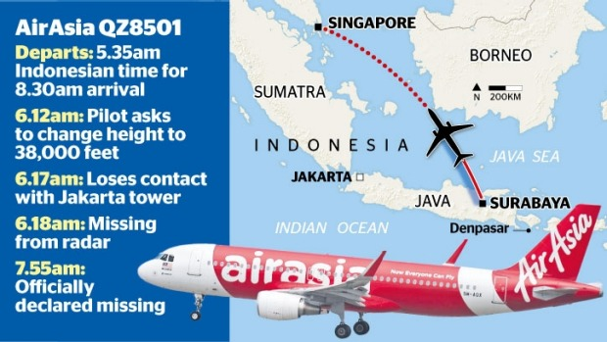
Vehicle integrated prognostic reasoner
Mandatory hand flying experience is needed for pilots
Implementation of Automatic Dependent Surveillance Broadcast
Notes:
Vehicle integrated prognostic reasoner (funded by NASA) - uses advanced data mining and machine-learning techniques to explore and analyze large amounts of flight data to derive new and useful knowledge. Human experts should then use this knowledge to improve diagnostic monitors and reasoning systems available on aircrafts.
Until the time, pilots can have real assistance from computers in handling critical situations, hand flying experience such as handling the plane in a stalled situation should be part of constant practice exercise. Computer aided flying has led to pilot’s losing hand flying skills. Not everyone is a “Chesley Sullenberger.”
Automatic Dependent Surveillance Broadcast, or ADS-B will be included by manufacturers. The system is designed to broadcast the airplane’s location to air-traffic controllers and to other airplanes nearby.

Slide 10
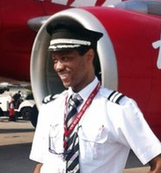
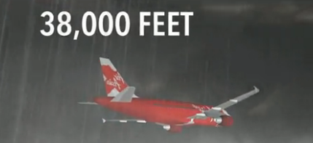
Process in place for speedy approvals in ATC including immediate escalations for route changes requested for weather pocket diversions.
Co-pilot at helm then
Investigation showed plane ascending to 37,400ft within 30 seconds, then dipping back to 32,000ft.
The process took about three minutes.
Strict emphasis on flying by wire, with ground control responsible for key decisions.
Notes:
Pilots try to climb over weather pockets, adding to the risk of an accident due to decreased safety margins and pilot inexperience in upset recovery at high altitudes and high speeds. ATC will need to take responsibility to handle these conditions in the flight path.
No automation can be turned off by pilots. Fire detection and fail safe will need to be constructed into the system. Ground control will be always in control of the automation built into airplanes. Pilots cannot voluntarily perform maneuvers like climbing above or going below flight path limits. In situations of emergency, there will be a recorded flight path that will get activated for nearest point of landing. The decisions for overriding this automation will need to come from ATC.
Boeing has done a research on flying by wire, but found it not practical due to the fact of an unsecure network used for transmitting data, which could be compromised easily. This has to change.

Slide 11
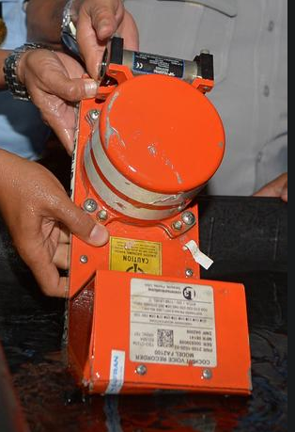
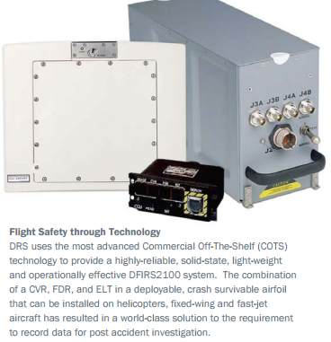
Deployable recorders that jettison upon impact, float, and transmit their position to satellites world-wide.
Satellite asset tracking devices
Notes:
Deployable recorders would assure location of the recorder with flight data and cockpit voice & video recordings within hours of a crash anywhere in the world, including remote ocean locations. Deployable recorders such as these are made by DRS Technologies, have been installed on military airplane
Satellite asset tracking devices, some of which cost less than $100 to purchase and less than $150 per year in tracking service fees per airplane, would allow authorities to track airliners anywhere in the world on Google Maps from a smart phone, laptop, or desktop computer. These devices, such as the SPOT Trace from Globalstar, can be hidden inside airliners to prevent tampering, operate off battery power for weeks after losing airplane power, and work anywhere in the world

Slide 12
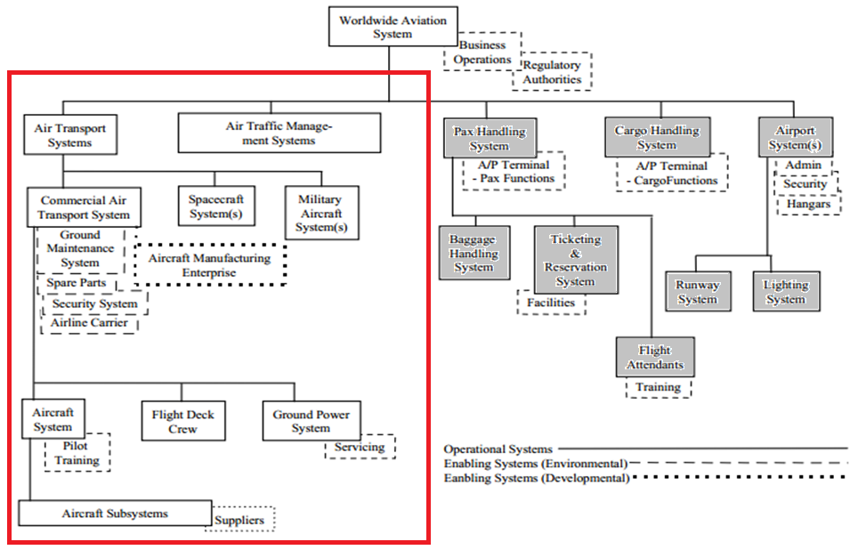
Worldwide Aviation
Systems Domain
Source : http://www.incose.org/
Notes:
The domain’s primary decision maker is business operations and regulatory authorities, which usually don’t go hand in hand.

Slide 13
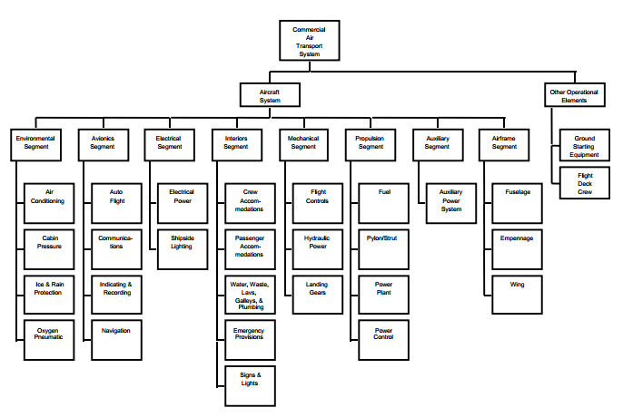
Commercial Aircraft Systems Domain
Source : http://www.incose.org/

Slide 14
Stakeholders
Passengers
  Customers
  Family
Airlines
Airports
  ATC
  Cargo Handling
Equipment Manufacturers
  Equipment – Electronic and mechanical
  Engine
Society
  Noise and pollution
  Economic growth
  Accident victims

Slide 15
Commercial Air Transport– WRSPM reference model
Beacons
Communication Devices
Sensors
Engine and electronics
Insufficient collaborations considered between domain and system
S, D ≠ R
D – Domain Properties
R - Requirements
C-Computer
P -Program
S-Specification
Piloting
Cockpit
Flight path
Pilots
Crew
Communication
Automation
Plane Manufacturers
ATC
Cargo
Airport
Weather
Most problems can be traced to erroneous assumptions about the environment

Slide 16
Class Diagram – Mitigation approaches
Notes:
Remediation measures are the operations of the sub classes.
We went through details on each of them in the preceding slides.

Slide 17
Analysis of the problem –
Problem Interdependency Graph
Notes:
Undesirable situations are the light pentagons
Undesirable operationalization are the dark pentagon
Dotted pentagon are the attribution
++ make -- break

Slide 18
Mitigation Approaches - Soft goals Interdependency Graph
Notes:
Light cloud are soft goals
Dark cloud are operationalizing soft goals

Slide 19
Traceability
Notes:
Light cloud are soft goals
Dark cloud are operationalizing soft goals

Slide 20

Why is it so difficult in this age to detect the whereabouts of a plane
  Technological improvements possible – improved beacons and transmitters
Why can't we do a better job at weather predictions for a plane
  Improved weather simulations from real-time data and internet of flying things
Why should a plane take off knowing a bad weather prediction in the sky
  Internet of flying things will be the solution here.
Why can't planes flying over dangerous terrain detect its surroundings better
  Sensors to detect radar locks
Why are we (ATC) not able to see what is happening inside the plane, and outside the plane
  Automated video recorders will get activated
Why do we need to rely on a pilot and co-pilot, being responsible for the lives of many
  ATC will not be traffic clerks, but instead will need to be treated as mission control
Why is piloting a plane not taken seriously anymore
  Regular manual flying drills made mandatory

