Slide 1
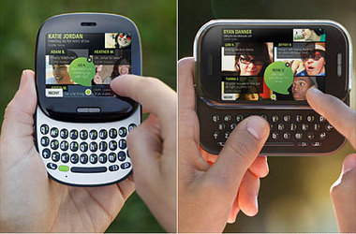
The Microsoft Kin Problem Analysis and Solution
By
Arun Perumb Krishnan
UTD Id: 20211 54585

Slide 2
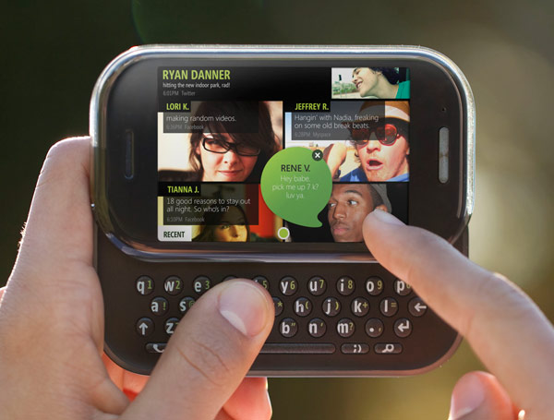
Microsoft Kin
Mobile phone from Microsoft
Phone with Twitter, Facebook and MySpace
Manufactured by Sharp
Sold through Verizon Wireless in US
Targeted at teens and social networking addicts

Slide 3
Microsoft Kin – Missing Features and Issues
Missing features
No additional Apps can be downloaded like any other smart phone
No extra options or downloads possible
Once shot, pictures cannot be edited – only shared or stored
Videos recorded with camcorder have no sound, can only be deleted not edited once captured

Slide 4
Microsoft Kin - Failure
Verizon stopped selling the phones within two months of its actual launch date due to poor sales
Verizon returned all the unsold phones to Microsoft
Microsoft scrapped Kin’s Europe release due to poor U.S Sales
Microsoft stopped promoting the Kin devices and ceased production and transferred the Kin dev team to join its Windows Phone developers
Microsoft CEO Steve Balmer had his bonus cut due to KIN failure !

Slide 5
Market Scenario
January 9th 2007 – Steve Jobs announced iPhone (First Generation)
June 29th 2007 – The first iPhone released
Apple released iPhone 1st Gen, 3G and 3GS before the Kin launch
MS released Kin on:- May 13th 2010
Apple released iPhone 4 on June 2010
Also beginning of 2010 Google released Nexus One phones from HTC
Kin phones overshadowed by the iPhone and Android Phones

Slide 6
Focus Test Group Opinion- Observation and Comments
Focus testers struggled with phone’s interface
Issues were present on basic functionality like making calls
Some of the opinions from the focus testers before Kin release:-
““The phone seems to be really slow in responding … and that makes it confused as to what it was doing”
“the phone was so unresponsive, it had a hard time registering a simple phone number.”
“lots of room to improve I think … especially since I don’t have a touch phone right now, even so I think coming to a touch phone like this is kind of a turnoff.. I think the biggest frustration I have is whether it’s the lag, or whether it’s my actual touch [causing problems]…”

Slide 7
Customer Opinion- What people say about Kin?
“I wouldn't say satisfied. I have a Kin TwoM, and it's a piece of crap. Not quite as laggy as the focus test videos show, but still noticeably bad. The camera, however, is just as bad as they say.”
“The HD video feature is unusable because it locks up constantly for a couple seconds at a time while recording.”
“I'd love to upgrade to a WP handset (my Verizon upgrade period), but unfortunately, I can't pay for the data plan.”

Slide 8
Some Solution Suggestions
Kin Development
2 years is considered a Significant development delay. Fasten the release date to beat the market leaders in smart phone.
Apple iPhone versions | Release dates
iPhone – 1st generation | June 29th, 2007
iPhone – 3G | July 11th, 2008
iPhone – 3GS | June 19th, 2009
iPhone – 4 | June 24th, 2010

Slide 9
Some Solution Suggestions – Ctd..
Avoid the Project Competency (Kin Vs Windows Platform)
Kin’s development was inside MicroSoft’s Premium Mobile Experiences (PMX) which was a parallel project to Windows Mobile Platform. Rather than two different platform, have one mobile platform for a better quality product and to avoid:-
Wastage of time
Wastage of resources
Wastage of money
Conflicts between colleagues/Management

Slide 10
Some Solution Suggestions – Ctd..
Give importance to Non-functional requirements in relation to some of the functional requirements
Camera
HD Video recorder
Making calls
Capture the functional and non-functional requirements to beat the existing smart phones and use Change Requests to constantly update them through the development cycle.

Slide 11
Some Solution Suggestions – Ctd..
Have a better Pricing strategy
Since the Kin uses the data network only for accessing a limited social networking sites the data usage would have been limited compared to the existing smart phones. The price of the data plan should have been minimized compared to the other smart phone data plans to attract more teenagers and social networking addicts

Slide 12
References
www.Wikipedia.org
http://www.mobiledia.com/phones/microsoft/kin-two.html
http://gizmodo.com/
http://images.google.com/
http://rdmanagement.blogspot.com/2010/07/r-portfolio-management-case-study.html
http://en.wikipedia.org/wiki/IPhone
http://bcgconsulting.blogspot.com/2011/01/failure-product-marketing-analysis.html
http://www.utdallas.edu/~chung/SYSM6309/syllabus.htm

