Slide 1
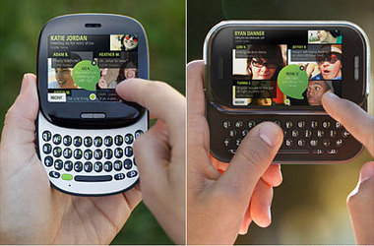
The Microsoft Kin Problem
By
Arun Perumb Krishnan
UTD Id: 20211 54585

Slide 2
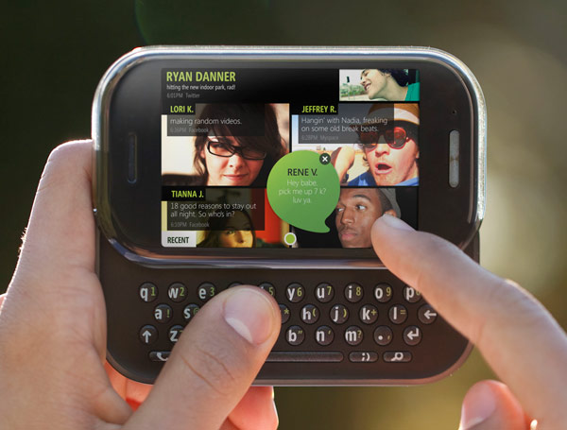
Microsoft Kin
Mobile phone from Microsoft
Phone with Twitter, Facebook and MySpace
Manufactured by Sharp
Sold through Verizon Wireless in US
Targeted at teens and social networking addicts

Slide 3
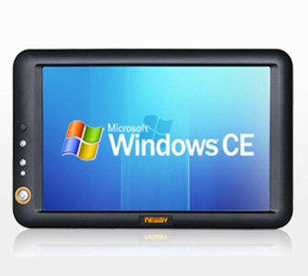
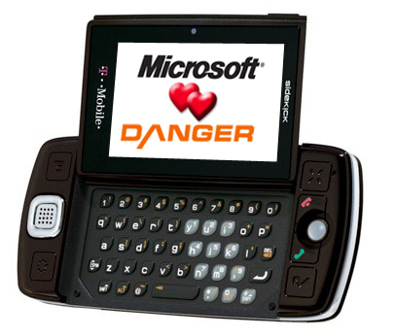
Microsoft Kin – Project Investment
Development of Kin platform
2 years of Kin platform development
US$ 1 billion project investment
Platform was based on WinCE
Microsoft- Danger Inc acquisition
Microsoft Acquired Danger Inc, in Feb 2008 for 500 million dollars

Slide 4
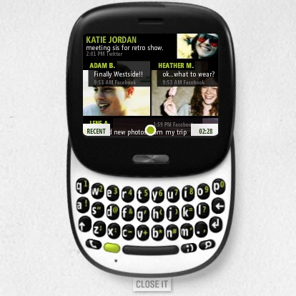
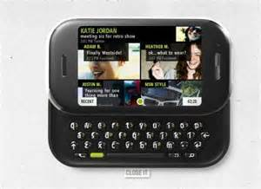
Microsoft Kin - Launch
MS Announced Kin on:- April 10, 2010
Launched two Kin models
Kin ONE and Kin TWO
Made available on Verizon Wireless stores on May 13th, 2010

Slide 5
Microsoft Kin – Missing Features and Issues
Missing features
No Instant messaging
No Visual Voicemail
No photo editing options
No Calendar or appointment application
No additional Apps can be downloaded like any other smart phone
No extra options or downloads possible
Once shot, pictures cannot be edited – only shared or stored
Videos recorded with camcorder have no sound, can only be deleted not edited once captured

Slide 6
Microsoft Kin - Failure
Verizon stopped selling the phones within two months of its actual launch date due to poor sales
Verizon returned all the unsold phones to Microsoft
Microsoft scrapped Kin’s Europe release due to poor U.S Sales
Microsoft stopped promoting the Kin devices and ceased production and transferred the Kin dev team to join its Windows Phone developers
Microsoft CEO Steve Balmer had his bonus cut due to KIN failure !

Slide 7
References
www.Wikipedia.org
http://www.mobiledia.com/phones/microsoft/kin-two.html
http://gizmodo.com/
http://images.google.com/

