Slide 1
Identification and Resolution of Inventory Management Problem
SYSM 6309 Advanced Requirements Engineering
By: Ben Smiley

Slide 2
Contents
I. Background
II. Problem Identification
III. Requirements Development
IV. Conclusion

Slide 3
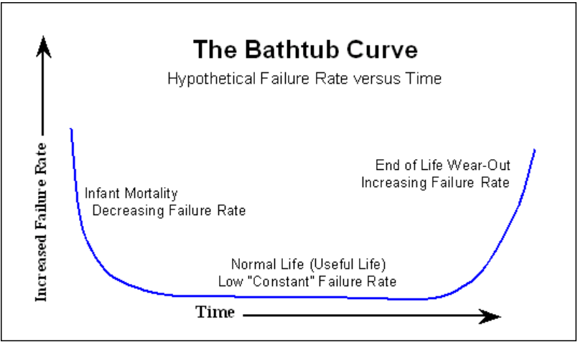
Background
Inventory consists of hard to find & obsolete parts
High margin business
Acquisition model creates unique inventory management problem

Slide 4
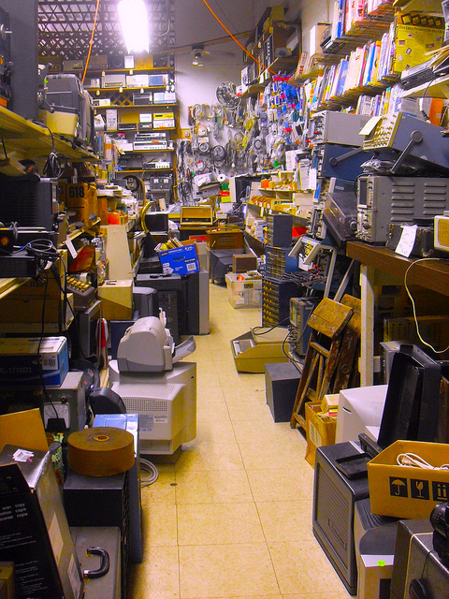
Background Cont.
Extremely slow inventory turnover
Inventory has become unmanageable
Company is in transition between small to mid sized
Outgrowing their processes and tools
Able to handle 20% of unsolicited sales requests due to problems in inventory mgmt.

Slide 5
Problem Identification Process
It is more important to understand the problem than the solution. [Albert Einstein] [3]
Sources
1) Conduct stakeholder interviews
2) Perform mapping of existing processes
3) Consulting contract

Slide 6
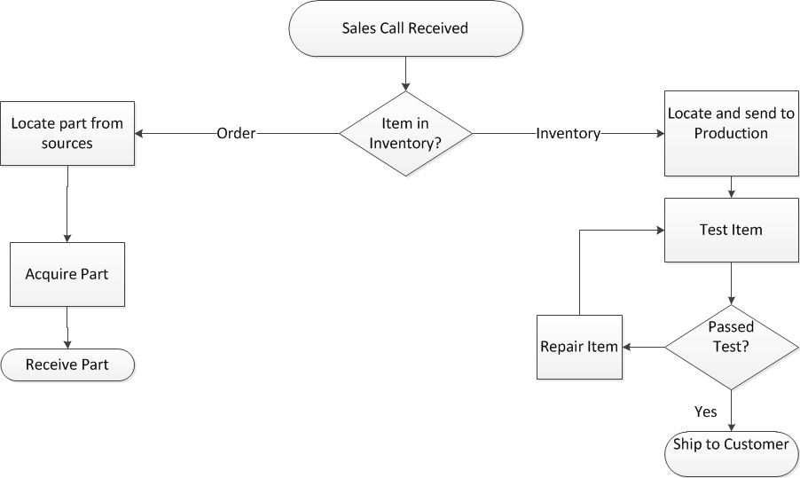
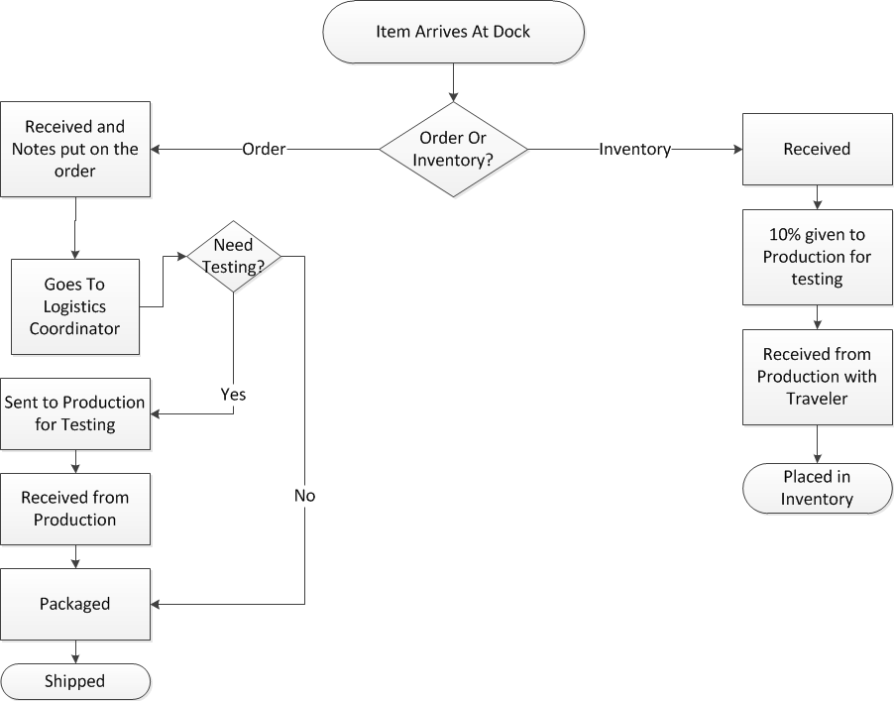
Problem Identification Cont. Process Flows

Slide 7
Requirements Development
Used the Why What How Model
Why – Captures the enterprise level justification
1. Provide accurate inventory information to sales team allow them to improve efficiency of servicing customers
2. Improve interdepartmental communication and cooperation
3. Provide single communication tool to support all business groups

Slide 8
Requirements Development
What – Is the non-functional requirement
Flexibility
The system shall allow for easy evolution to allow for necessary changes to the user interface as the needs of the enterprise changes.
The system should allow for integration of disparate business processes and provide screens that are easily customizable to support a given enterprise function.
The system should successfully combine all existing inventory tracking, defect tracking, purchase order tracking and sales tracking into one system without sacrificing required functionality that current individual systems support.
Usability
The system shall be designed such that an average high school graduate can use the system to enter the required information into the system with minimal training.
The system should provide a rich set of reporting capabilities that provides required reports that is customizable for the needs of individual groups such as sales, customer care and procurement.
The system shall make clear distinction between information that is voluntary and the information that is required.

Slide 9
Requirements Development
How – Is the specific Functional Requirements
Software shall provide the capability to make the state or condition of an item a mandatory field before allowing the data to be updated in the system.
Software shall have the ability to track all types of requests that are currently being tracked via spreadsheets so that all processes are merged into one system.
Software shall provide the capability to track the condition of an item (new or refurb)
Software shall provide the capability to track defects or non conformances.
Software shall provide the ability to track a vendor's RMA in the system
Software shall provide the ability to track the items history as it passes through the various states of the process
Software shall provide the ability to enter vendor contact information for each item obtained.
Software shall provide the ability to track customer contact information for each item shipped.
Software shall provide the ability to generate and track service requests to initiate work for production from the order screen.
Software shall provide the capability to track different revs of the same part number
Software shall have the ability to track different model numbers of the same part number.
Sales would like to be able to see the status of an item from the sales screen
Software shall be able to support all 4 types of requests (RMA, service request, purchase order, and inventory purchase) and be able to differentiate between the type of request an item was placed in the system.
Software should be capable of generating reports to compare budget against a given Purchase Order.
Software should support ability to enter information regarding received quality for purposes of tracking supplier quality
Software shall support entering of photos for each part in database
Software shall support the generation of a logistics request from the sales screen
Software generated logistics request shall contain all pertinent part identification data as well as location and priority of the request.
Software shall support entry of shipping tracking numbers for both purchased and shipped items
Software should support integration with COTS based customer relationship management software
Software should have the ability to track subcomponents on a given item and expose these as available parts within the system.

Slide 10
Conclusion
Focus on
Problem definition
Why What How Model
Resulted In
Delivery of detailed requirements that are traceable back to enterprise need
Provide a good problem statement for the next phase of the project

Slide 11
References
[1] Consulting Project Contract Between ____ & UTD Consulting Club
[2] Adopted from Reliability Hotwire Issue 21 November 2002 www.weibull.com
[3] Adapted from Chung, Lawrence Requirements Engineering Journal and a Swing Cartoon
[4 ] Supplied by ______ Senior Management

