Slide 1
Resolution of Inventory Management Problem
SYSM 6309 Advanced Requirements Engineering
By: Ben Smiley

Slide 2
Background
Local company with unique business model
Operating in the electronic component space
Solicited help from UTD consulting club for their inventory management problem

Slide 3
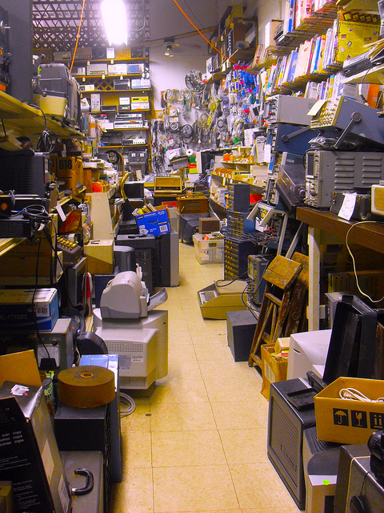
Problem Description
Inventory consists of hard to find & obsolete parts
High margin business
Extremely slow inventory turnover
Inventory has become unmanageable

Slide 4
Problem Description Cont.
Company is in transition between small to mid sized
Outgrowing their processes and tools
Able to handle 20% of unsolicited sales requests due to problems in inventory mgmt.

Slide 5
Business Cost of Problem
Current annual sales are approx. 6.2M
Potential annual sales are approx. 31.3M

Slide 6
Consultation Process
1) Conduct interview with reps from all depts.
a) Develop understanding of existing process
b) Identify pain points for all depts.
2) Develop process mapping
3) Consolidate inputs into problem definition.
4) Prioritize problems by severity
5) Write requirements to address problems
6) Present to stakeholders for feedback
7) Modify requirements as required

Slide 7
Preliminary Findings
Current software system designed Ad-hoc
Inadequate to current needs
Several groups have devised their own system using spreadsheets
User training on processes and software are inadequate
Serious interdepartmental communications issues
Sales
Production
Logistics
Customer Care
Procurement

Slide 8
Next Steps
Develop Requirements for Inventory Mgt. Software
Investigate options
COTS
Internally developed customized solution
Evaluate strengths and weaknesses of options
Present final recommendations to senior management

