Slide 1
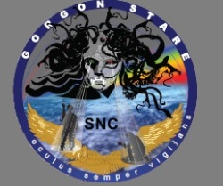
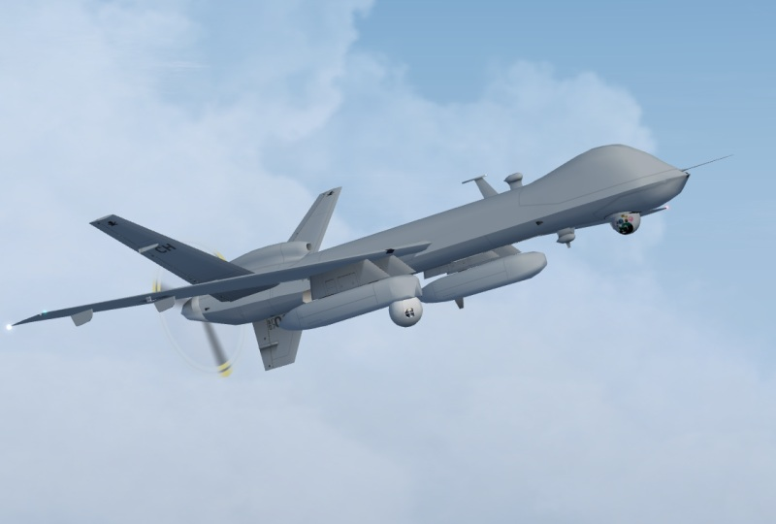
Gorgon Stare Unclear Requirements and Lack of Traceability
Dylan Brandt
June 22, 2013
SYSM 6309

Slide 2
Outline
Program History
Program Objectives
Gorgon Stare Sensor
Operational Capabilities
System Level Testing
Lack of Traceability

Slide 3
Program History
Air Force quick reaction capability program to address urgent operational need for wide area airborne surveillance.
Funding allocated FY09-FY13 for delivery in two increments with expanding capabilities.
Managed through the 645th Aeronautical Systems Group (BIG SAFARI program office).
Built by Sierra Nevada Corporation.
Cost of $17.5 million per set of pods.
Pentagon spent $400 million from 2009-2010.
Advertised as a revolutionary airborne surveillance system.

Slide 4
Program Objectives
Image a larger area than Constant Hawk or Angel Fire (legacy WAAS systems).
Enable night operations.
Provide real-time support to ground forces.
Provide a forensic capability.
Support many simultaneous targeting and surveillance missions.
Cue and hand off targets to full-motion video platforms for prosecution.
Developed with no clear requirements.

Slide 5
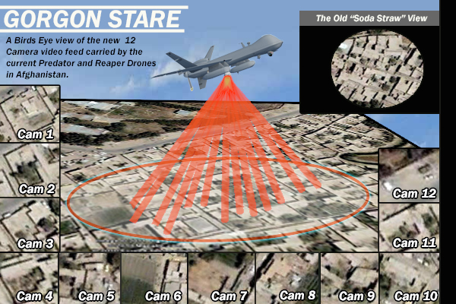
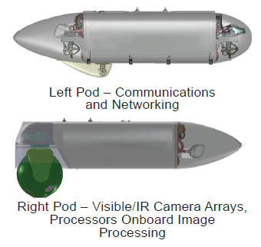
Gorgon Stare Sensor - WAAS
Wide-Area Airborne Surveillance sensor mounted under MQ-9 Reaper UAV.
Consists of 2 pods: one for cameras, the other for communication.
Contains array of 5 electro-optical and 4 infrared cameras.
Provides continuous aerial surveillance of “city-sized” 4 km² area.
Can follow as many as 64 separate targets.
Video can be chipped out and simultaneously broadcasted from 12 different angles to ground station or ground troops.
Quilt images into mosaic for single wide-are view.

Slide 6
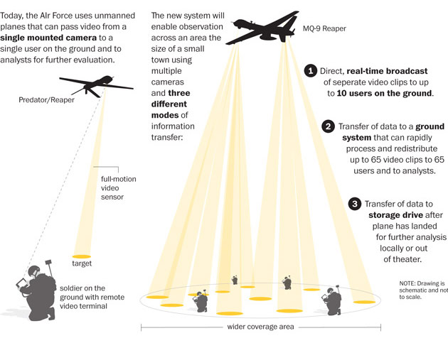
Operational Capabilities

Slide 7
Operational Capabilities

Slide 8
System Level Testing
Conducted by the 53rd Air Wing Air Combat Command
Dec 2010 - 20 sorties totaling 234 hours of flight time.
DO NOT FIELD RECOMMENDATION
Not Operationally Effective and Not Operationally Suitable
Faulty coordinate grid, rendering location information inaccurate and inconsistent.
Inferior image stitching resulting in large black triangle.
Inferior image quality compared to older systems.
Problematic night vision system.
Inability to track people on the ground.
55 to 65 percent reliable.

Slide 9
Lack of Traceability
Big Safari disputed the test results.
Claimed that the tests were unfair as they probed performance areas that were beyond the specifications for the system.
No requirements, No traceability

Slide 10
References
http://www.globalsecurity.org/intell/systems/gorgon-stare.htm
http://ukarmedforcescommentary.blogspot.com/2012/07/towards-scavenger.html
http://www.defence.pk/forums/pakistan-defence-industry/92072-new-us-drone-spy-cameras-gorgon-stare-fail-air-force-test.html
http://www.strategypage.com/htmw/htecm/articles/20130524.aspx
http://www.darkgovernment.com/news/reaper-sensors-called-gorgon-stare/
http://images.dodbuzz.com/wp-content/uploads/2011/01/53D-Tests-and-Recommendation.pdf

