Slide 1
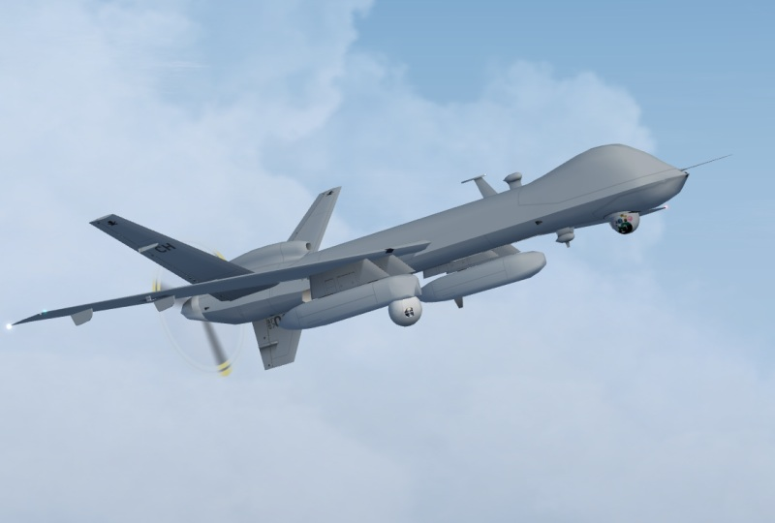
Gorgon Stare Unclear Requirements and Lack of Traceability
Dylan Brandt
August 3, 2013
SYSM 6309

Slide 2
Outline
Acronyms
Problem Statement
Program History
Program Objectives
Gorgon Stare Sensor
Operational Capabilities
System Level Testing
Operational Effectiveness
Operational Suitability
V-Model

Slide 3
Acronyms
EO - Electro-optical
GS - Gorgon Stare
GSGS - Gorgon Stare Ground Station
IED - Improvised explosive device
IR - Infrared
NRT - Near real time
OUE - Operational Utility Evaluation
QRC - Quick Reaction Capability
RFI - Request for intelligence
RVT - Remote video terminal
TO - Technical order

Slide 4
Problem Statement
Gorgon Stare is an advanced intelligence; surveillance and reconnaissance (ISR) sensor developed by Sierra Nevada Corp as a quick reaction capability for the Air Force to address the urgent operational need for wide area airborne surveillance.
The Gorgon Stare sensor was developed with no formal requirements.
System level testing was conducted by the 53rd Air Wing Air Combat Command in December of 2010.
The Gorgon Stare system was found to be not operationally effective and not operationally suitable for deployment.

Slide 5
Program History
In 2008 the DOD requested funds for the Air Force acquire an enhanced to address urgent operational need for wide area airborne surveillance.
Funding allocated FY09-FY13 for delivery in two increments with inc2 expanding the capabilities of inc1.
Managed through the 645th Aeronautical Systems Group (BIG SAFARI program office).
Prime contractor Sierra Nevada Corporation.
EO/IR payload made by ITT Exelis Geospatial Systems.
Cost of $17.5 million per set of pods.
Total funding allocated for the Gorgon Stare program was 150 million dollars.
Advertised as a revolutionary airborne surveillance system.

Slide 6
Program Objectives
ID | OBJECTIVES
01 | Image a larger area than Constant Hawk or Angel Fire (legacy WAAS systems).
02 | Enable night operations.
03 | Provide real-time support to ground forces.
04 | Provide a forensic capability.
05 | Support many simultaneous targeting and surveillance missions.
06 | Cue and hand off targets to full-motion video platforms for prosecution.
07 | Operationally effective / suitable.
Developed with no clear requirements.

Slide 7
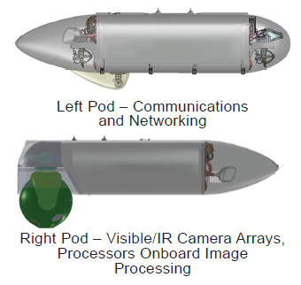
Gorgon Stare Sensor - WAAS
Wide-Area Airborne Surveillance sensor mounted
under MQ-9 Reaper UAV.
Consists of 2 pods: one with a sensor ball for
cameras, the other for communication.
Contains array of 5 electro-optical (EO) and
4 infrared (IR) cameras for nighttime ISR.
Provides continuous aerial surveillance of
“city-sized” 4 km² area.
Can follow as many as 64 separate targets.
Video can be chipped out into 10 different views and simultaneously broadcasted to ground stations or ground troops.
Quilt images into mosaic for single wide-are view.

Slide 8
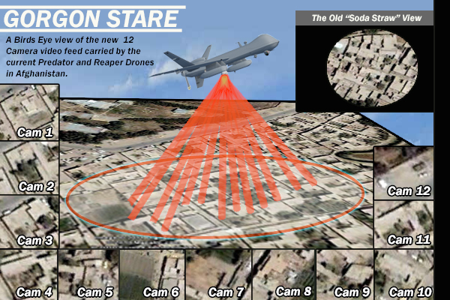
Operational Capabilities

Slide 9
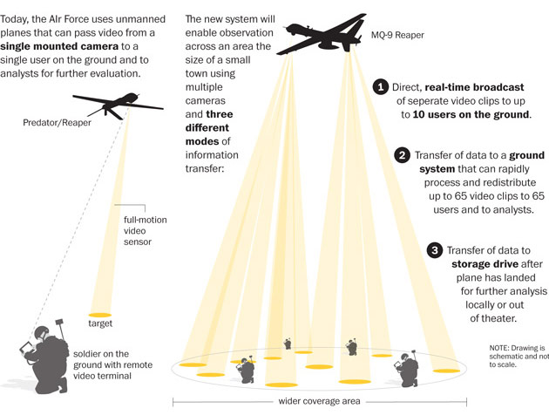
Operational Capabilities

Slide 10
Operational Capabilities

Slide 11
System Level Testing
Conducted by the 53rd Air Wing Air Combat Command.
Dec 2010 - 20 sorties totaling 234 hours of flight time.
DO NOT FIELD RECOMMENDATION
Not Operationally Effective and Not Operationally Suitable

Slide 12
Lack of Traceability
Big Safari disputed the test results.
Claimed that the tests were unfair as they probed performance areas that were beyond the specifications for the system.
No requirements, No traceability, Unclear Validation

Slide 13
Operational Effectiveness
ID | OBJECTIVES | TEST RESULTS
01 | Image a larger area than Constant Hawk or Angel Fire (legacy WAAS systems). | Inferior image stitching resulting in large black triangles. Dropped frames during download.
02 | Enable night operations. | Problematic night vision systems. IR image quality poor.
03 | Provide real-time support to ground forces. | Two second latency to RVT operators. Unpredictable software error - faulty coordinate grid for chipout imagery.
04 | Provide a forensic capability. | EO imagery sufficient for detecting ground activity. IR imagery not sufficient.
05 | Support many simultaneous targeting and surveillance missions. | Unpredictable software error - faulty coordinate grid for chipout imagery. Image quality not sufficient to track dismounts.
06 | Cue and hand off targets to full-motion video platforms for prosecution. | 12 to 18 second latency to GSGS, limits ability to cross-cue the MTS targeting pod or track a dynamic target.

Slide 14
Operational Suitability
Non-Functional Requirement | Test Results
Operations | Formally developed operator TOs and checklists were not delivered for operating the aircraft sensor pods.
Maintenance | Formally developed TOs do not exist for the physical changes made to the GS modified MQ-9 aircraft.
Availability | Pod set availability was problematic during the operational utility evaluation. Parts were not interchangeable between pods. Lack of configuration.
Reliability | Overall availability of the system was 63.8%. MTBF was 119 minutes, with an average of 3.7 failures per sortie.
Training | Training program still in development.
Mobility | Requires semi-permanent collocation of 80 nautical miles.
Security | Contains “SECRET // NOFORN” restrictions.

Slide 15
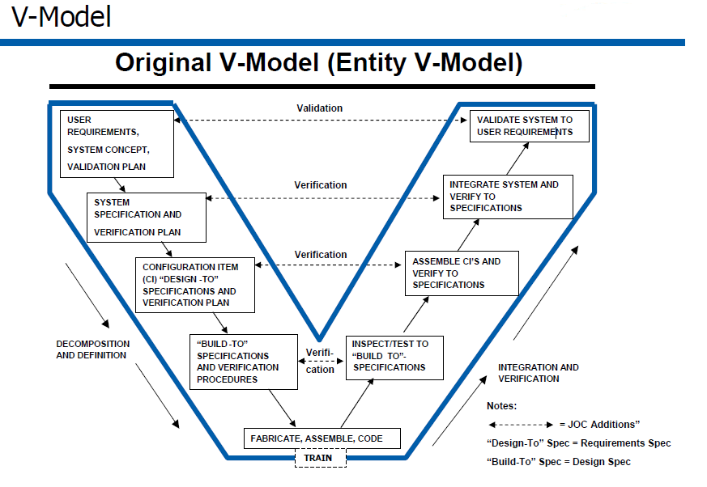
V-Model

Slide 16
References
http://www.globalsecurity.org/intell/systems/gorgon-stare.htm
http://ukarmedforcescommentary.blogspot.com/2012/07/towards-scavenger.html
http://www.defence.pk/forums/pakistan-defence-industry/92072-new-us-drone-spy-cameras-gorgon-stare-fail-air-force-test.html
http://www.strategypage.com/htmw/htecm/articles/20130524.aspx
http://www.darkgovernment.com/news/reaper-sensors-called-gorgon-stare/
http://images.dodbuzz.com/wp-content/uploads/2011/01/53D-Tests-and-Recommendation.pdf

