Slide 1
Technology Fail: Apple MAPS
Howard Fantroy
SYSM 6309

Slide 2
Who is Apple?
Apple Inc. (Apple) designs, manufactures and markets mobile communication and media devices, personal computers, and portable digital music players, and sells a variety of related software, services, peripherals, networking solutions, and third-party digital content and applications. The Company's products and services include iPhone, iPad, Mac, iPod, Apple TV, a portfolio of consumer and professional software applications, the iOS and OS X operating systems, iCloud, and a variety of accessory, service and support offerings. The Company also sells and delivers digital content and applications through the iTunes Store, App StoreSM, iBookstoreSM, and Mac App Store. It sells its products worldwide through its retail stores, online stores, and direct sales force, as well as through third-party cellular network carriers, wholesalers, retailers, and value-added resellers. In March 2013, it acquired a Silicon Valley startup, WiFiSlam, which makes mapping applications for smart phones.

Slide 3
Apple History High notes
1976: The Apple I personal computing system is released with a market price of $666.66. The following year, Apple Inc. is incorporated by Steve Jobs, Steve Wozniak and Ronald Wayne.
December 1979: Several Apple employees, including Jobs and Jeff Raskin, were granted access to Xerox Park facilities to see the Xerox Alto. Jobs was convinced that all future computers would use a graphical user interface (GUI), a belief that inspires his work in the development of the Apple Lisa.
1980: Apple goes public with 4.6 million shares. Apple III is released to disappointing sales in an attempt to compete with IBM and Microsoft in the corporate computing market.
1981: Steve Jobs becomes Apple's chairman, and Markkula becomes the company's president. The European headquarters open in Paris and Slough, England.
1982: The company hits the $1 billion-mark in annual sales. Jeff Raskin resigns, and Jobs takes over his lower-cost computer project, the Macintosh, after Jobs was squeezed out of the Lisa computer development team due to infighting over whether the Lisa or the Macintosh would be the first personal computer sold to the public with a GUI.

Slide 4
Apple History High notes
1983: The Lisa won out: it was marketed to the public and the Lisa and Macintosh divisions were combined. But its high prices and limited software capabilities made it a commercial failure. John Sculley is named president and CEO of Apple.
January 22, 1984: The Macintosh is released, announced by the landmark $1.5 million Superbowl commercial, "1984," directed by Ridley Scott:
The Macintosh sold well initially, but sales faltered for the same reasons as the Lisa. Later that year, the addition of the Laserwriter and PageMaker software helped reinvigorate sales. Andy Hertzfeld, one of the main authors of the Macintosh system software, leaves the company.
1985: The infighting between Jobs and Sculley escalates. The Board of Directors tells Sculley to limit Jobs' role; Jobs in turn attempts a coup, for which he's dismissed from his role at the company. After he leaves, Jobs founds NeXT Software. Wozniak resigns from Apple as well. The same year, President Reagan presents Jobs and Wozniak with the National Technology Medal.
1986: Jobs establishes Pixar, buying LucasFilm's computer graphics group for $10 million. The Apple Programmers and Developers Association forms. The Macintosh Plus is released.

Slide 5
Apple history high notes
1987: Mac II and Mac SE are released.
1988: Jean-Louis Gassee is named president of Apple. The company sues Microsoft over its GUI.
1989: The Mac Portable is released. The company is sued by both the Beatles' Apple Corps and by Xerox.
1990: Jean-Louis Gassee resigns, and Mac LC is released. The company is listed on the Tokyo SE.
1991: Apple releases the PowerBook 100, which set the standard for the modern laptop. It weighed 17 pounds and had a 12-hour battery life. The company also introduced System 7, an upgraded operating system which added color to the interface and introduced new networking capabilities. System 7 would remain the architectural basis for Mac OS until 2001. The magazine MacAddict named the period between 1989 and 1991 the "first golden age" of the Macintosh.

Slide 6
Apple history high notes
1996: Gil Amelio replaces Michael Spindler as CEO and implements massive layoffs. The company acquires Jobs' NeXT Software company. Apple's fourth-quarter results in $25 million profit.
1997: Amelio is ousted by the Board of Directors from the CEO position after overseeing a three-year record-low stock price and major financial losses. Jobs is named the interim replacement. At the 1997 MacWorld Expo, Jobs announces that Apple will join Microsoft to release new versions of Microsoft Office for the Macintosh, and that Microsoft would make a $150 million investment in non-voting Apple stock.
1998: The iMac/233 is released. The iMac design team was led by Jonathan Ive, who would later be the designer of the iPod and the iPhone. The iMac sold nearly 800,000 units in its first five months. The Newton Operating System is scrapped.

Slide 7
Apple history high notes
1999: The company invests $100 million in Samsung and sues eMachines over an iMac lookalike.
2000: PowerMac Cube launches. Jobs becomes Apple's permanent CEO, and chief sales exec Mitch Mandich steps down.
2001: The iPod launches, as well as OS X. The company opens its first retail store in MacLean, Virginia.
2002: iMac G4 launches. Retail stores go overseas.
2003: Jobs is diagnosed with cancer in his pancreas and tries to treat the illness by switching to a special diet, according to a 2008 Fortune magazine article. Apple does not tell investors. iTunes music store opens and hits 25 million downloads.
2004: iMac G5 launches. Jobs, now 49, discloses his cancer to the public when he announces that he had successful surgery to extract a tumor. The ad campaign featuring U2 kicks off.
2005: The Video iPod and iPod Nano launch. Jef Raskin dies at 61. iTunes downloads top 500 million. Jobs talks about his fight with cancer during a commencement speech at Stanford, saying that his surgery had been a success "and I'm fine now."

Slide 8
Apple history high notes
2006: The iMac Core Duo launches. Disney buys Pixar, putting Jobs on the board at Disney. Software development leader Avie Tevanian leaves Apple. The PowerMac, iBook and PowerBook brands are retired, replaced by the Mac Pro, MacBook and Macbook Pro. Between early 2003 and 2006, the price of Apple's stock increased more than tenfold, from around $6 per share to over $80.
2007: Apple Computer, Inc., becomes Apple Inc., because computers are no longer the company's singular focus. The iPhone and Apple TV are announced. The following day, Apple shares hit an all-time high (at that point) at $97.80.
2008: Apple launches the App store to sell third-party applications for the iPhone and iPod Touch. Within a month, the store sold 60 million apps and brought in $1 million daily on average. Apple becomes the third largest mobile handset supplier in the world due to the iPhone's popularity. Apple also releases MacBook Air, a slimmed-down portable computer.
December 16, 2008: After 20 years of attending MacWorld, the company announces that 2009 will be its final year of doing so. And, instead of the expected Jobs, Phil Schiller would deliver the final keynote.

Slide 9
Apple history high notes
January 14, 2009: Jobs announces in an internal memo that he would be taking a six-month leave to focus on his health.
June 29, 2009: Apple announces Jobs' return to work. At the time, Apple shares have risen 70 percent since January 15.
2009: Apple releases the iPhone 3GS.
January 27, 2010: Apple announces the impending launch of the iPad.
April 3, 2010: The iPad launches in the U.S., and more than 300,000 units are sold on that day, reaching 500,000 by the end of the first week.
May 2010: Apple's market cap exceeds that of competitor Microsoft for the first time since 1989.

Slide 10
Apple history high notes
June 2010: Apple releases the fourth generation iPhone, with video calling, multitasking and a new un insulated stainless steel design which acts as the phone's antenna. Some users report a reduction in signal strength due to the new antenna.
October 2010: Apple shares hit an all-time high, surpassing $300.
November 2010: For the first time, The Beatles' 13 albums are up for sale on iTunes, ending years of talks among Jobs, The Beatles' management company Apple Corps and The Beatles' label EMI Group. The group sells more than 2 million songs and more than 450,000 albums in its first week on iTunes.
January 17, 2011: An internal memo from Jobs, now 55, announces he will once again take a medical leave for an indeterminate time period. COO Tim Cook will take up Jobs' day-to-day operations at the company.
January 18, 2011: Apple's stock opens for trading at $327.05 per share, down more than five percent from its close on the previous trading day.
Steve Jobs passes away on October 5th, 2011

Slide 11
Apple Timeline

Slide 12
What is/was “Apple maps”
Designed by Apple from the ground up, Maps gives you turn-by-turn spoken directions, interactive 3D views, and the stunning Flyover feature.
All in a beautiful vector-based interface that scales and zooms with ease.

Slide 13
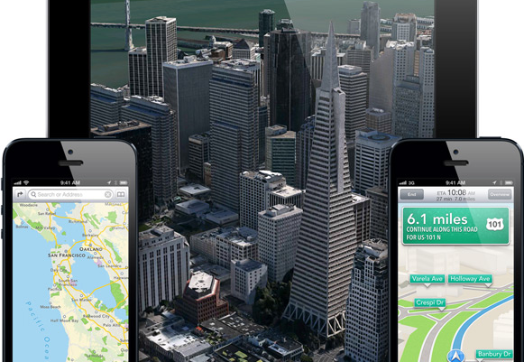

Slide 14
Where did apple go wrong?

Slide 15
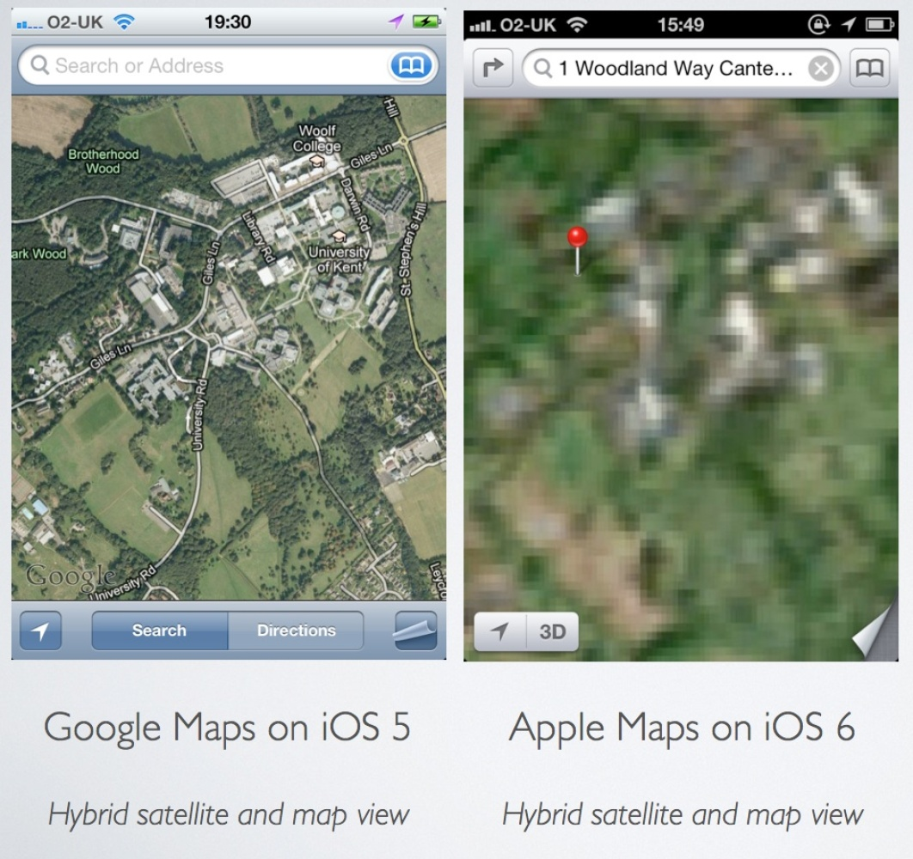
Still going Wrong

Slide 16
‘we screwed up”
To our customers, At Apple, we strive to make world-class products that deliver the best experience possible to our customers. With the launch of our new Maps last week, we fell short on this commitment. We are extremely sorry for the frustration this has caused our customers and we are doing everything we can to make Maps better.
We launched Maps initially with the first version of iOS. As time progressed, we wanted to provide our customers with even better Maps including features such as turn-by-turn directions, voice integration, Flyover and vector-based maps. In order to do this, we had to create a new version of Maps from the ground up.
There are already more than 100 million iOS devices using the new Apple Maps, with more and more joining us every day. In just over a week, iOS users with the new Maps have already searched for nearly half a billion locations. The more our customers use our Maps the better it will get and we greatly appreciate all of the feedback we have received from you.
While we’re improving Maps, you can try alternatives by downloading map apps from the App Store like Bing, MapQuest and Waze, or use Google or Nokia maps by going to their websites and creating an icon on your home screen to their web app.
Everything we do at Apple is aimed at making our products the best in the world. We know that you expect that from us, and we will keep working non-stop until Maps lives up to the same incredibly high standard.
Tim Cook Apple’s CEO

Slide 17
An expert Opinion
Perhaps the most egregious error is that Apple’s team relied on quality control by algorithm and not a process partially vetted by informed human analysis. You cannot read about the errors in Apple Maps without realizing that these maps were being visually examined and used for the first time by Apple’s customers and not by Apple’s QC teams. If Apple thought that the results were going to be any different than they are, I would be surprised. Of course, hubris is a powerful emotion.
Dr. Dobson
TeleMapics

Slide 18
Only apple makes mistakes?
Dr. Dobson goes on to add that Google started in much the same position and their efforts failed miserably. Google eventually realized that this process could not be automated nearly as much as they first thought; it needs a human eye to verify the accuracy of the maps.
In relation to the issues with map applications. Google experienced many of the set back that have plagued Apple Maps

Slide 19
Where now?
How can Apple find a group of individuals experienced in mapping and understand the problems that can and do occur when compiling complex spatial databases designed for mapping, navigation and local search?
How can Apple better control requirements for the next generation of Apple Maps, utilizing the lessons learned from the first failure?
Should Apple even consider another strike in to the mapping software niche?

Slide 20
References
Berger, M. (2011, August 24). Apple: An Illustrated History. Retrieved June 21, 2013, from Marketplace The Breakdown: http://www.marketplace.org/topics/tech/news-brief/illustrated-history-apples-products-and-executives
Fitzgerald, B. (2012, September 20). Apple Map Fails: 19 Ridiculous Glitches Spotted in Apple iOS6's Anti-Google App. Retrieved June 20, 2013, from huffingtonpost.com: www.hurringtonpost.com/2012/09/20/apple-map-fails-ios6-maps_n_1901599.html
Inc., A. (2013). Apple Maps. Retrieved June 20, 2013, from apple.com: www.apple.com/ios/maps/
Hoffelder, N. (2012, September 21). Map Expert Explains where apple went wrong with apple maps. Retrieved June 2013, 2013, from appnewser: www.mediabistro.com/appnewser/map-expert-explains-where-apple-went-wrong-with-apple-maps.com
The New York Times. (2013). Apple Incorporated. Retrieved June 20, 2013, from The New York Times: www.topics.nytimes.com/top/news/business/companies/apple_computer_inc/index.html

Slide 21
Questions

