Slide 2
UTSW Thermal Energy Plants, Power Generation and Electrical System
What do we do to meet the Emission Reduction, Energy usage Reduction and Electrical generation goals?

Slide 3
Mission
We are a service organization with mission to provide QUALITY SERVICE in support of the educational, research, health care, and community service goals of UT Southwestern.

Slide 4
How big are we in Utilities?
Consumption per year (2010)
Electric – 317,199,934 KWh or $23,954,638
Gas – 1,051,310 MCF or $7,612,321
Water – 559,372 MGal. or $3,175,029
52,000 tons of cooling capacity – Chillers
550,000 lbs/hr Steam capacity – Boilers
31 MW of Power – Peak engine/backup
38 plus Emergency Generators
250,000 EMS points monitored – We are the biggest in the D/FW Metroplex.
11.2 Million ft² Campus

Slide 5
Introduction to the total Plants
North Thermal Energy Plant – 1992
Chillers – 18,500 tons
Boilers – 138,000 lbs/hr steam
South Thermal Energy Plant – 1972
Chillers – 18,750 tons
Boilers – 246,000 lbs/hr Steam
Bass Thermal Energy Plant – 1956
Chillers – 4,500 tons
Boilers – 40,000 lbs/hr Steam
St. Paul Thermal Energy Plant – 1961
Chillers – 3,000 tons
Boilers – 50,000 lbs/hr Steam
Zale Thermal Energy Plant – 1987
Chillers – 2,800 tons
Boilers – 30,000 lbs/hr Steam
North Campus Generation Plant – 2005
Natural Gas Driven Engines – 9 MW
South Campus Generation Plant - 2004
Natural Gas Driven Engines – 12 MW

Slide 6
Serves North Campus

Slide 7
Serves North Campus

Slide 9
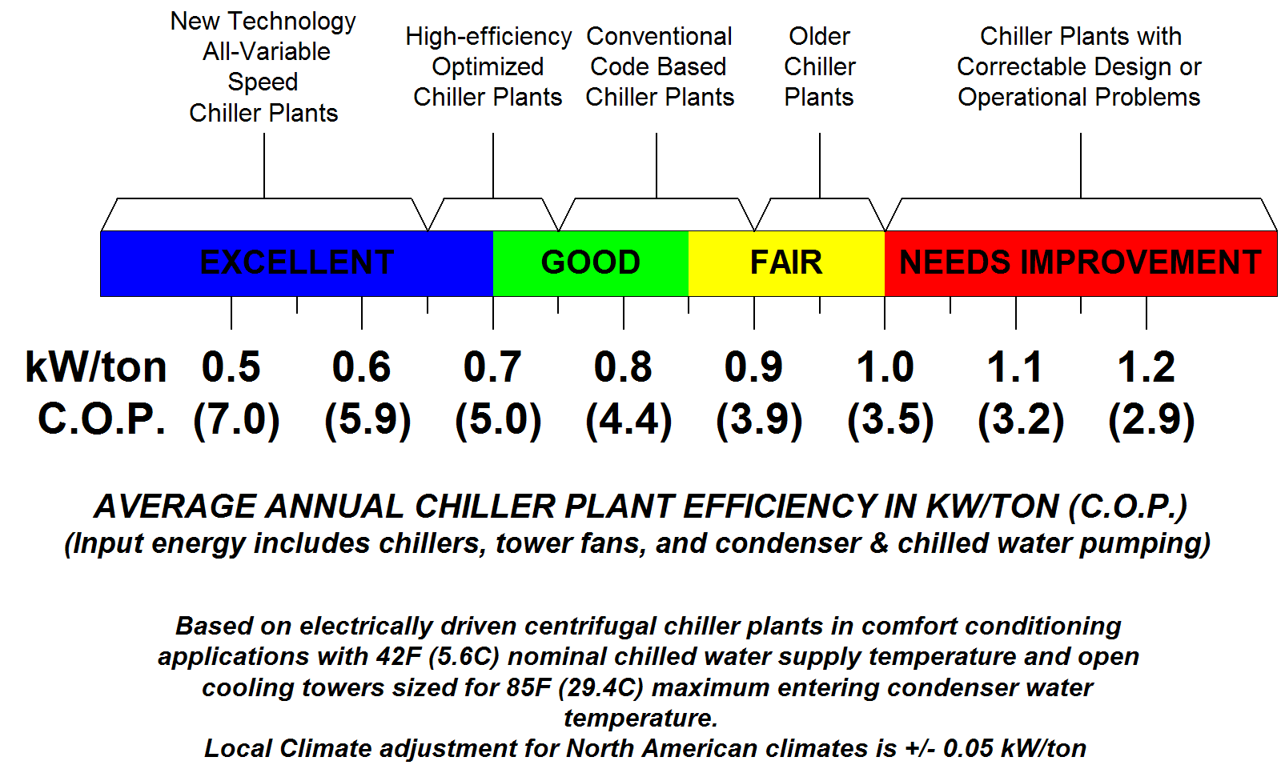
Sustainable Chiller

Slide 11
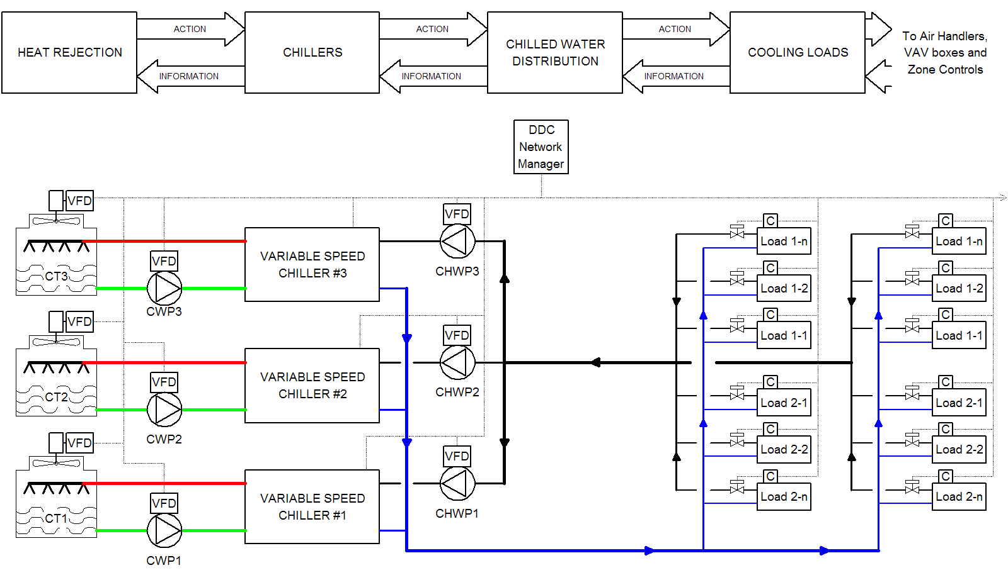
Sustainable Chilled Water Systems
Equal Marginal Performance Principle Based Control

Slide 12
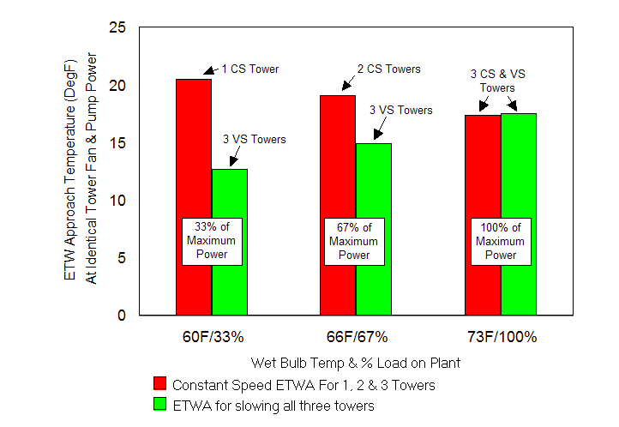
Sustainable Chilled Water Systems
Tower Approach Temperature For 3 Tower System
At lower wet bulb temperatures, the approach of cooling towers rises due to reduced moisture capacity of cooler air. By keeping towers on line and slowing fans and pumps, greater air and water volumes pass over larger surface areas per unit energy expended to improve part load approach temperatures, as shown in this chart.
The total power to fans and pumps is the same for the variable speed and constant speed systems at each condition. Note the improved approach by slowing, not shedding towers at low loads.

Slide 13
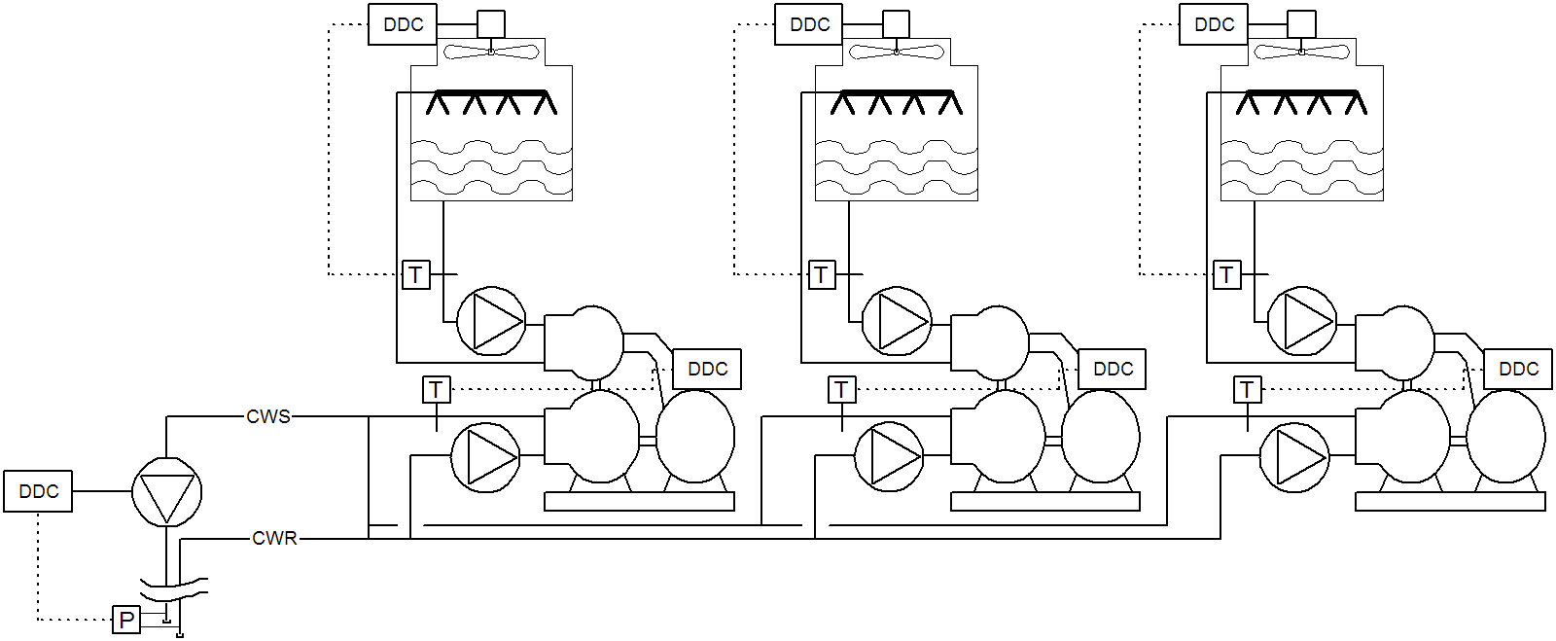
Sustainable Chilled Water Systems
Chiller Plant with Conventional Controls
Equipment is operated independently with local PID temperature and pressure loops. Chillers and towers are sequenced to keep on-line equipment as fully loaded as possible. Plant optimization, if it is applied at all, requires another level of control that continuously resets the various set-points, which can reduce overall system stability.

Slide 14
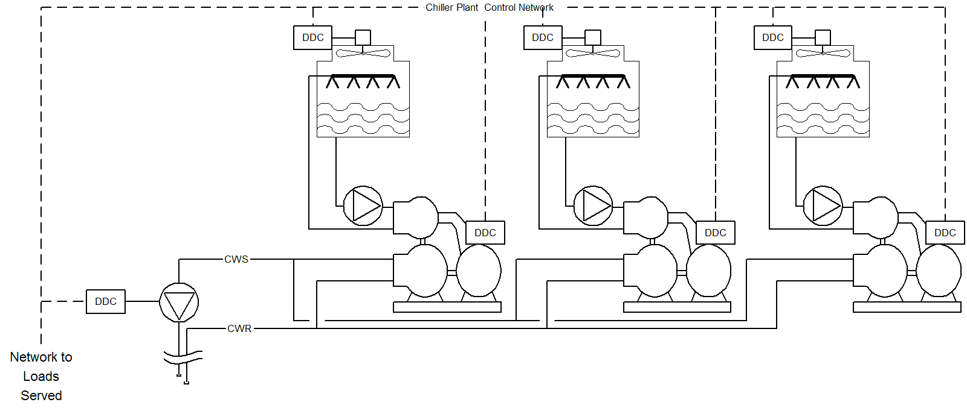
Sustainable Chilled Water Systems
All-Variable Speed Demand Based Control
Equipment is connected via an integrated network and operation is coordinated to maintain lowest overall energy use at all load conditions using demand based control and natural curve sequencing of equipment. Unless incorporated as design criteria, temperature and pressure setpoints are not employed except as operating limits.

Slide 15
Sustainable Chilled Water Systems
Network Enabled Demand Based Control Of All-Variable Speed Chiller Plants
Control Features:
Simple Direct Control Relationships between Chillers, Pumps and Tower Fans
"Natural Curve" Sequencing of chillers
Benefits:
Ultra-Efficient Plant Operation
Simpler and More Stable Plant Operation
Longer Life for Equipment and Lower Maintenance Costs

Slide 16
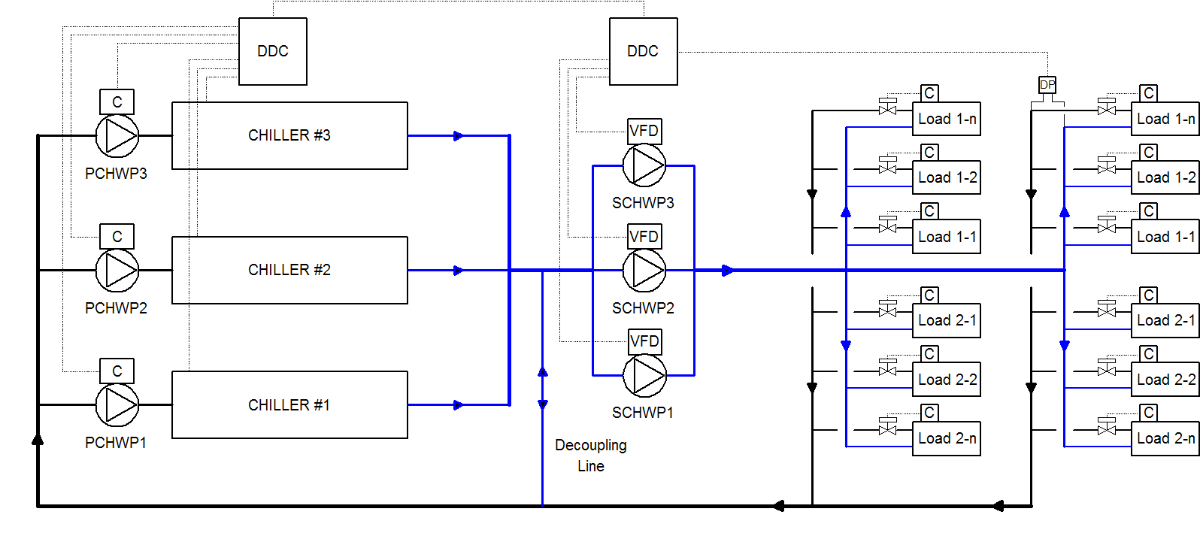
Sustainable Chilled Water Systems
Primary/Secondary CHW Distribution System

Slide 17
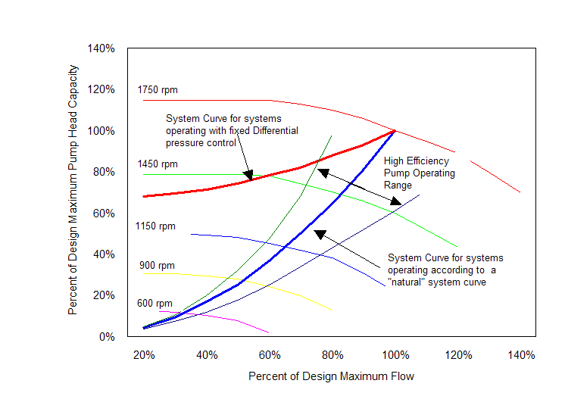
Sustainable Chilled Water Systems
Variable Speed Pump Operation Comparison

Slide 18
Sustainable Chilled Water Systems
Improving Efficiency of Variable Flow Distribution System for Demand Based Control
Reduce the pressure drop through chilled water valves. Line size valves with zero pressure drop at full flow are effective if they are properly controlled.
Operate chilled water pumps with network control that reacts to actual demand for flow by the valves served and sequence pumps to so that on-line pumps operate as close as possible to their natural curve.

Slide 19
Sustainable Chilled Water Systems
Implementing All-Variable Speed Chilled Water Systems
WHY?
Achieves approximately 0.5 kW/ton overall annual plant & distribution system performance – about half the energy use of most existing plants.
Simple, stable, ultra-efficient control with reduced system maintenance.
HOW?
Network control coordinates all-variable speed equipment for optimum operation in response to actual demand on system.
Plant is designed for direct control among components, and distribution system to minimize pressure drops and variations

Slide 20
Sustainable Chilled Water Systems
Next Steps Toward a Sustainable Chilled Water System
Instrument current facility or facilities to obtain actual energy used to generate and distribute chilled water.
Calculate the potential avoided costs by converting to an ultra-efficient all-variable speed chilled water system.
Develop cost-effective budgets, goals and target dates to implement a conversion to a more sustainable system.
Implement the project or projects required to achieve the targeted plant performance.
Incorporate performance verification and performance accountability to ensure the goals are achieved and maintained.

Slide 21
ANY Questions?

