Slide 1
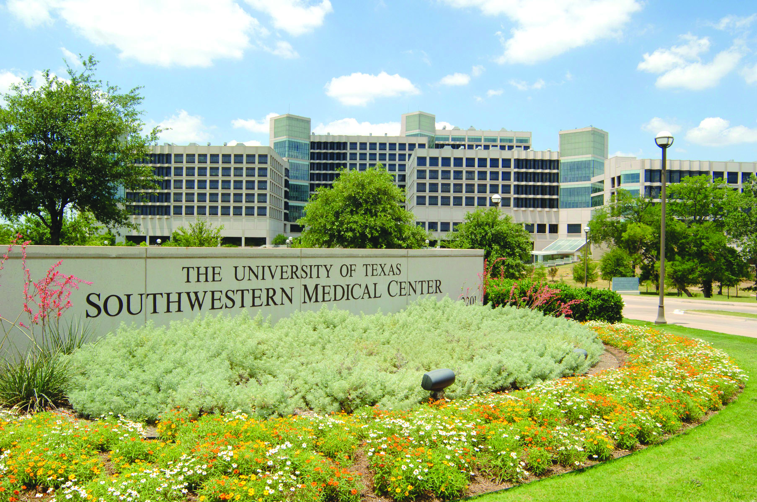

Slide 2
UTSW Thermal Energy Plants, Power Generation and Electrical System
What do we do to meet the Emission Reduction, Energy usage Reduction and Electrical generation goals?

Slide 3
Mission
We are a service organization with mission to provide QUALITY SERVICE in support of the educational, research, health care, and community service goals of UT Southwestern.

Slide 4
Thermal Energy Plants
NTEP, STEP, Bass TEP, Zale TEP, St Paul TEP
Electrical Systems Group
Primary Electrical Substation (138KV), Medium Voltage(15KV and 5KV), low voltage substation (600 V), Photovoltaic System
Power Generation Group
Peak Engines and Emergency Generators

Slide 5
How big are we in Utilities?
Consumption per year (2010)
Electric – 317,199,934 KWh or $23,954,638
Gas – 1,051,310 MCF or $7,612,321
Water – 559,372 MGal. or $3,175,029
52,000 tons of cooling capacity – Chillers
550,000 lbs/hr Steam capacity – Boilers
31 MW of Power – Peak engine/backup
38 plus Emergency Generators
250,000 EMS points monitored – We are the biggest in the D/FW Metroplex.
11.2 Million ft² Campus

Slide 6
Introduction to the total Plants
North Thermal Energy Plant – 1992
Chillers – 18,500 tons
Boilers – 138,000 lbs/hr steam
South Thermal Energy Plant – 1972
Chillers – 18,750 tons
Boilers – 246,000 lbs/hr Steam
Bass Thermal Energy Plant – 1956
Chillers – 4,500 tons
Boilers – 40,000 lbs/hr Steam
St. Paul Thermal Energy Plant – 1961
Chillers – 3,000 tons
Boilers – 50,000 lbs/hr Steam
Zale Thermal Energy Plant – 1987
Chillers – 2,800 tons
Boilers – 30,000 lbs/hr Steam
North Campus Generation Plant – 2005
Natural Gas Driven Engines – 9 MW
South Campus Generation Plant - 2004
Natural Gas Driven Engines – 12 MW

Slide 7
Serves North Campus

Slide 8
Serves North Campus

Slide 9
Serves North Campus

Slide 10
NL – Bldg at North Campus

Slide 11
Power Generation Uses
Backup to the Campus
Electric Reliability Council of Texas 4 Coincident Peak – (ERCOT 4 CP) Program – 21 MW - $535K per year
North Campus Generators
9 MW
South Campus Generators
12 MW
ERCOT – Emergency Interruptible Load Service (EILS) Program - $414K per year
North Campus Generators
9 MW

Slide 12
What do we do to meet Energy Reduction Goals?
NA Bldg Lab Exhaust fan VFDs installation
Heat exchanger installation
Insulation Project throughout the Campus
Air Balance (NA, NB Bldg.)
VFDs for AHUs
Control Valves
Pre-heat Valves
Chilled Water Valves
Hot Water Control Valves
Secondary Pumping control and VFDs
Night Setbacks – Campus Wide
Motor upgrade
Air Compressors Upgrade
Operational and Maintenance
Cleaning tubes (Chiller and boiler tubes)
Repairing leaks (Chilled Water, Steam, Condensate)
Etc…

Slide 14
Energy Reduction Goal
Over the last 10 years the medical center has reduced its energy usage per square foot by 37.7 percent. UT Southwestern’s goal is a further 30 percent reduction by 2021.

Slide 15
Electrical System
138 KV from UTSW Substation
15KV electrical infrastructure associated with the Campus Substation/Distribution components
Underground distribution system
Low Voltage substation (600 Volt) at the building
Photovoltaic – 260 KW (Solar Panel)
Inspection of New Construction Projects
Thermographic Surveys on the Electrical Systems

Slide 16
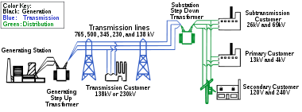
Simplified diagram of AC electricity distribution from generation stations to consumers

Slide 18
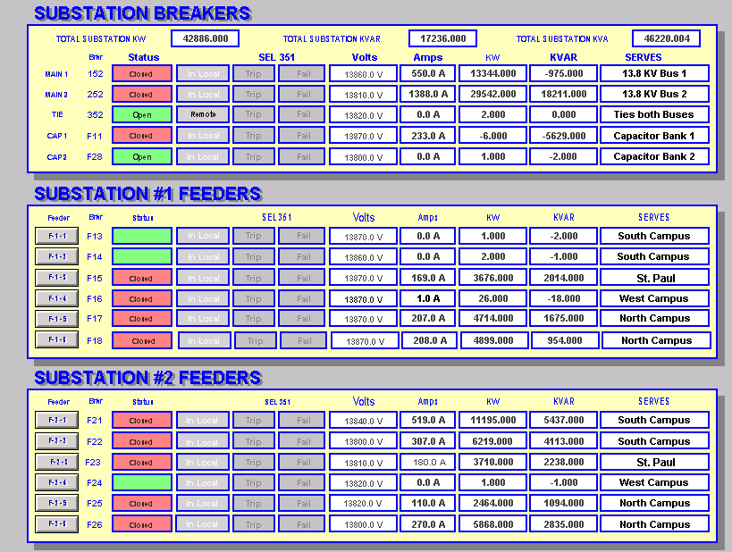

Slide 19
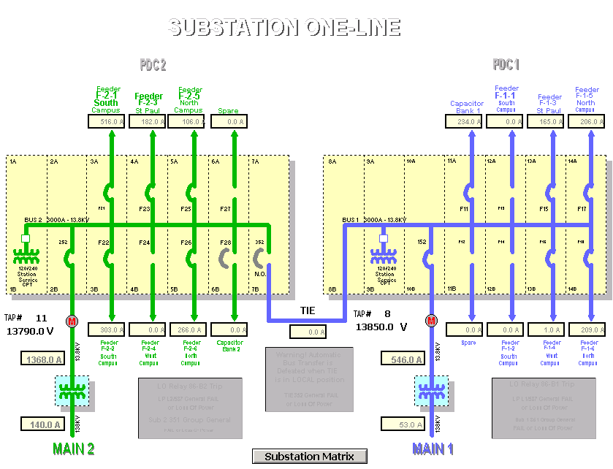

Slide 20
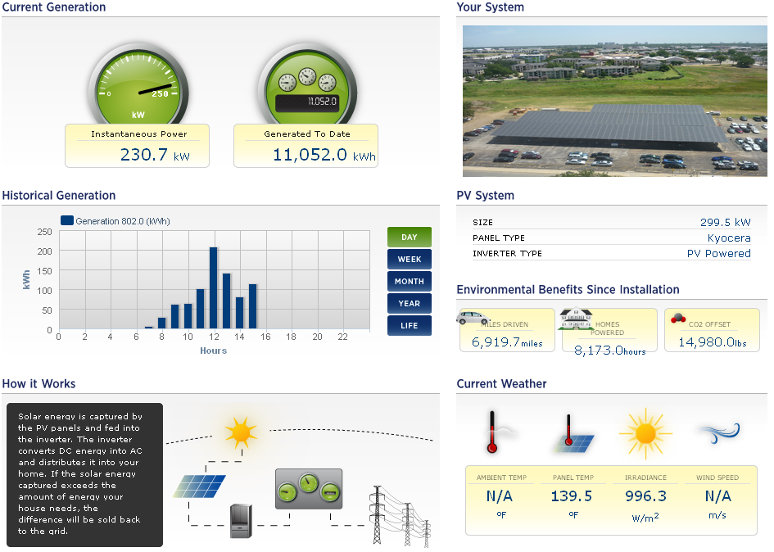

Slide 21
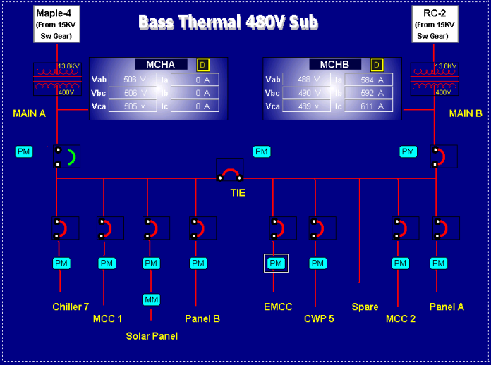

Slide 22
Photovoltaic System
Construction of solar panels at Paul M. Bass Administrative and Clinical Center will save 406,281 kilowatt-hours, the equivalent of taking 56 passenger vehicles off the road.

Slide 23
Actual Site
Siemens Apogee Link (Building Automation)
Wonderware Link (UTSW Electrical System)
Photovoltaic (Solar Panel)
www.Datareadings.com

Slide 24
ANY Questions?

