Slide 1
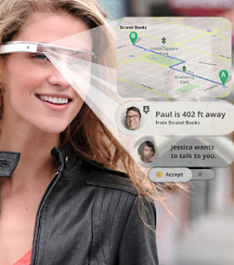
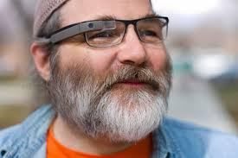
Google Shades for Accessibility
Randi Craig, Nikolaus Walch, Dylan Brandt, Ben Smiley
13 July 2013

Slide 2
Storyboard

Slide 3
Outline
Many technologies exist to assist individuals with accessibility
How can they be helped in the best way?
Maximum benefit to mitigate disability
Minimum inconvenience to employ technology
Individuals have two goals:
Have same abilities as “normal” individuals
Limit the noticeability of their impairment, and the technology they rely upon

Slide 4
Outline
1.1 Project overview
Requirements for Google Glass to augment reality to improve real world accessibility. This can be used for anyone that needs assistance processing the world around them.
Examples:
Dementia/Alzheimer’s patients
Those suffering temporary or permanent auditory or visual impairment
Disabled children and adults
Travelers that do not speak the local language
Notes:
For the purpose of this project, we will focus on the example of dementia patients

Slide 5
Outline
The technology required to aid with multiple needs
Triggered by some types of stimuli.
Information can be static and/or passive,
Proximity sensor triggering a prerecorded message
Passive information is generally static; no custom to that person’s needs.
interactive information requires a more complex solution:
using breath or eye movements,.
Our project is to combine a passive stimuli for the user, where the user is not required to do anything at that moment, with customized information.
Google Glasses technology; see the world and help interpret it for the wearer.
Many commercial applications for the technology, but our team is focusing on improving real world accessibility for dementia/Alzheimer’s patients.
Glasses interpret the world and provide customized information to the wearer, and customized information is entered by care givers at any time, and can be actively maintained.

Slide 6
User Groups
Who | Expected Skill Level | Why Virtual Memory App?
Patient suffering from early on-set Alzheimer’s | Familiarity with smartphones. Concept of virtual/augmented reality a plus. | Provide a supplement to daily life to minimize effects of disease.
Spouse, Partner of patient | Familiarity with smartphones. | Experience benefits of patient’s ability to be more self-sufficient and consistent to traditional behavior. Provide input to application to customize it to the patient’s needs.
Professional caregiver | Familiarity with care for those affected by neurological degenerative diseases. | Monitor patient for the management of symptoms, calibration of application.
Doctor | Familiarity with neurological degenerative diseases, and various forms of treatment and care management. | Monitor patient for the management of symptoms, calibration of application.
Insurance | Familiarity with benefits of technological aided disease management | Few other treatment options exist for the management of Alzheimer’s.

Slide 7
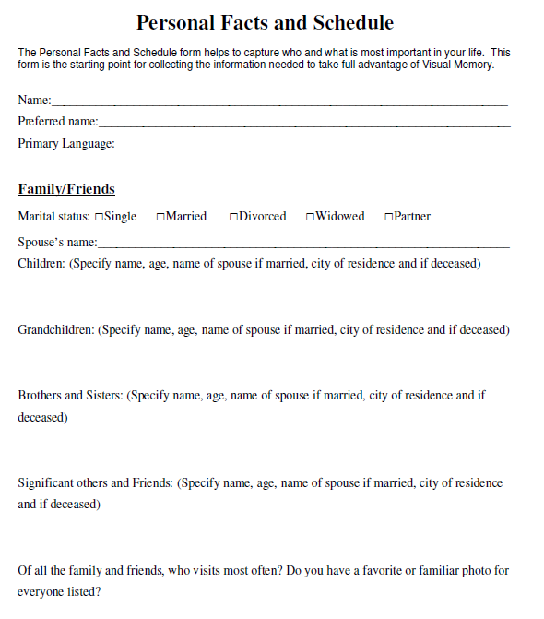
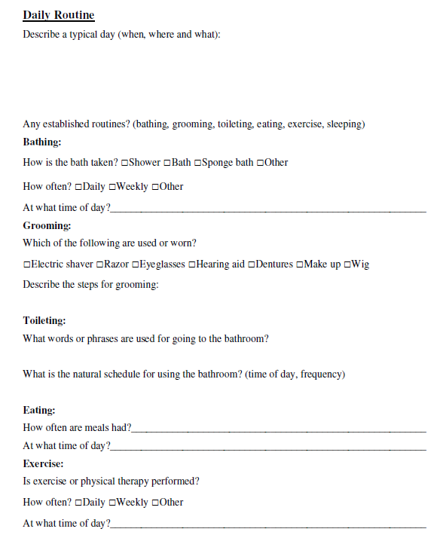
Understanding users

Slide 8
Outline
There are 2 ways to approach project outline:
Point of view as if we were Google
Large budget, more resources, longer timeline
Point of view of UTD class
Limited resources and budget, but also more manageable scope and timeline
Notes:
We are using the much more contained point of view of the UTD class.

Slide 9
Outline
Goals:
Google Glasses will improve real world accessibility for early stage dementia/Alzheimer’s patients.
Provide a total solution for the family/caregivers of patients to use the application for the joint benefit of their lives and the patient’s
Integrate successfully of the app into platform
Capture market share in accessible technology market

Slide 10
Outline
1.2 Project deliverables
High-level functional and technical requirements for a Google Glass application which would use the Google Glass platform. Would provide a specialized application for the use of people with real world accessibility challenges.
User interface for caregiver to load customized content for the individual wearer.
High-level marketing and sales requirements.

Slide 11
Outline
1.3 Evolution of this document
1.4 References
alzheirmers.org foundation; others to be added
1.5 Definitions, acronyms, and abbreviations
Not applicable at this time
1.6 Online
Location of project website: http://bit.ly/13iyKMR
Version | Date | Resource
1.0 | 5 June 2013 | Randi Craig
1.1 | 6 June 2013 | All team members
1.2 | 7 July 2013 | All team members
1.3 | 13 July 2013 | All team members

Slide 12
Project Organization
2.1 Process model - Agile approach
Based on iterative and incremental development, where requirements and solutions evolve through collaboration between self-organizing and, cross-functional individuals.
Promotes adaptive planning, evolutionary development and delivery, a time-boxed iterative approach,
Encourages rapid and flexible response to change.
Conceptual framework that promotes interactions throughout the development cycle.

Slide 13
Project Organization
2.2 Organizational structure
This project has a non-hierarchical organization, a flat structure.
Project Manager = Randi Craig
Product Experience Manager = Nikolaus Walch
Systems Engineer = Dylan Brandt
Senior Business Analyst = Ben Smiley

Slide 14
Project Organization
Lawrence Chung, Professor
Nikolaus Walch, Product Experience Manager
Dylan Brandt, Systems Engineer
Ben Smiley, Senior Business Analyst
Randi Craig, Project Manager

Slide 15
Project Organization
2.3 Organizational boundaries and interfaces
Abilities of each individual, as well as the research material available online regarding Google Glass development are the extent of the resources utilized.
2.4 Project responsibilities
Each resource is required to take meeting notes at least once
Each resource is required to participate in presentations
Each resource is required to provide content in a timely manor

Slide 16
Managerial process
3.1 Management objectives and priorities
Business need addressed with this solution
Google Glass
Doctor, Hospital/Clinic, Insurance, other accessibility apps
Project scope applicable for our time and resource constraints is limited to patients with early on-set Alzheimer’s

Slide 17
Managerial process
3.2 Assumptions, dependencies, and constraint
Real World App sits on Google Glass platform. Basic functionality already covered by Google Glass platform.
Google Glass hardware and software platform requirements are also a constraint.
We assume the technology described in Google’s requirements exists, or will be in place before needed in production

Slide 18
Managerial process
3.3 Risk management
Timeline and scope creep are always project risks.
A competitor app may come to market first.
A competitor app with a richer set of features
Google Glass hardware and/or software requirements may change, requiring extensive rework of our designs.
Additionally our team my suffer
Loss of team members
Wasted resources on requirements which do not ultimately benefit the project.
3.4 Monitoring and controlling mechanisms
We will address timeline and scope creep with a strict timeline of team defined deliverables and regular weekly meetings; or as needed.

Slide 19
Technical process
4.1 Methods, tools, and techniques
MS Office Suite, including Word, PowerPoint, Visio, Excel
Communications we are using Facebook, email, Dropbox
PMI project management methodology including all phases of SDLC
RE-Tools requirements modeling toolkit
Wix.com webpage design and hosting
4.2 Software documentation
MS Word, PDF, Powerpoint
4.3 Project support functions
Marketing, communications, R&D support, the Alzheimer's Foundation - alzfdn.org‎ requirements and endorsement.

Slide 20
Work elements, schedule, and budget
Work elements
WRS document
Schedule
Time constraint - class due dates
Weekly team meetings - more if necessary
Budget
There is no budget for the requirements project. We are poor grad students.
If we approach Google, they may choose to invest significantly in our project

Slide 21
Functional Requirements
Define specific behavior or functions

Slide 22
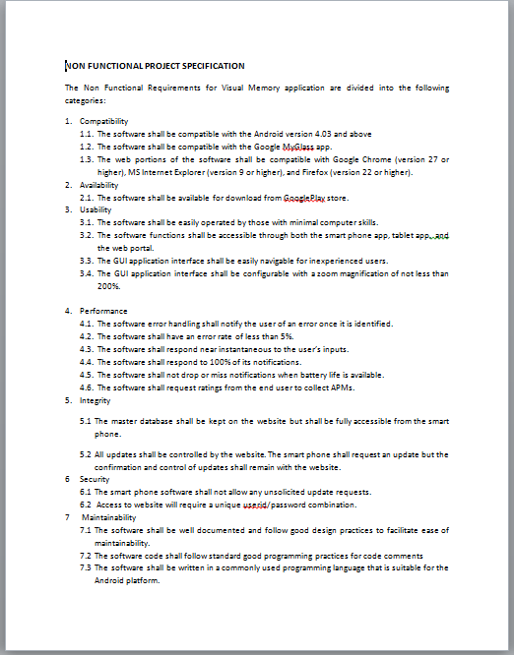
Non-Functional Requirements
Specifies criteria that can be used to judge the operation of a system, rather than specific behaviors;
Compatibility
Availability
Usability
Performance
Integrity
Security
Maintainability

Slide 23
Traceability and Creeping Requirements
Traceability – documents the life of a requirement and providing bi-directional traceability between various associated requirements. It enables users to find the origin of each requirement and track every change that was made to this requirement.
Creep - changes or continuous growth in a project’s scope
i.e. Nutritional information

Slide 24
Application Mock-up

Slide 25
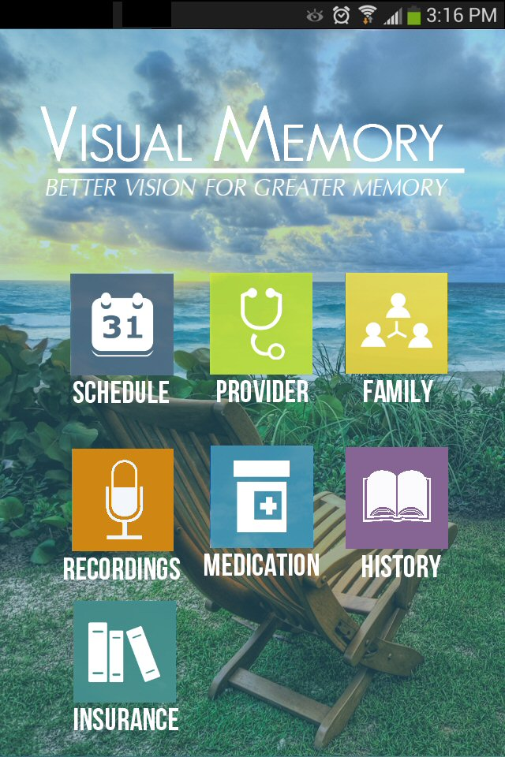
Home Screen

Slide 26
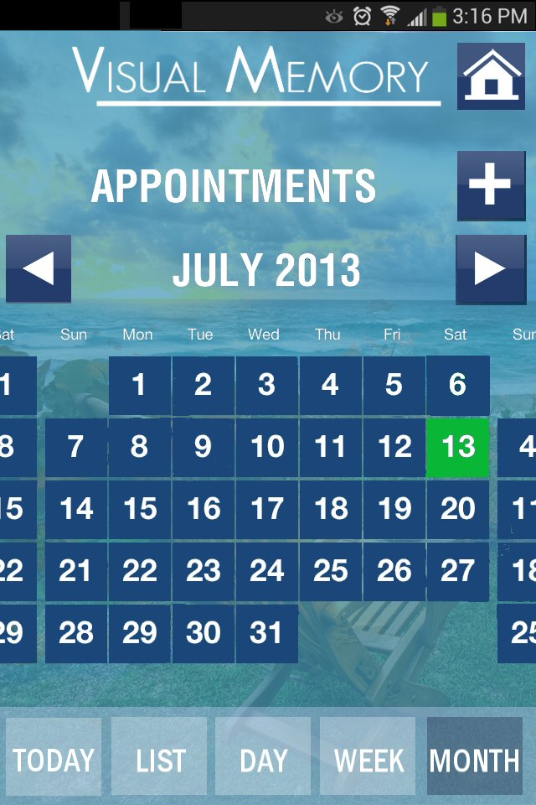
Schedule

Slide 27
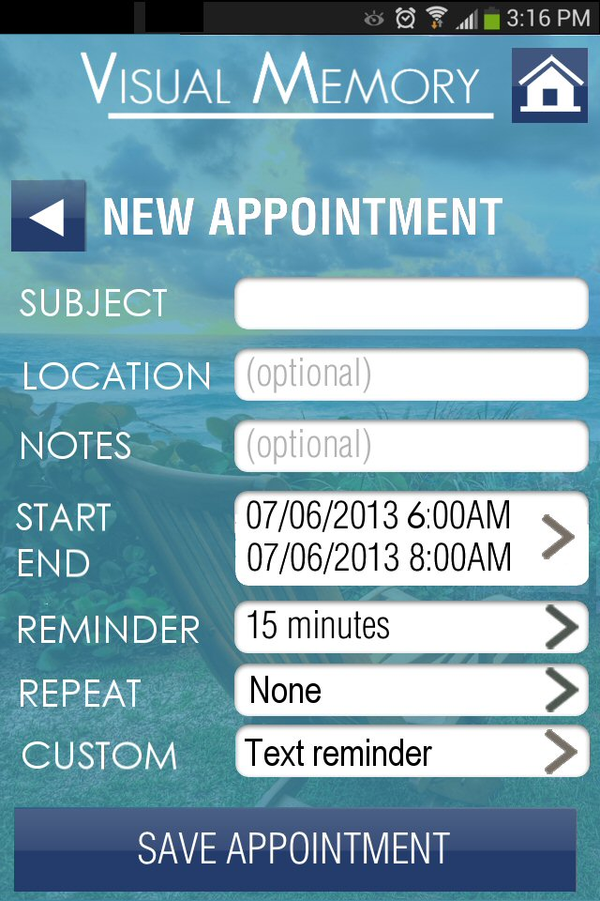
New Appointment

Slide 28
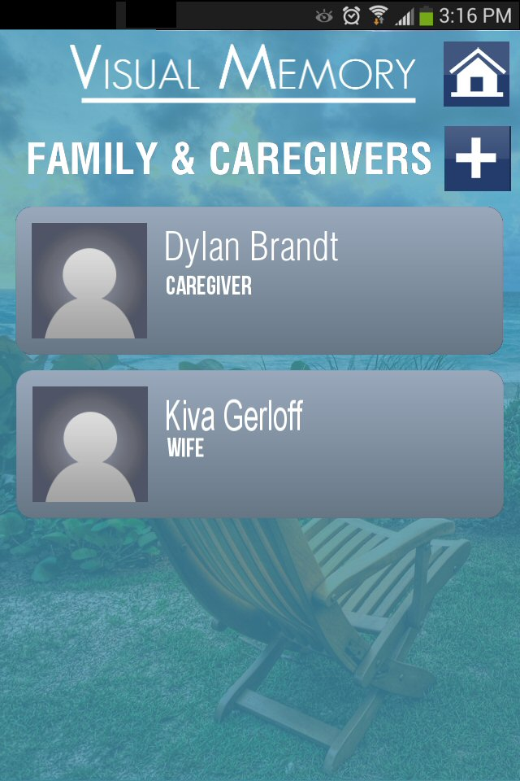
Family & Caregivers

Slide 29
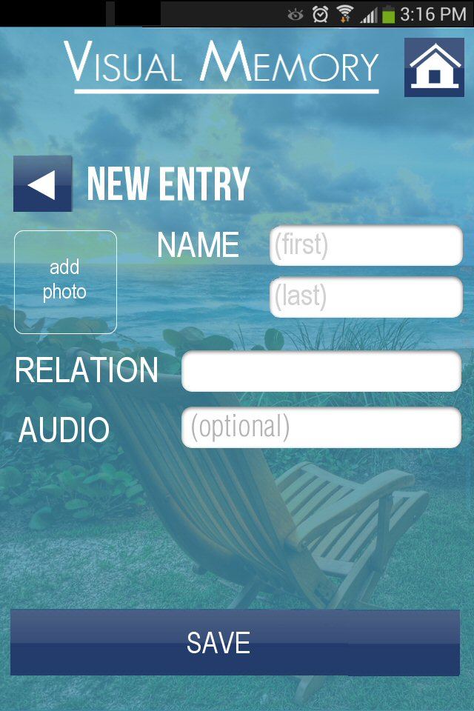
New Contact

Slide 30
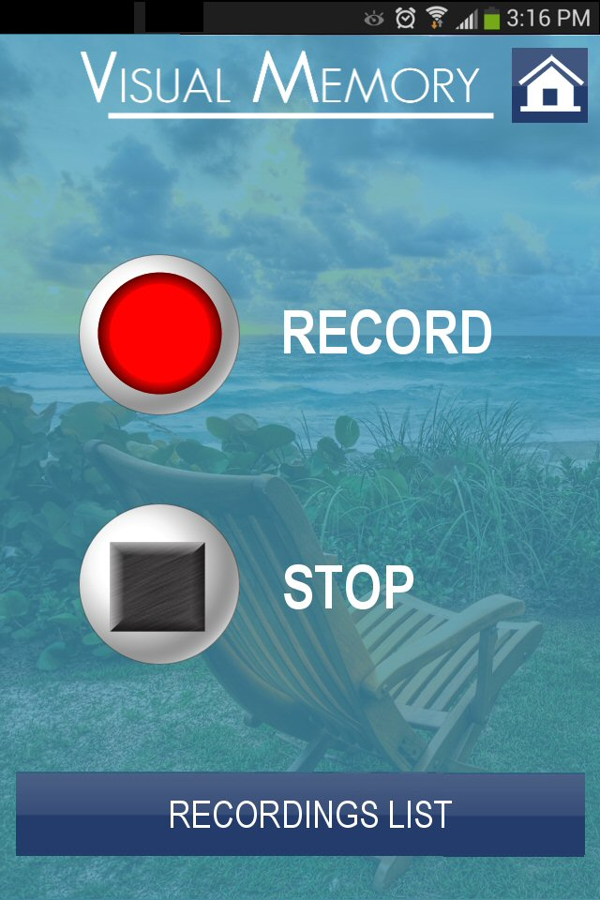
Recordings

Slide 31
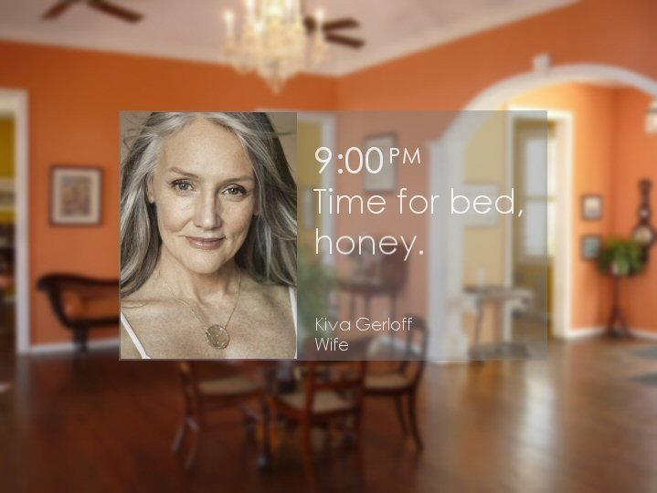
Glass Interface

Slide 32
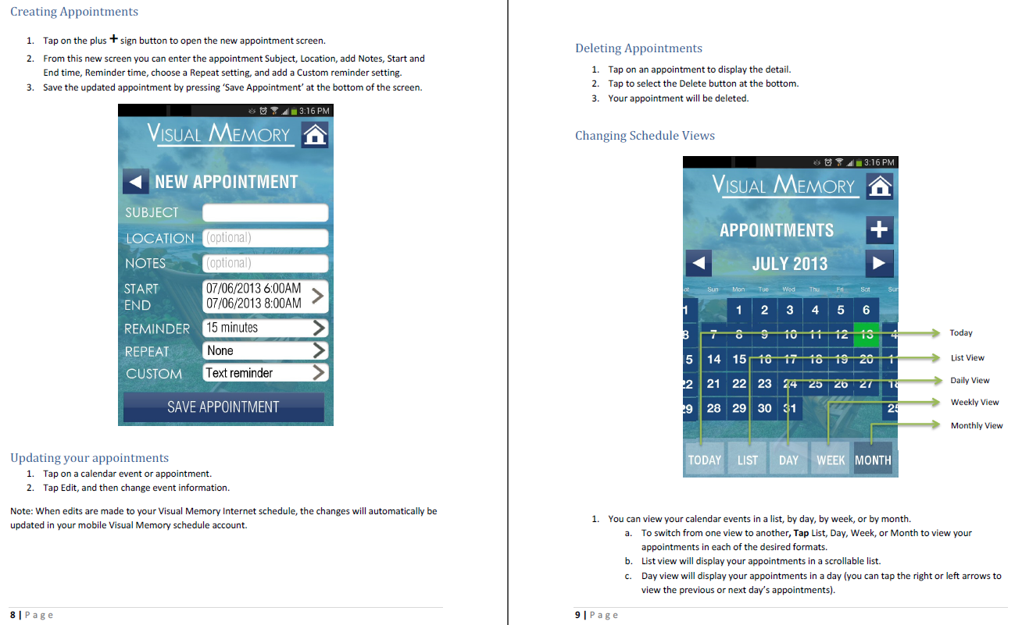
User Manual

