Slide 1
SAVER Strategic Allocation of Vital Emergency Resources
SAVER
Kristen Hieronymus
Howard Fantroy
Arun Krishnan
Preston Burkhalter
20130713
UTD Advanced Requirements Engineering

Slide 2
Table of Contents
Purpose
High-level requirements
Incident Command System
Mock-up screens
Detailed requirements
Screens
App
Server back-end
Security
Hardware
Mobile Protocol
Non-functional requirements
Feedback/roll-out process requirements
Questions
Misc. house-keeping notes

Slide 3
Purpose
When a disaster strikes or a person goes missing, a user creates a polygon search area and names the event.
Searchers launch the app to automatically periodically report their location, and to pull a map of the search area, including an activity map indicating areas already searched. This will assist in ensuring that the whole search area is covered, not just the area closest to where searchers are starting.

Slide 4
High-level requirements
Searchers have roles (medic, gas company worker, general searcher)
Searchers can define search area or select existing one
Searchers can see areas already searched (dynamically updated)
Searchers’ locations are sent to back-end server
Back-end server must interact with ICS (Incident Command System)

Slide 5
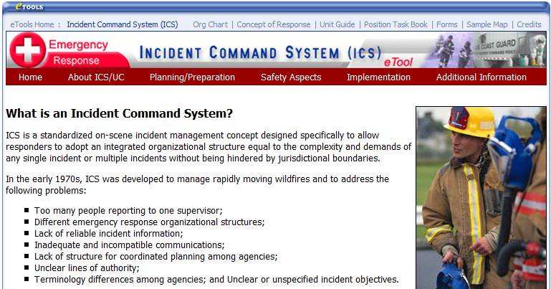
Incident Command System

Slide 6
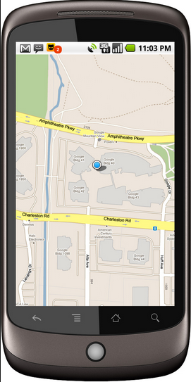
SAVER Launch Screen
Welcome
Medic
Kristen
Enter
Not Medic?
Not Kristen?

Slide 7
SAVER Launch Screen
This App requires GPS for full functionality.
Turn on GPS
Battery saver: limit GPS. I am searching a small area.
Battery saver: limit GPS. I am searching a large area.
No GPS. Search location will not be reported.

Slide 8
Choose Search Area Screen
Choose Search Area
Choose Other Search Area
Define New Search Area

Slide 9
Activity Map Screen
Activity Map
Legend

Slide 10
Requirements - Screens
All app screens shall display the standard Status bar and Action bar as applicable to the platform.
App launch
Upon launch, the app shall show a welcome screen.
The welcome screen shall contain:
the “SAVER” logo
an “Enter SAVER” button
the username from the last time the app was launched
the role from the last time the app was launched
a “not <username>?” button
a “not <role>?” button
If the “Not <username?” button is selected, the current user shall be logged out and the “User Login” display shall be displayed.
The “User Login” page shall include:
Username and password textboxes, and “Enter SAVER” button
“Define new user” button

Slide 11
Requirements - Screens
The “Define new user” button shall take the user to the “Define new user” screen
The “Define new user” screen shall include:
Username textbox
Password textbox
Password reenter textbox (with automatic match checking with Password textbox)
E-mail address textbox
Role radio-buttons (mutually exclusive)
“Create user” button
The “Create user” button sends the new user information to the server back-end.

Slide 12
Requirements - Screens
If “User successfully created” is received from server backend, the app shall proceed as if “Enter SAVER” was selected.
If “Username already taken” is received from server backend, the app shall present “Username already taken” at the top of the “Define new user” screen.
Upon “Enter SAVER” selection, one of the following shall occur:
If the device supports GPS and GPS is off, the app shall go to the GPS Enable screen
Otherwise, the Choose Search Area screen shall be displayed.

Slide 13
Requirements - Screens
The GPS Enable screen shall present the following:
A notice indicating, “This App requires GPS for full functionality.”
Button indicating “Turn on GPS”.
Button indicating “Battery Saver: limit GPS. I am searching a small area.”
Button indicating “Battery Saver: limit GPS. I am searching a large area.”
Button indicating “Battery Saver: No GPS. Search locations will not be reported.”

Slide 14
Requirements - Screens
The “Choose Search Area” screen shall present the following:
Text indicating “Choose Search Area ”, with map of nearby search areas displayed below.
The map displayed shall be centered on the user’s location, with a nominal range from left edge to right edge.
The nominal range shall be 10 miles from left edge to right edge.
If no user location is available, the map shall be of the entire continental U.S., centered around Kansas.
The map displayed shall permit zooming and panning.
The map displayed shall display a layer with search polygons outlined in red.
The map shall permit clicking on/within a polygon and recognizing that as a selection of the indicated search area.
Button indicating, “Choose Other Search Area”.
Button indicating, “Define New Search Area”.

Slide 15
Requirements - Screens
Selection of the “Choose Other Search Area” button shall go to the “Choose Other Search Area” screen.
The “Choose Other Search Area” screen shall present the following:
“City, State or Zip” textbox
“Enter” button
Selection of the “Enter” button shall take the user to the “Choose Search Area” screen, with the map centered on the entered city,state/zip.

Slide 16
Requirements - Screens
Selection of the “Define New Search Area” button shall go to the “Define New Search Area” screen.
The “Define New Search Area” screen shall present the following:
“Enter City, State or Zip” textbox and “Enter” button
“Use Current Location” button
Selction of either button shall take the user to the “Define Search Polygon” screen

Slide 17
Requirements - Screens
The “Define Search Polygon” screen shall present the following:
A map of the designated area, centered on the specified location, with a nominal range from left edge to right edge.
The nominal range shall be 1 mile from left edge to right edge.
The map displayed shall permit zooming and panning.
The map displayed shall display a layer with the outline of the polygon in red.
The map outline shall be 1mm wide.
A text message saying, “Zoom/pan to include whole area to be searched. Long press and drag corners.”
The polygon displayed shall change shape in response to long-press and drag of corners.
Long-press within 3mm of a corner shall be interpreted to mean selection of that corner.
A “Done creating/updating search area” button.

Slide 18
Requirements - Screens
The “Done creating/updating search area” button shall take the user to the “Activity Map” screen.
The “Activity Map” screen shall present the following:
A map of the designated search area, nominally showing the entire search area.
The map displayed shall permit zooming and panning.
The map displayed shall display a layer with the outline of the search polygon in red.
The outline shall be 1mm wide.
The map shall optionally display “activity” icons, “clear” icons, “fire icons”, “gas leak” icons, “water leak” icons, “victim” icons, “survivor” icons, “medic requested” icons, and “medic present” icons.

Slide 19
Requirements - Menu
The menu shall include:
Request medic
Request gas company worker
Request fireman
Request water company worker
Request muscle
Request back-hoe
Victim found
Survivor found
Area clear (search activity complete for immediate area)
Change user
Change role
Update GPS usage
App logout

Slide 20
Requirements – App
The app shall coordinate with the server back-end for search area association.
If GPS is ON, the app shall send the server back-end location information on a periodic basis (nominally 30 seconds).
The period for location information shall be once every 3 minutes for the option of “battery saver: limit GPS. I am searching a small area.”
The period for location information shall be once every 1 minute for the option of “battery saver: limit GPS. I am searching a large area.”
The app shall receive activity map information from the server back-end.
The app shall notify the user if their support is requested for a particular area.
The app shall request confirmation of dispatch accepted.

Slide 21
Requirements – Server
Upon receipt of “Create User” message, the server shall check the database for uniqueness of username and MAC address combination.
If username/MAC address combination is unique, the server shall respond with “Username successfully created” to the app.
If username/MAC address combination is not unique, the server shall respond with “Username already taken” to the app.
The back-end server shall associate and merge overlapping search areas.
The back-end server shall associate location information from searchers with a search area.
The back-end server shall provide activity map information to searchers local to the search area.
The back-end server shall provide activity map information to users requesting activity map information for a given area.
The back-end server shall provide efficient dispatch of requested support.
The back-end server shall interface with the ICS (Incident Command System).

Slide 22
Requirements – Server
The dataserver system shall allow administrator logins.
The dataserver system shall collect audit logs for all administrator actions.
The dataserver system shall house a relational database.
The database shall support automatic backups periodically and upon admin action.
The database shall support automatic purging on a configurable interval.
The database at each regional subsystem station shall support 50 million rows of location information.
The database at each regional subsystem station shall support 25,000 unique users.
There will be 64 regional subsystem stations in the U.S., co-located with the ICS Fusion centers.
The servers shall be configured in active/passive mode within a regional subsystem station.

Slide 23
Requirements – Security
The username shall have a minimum length of 6 characters.
The password shall have a minimum length of 6 characters with one number.
There shall be encryption for the communication with the server back-end.
The backend server system shall perform MAC address filtering to ensure that only communications from registered users are accepted and processed.
The backend server system shall only process known message types.
The supported message types shall be:
Account creation
User login
Role change
Location report
Request for support
Activity map request
Dispatch acknowledge/rejection

Slide 24
Requirements – Networking
The bandwidth connection speed for the server back-end system shall support 6mbps upload speed and 12 download.
The dataserver shall use a dedicated static IP as given by the ISP.
The dataserver shall have a dedicated port (80).
The dataserver shall act as a server.
The dataserver subsystem station shall support 700 simultaneous users.

Slide 25
Requirements – Hardware
Each regional location shall have a server farm of 6 servers.
Each server shall have a chassis, motherboard, processor, RAM, power supply, hard drive, and optical drive, and networking connections.

Slide 26
Requirements – Hardware
Each chassis shall:
have an Asset Tag on System Chassis
be 3RU or less rack mountable
have Sliding Rails With Cable Management Arm
have front facing 3.5 bays X3
have front facing USB
have front facing power indicator
have front facing Hard Drive status light
have minimum mounting for two fans
have removable front debris filters
have front facing hot swapable drive bays
have a heat tolerance > 110 degrees Farenheight
have a cold tolerance of sub 15 degrees Farenheight temperature tolerance
support a standard ATX motherboard

Slide 27
Requirements – Hardware
Each motherboard shall:
support a minimum of 64GB of DDR3 RAM
have 1333MHz minimum
support a LGA1150 Socket
utilize an on board RAID controller
have a board controller that supports:
RAID (0)
RAID (1)
RAID (10)
RAID (5)
have a minimum of 8 SATA III headers
have a minimum of 2 USB 3.0 headers
have a minimum of 1 24-pin EATX Power Connector
1x8-pin EATX 12v Power Connector
have a minimum of 3 PCI Express X1 slots
have a minimum of 3 PCI Express X16 slots
support 2 processors of the LGA1150 socket
support two eth interfaces
perform to 1000Mbit/s per interface

Slide 28
Requirements – Hardware
Each processor shall
be an LGA1150 interface
have an L3 Cache of 8MB or greater
have 4 cores or greater
have a processor speed of 3GHz or greater
The RAM shall
be 1333MHz memory speed or greater
be DIMM socket form factor
have a memory CAS Latency of 9-9-9
have 240 pins

Slide 29
Requirements – Hardware
The hard drives shall
have 2TB storage capacity or greater
have SATA III interface
be Solid State

Slide 30
Requirements – Hardware
The Power Supply shall
Be ATX form factor
have modular cabling
have an energy efficiency of 80 plus or greater
have an input voltage range of:
90V-264V at 47-63Hz
+3.3V at 22A
+5V at 22A
+12V at 66A
have a life span rating of 100K hours or greater
have a 20+4 pin mother board connector
have (> or =)2 4-pin/8-pin EPS Connector
have (> or =)6 6-pin/8-pin PCI-Express Connector
have (> or =)6 4-pin Peripheral Connector
have (> or =)9 SATA Power Connector
connect to shore line power with a Power Cord:
10 feet (3m)
125 volt
15 AMP

Slide 31
Requirements – Hardware
Each Optical Drive shall:
have a DVD(+,-) 16X minimum write speed
have a CD 48X minimum write speed

Slide 32
Requirements – Mobile Protocol
The app shall make use of the 4G-LTE networks’ Location based services over IP Multimedia Subsystem (LBS over IMS) for the location tracking system
The app shall use the API’s provided by the ILS (IMS Location Server) and Mobile Positioning System to track the location
The app shall meet the FCC criteria for supporting location based services
The handset shall support the GPS-enabled 4G-LTE network

Slide 33
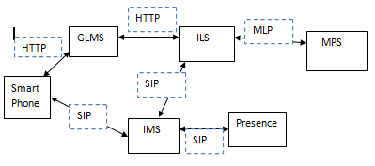
Requirements – Mobile Protocol

Slide 34
Non-functional requirements
The server back-end availability shall be 99.9%
Message traffic shall include message version numbers to facilitate backward compatibility between apps and the back-end server.
One back-end server shall support pushing upgrades to the mobile devices periodically and upon receipt of out-of-date messages.

Slide 35
Feedback/Roll-out Process
For usability, three rounds of user feedback focus groups shall be performed.
There shall be a 3-week test with a small municipality 911 dispatch center prior to roll-out to the first FUSION center.
The roll-out and test period at the first FUSION center shall be for 3 months.
The roll-out to subsequent FUSION centers shall be one at a time, over a period of 3 weeks each.

Slide 36
Questions
Any questions?

Slide 37
Meetings/roles
Meetings:
6/22/13 – Divided requirement categories among team members
7/6/13 – Met to discuss and refine requirements
7/13/13 – Met to review presentation
Roles:
Kristen Hieronymus – Project Manager, Screens, App, Server, Non-functional
Howard Fantroy – Hardware, Server
Preston Burkhalter – Security/DB
Arun Krishnan – Mobile Protocol

Slide 38
Links
https://www.osha.gov/SLTC/etools/ics/what_is_ics.html

