Slide 1
Uncovering the Topology of Time-Varying fMRI Data using Cubical Persistence
Authors: Bastian Rieck, Tristan Yates, Christian Bock, Karsten Borgwardt, Guy Wolf, Nicholas Turk-Browne, Smita Krishnaswamy
Presentor: Jaime A Mena Padilla

Slide 2
Paper Overview
-Authors contribute novel non-parametric framework to transform time-varying fMRI data into time-varying topological representations, i.e. time-varying fMRI datasets are converted to cubical complexes, which are filtered along the BOLD activation function creating a sequence of persistence diagrams and images for each participant sequence along time steps,
-These topological signatures are used to cluster participants, and study brain state trajectories of subjects, with meaningful results showing topological features in blood flows in the brain carry meaningful information of function and structure

Slide 3
Functional Magnetic Resonance Imaging (fMRI)
-Neurons lack internal energy stores, requiring increased blood flow to carry oxygen and glucose during activation creating a coupling of neural activity and blood flow
-fMRI utilizes the magnetic properties of oxygen levels in blood to create the blood-oxygen-level dependent (BOLD) contrast, creating scans of blood flow in the brain
-Resulting dataset is complex, structured, voxel activity measurements with a BOLD activation function that varies in time, with spatial resolutions at the mm scale and temporal resolution in seconds
-Due to coupling of neural activity and blood flow, fMRI data thought to hold insights into cognitive processes in animal brains
-Inherit noise in fMRI process and high variability of stimulus and activity in the brain between people result in complex datasets, with complexity inherent to measurement process and complexity inherent to activity being measured itself making analyses challenging
-Standard approaches to fMRI analysis include transforming voxel data into correlation matrices, either across time points or across voxels which are often atlas parcellated, and shared response models SRMs which ‘learn’ a mapping of multiple subjects into a shared space

Slide 4
Motivation for application of Cubical-TDA to fMRI Datasets
-Due to aforementioned difficulties, fMRI dataset representations robust to noise and invariant with respect to some reasonable transformations are therefore desirable. Persistent homology produces such topological representations which intuitively measure noise as low persistence features and are invariant to homeomorphic transformations
-PD’s also stable relative to small amplitude perturbations by stability theorem
-Cubical complexes built on underlying orthonormal grids, with cubicals located and aligned on the grid, and size fixed by grid, where PH machinery otherwise similar to simplicial PH
-Cubical PH used since voxels are aligned in regular, orthogonal 3D grid with basic structural connectivity which matches well with the theoretical machinery of cubical complexes, which allows one to avoid having to interpolate additional structure not present in the data if using simplices

Slide 5
Dataset Terminology and Description
-For n participants and m time steps, we observe n activation functions fⱼ:Vⱼ⨯T→ℝ, aligned along their time steps T={t₁,...,tₘ}⊆ℕ, for bounded Vⱼ⊆ℝ³ with vert(Vⱼ) the vertex set of Vⱼ
-In this application n=155, 33 adults and 122 children who watched movie ‘Partly Cloudy’ while undergoing fMRI with feature vectors composed of age and gender, and m=168, with each time step compromising 2s of movie runtime aligned across participants
-Note due to hemodynamic lag and initial blank screen of movie, a total of 7 time steps removed, so each participant results in a 4D tensor of dimensions 65×77×60×168
-Each participant has a whole brain mask (BM) which is the entire scan, ‘occipital-temporal’ mask (OM) which only considers the occipital, temporal, and precuneus ROI, and ‘logical XOR’ mask (XM) between BM and OM which makes study of relevance of topological features with respect to non-visual regions possible

Slide 6
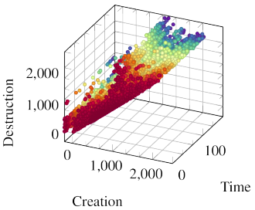
From fMRI Datasets to Topological Feature Representations
For each fⱼ, topological features obtained by 3 step procedure: (1) cubical complex conversion, (2) filtration calculation, (3) PD calculation
-(1): Cubical complex Cⱼ has vertices vert(Vⱼ), with edges between neighboring vertices defined by a regular 3D grid derived from the orthogonal structure of Vⱼ. These neighborhoods define the connectivity of higher-dimensional elements 𝜎 in Cⱼ, i.e. squares and cubes
-(2): Impose ordering of 𝜎∈Cⱼ for every time step tₖ, assigning value fⱼ(⦁,tₖ) to all vertices in Cⱼ, and recursively assigning value fⱼ(𝜎,tₖ)≔max{fⱼ(v,tₖ):v∈vert(𝜎)} to higher-dimensional 𝜎∈Cⱼ. Sort Cⱼ at every time step ascendingly according to fⱼ(⦁,tₖ)
-(3): From these orderings, calculate the PH of Cⱼ at every time step tₖ, resulting in PD’s (𝐷⁰₍ⱼ,ₖ₎,𝐷¹₍ⱼ,ₖ₎,𝐷²₍ⱼ,ₖ₎), where there are no homological features of dimension d>2. Denote 𝐷₍ⱼ₎ as set of PD’s associated with participant j, embedded in ℝ³

Slide 7
Static Analysis Based on Summary Analysis
-Due to computational infeasibility of metrics on space of PD’s (typically with 10,000 features), calculate topological summary statistics of form f:𝐷→ℝ, for PD’s of d=2, using two norms where each norm results in a univariate time series for each participant:
|𝐷|₍∞₎≔max{pers(𝜙):𝜙∈𝐷} |𝐷|₁≔√[∑₍𝜙∈𝐷₎pers(𝜙)]
To quantify efficacy of proposed topological feature extraction pipeline, predict age of child participants using a ridge regression and leave-one-out cross-validation, trained either on curves of summary statistics for (parcellated) and non-parcellated datasets, baseline spatial parcellated (PP) and temporal non-parcellated (TT) correlation matrices, and persistence images calculated from the correlation matrices (TT-CORR-TDA, PP-CORR-TDA)

Slide 8
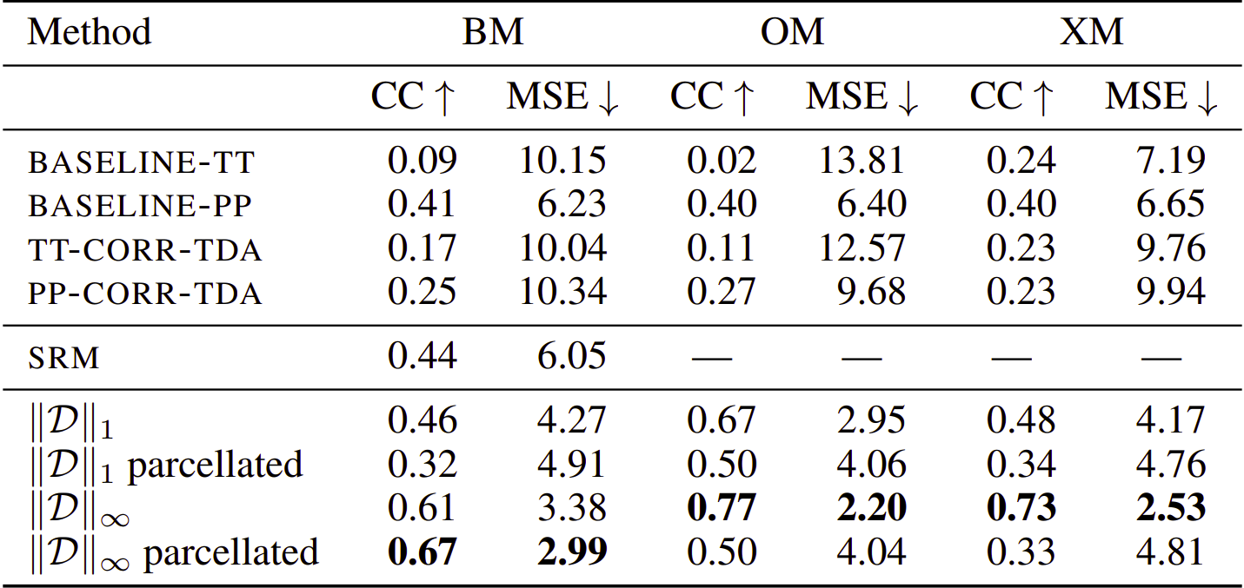
Results from Summary Statistics Analysis
-Bolded results indicate best results, where MSE indicates Mean Squared Error

Slide 9
Dynamic Analysis from Brain State Trajectories
-For d=2, calculate persistence images from PD’s for all participants across all time steps, and bin participants according to age
-Unravel PI’s into vectors and organize them into matrices per participant across time, and calculate mean matrix per participant cohort resulting in six matrices representing average topological activity of participants in respective cohort
-Calculate pairwise distances between rows in sample mean matrices for each cohort, and embed them using PHATE, creating 2D brain state trajectories from mean matrices
-Resulting trajectories indicate structure

Slide 10
Directions of Further Study
-Directions of interest for further study include application of zig-zag persistence calculations to these data sets, to try and better capture topological features across time [3]
-Application of zigzag filtration curve as described in [2]
-Further study into possible bifiltrations as another avenue to better capture topological features of BOLD across time
-Study into how AT tools might handle multimodal datasets being currently researched, such as fMRI-EEG datasets

Slide 11
References
[1]: https://www.youtube.com/watch?v=r6mu8YnDAHk&list=PL4kY-dS_mSmKqno6Rqk6f4O-Li9GPEVwb&index=12
[2]: https://openreview.net/pdf?id=2Ln-TWxVtf
[3]: https://openreview.net/pdf?id=QjlNs8ymHNc

