Slide 1
Improved line facility location in weighted subdivisions
Ovidiu Daescu and Ka Yaw Teo
Department of Computer Science
University of Texas at Dallas, Richardson, TX

Slide 2
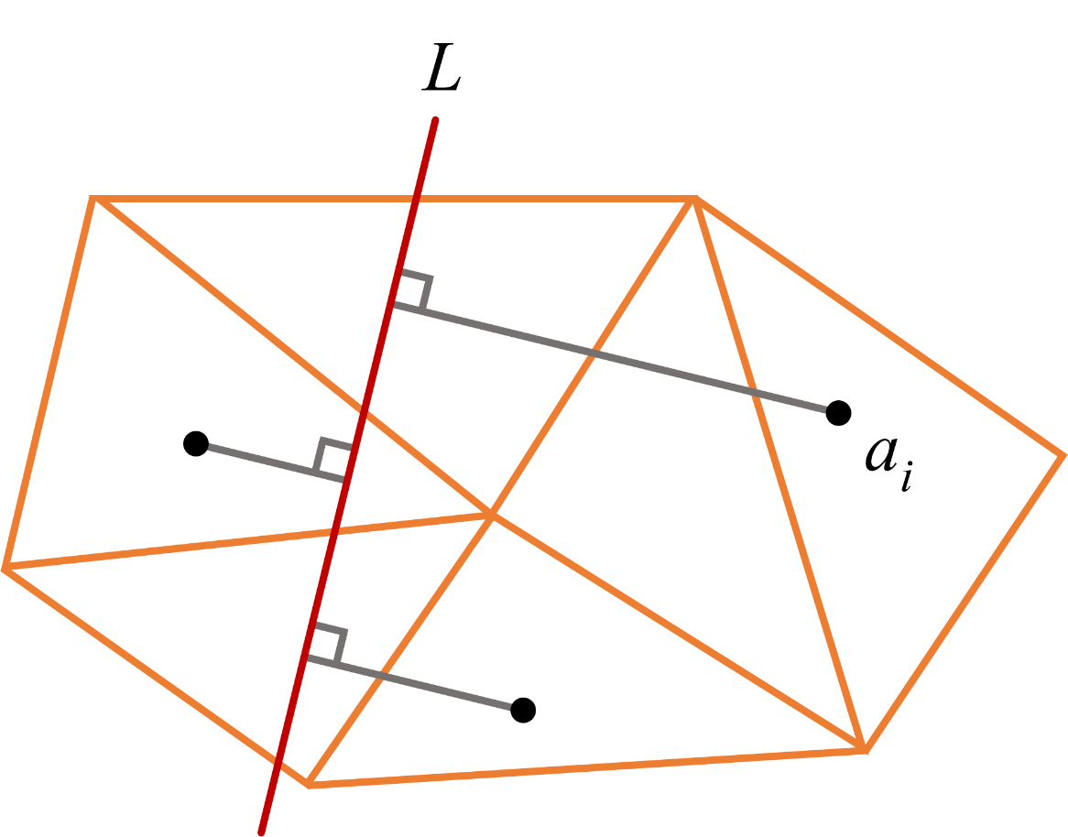
Line facility in planar weighted subdivision
The plane is partitioned into convex regions with a set V of m vertices and a set E of k = O(m) edges.
Each convex region is associated with a non-negative integer weight.
A set of n points, A = {a₁, …, a_{n}}, is given in the weighted subdivision.
Find a line L that minimizes the sum of the weighted Euclidean distances from the given points of A to line L.

Slide 3
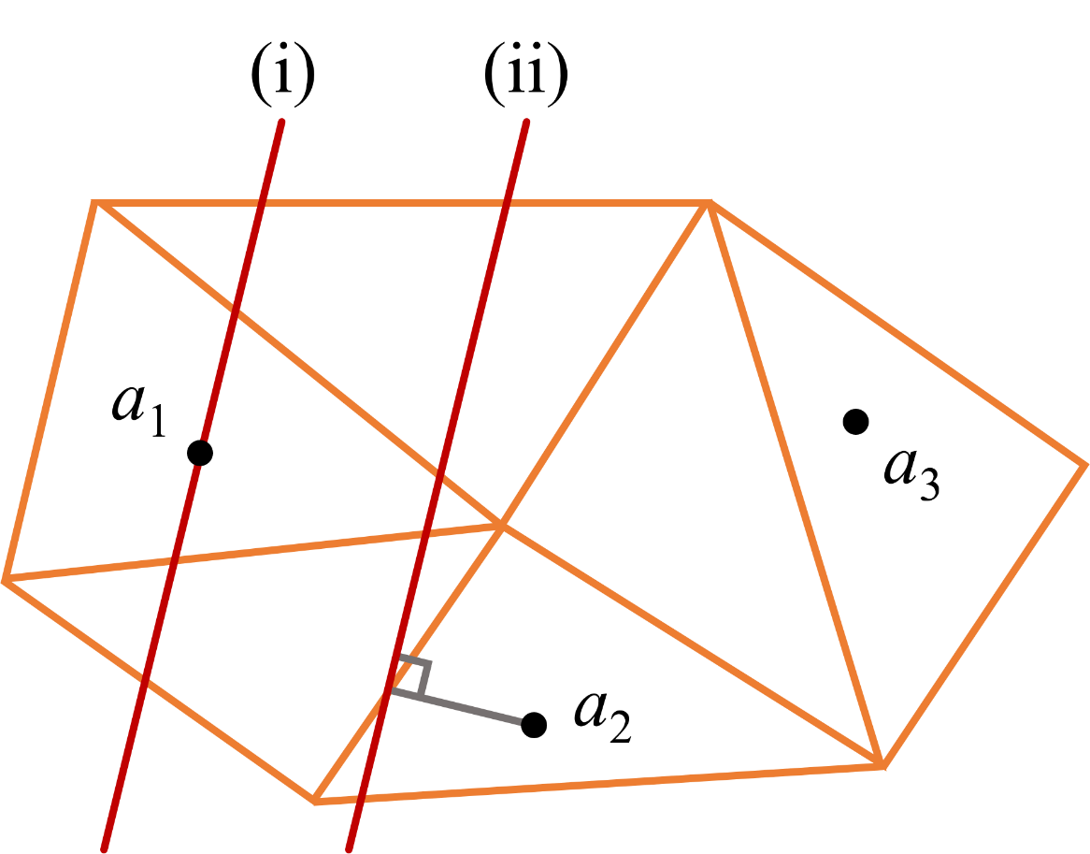
Previous result [1]
Lemma 1.
If a line L is optimal, then either
i) L passes through a point of A or
ii) the projection of a point of A on L coincides with an edge of E.
By using this observation, the original problem can be reduced to O(m²n²) 1-variable optimization subproblems.

Slide 4
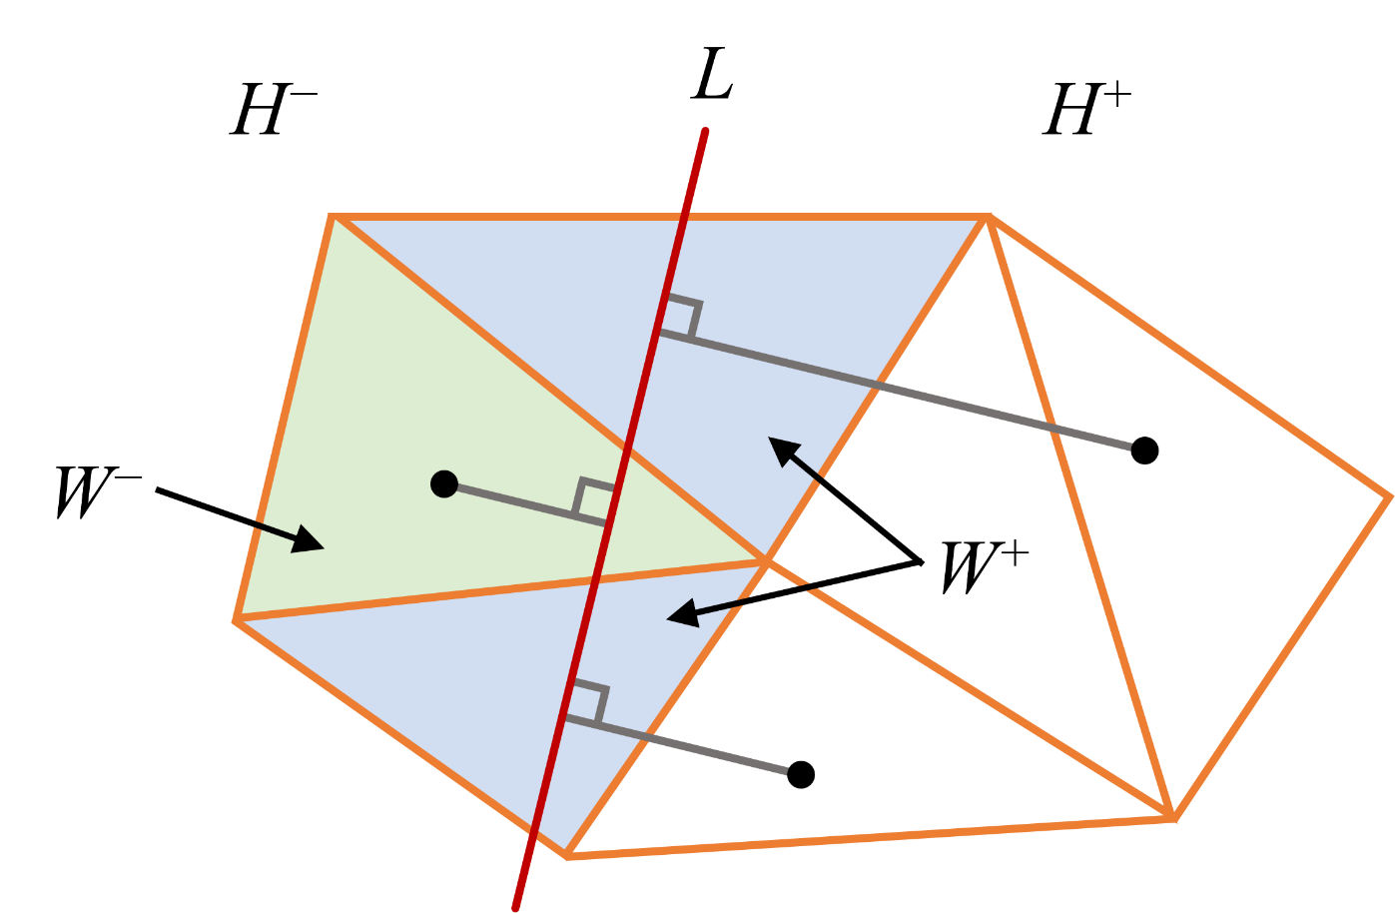
Current study
Derive an improved solution approach by exploiting a halving property associated with the problem.
If a line L is optimal, then line L splits the set of (intersected) weighted regions into two sets of nearly equal weights.
O(mn²) 1-variable optimization subproblems – an O(m) improvement over the previous result.

Slide 5
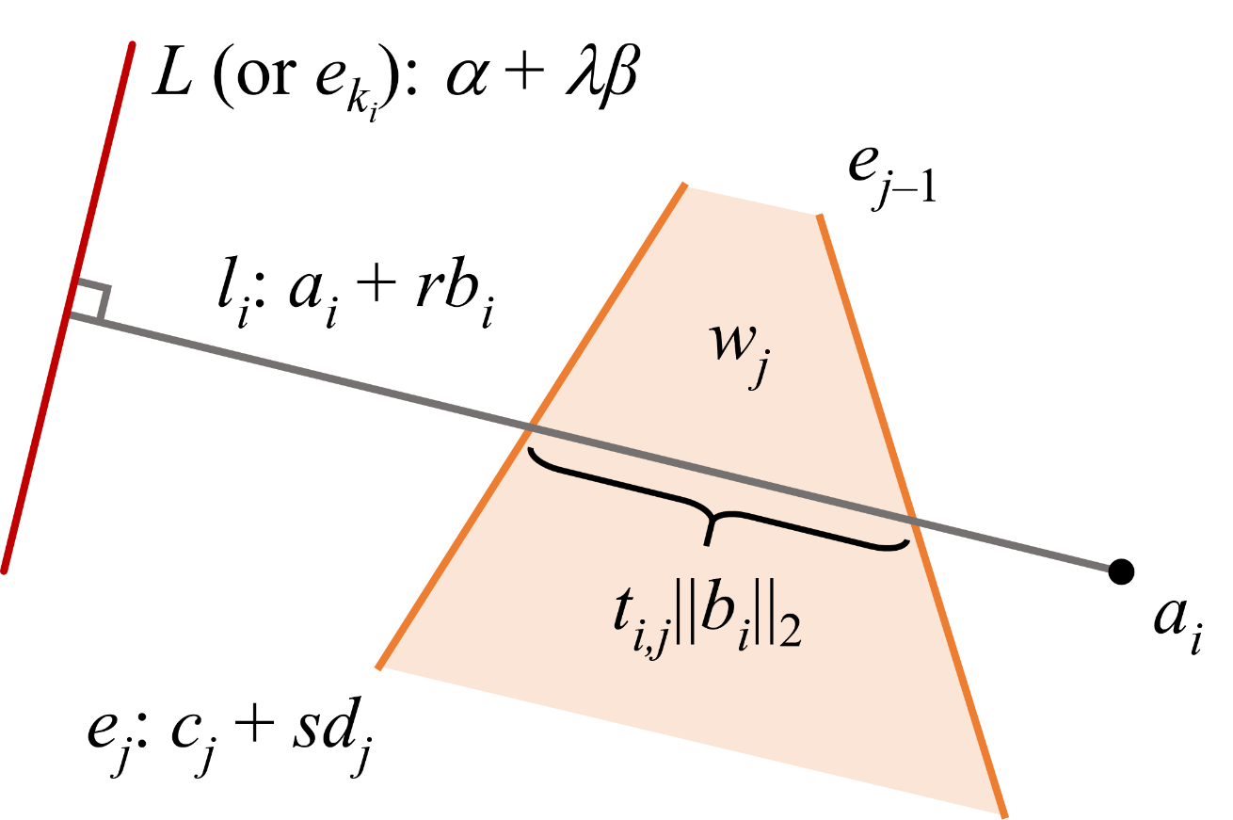
Objective function
The sum of the weighted Euclidean distances from the points of A to a line L is given by
||b_{i}||₂ is the length of the projection path l_{i} from point a_{i} to line L.
t_{i,j} is the fraction of l_{i} that passes through the region of weight w_{j}.
{e_{j} : j = 1, 2, …, k_{i}} is the sequence of edges intersected by l_{i}.

Slide 6
Halving property
A line L divides the plane into two half-planes, H⁺ and H⁻.
Let W, W⁺, W⁻, and W⁰ be defined as
Lemma 2. If a line L is optimal, then W⁺ ≤ ½ W and W⁻ ≤ ½ W.

Slide 7
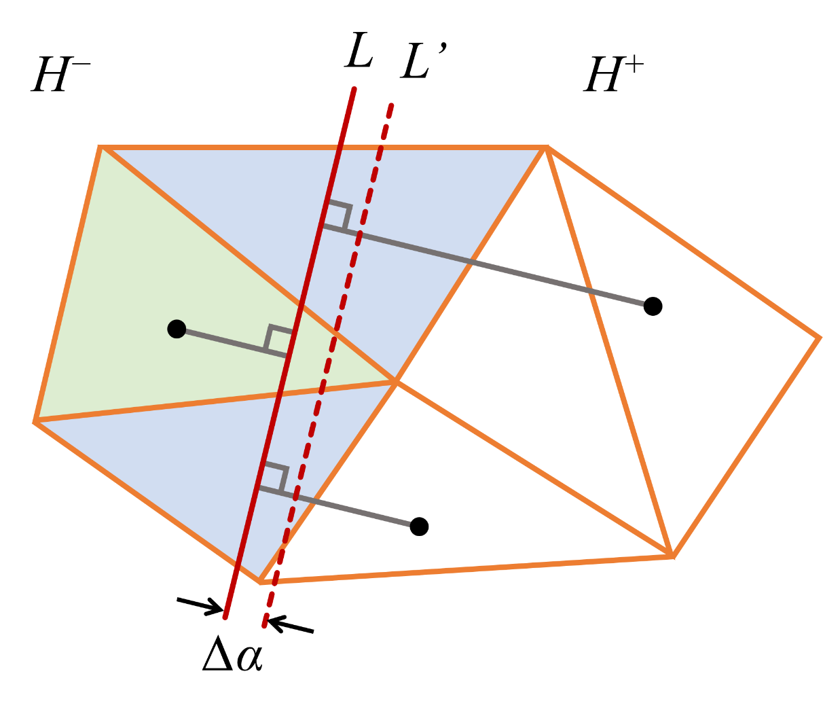
Halving property
Proof.
Suppose that L is optimal, and W⁺ > ½ W.
Let L’ be a line parallel to L at Δα away from L in H⁺, such that
none of the points in A changes from one side of L’ to the other, and
the set of intersecting edges for each l_{i} does not change.

Slide 8
Halving property
Proof (continued).
The objective function for L’ can be expressed as
f(L’) = f(L) – Δα(W⁺ – W⁻ – W⁰)
According to the supposition,
W⁺ > ½ W ⇒ W⁺ > ½ (W⁺ + W⁻ + W⁰) ⇒ W⁺ – W⁻ – W⁰ > 0
This implies that
f(L’) < f(L) ⇒ L is not optimal.
∴ If L is optimal, then W⁺ ≤ ½ W.
A similar argument can be made to prove that if L is optimal, then W⁻ ≤ ½ W.

Slide 9
Solution space
As a result of Lemma 1, two cases are considered:
I. Line L passes through a point a’ ∈ A.
II. The projection of a point a’ ∈ A on line L coincides with an edge
e’ ∈ E.
A transition-point event refers to either
i) line L passes through a point a_{i}, or
the projection of a point a_{i} on line L coinciding with an edge e_{j}.

Slide 10
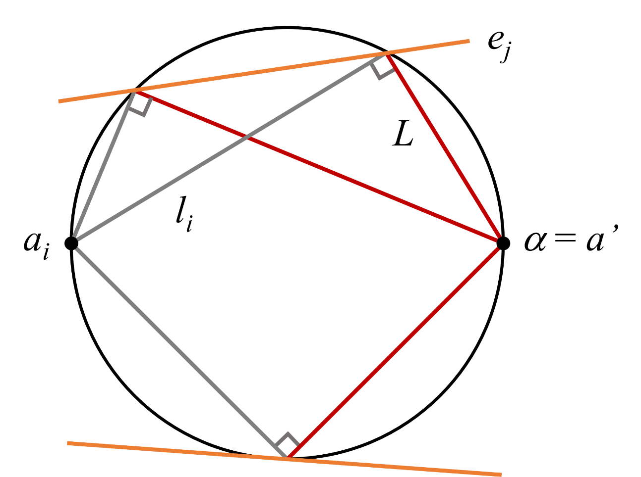
Case I. Line L passes through a point a’ ∈ A
Given L(α, β) = α + λβ, if α = a’, then L is a function of only β.
W⁺ and W⁻ change only when a transition-point event is encountered.
Each transition-point event yields a β-interval in which W⁺ and W⁻ are constant.
i) n − 1 β-intervals:
L can pass through any of n − 1
points in A \ {a’}.
ii) 2k (n − 1) β-intervals:
The projection of a point in
A \ {a’} on L can coincide with
an edge e_{j} at most twice.
∴ For a total of n points in A, the number of β-intervals is O(kn²) = O(mn²).

Slide 11
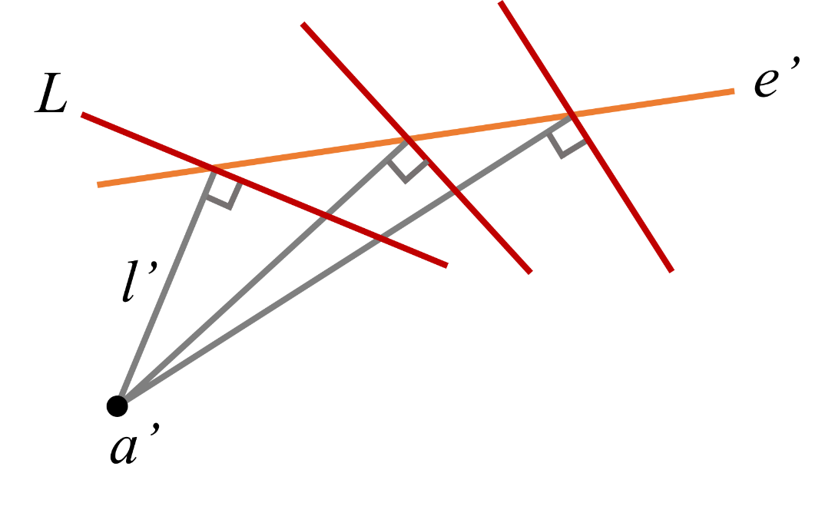
Case II. The projection of a point a’ ∈ A on
line L coincides with an edge e’ ∈ E
Given l’(a’, b’) = a’ + rb’, as the
projection of a’ on L changes
position along an edge e’, b’ varies.
W⁺ and W⁻ change only when a transition-point event is encountered.
Each transition-point event yields a b’-interval in which W⁺ and W⁻ are constant.
i) n − 1 b’-intervals: L can pass through any of n − 1 points in A \ {a’}.
ii) Any transition-point event due to the projection of a point in A \ {a’} on L coinciding with an edge e_{j} has been accounted for.
∴ For a total of n points in A (along with k edges), the number of b_{i}-intervals is O(kn²) = O(mn²).

Slide 12
Optimization subproblems
The resulting O(mn²) β- and b_{i}-intervals can be pruned to only those for which W⁺ ≤ ½ W and W⁻ ≤ ½ W (halving property).
For each β-interval, the optimization problem is of the form
For each b_{i}-interval, the optimization problem is of the form
The overall minimum f* gives the optimal line L for the original problem.
Lemma 3.
An optimal line L can be determined by solving at most O(mn²) 1-variable optimization subproblems.

Slide 13
Special cases
Find an optimal line L that lies outside the convex hull of A, CH(A).
Lemma 4. An optimal line L passes through a vertex of CH(A).
Can be generalized to a convex polygon P enclosing A.
Corollary 5. An optimal line L passes through a vertex of P.
Can be extended to d ≥ 3 dimensions, where P is a convex polyhedron enclosing A, and L is a hyperplane.
Corollary 6. An optimal hyperplane L passes through a vertex of P.

Slide 14
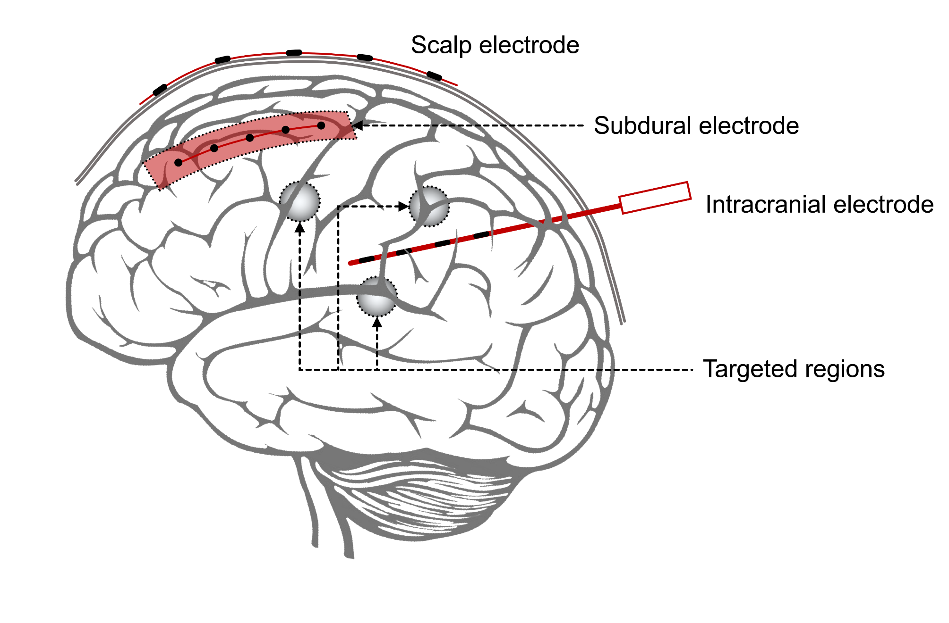
Relevance and Applications
Non- and minimally-invasive brain activity recording and modulation.
Line electrode ~ a line L.
Targeted brain structures ~ a set of n points, A = {a₁, …, a_{n}}.
The electrical conductivity of a brain region ~ a non-negative weight.

Slide 15
Relevance and Applications
The orthogonal path between a point a_{i} and a line L can be viewed as an electrical circuit with k_{i} resistors arranged in series.
Minimizing the weighted distances between the points of A and line L is equivalent to maximizing the sum of current flows between the targeted brain structures and the line electrode.

Slide 16
Summary
A halving property has been used to derive an improved solution approach to the problem of locating an optimal line facility in a planar weighted subdivision.
An optimal line facility can be found by solving O(mn²) 1-variable optimization subproblems.
Results have been extended to special cases with the optimal line lying outside the convex hull (or polyhedron) enclosing the set of given points.
The relevance of the problem has been discussed in the context of optimizing the electrode placement for brain activity measurement and stimulation.

Slide 17
Reference
[1] Y. K. Cheung and O. Daescu. 2011. Line facility location in weighted regions. Journal of Combinatorial Optimization, 22(1), pp. 52-70.

