Slide 1



The iPerform NSF I/UCRC Center http://www.nsf.gov/eng/iip/iucrc/
National Science Foundation
WHERE DISCOVERIES BEGIN
iPerform.uta.edu: Assistive Technologies to Enhance Human Performance
A Platform for Innovation
Research to Accelerate Commercialization
Fillia Makedon (UTA) and Ovidiu Daescu (UTD)
Fall Semi-Annual IAB meeting
October 9, 2015

Slide 2
iPerform Center Background
iPerform Center
Assistive Technologies to Enhance Human Performance
NSF approved the creation of a new I/UCRC center called iPerform, with focus to enhance (human) performance at all levels for healthy and disabled people.
iPerform is one of over 74 such NSF centers with more than 180 sites and 800 members, over 600 companies & over 1080 memberships
The center currently includes U. of Texas Arlington (UTA) (lead) and U. of Texas at Dallas (UTD).
Three more universities are interested in joining the center.

Slide 3
Current iPerform IAB members
Current Companies and institutions members:
    UTD:
      Texas Instruments
      Raytheon
      Bosch
      NIST
    UTA:
      National Center for Scientific Research (NCSR)
      Barrett Robotics
      Veteran Affairs North Texas
      Agillaire (most recent)
Interested in joining :
    University of Texas at San Antonio (UTSA) (together with UTHSCSA),
    NORTHEASTERN U., and
    University of South Florida (USF)

Slide 4
Budget (first year)
NSF (at 51.5% overhead):
  $65,000 (UTD)
  $117,000 (UTA – including evaluator)
Members (at 10% overhead): $300,000 (including in kind)
Total first year: $300,000 + $65,000 + $117,000 = $ 482,000
Detailed Member contribution:
    UTD total : $160K
      Texas Instruments - $40K
      Raytheon - $40K
      Bosch - $40K
      NIST - $40K
    UTA total: $140 K
      NCSR - $40K (in kind)
      Barrett Robotics - $40K
      Veteran Affairs North Texas - $40K
      Agillaire - $20K (Associate Membership)

Slide 5
Why Join the iPerform NSF I/UCRC Center
New opportunities for investment
    Research pre-competitive new technologies
Gain access to cutting edge research projects
    Access to university labs to build / test and evaluate
    Access to top students to perform cutting edge research
    Access to top Faculty experts to advise and suggest solutions
Connect and advertise to other center members
    Expand market base by interconnecting with other members
    Visibility, prestige & international prominence through NSF
    Opportunities to pursue federal funding (SBIR, STTR).
Targeted employee recruiting and training
    Identify talented employees and Faculty to support company research

Slide 6
Research and Application Areas
Assistive Technologies (AT) is about human capabilities:
  Optimize how humans deal with objects, data, services, products, software, hardware and environments around them
  Impact performance at home, at work, online, onsite, for healthy persons and for those with disabilities
Applications:
  robotics, virtual reality, healthcare delivery, energy conservation, transportation, manufacturing, training, education, medicine, other.
Cutting-edge research through center faculty
  Big Data, new sensors, simulations, automation, software/hardware development and integration.

Slide 7
Membership
Membership fees
    Full: $40K/year – 1 vote
    Associate: $20K/year – half a vote
Membership goes to support projects voted by the IAB.
    Members attend semi-annual meetings & vote on projects to partner in research and education
    Members vote on the projects that best suit their mission
All members have common ownership of the entire center research portfolio with the universities.
    Membership funds are channeled through Grants and Contracts Office, with 10% overhead.

Slide 8
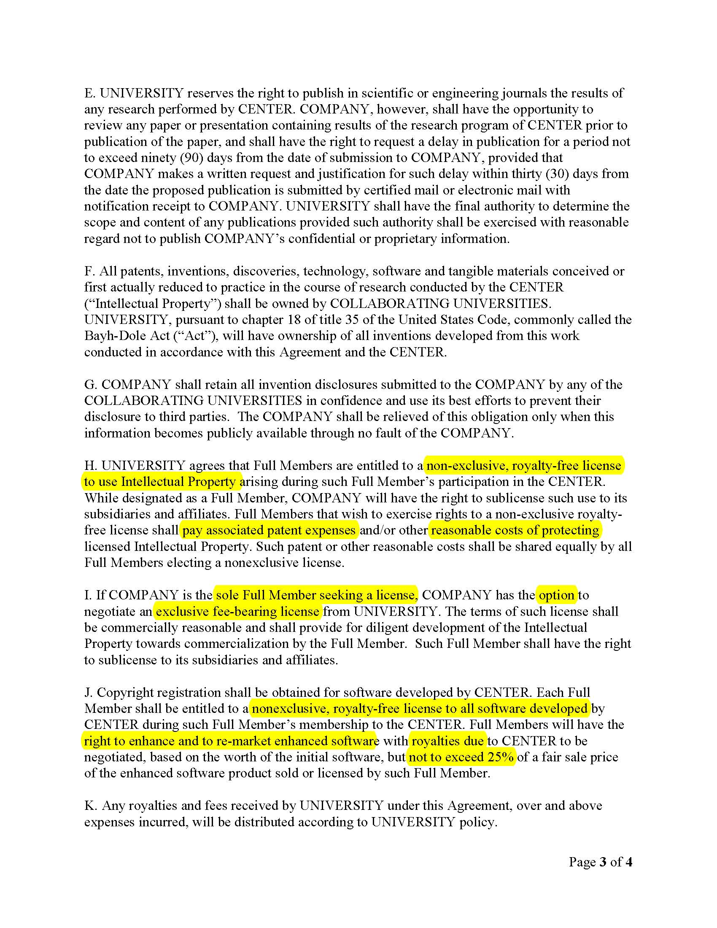
IP & Software Rights (I/UCRC website at nsf.gov)
$40,000 for a Full Membership includes the following IP rights:
Access to publications, documentation and software
Ongoing Royalty Free (protection cost only) Center patents and copyrights, as specified in Agreement
Option for exclusivity

Slide 10
Organizational Structure of Center
Fillia Makedon UTA Site director
  Christoph Csallner & Gian-Luca Mariottini (co-Pis)
Ovidiu Daescu, UTD Site Director
  Dinesh Bhatia, Gopal Gupta, Prabha Balakrishnan (co-Pis)
UTA and UTD Resources available to all members
    ~40 students and 20 labs
    ~18 center faculty researchers
    ~Access to interdisciplinary expertise, as needed
    Technical Staff support
Joint meetings: Once per semester

Slide 11
Closing remarks
The iPerform I/UCRC center offers :
  Cutting edge technologies to promote its members
  Unlimited faculty expertise across all center universities
  First rights to developments (tools, methods, prototypes, publications)
Contact:
    Fillia Makedon (makedon@uta.edu)
    Ovidiu Daescu (daescu@utdallas.edu)

