Slide 1
Logic Puzzles
What can we learn from them?

Slide 2
Outline
Introduction
What is a typical logic puzzle?
How is it related to computer science?
Matching Problem
What languages can they speak?
What are these tennis fans?
Cats and Dogs.
Who are my family?
Boolean Logic
Who is the youngest of them all?
Who will be hired?
McDonald’s Addicts.

Slide 3
Introduction

Slide 4
Red Ball? Blue Ball?
Introduction
The labels on the bags are all wrong!
Can you tell what colors the balls are in each bag
by taking out only one ball?

Slide 5
Red Ball? Blue Ball?
Introduction
What can we know?
The labels on the bags are all wrong!
/
Case 1:
Case 2:
Answer: Yes! Pick one ball from the first bag.

Slide 6
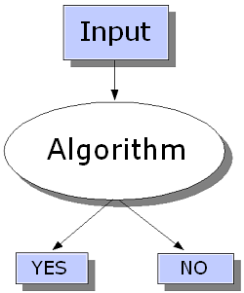
Decision Problem
Introduction
A question in some formal system with a yes-or-no answer, depending on the values of some input parameters.
Common Problem in computational complexity theory
⊂ theory of computation
⊂ computer science
Shares similarity with logic puzzles

Slide 7
Matching Problem

Slide 8
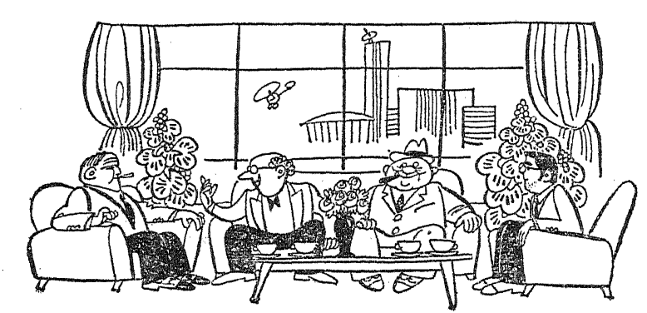
What languages can they speak?
Matching Problem
Four guys (A,B,C,D) meet at the lobby of a hotel. There are some communication problems when they are trying to make conversations.

Slide 9
What languages can they speak?
Matching Problem
Among English, French, German and Italian, each of them can speak exactly two languages. However, they cannot find a language that all can speak, and there is only one language that three of them can speak.
Nobody understand both French and German.
A don’t speak English, but B and C need him as an interpreter.
C speaks German, D doesn’t, but they can communicate directly.
A, B and D want to talk, but cannot find a language they all can speak.
Can you figure out what languages
each of them can speak?

Slide 10
What languages can they speak?
Matching Problem
Two sets: Person & Language
Key relation: speaks
0-1 table can be a useful tool to solve such problems:
 | English | French | German | Italian
A
B
C
D

Slide 11
What languages can they speak?
Matching Problem
Each person speaks exactly 2 languages.
There is no language that all of them can speak.
there is only one language that 3 of them can speak.
Nobody understand both French and German.
A don’t speak English, but B and C need him as an interpreter.
C speaks German, D doesn’t, but they can communicate directly.
A, B and D want to talk, but cannot find a language they all can speak.
 | ENG | FRE | GER | ITA
A
B
C
D
0
1
0
0
1
0
8) B = − C

Slide 12
What languages can they speak?
Matching Problem
Each person speaks exactly 2 languages.
There is no language that all of them can speak.
there is only one language that 3 of them can speak.
Nobody understand both French and German.
A don’t speak English, but B and C need him as an interpreter.
C speaks German, D doesn’t, but they can communicate directly.
A, B and D want to talk, but cannot find a language they all can speak.
 | ENG | FRE | GER | ITA
A
B
C
D
0
1
0
1
1
1
0
0
0
0
1
1
1
0
0
1
8) B = − C
Assume A and B both speak French
Is this answer unique?

Slide 13
What languages can they speak?
Matching Problem
Each person speaks exactly 2 languages.
There is no language that all of them can speak.
there is only one language that 3 of them can speak.
Nobody understand both French and German.
A don’t speak English, but B and C need him as an interpreter.
C speaks German, D doesn’t, but they can communicate directly.
A, B and D want to talk, but cannot find a language they all can speak.
 | ENG | FRE | GER | ITA
A
B
C
D
0
0
1
1
0
1
0
1
1
0
1
0
1
1
0
0
8) B = − C
Assume A and B both speak Italian
Answer: Yes! See Previous Slide

Slide 14
Matching
Matching Problem
Given a 0-1 table representing some relation between sets A and B:
if each column and row of the table contains at most one “1”, then this relation is a matching between A and B.
if each column and row of the table contains exactly one “1”, then this relation is a perfect matching between A and B.

Slide 15
What are these tennis fans?
Matching Problem
Adam, Brian, Chris and David are all tennis fans in a company. Their titles are VP, manager, secretary and intern (not necessarily in this order).

Slide 16
What are these tennis fans?
Matching Problem
Although the VP always loses to the manager, he plays only with the manager.
The manager and intern play better than the secretary.
Adam and Brian’s offices are next to each other, and they play together quite often.
Chris always wins when playing with Adam.
The secretary’s office is only next to the VP’s office.
Can you figure out what title each of them has?

Slide 17
What are these tennis fans?
Matching Problem
The VP always loses to the manager, and they only play with each other.
The manager and intern play better than the secretary.
Adam and Brian’s offices are next to each other, and they play together quite often.
Chris always wins when playing with Adam.
The secretary’s office is only next to the VP’s office.
 | VP | Man | Sec | Int
A
B
C
D
0
1
0
0
1
0
0
0
0
0
0
1
0
0
1
0
Answer: Yes! See the table

Slide 18
Procedure to Solve Perfect Matching Problem
Matching Problem
Step 1: find as many “exist” and “not exist” relations as possible from the conditions
Step 2: fill “0” to all empty cells in the rows and columns that have “1”
If there is no empty cell, then stop;
If there is any row or column containing only one empty cell, then fill it with “1”, go to Step 2; otherwise, go to Step 1.

Slide 19
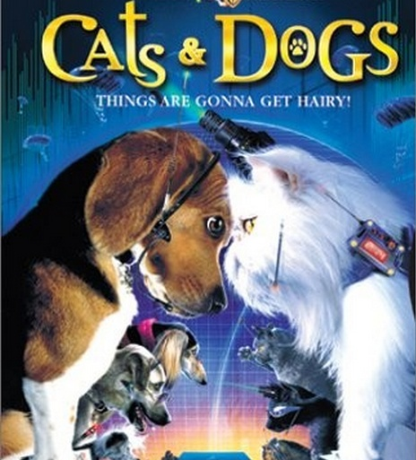
Cats and Dogs
Matching Problem
Families A, B, C, D, and E have pets. Each of them has one dog and one cat.
Within the family, the cat and dog get along peacefully with each other.
However, every dogs would love to bite cats from other families.

Slide 20
Cats and Dogs
Matching Problem
One day, every dog bit a cat.
All cats got bitten.
The cat bitten by the dog from family A is from the family whose dog bit the cat from family E.
The dog from family B bit the cat from family A.
The dog who bit the cat from family D is from the same family whose cat was bitten by the dog from family C.
Can you figure out whose cat was bitten
by the dog from family D?

Slide 21
Cats and Dogs
Matching Problem
Dogs don’t bite cats from the same family.
Every dog bit a cat.
All cats got bitten.
The cat bitten by the dog A is from the family whose dog bit cat E.
Dog B bit cat A.
The dog who bit cat D is from the same family whose cat was bitten by dog C.
 | CatA | Cat B | Cat C | Cat D | Cat E
Dog A
Dog B
Dog C
Dog D
Dog E
0
0
1
0
0
1
0
0
0
0
0
0
0
0
1
0
1
0
0
0
0
0
0
1
0
(A,x) = (x,E) = 1
➔ x = C or E
(y,D) = (C,y) = 1
➔ y = E
Answer: Yes! Dog D bit cat B.

Slide 22
3-Matching
Matching Problem
Sets A, B and C, each contains n elements.
Set F contains vectors (a,b,c), a∈A, b∈B, c∈C.
F is a 3-matching of A,B and C if:
It contains exactly n vectors;
Each element in A,B and C appears exactly once in F.
Many logic puzzles are 3-matching problem.
We may need more than one table to solve them.

Slide 23
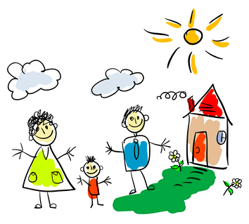
Who are my family?
Matching Problem
There are three families, each has three members.
The husbands’ names are Adam, Brian and Chris;
The wives’ names are Dana, Ella and Fanny;
The kids’ names are Matt, Nancy and Oliver.

Slide 24
Who are my family?
Matching Problem
Chris is not Fanny’s husband, nor Nacy’s dad.
Ella is not Brian’s wife, nor Oliver’s mom.
Fanny is Matt’s mom if Oliver’s dad is Brian or Chris.
If Fanny is Brian’s wife, Dana is not Oliver’s mom.
Can you figure out the members of each family?

Slide 25
Who are my family?
Matching Problem
Husband =
{Adam, Brian, Chris}
Wife =
{Dana, Elle, Fanny}
Kid =
{Matt, Nancy, Oliver}
 | Dana | Ella | Fanny
Adam
Brian
Chris
 | Matt | Nancy | Oliver
Adam
Brian
Chris
 | Dana | Ella | Fanny
Matt
Nancy
Oliver

Slide 26
Who are my family?
Matching Problem
Chris is not Fanny’s husband, nor Nacy’s dad.
Ella is not Brian’s wife, nor Oliver’s mom.
Fanny is Matt’s mom if Oliver’s dad is Brian or Chris.
If Fanny is Brian’s wife, Dana is not Oliver’s mom.
 | Dana | Ella | Fanny
Adam
Brian
Chris
0
0
 | Matt | Nancy | Oliver
Adam
Brian
Chris
0
 | Dana | Ella | Fanny
Matt
Nancy
Oliver
0

Slide 27
Who are my family?
Matching Problem
Chris is not Fanny’s husband, nor Nacy’s dad.
Ella is not Brian’s wife, nor Oliver’s mom.
Fanny is Matt’s mom if Oliver’s dad is Brian or Chris.
If Fanny is Brian’s wife, Dana is not Oliver’s mom.
 | Dana | Ella | Fanny
Adam
Brian
Chris
0
0
1
1
0
0
0
1
0
 | Matt | Nancy | Oliver
Adam
Brian
Chris
1
1
0
1
 | Dana | Ella | Fanny
Matt
Nancy
Oliver
Assume Fanny is Matt’s mom.
0
0
1
0
1
0
1
0
0

Slide 28
Who are my family?
Matching Problem
Chris is not Fanny’s husband, nor Nacy’s dad.
Ella is not Brian’s wife, nor Oliver’s mom.
Fanny is Matt’s mom if Oliver’s dad is Brian or Chris.
If Fanny is Brian’s wife, Dana is not Oliver’s mom.
 | Dana | Ella | Fanny
Adam
Brian
Chris
0
0
0
1
0
 | Matt | Nancy | Oliver
Adam
Brian
Chris
0
0
1
0
1
0
1
0
0
 | Dana | Ella | Fanny
Matt
Nancy
Oliver
Oliver’s dad is Adam.
0
1
0
0
0

Slide 29
Who are my family?
Matching Problem
Chris is not Fanny’s husband, nor Nacy’s dad.
Ella is not Brian’s wife, nor Oliver’s mom.
Fanny is Matt’s mom if Oliver’s dad is Brian or Chris.
If Fanny is Brian’s wife, Dana is not Oliver’s mom.
 | Dana | Ella | Fanny
Adam
Brian
Chris
1
0
0
0
0
1
0
1
0
 | Matt | Nancy | Oliver
Adam
Brian
Chris
0
0
1
0
1
0
1
0
0
Oliver’s dad is Adam.
 | Dana | Ella | Fanny
Matt
Nancy
Oliver
Assume Dana is Adam’s wife.
0
1
0
0
0
1
1
0
0

Slide 30
Who are my family?
Matching Problem
Chris is not Fanny’s husband, nor Nacy’s dad.
Ella is not Brian’s wife, nor Oliver’s mom.
Fanny is Matt’s mom if Oliver’s dad is Brian or Chris.
If Fanny is Brian’s wife, Dana is not Oliver’s mom.
 | Dana | Ella | Fanny
Adam
Brian
Chris
0
1
1
0
0
1
0
 | Matt | Nancy | Oliver
Adam
Brian
Chris
0
0
1
0
1
0
1
0
0
Oliver’s dad is Adam.
 | Dana | Ella | Fanny
Matt
Nancy
Oliver
Fanny is Adam’s wife.
0
1
0
1
0
Answer: Yes! See the table.
0
1

Slide 31
Boolean Logic

Slide 32
Boolean Logic
Boolean Logic
A form of algebra in which all values are reduced to either TRUE or FALSE.
Especially important for computer science because it fits nicely with the binary numbering system (0 or 1).
Powerful tool for reasoning.

Slide 33
What is Boolean Logic?
Boolean Logic
Operand: TRUE (1), FALSE (0).
Operator: AND(⋅), OR(+), NOT(¬).
0+0 = 0; 0+1 = 1; 1+0 = 1; 1+1 = 1;
0 ⋅ 0 = 0; 0 ⋅1 = 0; 1 ⋅0 = 0; 1 ⋅1 = 1;
¬0 = 1; ¬1 = 0.

Slide 34
Properties
Boolean Logic
Commutative:
x + y = y + x;
xy = yx;
Associative:
x + (y + z) = (x + y) + z;
x(yz) = (xy)z;
Distributive.
x(y + z) = xy + xz;
(x + y)z = xz + yz;
De Morgan's laws:

Slide 35
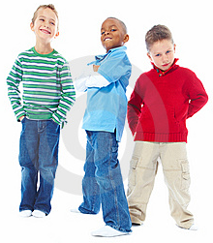
Who is the youngest of them all?
Boolean Logic
Three kids are talking about their ages.
Adam: “If Chris is not the youngest, then I am.”
Brian: “If I am not the youngest, then Adam is the oldest.”
Who is the youngest of them all?

Slide 36
Who is the youngest of them all?
Boolean Logic
A, B, C stand for Adam, Brian and Chris respectively.
X_{o} means X is the oldest; X_{y} means X is the youngest.
“If Chris is not the youngest, then Adam is.”
➔ C_{y} + A_{y} = 1
“If Brian is not the youngest, then Adam is the oldest.”
➔ B_{y} + A_{o} = 1

Slide 37
Who is the youngest of them all?
Boolean Logic
(C_{y} + A_{y} )(B_{y} + A_{o}) = 1
➔ C_{y} B_{y} + C_{y} A_{o} + A_{y} B_{y} + A_{y} A_{o} = 1
Since C_{y} B_{y} = A_{y} B_{y} = A_{y} A_{o} = 0, C_{y} A_{o} = 1.
Answer: Chris is the youngest; Adam is the oldest.

Slide 38
Who will be hired?
Boolean Logic
After interviewing 3 candidates, the manager told HR:
“We need more than one person this time. If we hire Adam or Brian and don’t hire Chris, then we want Adam, and we will hire Chris if we hire Brian. Otherwise, we will do the opposite.”
Can you help HR to figure out
whom the manager wants to hire?

Slide 39
Who will be hired?
Boolean Logic
“We need more than one person this time.
If we hire Adam or Brian and don’t hire Chris,
then we want Adam, and we will hire Chris if we hire Brian.
Otherwise, we will do the opposite.”
A = hire Adam, B = hire Brian, C = hire Chris.

Slide 40
Who will be hired?
Boolean Logic
“We need more than one person this time. ”
➔
➔
Answer: The manager wants to hire Brian and Chris.

Slide 41
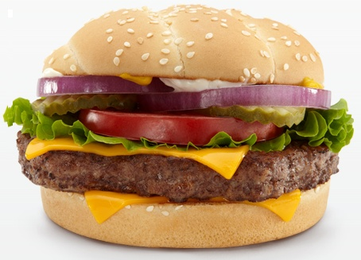
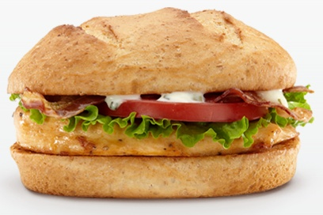
McDonald’s Addicts
Boolean Logic
Adam, Brian and Chris go to McDonald’s for lunch every day. They eat only beef burgers or chicken sandwiches.

Slide 42
McDonald’s Addicts
Boolean Logic
If Adam buys beef burgers, Brian will definitely buy chicken sandwiches.
Either Adam or Chris will have beef burgers.
Neither Brian nor Chris eats chicken sandwiches.
Who had a beef burger yesterday and
a chicken sandwich today?

Slide 43
McDonald’s Addicts
Boolean Logic
A, B, C stand for Adam, Brian and Chris respectively.
X_{b} means X had beef; X_{c} means X had chicken.
If Adam buys beef burgers, Brian will definitely buy chicken sandwiches.
Either Adam or Chris will have beef burgers.
Neither Brian nor Chris eats chicken sandwiches.
They eat only beef burgers or chicken sandwiches.

Slide 44
McDonald’s Addicts
Boolean Logic
Adam only eats chicken sandwich, and Chris only eats beef burger.
Answer: Brian had beef burger yesterday and
chicken sandwiches today.

Slide 45
What have we learned?
Discrete Math is a powerful tool to solve logic puzzles.
Matching
Perfect Matching
3-Matching
Boolean Logic
Discrete Math is fundamental to computer science.
Discrete Math can also be fun!

Slide 46
What have we learned?
Discrete Math is a powerful tool to solve logic puzzles.
Matching Polynomial-time solvable!
Perfect Matching Polynomial-time solvable!
3-Matching NP-complete!
Satisfiability (Boolean Logic) NP-complete!
Computational Complexity is in the foundation of computer science.
Computational Complexity is can also be fun!

