Slide 1
Embedded Programming and Robotics
Lesson 1
Basic Electricity and Electronics
Transistor Basics

Slide 2
Basic Electricity
Ohm’s Law
Voltage
Current
Resistance
Using a Multi-meter
Breadboarding

Slide 3
Ohm’s Law

Slide 4
Electrical Properties

Slide 5
Current
Current, measured in Amperes (or Amps) is technically the number of electrons flowing past a certain point in a circuit in one second
Most electronic circuits are relatively low-current
You can visualize this as water flowing out of a hose. If you have a large hose, you can get more water than from a small one, even if the water pressure isn’t very high.

Slide 6
Voltage
Voltage is technically the difference in potential between two parts of a circuit
Usually, this is measured between some source of electricity, such as the positive terminal of a battery, and ground
You can visualize this as the pressure behind the water coming out of a hose. The more pressure, the faster the flow for the same amount of water.

Slide 7
Resistance
Resistance, measured in ohms and symbolized by omega (Ω) causes less energy to flow through a circuit
Again using the water analogy, a small pipe causes higher resistance while a large one causes lower resistance
Thus for high-current circuits we need to use large-diameter wire, while for most electronic circuits, thin wire will suffice

Slide 8
Continuity – Is it a Circuit?
A basic problem you can encounter in working with electricity is disconnection
Current cannot flow if there is no electrical connection
You can use a multimeter to test this

Slide 9
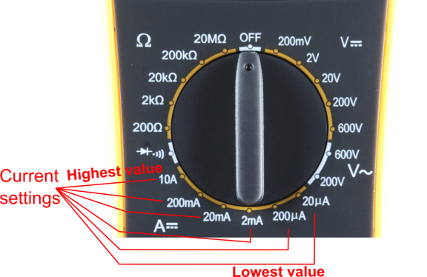
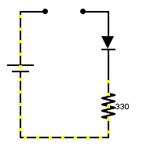
Measuring Current
In order to measure current, you must break the circuit or insert the meter in-line (series).

Slide 10
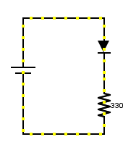
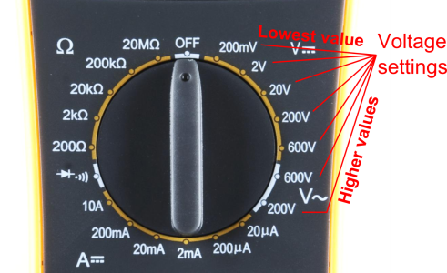
Measuring Voltage
Voltage is measured between two points in a circuit – across a device.

Slide 11
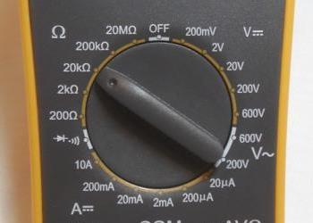
Measuring Resistance
Components should be removed entirely from the circuit to measure resistance. Note the settings on the multi-meter. Make sure that you are set for the appropriate range.
Resistance
settings

Slide 12
The Multimeter
This device, as you have seen in the illustrations can measure:
Voltage
Amperage (current)
Resistance
And continuity (circuit open or closed)
Generally the red probe is connected to the source of current and the black to ground

Slide 13
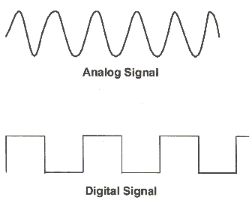
Analog vs. Digital
Microcontrollers are digital devices – ON or OFF, 1 or 0
Analog signals are anything that can be a full range of values. What are some examples? More on this later…
5 V
5 V
0 V
0 V

Slide 14
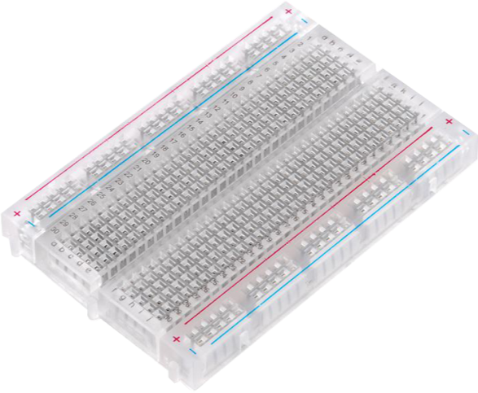
The Breadboard
One of the most useful tools in an engineer’s or Maker’s toolkit. The four most important things:
A breadboard is easier than soldering
You can change your circuit easily
A lot of those little holes are connected, which ones?
Sometimes breadboards break

Slide 15
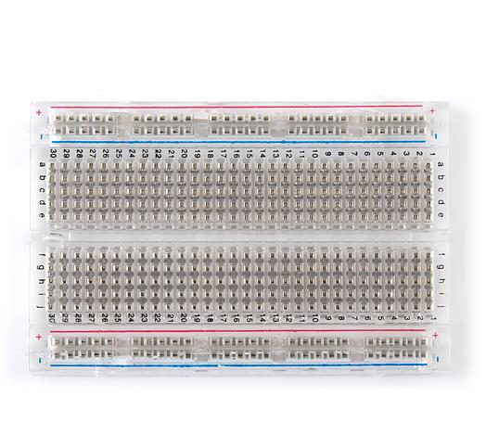
Solderless Breadboard
Each row (horizontal) of 5 holes are connected. That is, abcde are connected and fghij are connected
Vertical columns on the outside–called power bus–are connected vertically

Slide 16
Simple Circuit
Note that we’re just using the +5-volt and ground pins.
Use a 330 Ohm resistor (orange, orange, brown)
The longer leg of the LED is positive and the shorter one is negative

Slide 17
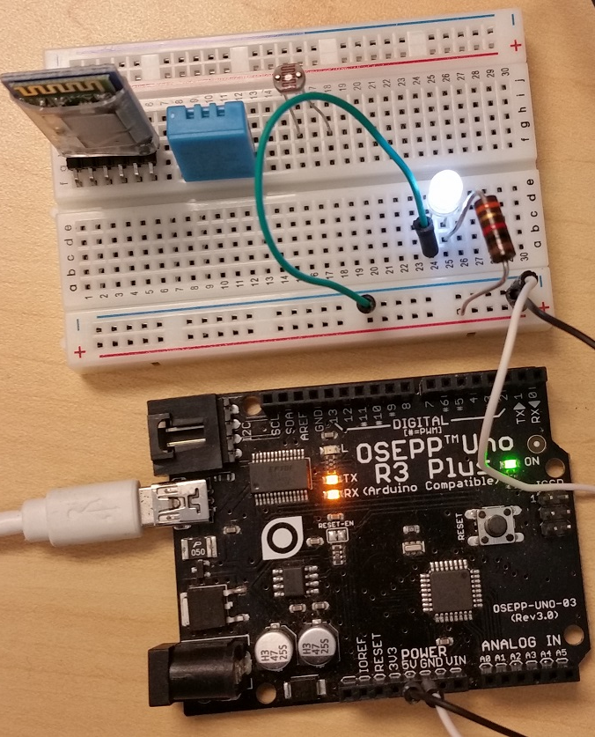
Let’s Build It
Jumper from the +5 of the Arduino to the + rail of the breadboard
Jumper from the Ground of the Arduino to the – (minus) rail of the breadboard
Connect the resistor from the + to A2 on the breadboard
Connect the LED from B2 to - (minus) on the breadboard

Slide 18
Let’s Build It
Connect the Arduino to a power supply
The LED lights up
If the LED seems too bright, use a larger value resistor, say 470 Ohms

Slide 19
Experiment: Measure Voltage
Set the multimeter on DC voltage
Touch the resistor lead with the red probe
Touch the jumper that goes to ground with the black probe. You may have to lift it a little to do this
The multimeter should read nearly exactly 5 volts

Slide 20
Experiment: Measure Current
Break the circuit by removing the jumper that comes from the LED from the ground (-) rail
Insert another jumper into the ground rail
Adjust the multimeter to measure Amperes. You may have to move the red probe to a different connector.
Reading should be about 2 milliamps
Current draw can be a big problem in embedded systems

Slide 21
Experiment: Check Resistor Value
Remove the 330-ohm resistor from the board
Set the multimeter to measure resistance in the proper range
Touch one probe of the multimeter to each resistor lead
The resistance should be pretty close to 330

Slide 22
Transistor Basics
Signals from the Arduino and Raspberry Pi boards are very weak
Although they are 3.2 or 5 volts, they carry so very little current
Thus although they can light an LED, they cannot do much more
Amplification is needed

Slide 23
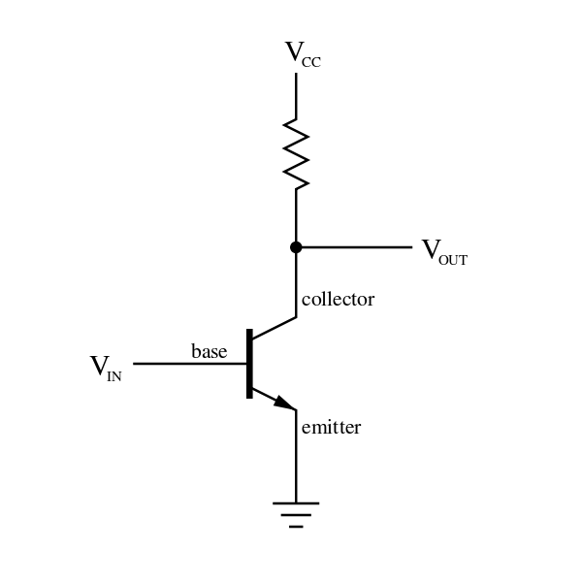
Transistor Basics
Transistors have three pins:
Emitter: usually connected to ground
Collector: connected to a voltage source through a resistor, between +5 and +20 VDC
Base: Connected to the pin whose signal we want to amplify

Slide 24
Transistor Basics
In the diagram on the previous page, the V_{out} is connected to the device that now receives the higher current
This can be used to switch relays on and off, for example, or to run motors
Some of the parts we will use, such as the LM293D motor driver, already have transistors

Slide 25
Voltage Regulators
The Arduino itself will run on a wide range of voltages
This is not true of some of the parts we’ll use, so in some cases we may need a voltage regulator
This takes as input a range of voltages, usually from 5 to 30 VDC and outputs a precise voltage, such as 5 or 12 VDC

Slide 26
Precautions
The voltages and current we’re working with will generally be so low that you cannot hurt yourself
When we work with solid-state relays that can turn a lamp on and off, you’ll have to be careful with the 110-volt AC current
The biggest danger is static electricity
Static can damage parts, sometimes in ways that the damage is not immediately noticeable
Ground yourself before handling parts

Slide 27
References
Resistor color code site: http://www.digikey.com/en/resources/conversion-calculators/conversion-calculator-resistor-color-code-4-band
Transistor Circuit diagram: http://commons.wikimedia.org/wiki/File:Transistor_Simple_Circuit_Diagram_with_NPN_Labels.svg

