Slide 1
Embedded Programming and Robotics
Lesson 3
The Arduino Board

Slide 2
The Arduino
This board is an open-source project designed to teach digital electronics
That is, anyone can build an Arduino board
It was designed in Ivrea, Italy in 2005 by Massimo Banzi & David Cuartielles
Uses an Atmel processor

Slide 3
Types of Arduino
Uno – The most common, cheapest board, suitable for most applications.
12 digital I/O pins (some of this handle PWM, discussed later)
6 analog inputs
3.3V power
5V power
Ground
This is what we’ll use

Slide 4
Types of Arduino
Mega – Much more powerful
Faster processor
More memory
More I/O pins
Takes more power to run
More expensive
Less suitable for what we’re doing, since size and power are important for a robot

Slide 5
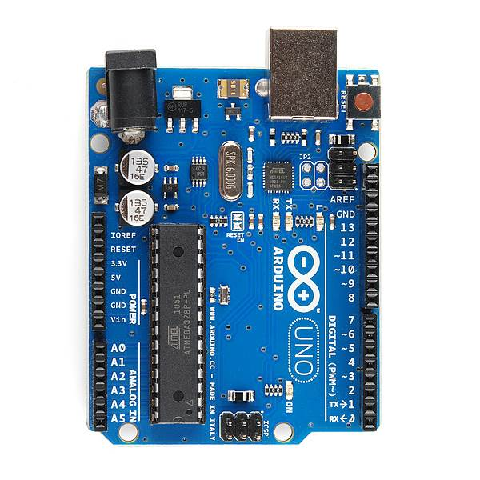
PWR IN
USB
(to Computer)
RESET
SCL\SDA
(I2C Bus)
POWER
5V / 3.3V / GND
Digital I\O
PWM(3, 5, 6, 9, 10, 11)
Analog INPUTS

Slide 6
Notes on Arduino
The USB connector can supply power, or you can use an external source, which we will use for the robot. The board has a voltage regulator.
The reset button will restart the current program
Programs don’t go away when you turn the power off

Slide 7
Arduino Shields
This is a term you’ll see in most things that talk about this board
It means a board that plugs into the I/O pins and covers the Arduino
You can (usually) stack multiple shields
We won’t be using shields in this workshop; we’ll go straight to the hardware

Slide 8
Using the Breadboard
All devices will be mounted on the breadboard, not connected directly to the Arduino
This will allow you to change things easily as we add new devices to your robot

Slide 9
Using the Breadboard
Connect the “rails” on the breadboard:
+5 from the Arduino to + on the breadboard, using a male-to-male jumper
Ground from the Arduino to – on the breadboard
When you add a device, plug it into the breadboard
Run control signals from the Arduino to the appropriate holes on the breadboard

Slide 10
Blinking an LED
We built a circuit to turn on an LED
Now let’s put it under computer control
Basic methodology:
Turn LED on
Wait
Turn LED off
Wait
Go back to step 1

Slide 11
Blinking an LED – Hardware Setup
Connect the LED as shown in the photo below. Note that the 330Ω resistor is in series with pin 2 and the long pin of the LED
This is to limit the current and prevent the LED from burning out
The short pin of the LED is connected to ground

Slide 12
Writing the Code
Decide which pin you’ll attach the LED to; I suggest pin 2, on the lower right in the diagram
Initialize the pin for output
In the loop:
Set the pin high
Wait 1 second (1000 milliseconds)
Set the pin low
Wait 1 second
Repeat
Notes:
// Blink a single LED on Pin 52 of the Mega board.
const int LEDPin =52;
// Initialize the LED pin for output
void setup() {
pinMode(LEDPin, OUTPUT);
}
// Loop, turning the LED on, then waiting a second, then off,
void loop() {
digitalWrite(LEDPin, HIGH);
delay(1000);
digitalWrite(LEDPin, LOW);
delay(1000);
}

Slide 13
Running the Program
Connect the Arduino to your PC with the USB cable
Wait until the PC acknowledges that it’s connected
Click the right arrow button to upload
The LED should blink, one second on, one second off
This One

Slide 14
What’s Going On?
The program will run as long as the board has power
Disconnect the USB cable from the computer
The LED goes dark
Reconnect the USB cable
The program starts running
The program is stored in non-volatile memory
Only the variables are in volatile memory

Slide 15
Blinking Two LEDs
You can use another pin to blink a second LED
You’ll need another 330-Ohm resistor
Write the code to blink the first LED for a second, turn it off for a second, then blink the second one for a second, and turn it off for a second

Slide 16
Writing a Function
You can write a function to blink any LED
Take the code you wrote for blinking a specific LED and make the pin number a parameter
Good coding practice, as you have seen, uses constants rather than literals for the numbers
Notes:
// Blink a two LEDs on Pins 52 and 51 of the Mega board.
void blinkLED(int led);
const int LEDPIN1 = 52;
const int LEDPIN2 = 51;
// Initialize the LED pin for output
void setup() {
pinMode(LEDPin, OUTPUT);
}
// Loop, turning the LED on, then waiting a second, then off,
void loop() {
blinkLED(LEDPIN1);
blinkLED(LEDPIN1);
}
void blinkLED(int led)
{
digitalWrite(led, HIGH);
delay(1000);
digitalWrite(led, LOW);
delay(1000);
}

Slide 17
Digital Sensors – Overview
Many sensors are, in effect, switches, in that they are either on or off: motion was detected or not, the door is open or closed, etc.
We’ll talk about analog sensors later

Slide 18
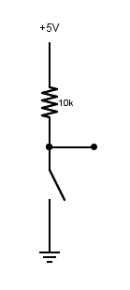
Basic Digital Sensor Circuit
Note that the Arduino pin is not in series with +5, the switch, and ground
When the switch is closed, a small amount of current flows from +5 to ground and also to the input pin 2, which is also a ground
How much current? By Ohm’s Law, I=V/R, 5/10000 = .0005 amperes
to Digital Pin 2
Notes:
I have such a circuit to determine whether my garage door is open or closed

Slide 19
Delayed Reaction
Normally, you flip a switch and something happens immediately
When the light (output) is isolated from the input (switch), you can do interesting things
Modify the program to wait for two seconds after the switch is pressed to turn off the light (this might give you time to leave the room, for example)

Slide 20
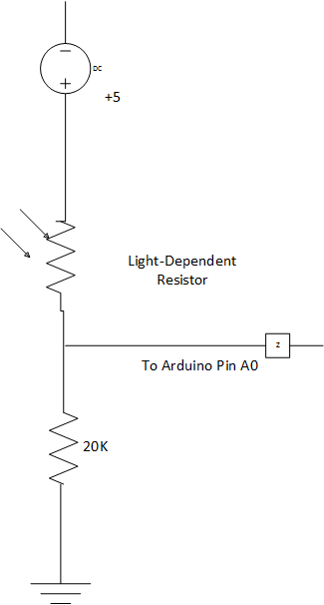
Analog Input
We can read a light sensor, which allows more voltage to flow with more light and less when it’s dark
Write a program that causes the LED to shine more brightly when the values from the LDR are lower, and less when they’re higher
We’ll cover this in detail later
Notes:
// Cause the LED to be brighter if there is less light, dimmer if
// there is more. This uses PWM for the output side.
const int LEDPIN = 2;
const int SWITCHPIN = 49;
const int SENSORPIN = A0;
int ledValue;
int sw = LOW;
// Initialize the LED pin for output
void setup() {
pinMode(LEDPIN, OUTPUT);
pinMode(SWITCHPIN, INPUT);
pinMode(SENSORPIN, INPUT);
Serial.begin(9600);
}
// Loop, turning the LED on, then waiting a second, then off,
void loop() {
sw = analogRead(SENSORPIN);
ledValue = 0;
if (sw > 750)
{
ledValue = 256;
}
else
{
ledValue = sw / 3;
}
Serial.println(ledValue);
analogWrite(LEDPIN, ledValue);
delay(10);
}

Slide 21
Analog Input
With the 18K resistor, light values range from about 800 in bright light to 10 or so in near-complete darkness.
Write a program that causes the LED to shine more brightly when the values from the LDR are lower, and less when they’re higher
Remember that you can use the serial monitor to see the values

