Slide 1
Embedded Programming and Robotics
Lesson 5
Motor Control

Slide 2
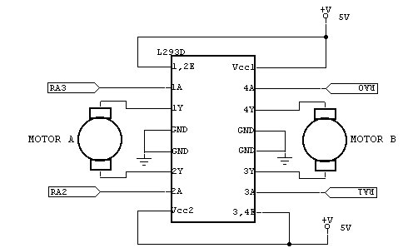
The L293D Motor Control Chip
This chip has four inputs and can control two motors
It is self-contained; you don’t need any external components

Slide 3
The L293D Motor Control Chip
You might think that you should just power the motors directly through the Arduino
Don’t do this!
The Arduino can supply only a very limited amount of current, considerably less than the motors require
The L293D provides both digital to analog conversion and power amplification

Slide 4
The L293D Motor Control Chip
The four pins on the ends of the chip take +5V
Use the rechargeable power pack connected to the +5 on the power pack
DO NOT use the rails on the breadboard for power or ground
Insert the positive lead into the same row as pin V_{CC}1
Jumper from pin V_{CC}1 to 1,2E
Jumper from 1,2E to V_{CC}2
Jumper from V_{CC}2 to 3,4E

Slide 5
Connect the Grounds
Insert the ground lead into any of the ground rows on the chip
Jumper to the other three grounds

Slide 6
Connect the Motors
Plug one wire from the left motor into 1Y and the other into 2Y
Plug one wire from the right motor into 3Y and the other into 4Y
Don’t worry if you have them right; we’re going to test them
The wires that come with the kit are not long enough to reach the prototype board. Do not use them. Cut pieces of wire long enough, or solder an additional 6 cm (2.5 inches) onto the end.
If your motors stop working, check continuity, then current

Slide 7
Connect the Arduino
I used Arduino pins 5 and 6 for the left motor and pins 3 and 9 for the right
Use the same pins so we can all exchange programs

Slide 8
Motor Control
The four inputs (RA0 through RA3) are from Arduino pins that allow PWM (Pulse-Width Modulation) output
These have the # symbol next to them on the board
The difference between the two voltages determines motor speed and direction
Use the analogWrite function to write these values

Slide 9
Motor Control
To make the robot go forward at full speed, write 255 to RA0 and RA3 and zero to RA1 and RA2
To make the robot go in a circle, write 255 to RA0 and zero to the other three pins
Try smaller values, like 10 and 30 and 100

Slide 10
Motor Control
Warning: motors do not all run at the same speed
If writing 255 to each motor does not make your robot go in a straight line, you might need to adjust in software to compensate for this difference.

Slide 11
First Motor Control Program
Write a program to make the robot go forward for 10 seconds, then stop.
If it does not go in a straight line, change the values going to the motors until it does.

