Slide 1
Embedded Programming and Robotics
Lesson 10
Ultrasonic Range Finder

Slide 2
The Range Finder
This analog sensor operates at short distances, giving you distance from an object
It sends out a pulse of high-frequency sound, then measures the time it takes to come back, much as bats do
The minimum range is about 2 CM, and the maximum is about 2 meters

Slide 3
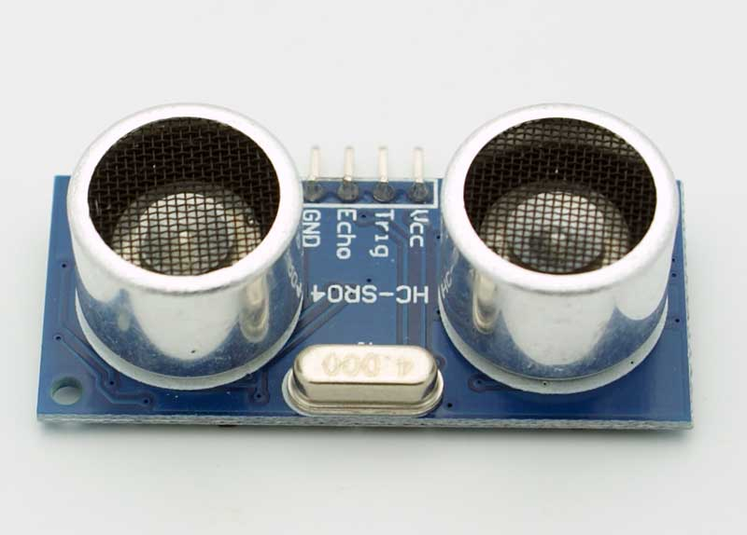
The Range Finder
Pins: V_{cc} and ground
Trig causes the rangefinder to send out a sound
Reading Echo gives you the time it took for the sound to return, and thus distance

Slide 4
The Range Finder
Define the two pins used by the device:
const int TRIGPIN = 7;
const int ECHOPIN = 8;

Slide 5
The Range Finder
Getting the distance:
long duration, distance;
digitalWrite(TRIGPIN, LOW);
delayMicroseconds(2);
digitalWrite(TRIGPIN, HIGH);
delayMicroseconds(10);
digitalWrite(TRIGPIN, LOW);
duration = pulseIn(ECHOPIN, HIGH);
distance = (duration/2) / 29.1;

Slide 6
The pulseIn Function
pulseIn(pin, value) pulseIn(pin, value, timeout)
Reads a pulse (either HIGH or LOW) on a pin
For example, if value is HIGH, pulseIn() waits for the pin to go HIGH, starts timing, then waits for the pin to go LOW and stops timing.
Returns the length of the pulse in microseconds.
Gives up and returns 0 if no pulse starts within a specified timeout.

Slide 7
“Follow-Me” Program
Write a program that will follow you at a distance of about a meter
If the robot gets closer than that, it should slow down
If it gets further than that, it should speed up
It should get no closer than 20 CM. Stop if it is closer and wait.
You can make it slowly turn until it finds something to follow
This program is not directional, since the sensor can only tell distance

