Slide 1
Embedded Programming and Robotics
Lesson 12
Introducing the Raspberry Pi

Slide 2
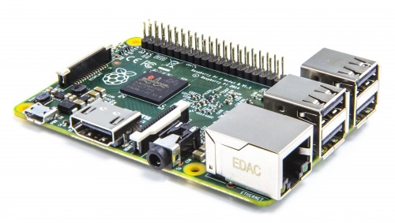
Raspberry Pi B Model 2

Slide 3
The Raspberry Pi
This tiny board, like the Arduino, is open-source hardware
It more expensive, at $30 to $35 for the board alone, versus $6 to $10 for the Arduino
It requires a MicroSD card as a disk drive, which can be had for as little as $6
Takes more electrical power than the Arduino

Slide 4
The Raspberry Pi
Advantages:
You can program the Pi from itself, without an external computer
Built-in wired Ethernet
1GB of main memory (B+)
40 GPIO pins
Camera connector

Slide 5
The Raspberry Pi
Runs Linux
You can download a disk image to burn onto a MicroSD card here, if you have not already done so: https://www.raspberrypi.org/downloads/
Get the Raspian Wheezy disk image
Get the disk image writer here: http://sourceforge.net/projects/win32diskimager/

Slide 6
Installing Linux
If you haven’t done this already, use the disk imager to burn the Linux image onto the MicroSD card
Insert the SD card into the slot under the board on the back edge away from the USB ports

Slide 7
Connecting It Up
Connect a mouse and keyboard to two USB ports
Connect the monitor to the HDMI port
Connect your cell-phone charger to the micro USB port
Connect the Ethernet cable if we have wired Ethernet available
The Pi should boot Linux
If not, make sure the SD card is seated properly and that the monitor is set for HDMI
The default user name is Pi and the password is raspberry

Slide 8
Configuring Linux
If the Pi has come up in the graphical shell, double-click on LXTerminal
At the prompt, type sudo raspi-config
The first option is to expand the file system. Do this.
Option 3 determines whether you boot into the command line or the graphical shell. If you didn’t get the shell, change it so you do.
Enable the camera; we’ll need it later
Reboot

Slide 9
Configuring Linux
Bring up raspi-config again
Go to the option on internationalization
Choose a US-style keyboard. If you don’t, the quotation marks on your keyboard are interchanged with the @ sign, and it can get confusing, especially if you touch-type
Reboot again

Slide 10
Upgrade and Update Linux
sudo apt-get upgrade
sudo apt-get update

Slide 11
Networking
Determine your IP address:
ifconfig
You may need this for connecting through remote desktop
If no IP address shows, troubleshoot your network connection

Slide 12
Remote Desktop
Install tightVNC. At the linux command prompt, type:
sudo apt-get install tightvncserver
Once it is installed, type:
sudo vncserver :1
On your laptop computer, download the tightVNC viewer from:
http://www.tightvnc.com/download.php
Notes:
While we do have monitors for the Pi, using remote desktop lets several people program at once.

Slide 13
Remote Desktop
Use the ifconfig command to determine your Pi’s IP address
Bring up the tightVNC Viewer on your PC
Enter the IP address followed by port 5901, something like this:
192.168.0.5:5901
You should get a Raspberry Pi desktop

Slide 14
GPIO Pins
Unlike the Arduino, the Pi’s GPIO pins are 3.2V, not 5V
You can still control a motor with them but it takes more code or extra chips
We’ll discuss how to control these from Python later

Slide 15
Camera
There is a special connector just behind the Ethernet connector for a camera
You must be very careful inserting the end of the cable; you can break the wires all too easily
Don’t do this yet

Slide 16
WiFi
To be really useful on a robot, you should not have to tether the Pi with a network cable
You have USB WiFi modules which we will discuss later

