Slide 1
Embedded Programming and Robotics
Lesson 2
C Programming Refresher

Slide 2
Arduino Software
At least one member of your team should have already downloaded the Arduino software onto your laptop
If not, go to http://www.arduino.cc/en/Main/Software and download the appropriate version

Slide 3
Connecting the Arduino
The Arduino connects to your laptop through USB, which can also supply power
Once connected, you can upload programs to it

Slide 4
Arduino C Datatypes
byte or char – 8 bits
int and unsigned int – 16 bits
long, unsigned long, double, and float – 32 bits
Boolean variables can be either true or false, but occupy one byte

Slide 5
Variable Declaration
Just like C/C++ (since it is)
int x;
float voltage = 5.0;
bool bContinue = true;
const int LEDPIN = 7;

Slide 6
Using Constants
Many programmers use #define for this:
#define LEDPIN 7
Better practice is to use const:
const int LEDPIN = 7;
Using constants lets you change your code easily should you decided to move things to different pins, for example
Constants are, by convention, in upper case

Slide 7
Statements and Operators
A statement is the fundamental unit of a program
Assignment statements give a value to a variable
Arithmetic operators are +, -, *, /, % (moduls) and ++, --
Relational operators are >, <, ==, >=, <=, and !=
Logical operators are &&, || and !(not)
Bitwise operators: &, |, ^(xor), ~(negation), <<(shift left), >>(shift right)

Slide 8
Comments
C allows two styles of comments
// This is a comment. The rest of the line is ignored
/* this is a comment up to the */
You can use the first kind for block comments and at the end of a line

Slide 9
Comments
You can even use the second kind within a statement:
void someFunction(int input, /*value in range 0-4 */ int modifier);
Use lots of descriptive comments in your programs

Slide 10
Comments
Programs you write for this workshop should have, at a minimum:
A block of comments at the beginning of the program with your team number, the names of team members, the date you started the program, and a short description of what it does
Comments above each function describing what it does
Comments at the start of loops describing what they do

Slide 11
Conditionals – if statement
The if statement executes the next statement or block of statements if the condition in the parentheses is true, and does not execute it if the statement is false:
int x = 5;
if (x > 4)
{
Serial.println(“This will get printed”);
}

Slide 12
Conditionals – if/else statement
The if/else statements allow you to execute one piece of code if the condition is true and another if it is false:
int x = 5;
if (x > 4)
{
Serial.println(“The statement was true”);
}
else
{
Serial.println(“The statement was false”);
}

Slide 13
Conditionals – switch/case statements
This allows you to select a group of statements to execute based upon the value of a variable
switch(expression)
{
case 1:
break;
case 2:
break;
default:
break;
}

Slide 14
Looping – while loop
You can loop while a condition is true
The loop exits when it becomes false
int x=0;
while (x < 10)
{
Serial.println(x);
x++; // Don’t forget this!
}

Slide 15
Looping – do-while loop
This is a post-test loop. It will always get executed at least once:
int x = 10;
do
{
Serial.println(“This is always executed once.”);
} while (x < 10);

Slide 16
Looping – for loop
If you want to iterate for a specific number of times, use this
It is also a pre-test loop, meaning the body may never get executed
for (int ix=0; ix<10; ix++)
{
Serial.println(ix);
}

Slide 17
Functions
You can create your own functions that do things and return values
You need to either define the function before you call it, or you can declare it at the top of the program.
int getSpeed(int); // This declares the function

Slide 18
Six Basic Arduino Concepts
digitalWrite()
analogWrite()
digitalRead()
digitalWrite()
Pulse Width Modulation (PWM)
Serial Communication

Slide 19
Arduino Programs
Arduino programs are called sketches, and your collection of programs is called your sketchbook
When you open Arduino Studio, you get a basic sketch that looks like this:
void setup() {
// put your setup code here, to run once:
}
void loop() {
// put your main code here, to run repeatedly:
}

Slide 20
Arduino Programs
And that’s it
Embedded programs are meant to run forever, so there is no exit from the “loop” function

Slide 21
Digital I/O
The pinMode function sets a pin for either input or output
pinMode(LEDPIN, OUTPUT);
Change the state of the pin:
digitalWrite(LEDPIN, HIGH);
Note that HIGH, LOW, INPUT, and OUTPUT are in all caps because they are constants built into the Arduino development system
LEDPIN is a constant you define, and should also be in all caps

Slide 22
Digital I/O
You can also read the value from a pin:
pinMode(SWITCHPIN, INPUT);
Read the state of the pin:
int switchState = digitalRead(SWITCHPIN);
Since this is a digital pin, you’ll get a value of 1 or 0

Slide 23
Analog I/O
The Arduino Uno has a 6-channel analog-to-digital converter and six analog input pins
This means that it will map input voltages between 0 and 5 volts into integer values between 0 and 1023
This yields a resolution between readings of: 5 volts / 1024 units or, .0049 volts (4.9 mV) per unit.
The input range and resolution can be changed using analogReference().

Slide 24
Pulse Width Modulation (PWM)
A few pins on the Arduino allow for us to modify the output to mimic an analog signal
This is done by a technique called Pulse Width Modulation (PWM)

Slide 25
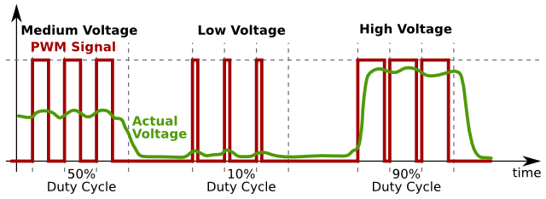
Pulse Width Modulation (PWM)
By varying the duty cycle, we can mimic an “average” analog voltage

Slide 26
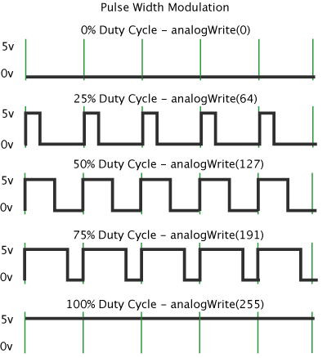
Writing Analog Values
analogWrite(pin, val);
pin – refers to the OUTPUT pin (limited to pins 3, 5, 6, 9, 10, 11.) – denoted by a # symbol
val – 8 bit value (0 – 255).
0 => 0V | 255 => 5V

Slide 27
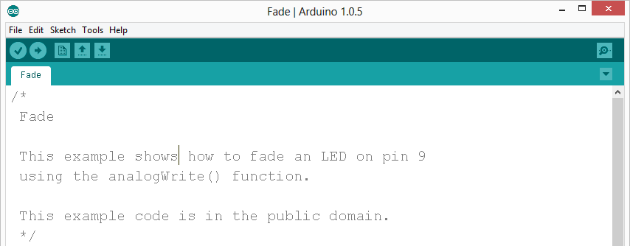
Writing Analog Values: Fade
Move the LED jumper to pin 9
In Arduino, open up:
File → Examples → 01.Basics → Fade

Slide 28
Writing Analog Values: Fade
Challenge – Change the rate of the fading in and out. There are at least two different ways to do this – can you figure them out?

Slide 29
Serial Communication
Method used to transfer data between two devices
Called serial because only one bit is transferred at a time
Arduino dedicates Digital I/O pin # 0 to receiving and Digital I/O pin #1 to transmit.

Slide 30
Serial Communication
You can output to the serial port from within your program
That’s the Serial.println() function I have been using
You can monitor this from your computer for debugging once the program is running:
Go to Tools->Serial Monitor and you’ll get a window showing all serial output

Slide 31
Arduino Programming Reference
Main programming reference page:
http://www.arduino.cc/en/Reference/HomePage

