Slide 1
Embedded Programming and Robotics
Lesson 4
Sensors

Slide 2
Digital Sensors
As we discussed before, many sensors are digital: on or off
This includes things like switches, motion sensors, etc.
Passive sensors, ones that don’t take power, or usually wired up the way you were shown in Lesson 3
Active sensors, such as motion detection, are wired as shown on the next slide. It’s called passive IR because it doesn’t emit anything, just detects it.

Slide 3
Motion Sensor
Connect jumpers to the three pins of the PIR (Passive Infrared) motion sensor
Connect the vcc pin to the +5 on the prototype board
Connect gnd to ground on the prototype board
Connect out to pin 3 of your Arduino

Slide 4
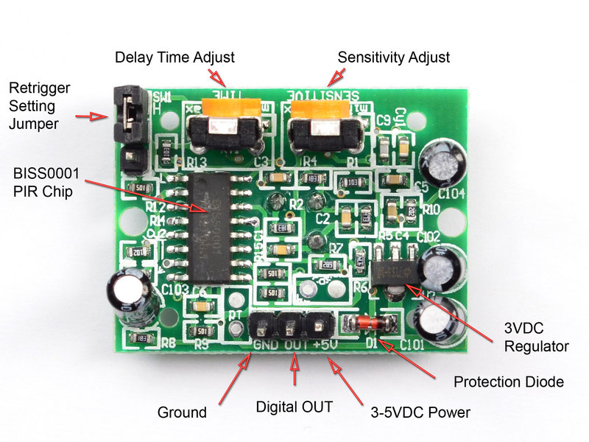
Motion Sensor
Back of the IR motion sensor
The middle pin, Digital Out, connect to an Arduino digital input pin

Slide 5
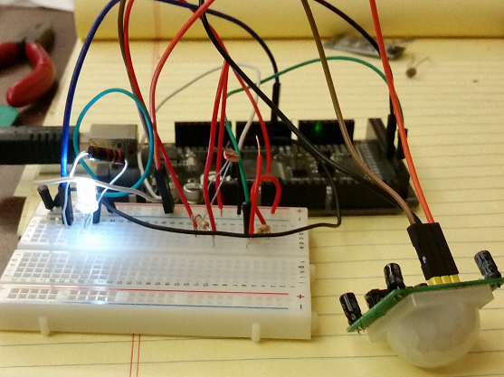
Motion Sensor
Write code to read the sensor:
If the sensor reads 1, write HIGH to the LED pin
If it reads 0, write LOW to the LED pin

Slide 6
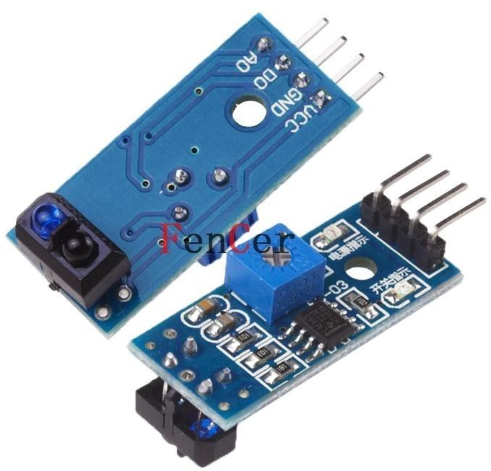
Infrared Reflective Sensor
TCRT5000 Infrared Reflective Photoelectric Sensor used to detect lines
Can be used to make your robot follow a specific path
Used in the edge-follower robot

Slide 7
Infrared Reflective Sensor
Connect vcc and gnd to +5 and ground, respectively
Connect A0 on the TCRT5000 to an analog input pin on the Arduino
Use analogRead to read from the sensor.
The larger the number, the further away

Slide 8
Edge-Follower Program

