Slide 1
Embedded Programming and Robotics
Lesson 6
Mechanical Assembly

Slide 2
Robot Assembly
We’re finally ready to put together the basic robot chassis, motors, and boards
Please follow along, and don’t get ahead of me

Slide 3
Robot Assembly
The chassis and motors are easy to assemble even though the instructions are in Chinese
You’ll need four pieces of wire about 20cm long with about 8mm of the insulation stripped from each end
Use different colors
Carefully solder the wires to the motor leads
The motor leads are fragile

Slide 4
Motor Wiring
Test the motor: Connect one lead to +5 and the other to ground on a battery, or on your Arduino board
Do not connect to 9v
The motor should spin

Slide 5
Robot Assembly
Attach the motor mount (metal block) to the motor with two screws
Attach the motor mount to the chassis with two screws
Attach the wheel to the motor
Attach the caster (small nylon wheel) to the front of the chassis

Slide 6
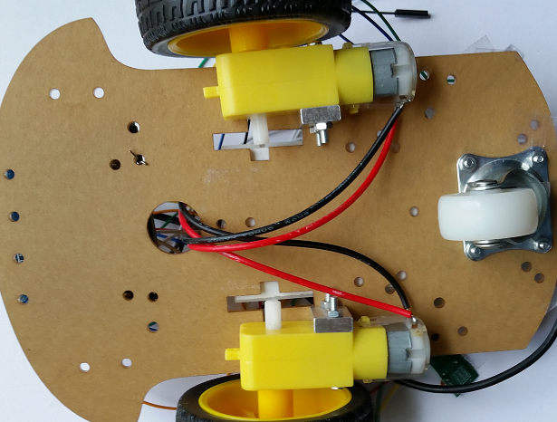
Robot Assembly
Run the motor wires through the large hole in the chassis, as shown

Slide 7
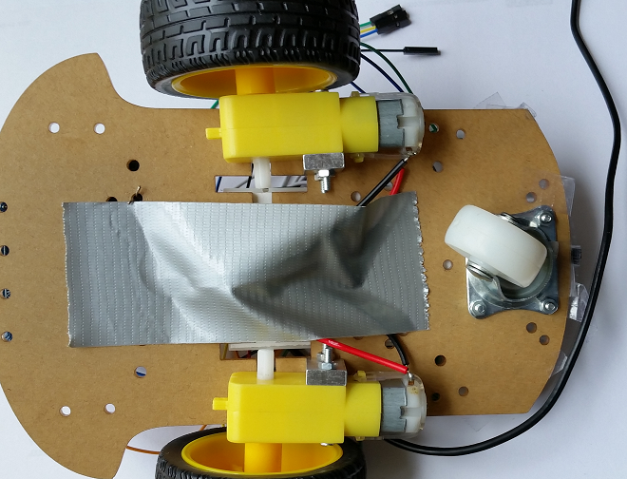
Robot Assembly
Use a piece of tape to keep the wires in place
Remember, the motor leads are fragile

Slide 8
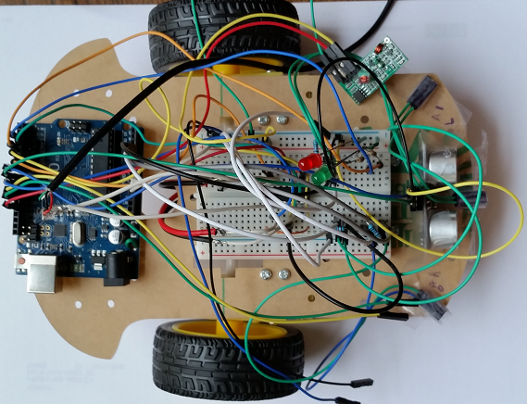
Robot Assembly
Use small pieces of wire to attach the Arduino board to the back of the chassis, as shown

Slide 9
Robot Assembly
Mount the prototype board between the wheels, but NOT as shown; turn it 90 degrees
This will be better for leaving room for batteries and sensors
Do NOT peel the sticky backing off the prototype board
Attach it using a small piece of double-sided tape

Slide 10
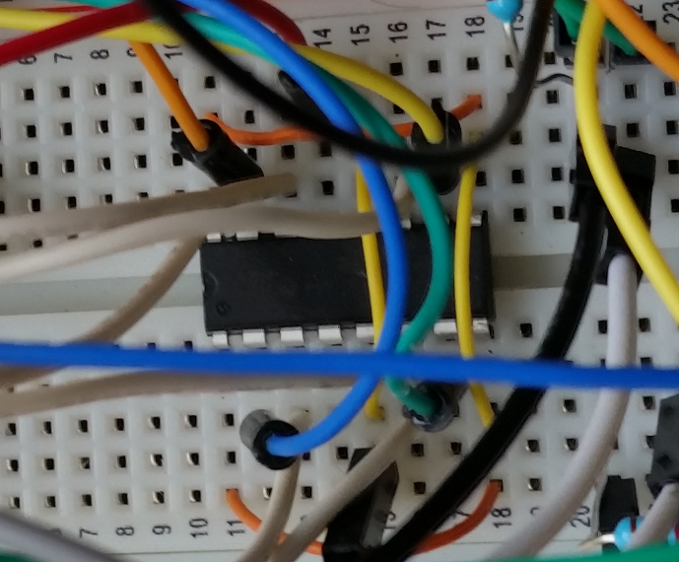
Wiring the Motor
Mount the L293D chip in the center of the prototype board
Make sure the semicircular cut-out in the chip faces the rear of the chassis
Put the front pins into row 11
Notes:
No special reason for 11; it is just convenient

Slide 11
Power
We’ll use two different power sources
The Arduino will be powered using 9V batteries
The motors will be powered from a 5V cell-phone external battery pack
The motors draw quite a bit of current and will wear out 9V batteries very quickly
This also makes the voltage regulator unnecessary for this configuration (but we’ll need it later)

Slide 12
Motor Control
The next sequence shows how to connect the L293D chip to the motors and the Arduino

