Slide 1
Embedded Programming and Robotics
Lesson 7
Bluetooth Communication

Slide 2
About Bluetooth
Bluetooth is a low-power, short-range communication protocol
It typically has a range of up to 10 meters (about 32 feet)
It is used in devices such as wireless keyboards and mice, remote controls, etc.
For further detail, see the Web site http://www.bluetooth.com
Reference for Bluetooth on the Arduino:
http://www.arduino.cc/en/Reference/SoftwareSerial

Slide 3
About Bluetooth
We can build a controller from another computer to remote-control your robot
This can be done with the Raspberry Pi, another Arduino board, or your smartphone

Slide 4
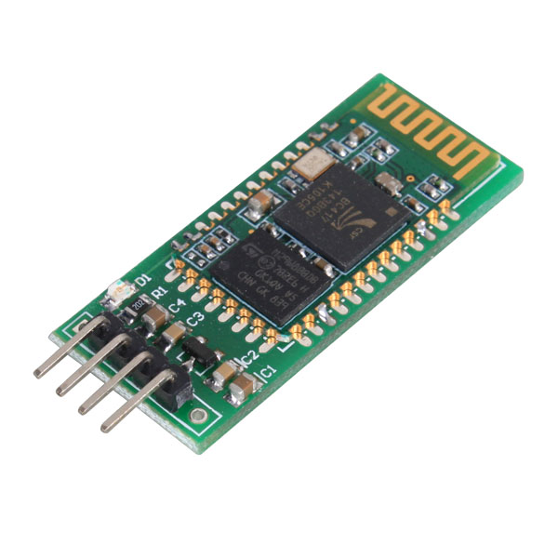
Bluetooth on the Arduino
The module plugs into your prototype board
It has 4 pins:
Receive (RX)
Transmit (TX)
V_{cc} (+5)
Ground

Slide 5
Bluetooth on the Arduino
Plug the Bluetooth module into your prototype board
Connect Arduino pin 10 to RX
Connect Arduino pin 11 to TX
Connect V_{cc} and ground

Slide 6
Bluetooth Control
The basic idea is this:
The user does something on a remote device, such as move a joystick or press an arrow key
The remote device decides what the user wanted and sends information to the robot
The robot receives the command and decides what to do with it

Slide 7
Software Setup
You’ll need to include the following:
#include <SoftwareSerial.h>
Just below this, include this line:
SoftwareSerial Bluetooth(10, 11); // RX, TX
This sets up the receive and transmit pins that you’ve connected

Slide 8
Software Setup
In the setup() function:
Bluetooth.begin(9600);
And that’s it. Your Arduino is now visible from other Bluetooth devices
You can connect to it from your phone or Pi

Slide 9
Receiving Data
For the robot, we’re mostly interested in sending commands to the Arduino
Here is code to receive them:
if (Bluetooth.available())
{
btData= Bluetooth.read();
…
}

Slide 10
Receiving Data
This gets a single character as an integer
read() returns -1 if no character is available

Slide 11
Sending Data
Use the print function:
Bluetooth.print(“L”);

Slide 12
Changing the Name
Every Bluetooth device has a unique address, which is what you use to pair it with other devices
However, every Arduino Bluetooth device has the name HC05
You can change this name to your team number, or anything else
Connect the RX pin of the Bluetooth module to the TX pin of the Arduino, and the TX Bluetooth pin to the RX Arduino pin
Connect ground and V_{cc}

Slide 13
Changing the Name
Do not connect +5 to the Bluetooth Vcc
Connect +3.3V to pin 34 of the Bluetooth module. See the second reference for this
Connect +5 to the Bluetooth Vcc now; the LED should blink slowly
Set baud rate in your sample serial program to 38400
Monitor the serial port
Set baud rate to 9600

Slide 14
Changing the Name
Type AT in the serial monitor and press enter
You should get a response of OK
Having verified that it works, enter:
AT+NAME=Team01 (or your actual team number)

Slide 15
Arduino Bluetooth Reference
http://www.e-gizmo.com/KIT/images/EGBT-04/EGBT-045MS-046S%20Bluetooth%20Module%20Manual%20rev%201r0.pdf
For entering command mode: http://www.instructables.com/id/AT-command-mode-of-HC-05-Bluetooth-module/?ALLSTEPS

Slide 16
The Joystick
For my testing I connected the joystick to another Arduino board, but we can also use the Raspberry Pi
The Joystick also has analog inputs and outputs
For the exercise with the Arduino, you’ll have to work with another team

Slide 17
The Joystick
The joystick requires two analog inputs
Use A2 and A3, but use constants:
const int JOYPIN1=A2;
const int JOYPIN2=A3;
int joyX;
int joyY;

Slide 18
The Joystick
Read values for the x and y coordinates:
joyX = analogRead(JOYPINX);
joyY = analogRead(JOYPINY);
Serial.print(“X=“);
Serial.print(joyX);
Serial.print(“ Y=“);
Serial.println(joyY);

Slide 19
The Joystick
Writing the above program will let you empirically determine the X and Y values for various positions of the joystick.
Do this and write down values for the four cardinal points and four points in between, as well as when the joystick is at rest.

Slide 20
Exercise
Write a program for the robot that receives commands from the joystick controller. Commands are:
L=Left, R=Right, F=Forward, B=Backward, and S=Stop
You’ll notice that if you move right, it really goes in a circle unless you change direction. It will take a little work to turn right, then go straight.

Slide 21
BLUETOOTH CONFIGURATION:
Connections:
Rx----- Pin 11.
Tx ----- Pin 10.
Vcc ---- 5V.(connect after uploading)
Gnd --- gnd.
Wakeup to Pin 9.
Google HC05, click on the first link & copy the program from Instructables.com website.(the link to the program is in Step 2)
Upload the program.
Connect Vcc to 5V.
On Serial monitor Screen
- Mode: NL&CR
- Baud Rate: 9600
then type,
- AT
- AT+NAME=TEAM(enter your Team No. here without brackets )
- AT+PSWD= set your password
- To verify, AT+NAME?
AT+PSWD?
10)Remove Wakeup & Vcc, then plug back Vcc.

