Slide 1
Embedded Programming and Robotics
Lesson 14
The Raspberry Pi Camera

Slide 2
Raspberry Pi Camera
The camera is a remarkably powerful device that can take still photos at up to 5 megapixels, and video
Link to video on setup:
https://www.raspberrypi.org/help/camera-module-setup/
If you haven’t already done so, enable the camera using raspi-config from a command line prompt

Slide 3
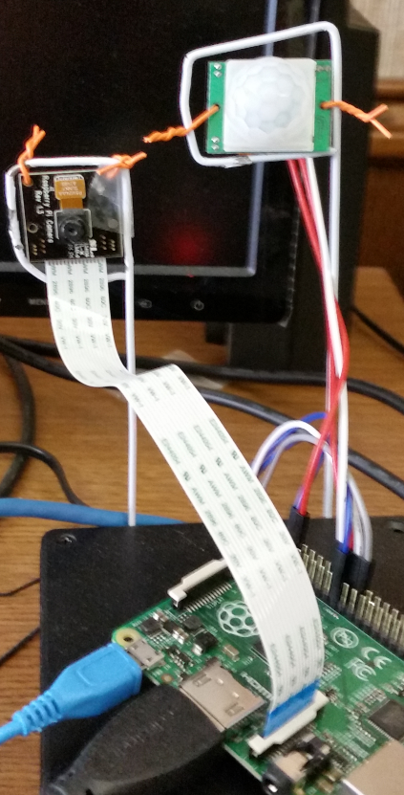
Raspberry Pi Camera
My setup: Camera held on a piece of bent coathanger
Motion sensor also connected to the Pi, so the system takes photos when motion is detected
There is a red LED on the camera that comes on when it is in preview mode or taking a photo

Slide 4
Using the Camera
raspistill
Capturing still photographs with the camera module
raspivid
Capturing video with the camera module
Time-lapse
Taking pictures at regular intervals and stitching them together in to a video
raspiyuv
Capturing still photographs and generating raw unprocessed image files

Slide 5
Programming the Camera
Get the Python package:
sudo apt-get install python3-picamera
In the program:
import picamera
camera = picamera.PiCamera() # camera object

Slide 6
Programming the Camera
It is easy to mount the camera upside-down, especially if you want it to face away from the ports
You can flip the camera:
camera.hflip = True
camera.vflip = True

Slide 7
Programming the Camera
You can start a preview, but this will overlay the entire display so you won’t be able to see your Python screen
Use Ctrl-D to terminate the program
camera.start_preview();
This can be useful for a “roving camera”
Or you can show the preview for a predetermined length of time, then stop it with
camera.stop_preview();

Slide 8
Camera Settings
camera.sharpness = 0
camera.contrast = 0
camera.brightness = 50
camera.saturation = 0
camera.ISO = 0
camera.video_stabilization = False

Slide 9
Camera Settings
camera.exposure_compensation = 0
camera.exposure_mode = 'auto'
camera.meter_mode = 'average'
camera.awb_mode = 'auto'
camera.image_effect = 'none'
camera.color_effects = None
camera.rotation = 0

Slide 10
Camera Settings
camera.hflip = False
camera.vflip = False
camera.crop = (0.0, 0.0, 1.0, 1.0)
camera.resolution = (320, 240)

Slide 11
Camera Programming
Capture a still image:
camera.capture('image1.jpg')
Capture 5 seconds of video:
camera.start_recording('video.h264')
sleep(5)
camera.stop_recording()

Slide 12
Programming Exercise
Write a program that takes a photo every 10 seconds, saving each one with a different name
Set the resolution relatively low so your disk doesn’t fill up
Provide a way to exit the program without pressing ctrl-C
Using Curses, show the name of each file as you save it
You can use the str function to convert a number to a string

