Slide 1
Embedded Programming and Robotics
Lesson 16
Robot Control with Raspberry Pi

Slide 2
GPIO and PWM
On the Pi B Model 2, which you have, 7 pins are marked as 'GPIO GEN0' to 'GPIO GEN6‘; these can be used for PWM
Write a program that dims an LED using any one of these pins, equivalent to the “fade” program you wrote for Arduino
No need for WiringPi, just use GPIO

Slide 3
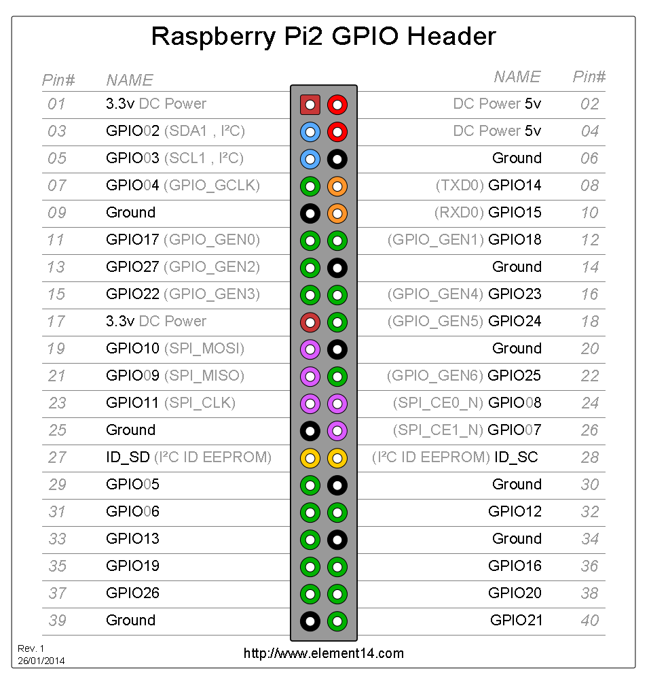

Slide 4
Download and Install WiringPi
sudo apt-get install git-core
git clone git://git.drogon.net/wiringPi
cd wiringPi
git pull origin
cd wiringPi
./build

Slide 5
Download and Install WiringPi
Test the installation:
gpio -v
gpio readall

Slide 6
Robot Control
You can use the GPIO pins and the WiringPi library to control your robot directly
One of the functions is a PWM output:
pinMode(MOTORL1, PWM_OUTPUT);
pwmWrite(MOTORL1, 255);

Slide 7
Robot Control
Write, in C or Python, a program that makes the robot move forward for 5 seconds at half speed, then forward for 5 more at full speed, then stop

Slide 8
http://wiringpi.com/download-and-install/

