Slide 1
Orientation – Fall 2023

Slide 2
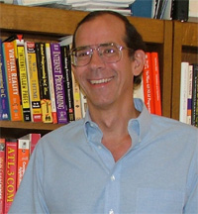
Prof. John Cole
Professor of Instruction (CS),
Director of Executive Master’s in SE
Email: John.Cole@utdallas.edu
Office: ECSS 4.606
Phone: (972) 883-6353
Computer Science & Software Engineering

Slide 3
Agenda
Welcome (Dr. Ovidiu Daescu)
Department Policies (Shyam Karrah)
UTD Requirements
EMSE Requirements
Administration (Norma Richardson)
Comet Card
Student Account
Parking
Meals
ECSS Building and Building Access
Program of Study (John Cole)
Curriculum / Program of Study
Fall 2023 Class Schedule

Slide 4
Dr. Ovidiu Daescu
Professor (CS, CE, & TE),
Department Head
Email: Ovidiu.Daescu@utdallas.edu
Office: ECSS 4.907
Phone: (972) 883-4196
Computer Science & Software Engineering

Slide 5
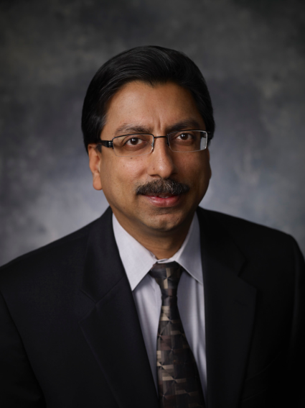
Dr. Gopal Gupta
Professor (CS & CE),
Erik Jonsson Chair
Email: Gupta@utdallas.edu
Office: ECSS 3.803
Phone: (972) 883-4107
Computer Science & Software Engineering

Slide 6
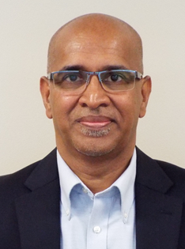
Shyam Karrah
Professor of Instruction (CS),
Director of Graduate Admissions,
And EMSE Admissions Coordinator
Email: Skarrah@utdallas.edu
Office: ECSS 3.907
Phone: (972) 883-4197
Computer Science & Software Engineering

Slide 7
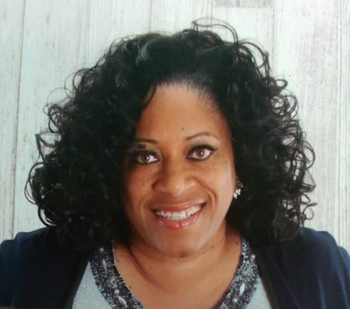
Norma Richardson
Computer Science
Business Manager
Email: nrichardson@utdallas.edu
Office: ECSS 4.906
Phone: (972) 883-4190
Computer Science & Software Engineering

Slide 8
UTD and EMSE Requirements
Students must comply with the general UT Dallas guidelines
Degree Plan Requirements
Enrollment
Holds
International students must submit official transcripts by mid-December
EMSE program DOES NOT support student visa (F1) or any changes to your current visa
Students on an H1B visa will be charged for health insurance if a waiver is not submitted to Student Health Services
Please visit our website for up-to-date information:
emse.utdallas.edu

Slide 9
Agenda
UTD and EMSE Requirements
Comet Card
Student Account
Parking
Meals
ECSS Building
Building/Room Access
Program of Study
Fall 2023 Courses

Slide 10
Comet Card
The Comet card is the official identification
card for all UTD students
Get a Comet Card at the Student Services Building Addition (SSBA)
Comet card center
Monday-Thursday 9am-7pm
Friday 9am-5pm
Saturday 10am-1pm
http://www.utdallas.edu/cometcard/

Slide 11
Agenda
UTD and EMSE Requirements
Comet Card
Student Account
Parking
Meals
ECSS Building
Building/Room Access
Program of Study
Fall 2022 Courses

Slide 12
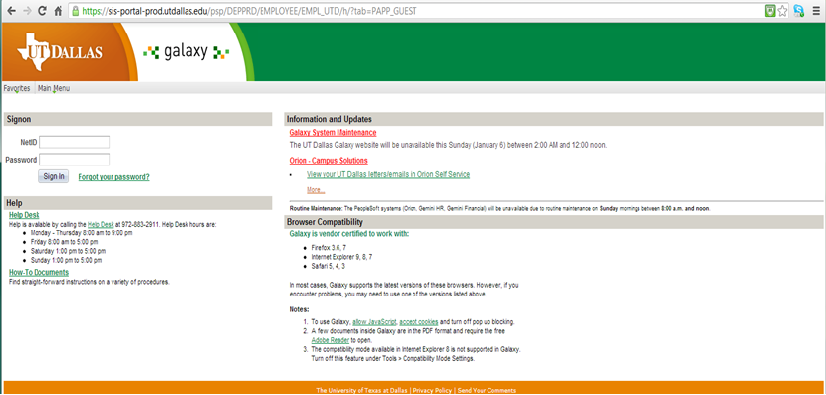
Student Account
Use your NetId to manage your account and make installment payments through Orion.
Do not use MarketPlace!

Slide 13
Agenda
UTD and EMSE Requirements
Comet Card
Student Account
Parking
Meals
ECSS Building
Building/Room Access
Program of Study
Fall 2023 Courses

Slide 14
Parking
You will be given Green parking permits. We will need the make, model, year, color, and license plate number of your car to get these for you.
On Fridays, park in the green area
If you want to upgrade to Gold, pay for the upgrade at the Parking Office
More information available at:
http://www.utdallas.edu/services/transit/

Slide 15
Agenda
UTD and EMSE Requirements
Comet Card
Student Account
Parking
Meals
ECSS Building
Building/Room Access
Program of Study
Fall 2023 Courses

Slide 16
Meals
Coffee, snacks and lunch will be ordered and served in class, following pandemic restrictions (if any) and university policy

Slide 17
Agenda
UTD and EMSE Requirements
Comet Card
Student Account
Parking
Meals
ECSS Building
Building/Room Access
Program of Study
Fall 2023 Courses

Slide 18
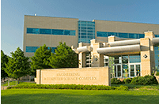
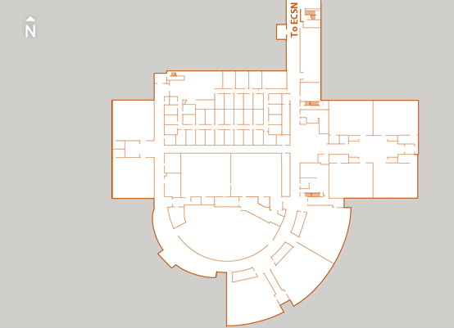
The ECS South Building
First Floor (Level 2)
Classroom
ECSS 2.305
CF21
Open Lab
CF20

Slide 19
Labs and Computer Accounts
Open Lab
8:00 AM to 12:00 AM Monday through Friday
9:00 AM to 11:00 PM on Saturday and Sunday.
You do not need your card to access the laboratory
250 Page Print Quota per semester
CS Grad Lab
Card access needed
Computer Accounts
Issues with your computer accounts: call (972) 883-2911
Issues with computer labs: email cs-tech@utdallas.edu

Slide 20
Agenda
UTD and EMSE Requirements
Comet Card
Student Account
Parking
Meals
ECSS Building
Building/Room Access
Program of Study
Fall 2023 Courses

Slide 21
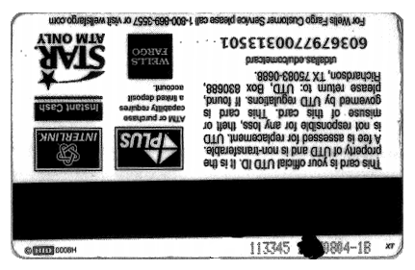
Building/Room Access
We have to activate your Comet card
Email emse@utdallas.edu the 6-digit code on the back of your card no later than September 15

Slide 22
Agenda
UTD and EMSE Requirements
Comet Card
Student Account
Parking
Meals
ECSS Building
Building/Room Access
Program of Study
Fall 2023 Courses

Slide 23
Executive MSE - Curriculum
Curriculum
Core Courses
Adv. Requirements Eng. (SE 6361)
Architecture and Design (SE 6362)
OOSE (SE 6329)
Software Testing (SE 6367)
Advanced SE Project (SE 6387)
Elective Courses
Project Planning and Management (SE 6388)
Database Design (SE 6360)
Big Data Analytics (CS 6350)
Cloud Computing / Security (CS6301)
Machine Learning (CS 6375)
AI / NLP (CS 6301)

Slide 24
Tentative Program of Study
Fall 2023
Adv. Requirements Engineering
OOSE
Fall 2024
Big Data Analytics
Software Testing
Spring 2024
Architecture and Design
Database Design
Spring 2025
AI/NLP
Cloud Computing / Security
Advanced Software Engineering project
Summer 2024
Project Planning and Management
Machine Learning

Slide 25
Agenda
UTD Requirements
Comet Card
Student Account
Parking
Meals
ECSS Building
Building/Room Access
Program of Study
Fall 2023 Courses

Slide 26
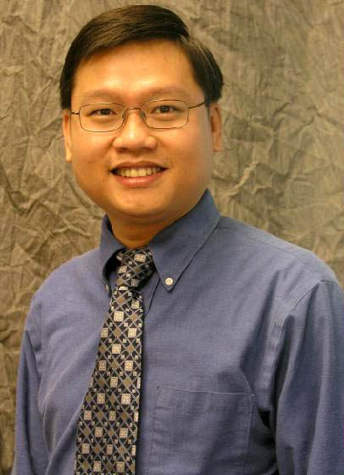
Dr. Tien Nguyen
Associate Professor (CS)
Fall 2023: SE 6329 Object-Oriented Software Engineering
Object-Oriented Software Engineering (3 semester credit hours) Concepts, methods and techniques necessary to efficiently capture software requirements in use cases and transform them into design and implementation. Use of UML in the context of an iterative, agile process with an OO model transformation approach. Use of an advanced CASE tool that allows the synchronization between the various models and the code.
Email: tien.n.nguyen@utdallas.edu
Office: ECSS 4.229
Phone: (972) 883-3893
Computer Science & Software Engineering

Slide 27
Dr. Mehra Nouroz Borazjany
Associate Professor of Instruction (CS)
Fall 2023: SE 6361 Advanced Requirements Engineering
Advanced Requirements Engineering (3 semester credit hours) System and software requirements engineering. Identification, elicitation, modeling, analysis, specification, management, and evolution of functional and non-functional requirements. Strengths and weaknesses of different techniques, tools, and object-oriented methodologies. Interactions and trade-offs among hardware, software, and organization. System and sub-system integration with software and organization as components of complex, composite systems. Transition from requirements to design.
Email: Mehra@utdallas.edu
Office: ECSS 4.203
Phone: (972) 883-2439
Computer Science & Software Engineering

Slide 28
Fall 2023 Class Schedule
You can always look at your class schedule on Coursebook: https://coursebook.utdallas.edu/myclasses
You will have to log in to access your own classes, but not to look up other classes using the “guided search”
For EMSE classes, be sure to choose “Include special classes” in “Other Options” at the bottom of the list
Official grades are posted on Orion

Slide 29
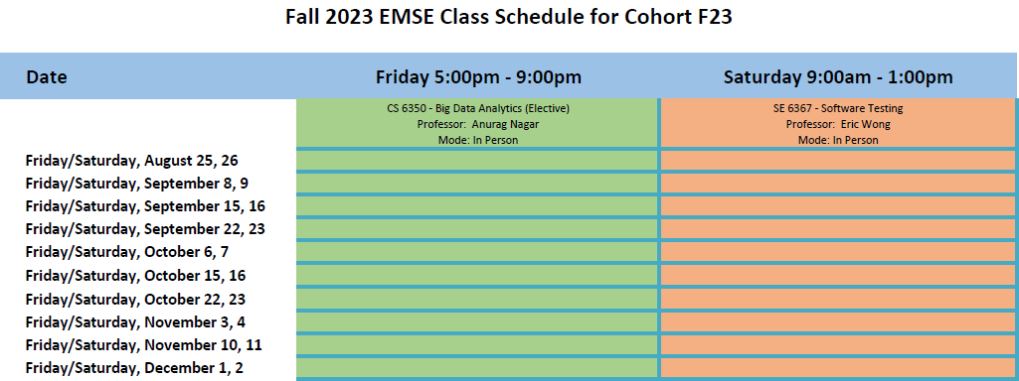
Fall 2023- Tentative Class Schedule

Slide 30
Classes and Teaching
All course material will be available on eLearning:
elearning.utdallas.edu

Slide 31
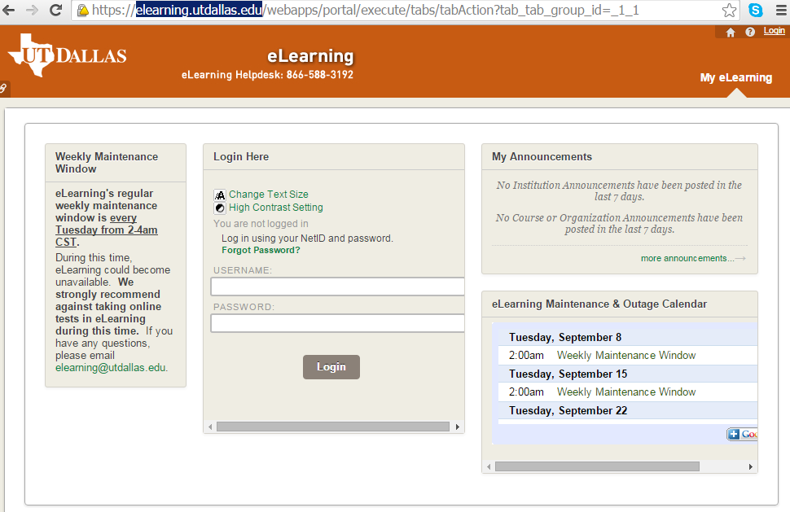
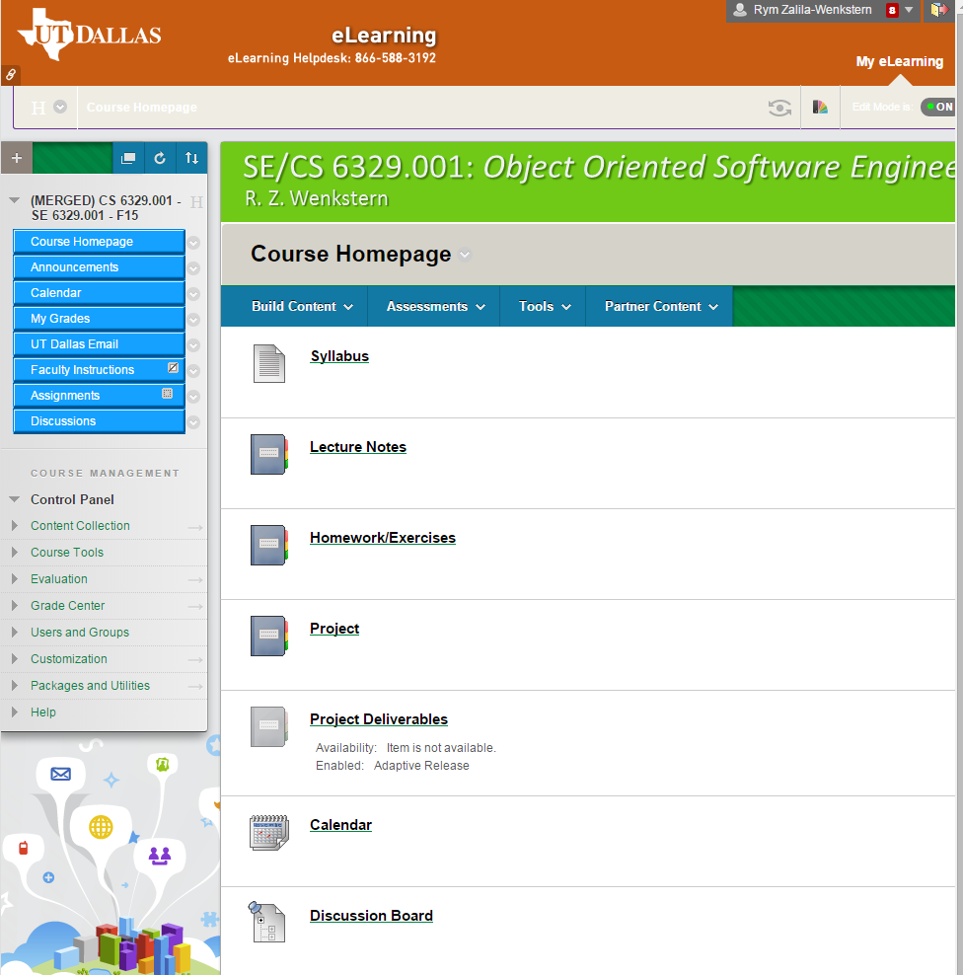

Slide 32
Executive MSE - Management
Executive Director
John Cole
John.Cole@utdallas.edu
972-883-6353
Business Manager
Norma Richardson
nrichardson@utdallas.edu
972-883-4190
Admissions Coordinator
Shyam Karrah
skarrah@utdallas.edu
972-883-4197
Academic Director
Gopal Gupta
gupta@utdallas.edu
972-883-4107

Slide 33
Questions?

