Slide 1
securing binary software through retrofitting
Dr. Kevin Hamlen
Associate Professor of Computer Science
The University of Texas at Dallas
Supported in part by:
AFOSR YIP (Career) Award FA9550-08-1-0044,
AFOSR Active Defense Grant FA9550-10-1-0088,
and NSF CAREER Award #1054629
Any opinions, findings, conclusions, or recommendations expressed in this presentation are those of the author(s) and do not necessarily reflect the views of the AFOSR or NSF.

Slide 2
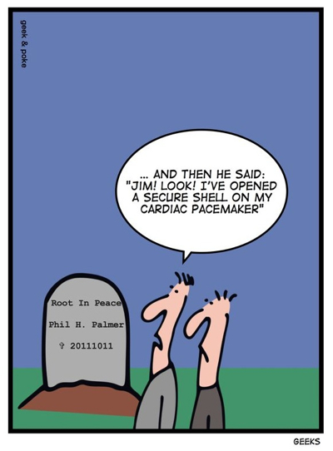
Mission-critical Software Environments
Myth: In mission-critical environments, all software is custom, rigorously tested, and formally verified.
Reality: Most mission-critical environments use commodity software and components extensively.
Commercial Off-The-Shelf (COTS)
widely available to attackers
mostly closed-source
independent security audit not feasible
supports mainstream OSes (Windows) and architectures (Intel)
some effort at secure development, but no formal guarantees

Slide 3
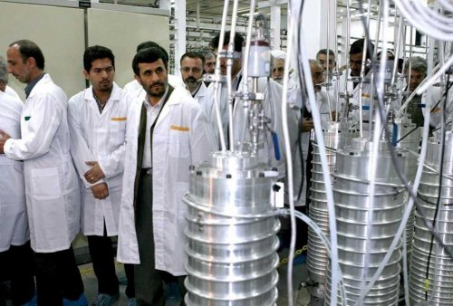
Example: The Power Industry
2010: Stuxnet virus successfully infiltrates and destroys nuclear centrifuges at Natanz, Iran
Software exploited: Siemens Windows apps and PLCs
Allegedly sets Iranian nuclear program back 3-5 years
2012: Shamoon virus destroys 30K power control workstations owned by Saudi Aramco, world’s largest oil producer
Software exploited: unpatched Windows NT
“All told, the Shamoon virus was probably the most destructive attack that the private sector has seen to date.” –Leon Panetta

Slide 4
Why COTS?
Alternative: Build all your own custom software in-house from scratch (or contract trusted third-party to build from scratch).
expensive, time-consuming
error-prone (not built by specialists)
63% of in-house IT projects fail to meet their own specs [Standish Group, 2011 CHAOS Report]
poor compatibility, hard to maintain
very questionable security assurance
vulnerable to insider threats, less tested, shaky design, etc.
Many COTS advantages
constantly updated for new threats
tested on a mass scale
crafted & maintained by specialists
cheaper, mass-produced

Slide 5
Why is COTS Software so Insecure?
Huge and constantly evolving
Windows XP has 40 million lines of code
Microsoft Office had 30 million lines in 2006
Debian 5.0 has a staggering 324 million lines!
contrast: Space shuttle has only 2.5 million moving parts!
Often written in unsafe languages
C, C++, VC++, Visual Basic, scripting languages, …
Increasingly sophisticated attacks
buffer-overrun
return-to-libc
return-oriented programming (RoP)

Slide 6
Code-injection Example
8D 45 B8
50
FF 15 BC 82 2F 01
65 72 61 73 65 20
2A 2E 2A 20
61 (x24) 61 61 61 61
30 FB 1F 00
lea eax,[ebp-48h]
push eax
call <system>
.data “erase ”
.data “*.* ”
.data “aaaaa…” .data “aaaa”
<addr of buf>
top of stack (lower addresses)
buf (64 bytes)
void main(int argc, char *argv[])
{
char buf[64];
strcpy(buf,argv[1]);
…
return;
}
saved EBP (4 bytes)
saved EIP (4 bytes)
argv (4 bytes)
argc (4 bytes)
bottom of stack (higher addresses)

Slide 7
Code-injection Example
8D 45 B8
50
FF 15 BC 82 2F 01
65 72 61 73 65 20
2A 2E 2A 20
61 (x24) 61 61 61 61
30 FB 1F 00
lea eax,[ebp-48h]
push eax
call <system>
.data “erase ”
.data “*.* ”
.data “aaaaa…” .data “aaaa”
<addr of buf>
top of stack (lower addresses)
lea eax,[ebp-48h]
push eax
call <system>
erase *.* aaaaaaaa
aaaaaaaaaaaaaaaa
aaaa
<addr of buf>
void main(int argc, char *argv[])
{
char buf[64];
strcpy(buf,argv[1]);
…
return;
}
argv (4 bytes)
argc (4 bytes)
bottom of stack (higher addresses)

Slide 8
Code-injection Example
8D 45 B8
50
FF 15 BC 82 2F 01
65 72 61 73 65 20
2A 2E 2A 20
61 (x24) 61 61 61 61
30 FB 1F 00
lea eax,[ebp-48h]
push eax
call <system>
.data “erase ”
.data “*.* ”
.data “aaaaa…” .data “aaaa”
<addr of buf>
top of stack (lower addresses)
lea eax,[ebp-48h]
push eax
call <system>
erase *.* aaaaaaaa
aaaaaaaaaaaaaaaa
aaaa
<addr of buf>
void main(int argc, char *argv[])
{
char buf[64];
strcpy(buf,argv[1]);
…
return;
}
argv (4 bytes)
argc (4 bytes)
bottom of stack (higher addresses)

Slide 9
Code-injection Example
8D 45 B8
50
FF 15 BC 82 2F 01
65 72 61 73 65 20
2A 2E 2A 20
61 (x24) 61 61 61 61
30 FB 1F 00
lea eax,[ebp-48h]
push eax
call <system>
.data “erase ”
.data “*.* ”
.data “aaaaa…” .data “aaaa”
<addr of buf>
top of stack (lower addresses)
lea eax,[ebp-48h]
push eax
call <system>
erase *.* aaaaaaaa
aaaaaaaaaaaaaaaa
aaaa
<addr of buf>
void main(int argc, char *argv[])
{
char buf[64];
strcpy(buf,argv[1]);
…
return;
}
argv (4 bytes)
argc (4 bytes)
bottom of stack (higher addresses)

Slide 10
Code-injection Example
8D 45 B8
50
FF 15 BC 82 2F 01
65 72 61 73 65 20
2A 2E 2A 20
61 (x24) 61 61 61 61
30 FB 1F 00
lea eax,[ebp-48h]
push eax
call <system>
.data “erase ”
.data “*.* ”
.data “aaaaa…” .data “aaaa”
<addr of buf>
top of stack (lower addresses)
lea eax,[ebp-48h]
push eax
call <system>
erase *.* aaaaaaaa
aaaaaaaaaaaaaaaa
aaaa
<addr of buf>
void main(int argc, char *argv[])
{
char buf[64];
strcpy(buf,argv[1]);
…
return;
}
argv (4 bytes)
<addr of “erase *.* …”>
bottom of stack (higher addresses)

Slide 11
Code-injection Example
8D 45 B8
50
FF 15 BC 82 2F 01
65 72 61 73 65 20
2A 2E 2A 20
61 (x24) 61 61 61 61
30 FB 1F 00
lea eax,[ebp-48h]
push eax
call <system>
.data “erase ”
.data “*.* ”
.data “aaaaa…” .data “aaaa”
<addr of buf>
top of stack (lower addresses)
lea eax,[ebp-48h]
push eax
call <system>
erase *.* aaaaaaaa
aaaaaaaaaaaaaaaa
aaaa
<addr of buf>
void main(int argc, char *argv[])
{
char buf[64];
strcpy(buf,argv[1]);
…
return;
}
argv (4 bytes)
<addr of “erase *.* …”>
bottom of stack (higher addresses)

Slide 12
Defense: W⊕X Pages
Data Execution Prevention (DEP)
disallow writable & executable pages
stack writable but non-executable by default
now default on most Windows & Linux systems
Counter-attack
don’t insert any code onto the stack
jump directly to existing code fragments
called “jump-to-libc” or RoP attack

Slide 13
Return-to-libc Example
65 72 61 73 65 20
2A 2E 2A 20
61 (x58)
BC 82 2F 01
61 (x8)
30 FB 1F 00
.data “erase ”
.data “*.* ”
.data “aaaa…”
.data <system>
.data “aaaa…”
.data <buf>
top of stack (lower addresses)
buf (64 bytes)
void main(int argc, char *argv[])
{
char buf[64];
strcpy(buf,argv[1]);
…
return;
}
saved EBP (4 bytes)
saved EIP (4 bytes)
argv (4 bytes)
argc (4 bytes)
bottom of stack (higher addresses)

Slide 14
Return-to-libc Example
65 72 61 73 65 20
2A 2E 2A 20
61 (x58)
BC 82 2F 01
61 (x8)
30 FB 1F 00
.data “erase ”
.data “*.* ”
.data “aaaa…”
.data <system>
.data “aaaa…”
.data <buf>
top of stack (lower addresses)
erase *.*
aaaaaaa…
aaaa
addr of <system>
aaaa
aaaa
addr of <buf>
void main(int argc, char *argv[])
{
char buf[64];
strcpy(buf,argv[1]);
…
return;
}

Slide 15
Return-to-libc Example
65 72 61 73 65 20
2A 2E 2A 20
61 (x58)
BC 82 2F 01
61 (x8)
30 FB 1F 00
.data “erase ”
.data “*.* ”
.data “aaaa…”
.data <system>
.data “aaaa…”
.data <buf>
top of stack (lower addresses)
erase *.*
aaaaaaa…
aaaa
addr of <system>
aaaa
aaaa
addr of <buf>
void main(int argc, char *argv[])
{
char buf[64];
strcpy(buf,argv[1]);
…
return;
}

Slide 16
Return-to-libc Example
65 72 61 73 65 20
2A 2E 2A 20
61 (x58)
BC 82 2F 01
61 (x8)
30 FB 1F 00
.data “erase ”
.data “*.* ”
.data “aaaa…”
.data <system>
.data “aaaa…”
.data <buf>
top of stack (lower addresses)
erase *.*
aaaaaaa…
aaaa
addr of <system>
aaaa
aaaa
addr of <buf>
void main(int argc, char *argv[])
{
char buf[64];
strcpy(buf,argv[1]);
…
return;
}

Slide 17
Return-to-libc Example
65 72 61 73 65 20
2A 2E 2A 20
61 (x58)
BC 82 2F 01
61 (x8)
30 FB 1F 00
.data “erase ”
.data “*.* ”
.data “aaaa…”
.data <system>
.data “aaaa…”
.data <buf>
top of stack (lower addresses)
erase *.*
aaaaaaa…
aaaa
addr of <system>
aaaa
aaaa
addr of <buf>
libc::system(char *cmd)
{
<passes cmd to the shell!>
}

Slide 18
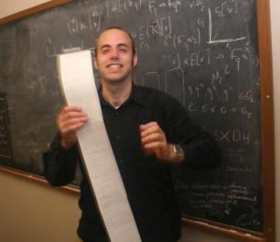
Return Oriented Programming Attacks
Weak Defense: Address Space Layout Randomization (ASLR)
randomize locations of all libraries at load-time
depends on linking info for dynamic-load libraries
NOT possible for most main modules (no link info)
Return-oriented Programming
jump to a series of pre-existing “gadgets” (code fragments)
large enough main module includes Turing-complete gadget set
arbitrary attack functionality possible with no code injection!
Researchers from UCSD, U. Mich, and Princeton hack a “secure” voting machine
no hardware tampering
hardware only lets proper voting program run
yet attacker can cause arbitrary vote miscounts
[Checkoway, Feldman, Kantor, Halderman, Felten, and Shacham, USENIX Security 2009]

Slide 19
Battling RoP
Microsoft’s 2012 BlueHat Competition
Focused on RoP Mitigation
$260,000 total for top three solutions
Successful attack against 2nd place solution was published one month later
Google Pwnium Competition
Hacker Pinkie Pie paid $60K
for Chrome RoP exploit
Google fixes the exploit
Five months later, Pinkie Pie finds a new RoP exploit in the fixed Chrome, gets paid another $60K
Google fixes the 2nd exploit
Five months later, Pinkie Pie finds a yet another (partial) exploit, gets paid another $40K

Slide 20
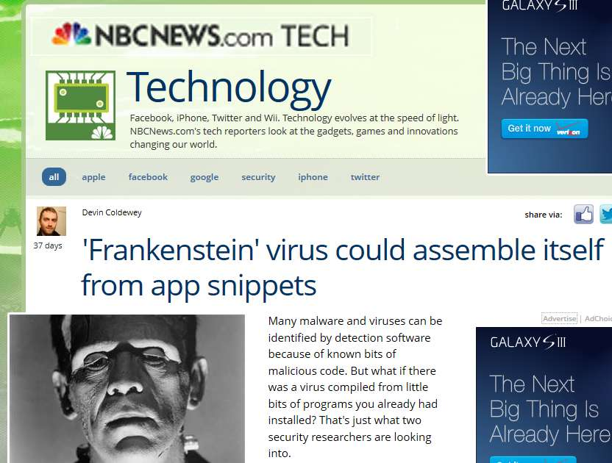
Frankenstein [Mohan & Hamlen, August 2012]
Virus recreates itself from gadgets
reads benign programs on victim system
steals gadgets to propagate on the fly
Wide media coverage
First published in USENIX Offensive Technologies, August 2012
then in thousands of news stories worldwide
The Economist, New Scientist, NBC News, Wired UK, …
Hard to detect
every instance completely different
every instance composed 100% of “normal” code
mutations become more diverse and “smarter” as they infect more systems

Slide 21
My Research
Secure commodity software AFTER it is compiled and distributed, by automatically modifying it at the binary level.
UNTRUSTED
TRUSTED
Binary
Rewriter
untrusted
binary code
secure
binary
Verifier
deploy
reject

Slide 22
Advantages
No need to get code-producer cooperation
No need to customize the OS/VM
No custom hardware needed (expensive & slow)
Not limited to any particular source language or tool chain
Can enforce consumer-specific policies
Maintainable across version updates (just re-apply rewriter to newly released version)
Rewriter remains untrusted, so can outsource that task to an untrusted third party!
Local, trusted verifier checks results

Slide 23
Challenges
Software is in purely binary form
no source, no debug info, no disassembly
Diverse origins
various source languages, compilers, tools, …
Code-producers are uncooperative
unwilling to recompile with special compiler
unwilling to add/remove features
no compliance with any coding standard
Highly complex binary structure
target real-world APIs (e.g., hundreds of thousands of Windows system dll’s and drivers)
multi-threaded, multi-process
event-driven (callbacks), dynamically linked (runtime loading)
heavily optimized (binary code & data arbitrarily interleaved)

Slide 24
First Step: Disassembly
Disassemble this hex sequence
Turns out x86 disassembly is an undecidable problem!
FF E0 5B 5D C3 0F 88 52 0F 84 EC 8B
Valid Disassembly
FF E0 | jmp eax
5B | pop ebx
5D | pop ebp
C3 | retn
0F 88 52 0F 84 EC | jcc
8B … | mov
Valid Disassembly
FF E0 | jmp eax
5B | pop ebx
5D | pop ebp
C3 | retn
Valid Disassembly
FF E0 | jmp eax
5B | pop ebx
5D | pop ebp
C3 | retn
0F | db (1)
0F 88 | db (2)
88 52 0F 84 EC | mov
8B … | mov
52 | push edx
0F 84 EC 8B … | jcc

Slide 25
Disassembly Intractability
Even the best reverse-engineering tools cannot reliably disassemble even standard COTS products
Example: IDA Professional Disassembler (Hex-rays)
Program Name | Disassembly Errors
Microsoft Foundation Class Lib (mfc42.dll) | 1216
Media Player (mplayerc.exe) | 474
Avant Web Browser (RevelationClient.exe) | 36
VMWare (vmware.exe) | 183

Slide 26
Innovation: De-shingling Disassembly
Byte Sequence: FF E0 5B 5D C3 0F 88 B0 50 FF FF 8B
Disassembled Invalid
 | Hex |  | Path 1 |  | Path 2 |  | Path 3 |  | Path 4
 | FF |  | jmp eax
 | E0 |  |  |  | loopne
 | 5B |  | pop
 | 5D |  | L1: pop
 | C3 |  | retn
 | 0F |  | jcc
 | 88 |  |  |  |  |  | mov
 | B0 |  |  |  |  |  |  |  | mov
 | 50
 | FF |  |  |  |  |  |  |  | N/A
 | FF
 | 8B |  | L2: mov
Included Disassembly
jmp eax
pop
L1: pop
retn
jcc
L2: mov
loopne
jmp L1
mov
jmp L2

Slide 27
Problem: Pointers
We just rearranged everything. Pointers will all point to the wrong places.
can’t reliably identify pointer data in a sea of unlabeled bytes
Two kinds of relevant pointers:
pointers to static data bytes among the code bytes
pointers to code (e.g., method dispatch tables)

Slide 28
Preserving Static Data Pointers
Put the de-shingled code in a NEW code segment.
Set it execute-only (non-writable)
Leave the original .text section
Set it read/write-only (non-execute)
Original Binary
Rewritten Binary
Header
Header
Import Address Table
Import Address Table
.data
.data
.text
.told (NX bit set)
.tnew
(de-shingled code)

Slide 29
Preserving Code Pointers
Almost half of all jump instructions in real x86 binaries compute their destinations at runtime.
all method calls (read method dispatch table)
all function returns (read stack)
almost all API calls (read linker tables)
pointer encryption/decryption logic for security
Must ensure these jumps target new code locations instead of old.
impossible to statically predict their destinations

Slide 30
Solution: Control-flow Patching
Create a lookup table that maps old code addresses to new ones at runtime.
Add instructions that consult the lookup table before any computed jump.
Original
jump eax
Rewritten
jump table[eax]
Suddenly we can enforce many security policies:
Original
call dangerous(x)
Rewritten
L1: if unsafe(x) then abort
L2: call dangerous(x)
To prevent circumvention of L1, just set table[L2]=null !

Slide 31
Optimizing
With these three tricks we can successfully transform (most) real-world COTS binaries even without knowing how they work or what they do!
de-shingling disassembly
static data preservation
control-flow patching
Limitations
runtime code modification conservatively disallowed
computing data pointers from code pointers breaks
These are compatibility limitations not security limitations.
But it’s prohibitively inefficient (increases code size ~700%)
need to optimize the approach

Slide 32
Optimization Philosophy
If the optimization fails, we might get broken code but never unsafe code.
The optimizations only need to work for non-malicious, non-vulnerable code fragments.
If the code fragment is malicious or vulnerable, we don’t want to preserve it!

Slide 33
Optimization #1: Pruning Shingles
Lots of extra overlapping information
Can we prune our disassembly tree?
 | Hex |  | Path 1 |  | Path 2 |  | Path 3 |  | Path 4
 | FF |  | jmp eax
 | E0 |  |  |  | loopne
 | 5B |  | pop
 | 5D |  | L1: pop
 | C3 |  | retn
 | 0F |  | jcc
 | 88 |  |  |  |  |  | mov
 | B0 |  |  |  |  |  |  |  | mov
 | 50
 | FF |  |  |  |  |  |  |  | N/A
 | FF
 | 8B |  | L2: mov

Slide 34
PPM Disassembler
Insight: Distinguishing real code bytes from data bytes is a “noisy word segmentation problem”.
Word segmentation: Given a stream of symbols, partition them into words that are contextually sensible. [Teahan, 2000]
Noisy word segmentation: Some symbols are noise (data).
Machine Learning based disassembler
based on kth-order Markov model
Estimate the probability of the sequence B:

Slide 35
PPM Disassembly Stats
 | PPM Disassembler
 | False Negative | False Positive | Accuracy
7zFM | 0 | 0 | 100%
notepad | 0 | 0 | 100%
DosBox | 0 | 0 | 100%
WinRAR | 0 | 39 | 99.982%
mulberry | 0 | 0 | 100%
scummvm | 0 | 0 | 100%
emule | 0 | 117 | 99.988%
Mfc42 | 0 | 47 | 99.987%
mplayerc | 0 | 307 | 99.963%
revClient | 0 | 71 | 99.893%
vmware | 0 | 45 | 99.988%

Slide 36
Disassembler Stats
# of instructions identified by our disassembler but not by IDA Pro

Slide 37
Optimization #2: Lookup Table Compression
Idea: Overwrite the old code bytes with the lookup table.
PPM disassembler identifies most code bytes
Also identifies subset that are possible computed jump destinations.
Overwrite those destinations with our lookup table.
Original
call eax
Rewritten
cmp [eax], 0xF4
cmovz eax, [eax+1]
call eax

Slide 38
Applications of our Rewriter
Two Applications
Binary randomization for RoP Defense (STIR)
Machine-certified Software Fault Isolation (Reins)
bytes
De-shingling Disassembler
PPM
Pruner
Assembly Listing
Rewriter
Safe Binary

Slide 39
RoP Defense Strategy
RoP is one example of a broad class of attacks that require attackers to know or predict the location of binary features
Defense Goal
Frustrate such attacks by randomizing the feature space

Slide 40
Self-Transforming Instruction Relocation
STIR -
User Address Space
2³¹
Randomly reorder all the basic blocks every time the program loads
Attacker cannot reliably locate gadgets for RoP attacks
Astronomically low chance of attack success due to much higher entropy than ASLR
lib1
lib2
lib3
main
2⁰

Slide 41
STIR Implementation
Supports Windows PE and Linux ELF files
Tested on SPEC2000 benchmarks and the entire coreutils chain for Linux
1.5% overhead on average
Wartell, Mohan, Hamlen, and Lin. Binary Stirring: Self-randomizing Instruction Addresses of Legacy x86 Binary Code. Proc. ACM Computer and Communications Security (CCS), 2012.
Won 2nd place in the NYU-Poly AT&T Best Applied Security Paper of the Year competition

Slide 42
Gadget Reduction

Slide 43
Windows STIR Runtime Overhead

Slide 44
Linux STIR Runtime Overhead

Slide 45
Custom Safety Policy Enforcement with Machine-provable Assurance
safety
policy
Binary
Rewriter
untrusted
binary code
secure
binary
Verifier
deploy
reject

Slide 46
An API Policy
function conn = ws2_32::connect(
SOCKET, struct sockaddr_in *, int) -> int;
function cfile = kernel32::CreateFileW(
LPCWSTR, DWORD, DWORD, LPSECURITY_ATTRIBUTES,
DWORD, DWORD, HANDLE) -> HANDLE WINAPI;
event e1 = conn(_, {sin_port=25}, _) -> 0;
event e2 = cfile(“*.exe”, _, _, _, _, _, _) -> _;
policy = e1* + e2*;
Policy: Applications may not both open email connections
and create files whose names end in “.exe”.

Slide 47
Reference Monitor In-lining
In-line security checks as rewriting progresses
checks uncircumventable due to control-flow and memory safety
ensures complete mediation
Rewritten Binary
Rewritten Code
Inline
Reference
Monitor
System Libraries

Slide 48
REINS -
Rewriting and
In-lining System
Prototype targets full Windows XP/7/8 OS
significantly harder than Linux
2.4% average runtime overhead
15% average process size increase
Tested on SPEC2000, malware, and large GUI binaries
Eureka email client and DOSBox, much larger than any previous implementation had accomplished
Wartell, Mohan, Hamlen, and Lin. Securing Untrusted Code via Compiler-Agnostic Binary Rewriting. Proc. 28th Annual Computer Security Applications Conference, 2012.
won Best Student Paper at ACSAC

Slide 49
Control-Flow Safety
Used PittSFIeld approach [McCamant & Morrisett, 2006]
Break binaries into chunks
chunk – fixed length (16 byte) basic blocks
Only one extra guard instruction necessary
Mask instruction only affects violating flows
Original
call eax
Rewritten
cmp [eax], 0xF4
cmovz eax, [eax+1]
and eax, 0x0FFFFFF0
call eax

Slide 50
Jump Table w/ Masking
Original Instruction:
eax = 0x411A40
.text:0040CC9B
FF DO
call eax
Original Possible Target:
.text:00411A40
5B
pop ebp
Rewritten Instructions:
eax = 0x534AB0
eax = 0x411A40
.tnew:0052A1C0
.tnew:0052A1C3
.tnew:0052A1C7
.tnew:0052A1CE
80 38 F4
0F 44 40 01
FF D0
cmp byte ptr [eax], F4h
cmovz eax, [eax+1]
and eax, 0x0FFFFFF0
call eax
Rewritten Jump Table:
.told:00411A40
F4 B9 4A 53 00
F4 dw 0x534AB0
Rewritten Target:
.tnew:00534AB0
5B
pop ebp

Slide 51
REINS Overhead

Slide 52
Verifier
New code is verifiable with a simple algorithm based on PittSFIeld [McCamant & Morrisett, 2006]
disassemble each chunk-aligned byte sequence
ensure all computed jumps are protected by masking operation
Conclusion: All jumps must target chunk boundaries.
Verifier is extremely small and trustworthy
1500 lines OCaml code
supports entire x86 instruction architecture and all Windows PE binary features
Formal proof that any binary accepted by verifier cannot violate the control-flow or memory safety policy.

Slide 53
Conclusions
Automated transformation of full-scale binary applications is actually possible and practical.
large, working prototypes for Windows & Linux
successful tests on hundreds of complex applications
Can attain the highest level of software assurance
fully automated, whole-program, machine-verification
formal proof of verifier soundness
SFI approach recently proved using the Coq theorem-prover! [Morrisett, Tan, Tassarotti, Tristan, and Gan, PLDI 2012]
New way to think about secure software development
Do we really need secure compilers and debuggers if we can add the security later?
Can we stretch this beyond security to add custom features?

Slide 54
References
Richard Wartell, Vishwath Mohan, Kevin W. Hamlen, and Zhiqiang Lin. Securing Untrusted Code via Compiler-Agnostic Binary Rewriting. In Proceedings of the 28th Annual Computer Security Applications Conference (ACSAC), pp. 299-308, December 2012.
Richard Wartell, Vishath Mohan, Kevin W. Hamlen, and Zhiqiang Lin. Binary Stirring: Self-randomizing Instruction Addresses of Legacy x86 Binary Code. In Proceedings of the 19th ACM Conference on Computer and Communications Security (CCS), pp. 157-168, October 2012.
Vishwath Mohan and Kevin W. Hamlen. Frankenstein: Stitching Malware from Benign Binaries. In Proceedings of the 6th USENIX Workshop on Offensive Technologies (WOOT), pp. 77-84, August 2012.
Kevin W. Hamlen, Micah M. Jones, and Meera Sridhar. Aspect-oriented Runtime Monitor Certification. In Proceedings of the 18th International Conference on Tools and Algorithms for the Construction and Analysis of Systems (TACAS), pp. 126-140, March-April 2012.
Richard Wartell, Yan Zhou, Kevin W. Hamlen, Murat Kantarcioglu, and Bhavani Thuraisingham. Differentiating Code from Data in x86 Binaries. In Proceedings of the European Conference on Machine Learning and Principles and Practice of Knowledge Discovery in Databases (ECML PKDD), Vol. 3, pp. 522-536, September 2011.
Micah Jones and Kevin W. Hamlen. A Service-oriented Approach to Mobile Code Security. In Proceedings of the 8th International Conference on Mobile Web Information Systems (MobiWIS), pp. 531-538, September 2011.
Meera Sridhar and Kevin W. Hamlen. Flexible In-lined Reference Monitor Certification: Challenges and Future Directions. In Proceedings of the 5th ACM SIGPLAN Workshop on Programming Languages meets Program Verification (PLPV), pp. 55-60, January 2011.

Slide 55
References
Micah Jones and Kevin W. Hamlen. Disambiguating Aspect-oriented Security Policies. In Proceedings of the 9th International Conference on Aspect-Oriented Software Development (AOSD), pp. 193-204, March 2010.
Aditi Patwardhan, Kevin W. Hamlen, and Kendra Cooper. Towards Security-aware Visualization for Analyzing In-lined Reference Monitors. In Proceedings of the International Workshop on Visual Languages and Computing (VLC), pp. 257-260, October 2010.
Meera Sridhar and Kevin W. Hamlen. ActionScript In-lined Reference Monitoring in Prolog. In Proceedings of the 12th International Symposium on Practical Aspects of Declarative Languages (PADL), pp. 149-151, January 2010.
Meera Sridhar and Kevin W. Hamlen. Model-checking In-lined Reference Monitors. In Proceedings of the 11th International Conference on Verification, Model Checking, and Abstract Interpretation (VMCAI), pp. 312-327, January 2010.
Brian W. DeVries, Gopal Gupta, Kevin W. Hamlen, Scott Moore, and Meera Sridhar. ActionScript Bytecode Verification With Co-Logic Programming. In Proceedings of the 4th ACM SIGPLAN Workshop on Programming Languages and Analysis for Security (PLAS), pp. 9-15, June 2009.
Micah Jones and Kevin W. Hamlen. Enforcing IRM Security Policies: Two Case Studies. In Proceedings of the IEEE International Conference on Intelligence and Security Informatics (ISI), pp. 214-216, June 2009.
Bhavani Thuraisingham, Latifur Khan, Mohammed M. Masud, and Kevin W. Hamlen. Data Mining for Security Applications. In Proceedings of the IEEE/IFIP International Conference on Embedded and Ubiquitous Computing (EUC), pp. 585-589, December 2008.
Kevin W. Hamlen and Micah Jones. Aspect-Oriented In-lined Reference Monitors. In Proceedings of the 3rd ACM SIGPLAN Workshop on Programming Languages and Analysis for Security (PLAS), pp. 11-20, June 2008.

