Slide 1
Lecture 10: The Singular Value Decomposition
Nicholas Ruozzi
University of Texas at Dallas

Slide 2
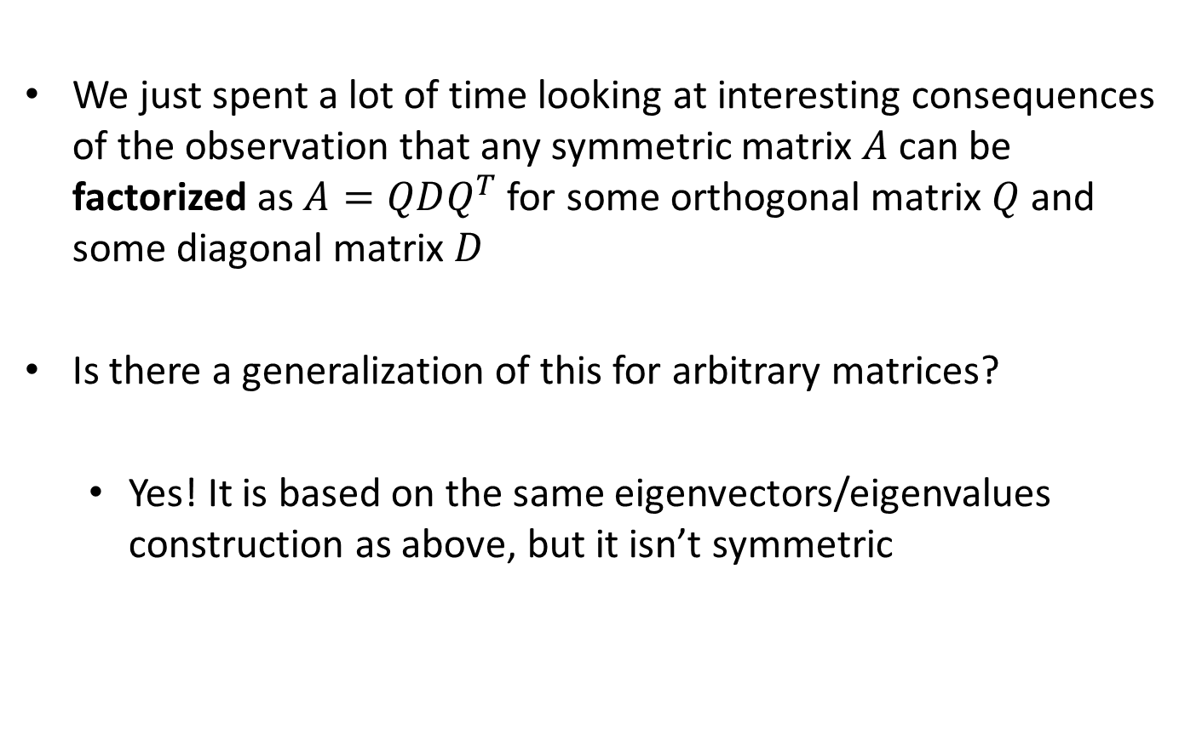
Motivation
We just spent a lot of time looking at interesting consequences of the observation that any symmetric matrix $A$ can be factorized as $A=QDQ^{T}$ for some orthogonal matrix $Q$ and some diagonal matrix $D$
Is there a generalization of this for arbitrary matrices?
  Yes! It is based on the same eigenvectors/eigenvalues construction as above, but it isn’t symmetric

Slide 3
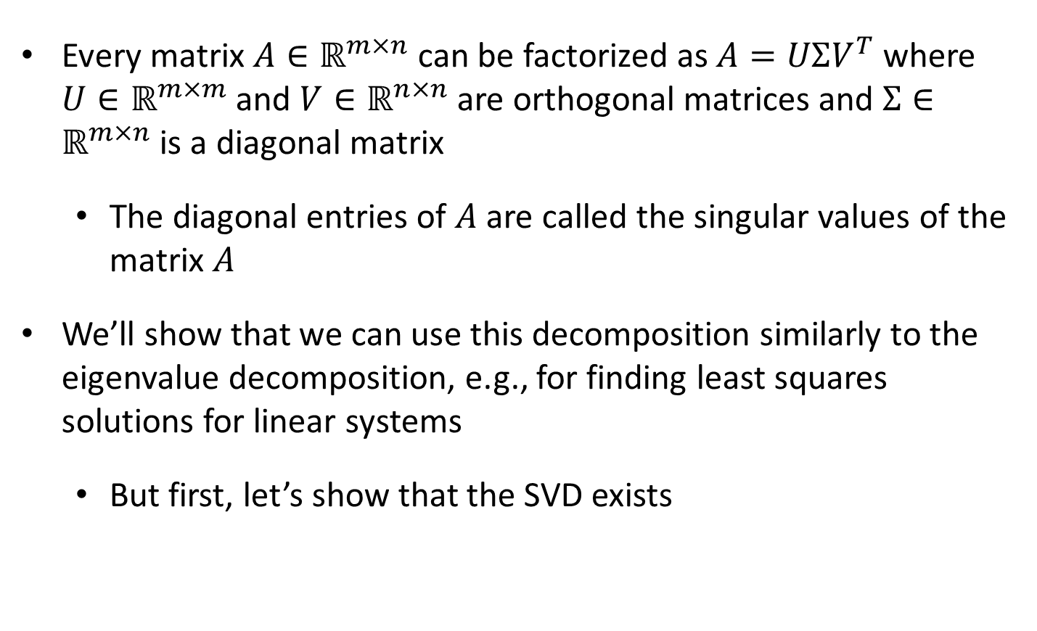
The Singular Value Decomposition
Every matrix $A∈ℝ^{m×n}$ can be factorized as $A=UΣV^{T}$ where $U∈ℝ^{m×m}$ and $V∈ℝ^{n×n}$ are orthogonal matrices and $Σ∈ℝ^{m×n}$ is a diagonal matrix
  The diagonal entries of $A$ are called the singular values of the matrix $A$
We’ll show that we can use this decomposition similarly to the eigenvalue decomposition, e.g., for finding least squares solutions for linear systems
  But first, let’s show that the SVD exists

Slide 4
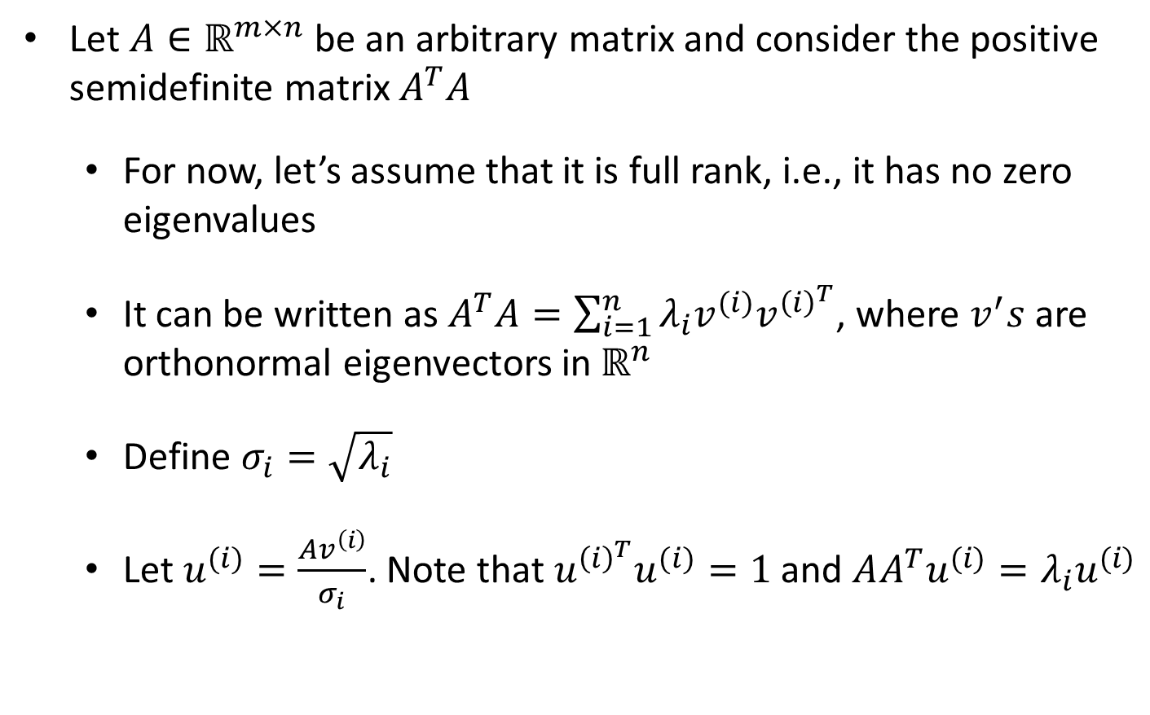
Existence of the SVD
Let $A∈ℝ^{m×n}$ be an arbitrary matrix and consider the positive semidefinite matrix $A^{T}A$
  For now, let’s assume that it is full rank, i.e., it has no zero eigenvalues
  It can be written as $A^{T}A=\sum_{i=1}^{n}{λ_{i}v^{(i)}v^{{\left(i\right)}^{T}}}$, where $v^{′}s$ are orthonormal eigenvectors in $ℝ^{n}$
  Define $σ_{i}=\sqrt{λ_{i}}$
  Let $u^{(i)}=\frac{Av^{\left(i\right)}}{σ_{i}}$. Note that $u^{{\left(i\right)}^{T}}u^{(i)}=1$ and $AA^{T}u^{(i)}=λ_{i}u^{(i)}$

Slide 5
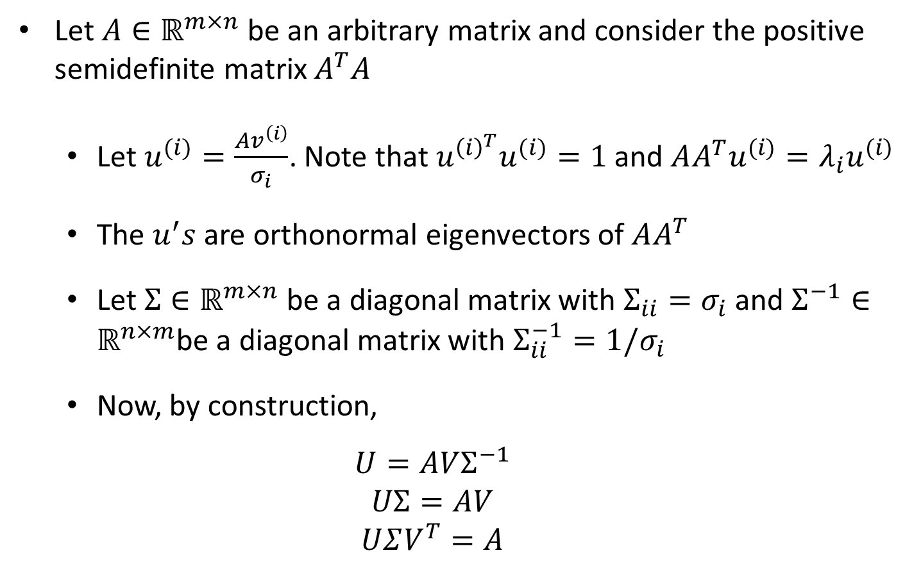
Existence of the SVD
Let $A∈ℝ^{m×n}$ be an arbitrary matrix and consider the positive semidefinite matrix $A^{T}A$
  Let $u^{(i)}=\frac{Av^{\left(i\right)}}{σ_{i}}$. Note that $u^{{\left(i\right)}^{T}}u^{(i)}=1$ and $AA^{T}u^{(i)}=λ_{i}u^{(i)}$
  The $u^{′}s$are orthonormal eigenvectors of $AA^{T}$
  Let $Σ∈ℝ^{m×n}$ be a diagonal matrix with $Σ_{ii}=σ_{i}$ and $Σ^{−1}∈ℝ^{n×m}$be a diagonal matrix with $Σ_{ii}^{−1}=1/σ_{i}$
  Now, by construction,
  $$U=AVΣ^{−1}$$
  $$UΣ=AV$$
  $$UΣV^{T}=A$$

Slide 6
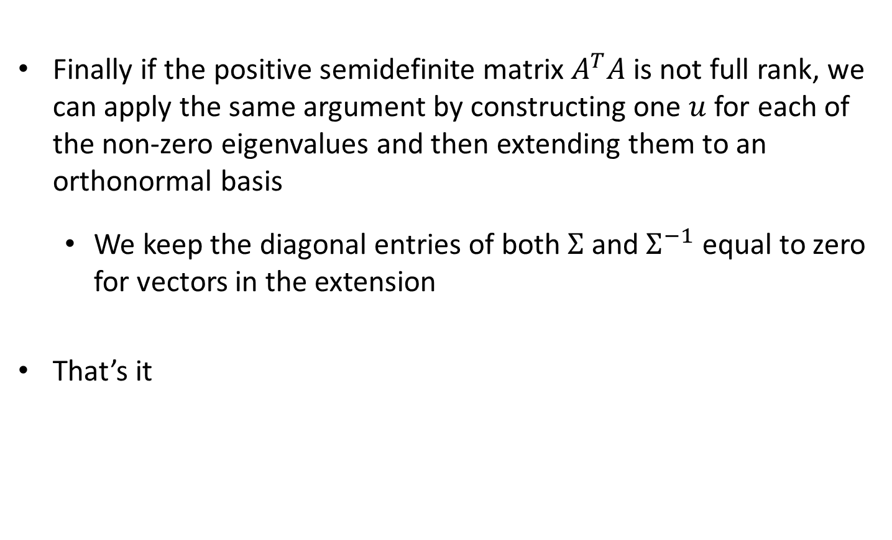
Existence of the SVD
Finally if the positive semidefinite matrix $A^{T}A$ is not full rank, we can apply the same argument by constructing one $u$ for each of the non-zero eigenvalues and then extending them to an orthonormal basis
  We keep the diagonal entries of both $Σ$ and $Σ^{−1}$ equal to zero for vectors in the extension
That’s it
*This nice argument was taken from a blog post of Gregory Gunderson

Slide 7
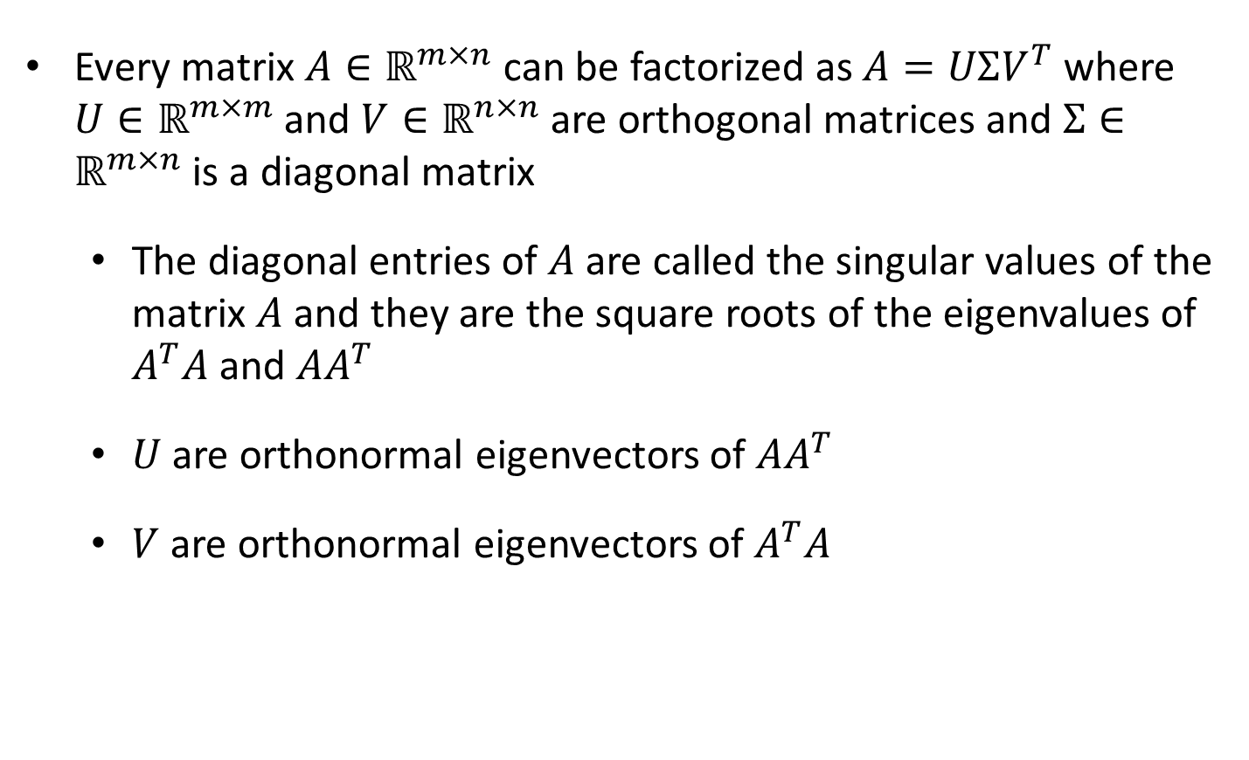
The Singular Value Decomposition
Every matrix $A∈ℝ^{m×n}$ can be factorized as $A=UΣV^{T}$ where $U∈ℝ^{m×m}$ and $V∈ℝ^{n×n}$ are orthogonal matrices and $Σ∈ℝ^{m×n}$ is a diagonal matrix
  The diagonal entries of $A$ are called the singular values of the matrix $A$ and they are the square roots of the eigenvalues of $A^{T}A$ and $AA^{T}$
  $U$ are orthonormal eigenvectors of $AA^{T}$
  $V$ are orthonormal eigenvectors of $A^{T}A$

Slide 8
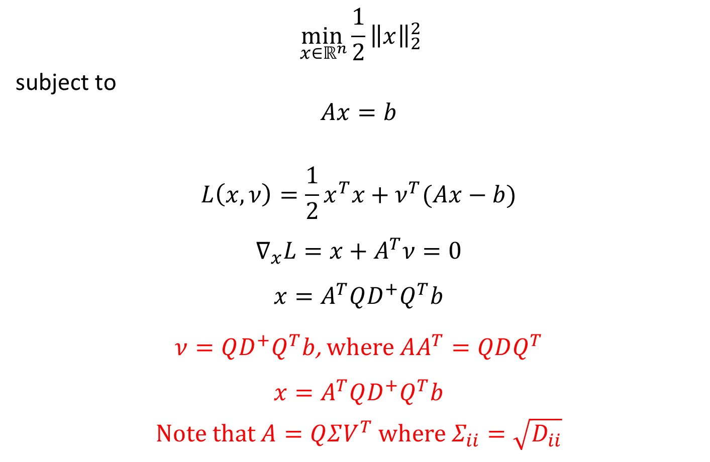
Least Squares Solutions Linear Systems
$$\min_{ x∈ℝ^{n}}{\frac{1}{2}{\left\|x\right\|}_{2}^{2}}$$
subject to
$$Ax=b$$
$$L\left(x,ν\right)=\frac{1}{2}x^{T}x+ν^{T}(Ax−b)$$
$$∇_{x}L=x+A^{T}ν=0$$
$$x=A^{T}QD^{+}Q^{T}b$$
$ν=QD^{+}Q^{T}b$, where $AA^{T}=QDQ^{T}$
$$x=A^{T}QD^{+}Q^{T}b$$
Note that $A=QΣV^{T}$ where $Σ_{ii}=\sqrt{D_{ii}}$

Slide 9
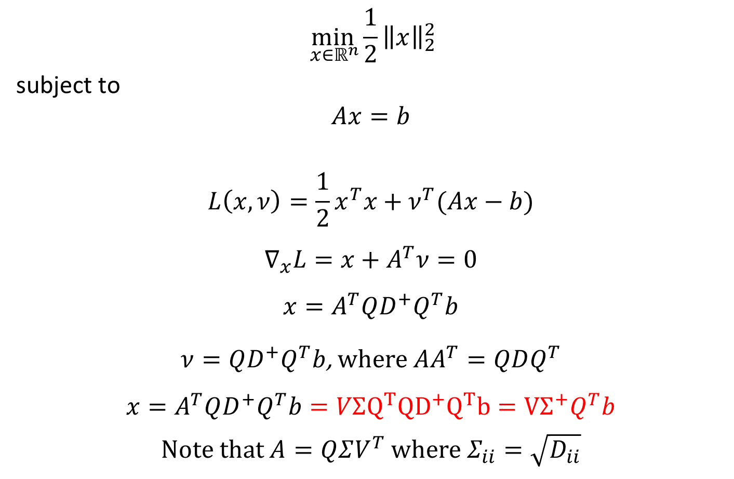
Least Squares Solutions Linear Systems
$$\min_{ x∈ℝ^{n}}{\frac{1}{2}{\left\|x\right\|}_{2}^{2}}$$
subject to
$$Ax=b$$
$$L\left(x,ν\right)=\frac{1}{2}x^{T}x+ν^{T}(Ax−b)$$
$$∇_{x}L=x+A^{T}ν=0$$
$$x=A^{T}QD^{+}Q^{T}b$$
$ν=QD^{+}Q^{T}b$, where $AA^{T}=QDQ^{T}$
$$x=A^{T}QD^{+}Q^{T}b=VΣQ^{T}{QD}^{+}Q^{T}b=VΣ^{+}Q^{T}b$$
Note that $A=QΣV^{T}$ where $Σ_{ii}=\sqrt{D_{ii}}$

Slide 10
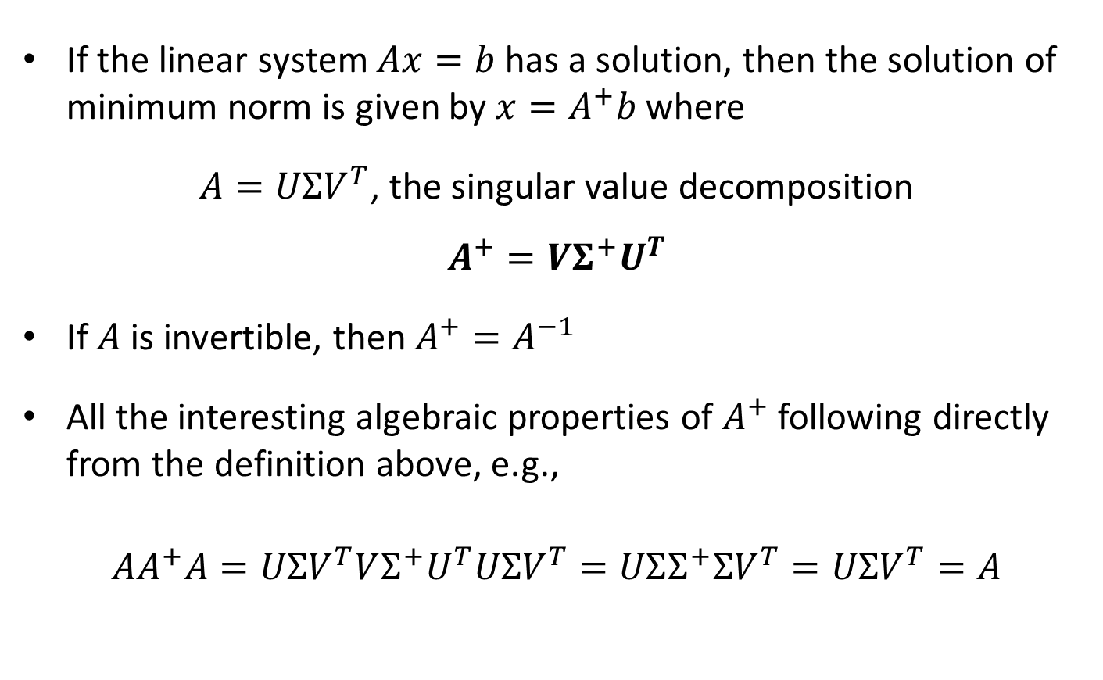
The Morse-Penrose Pseudo-inverse
If the linear system $Ax=b$ has a solution, then the solution of minimum norm is given by $x=A^{+}b$ where
$A=UΣV^{T}$, the singular value decomposition
$$A^{+}=VΣ^{+}U^{T}$$
If $A$ is invertible, then $A^{+}=A^{−1}$
All the interesting algebraic properties of $A^{+}$ following directly from the definition above, e.g.,
$$AA^{+}A=UΣV^{T}VΣ^{+}U^{T}UΣV^{T}=UΣΣ^{+}ΣV^{T}=UΣV^{T}=A$$

Slide 11
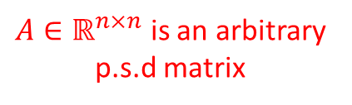

Ex 1: Convex Quadratic Minimization
$$\inf_{x∈ℝ^{n}}{\frac{1}{2}x^{T}Qx−s^{T}x}$$
Either
$$Qx=s$$
or
$$\inf_{x}{\frac{1}{2}x^{T}Qx−s^{T}x=−∞}$$
$A∈ℝ^{n×n}$ is an arbitrary p.s.d matrix

Slide 12

Pseudoinverse
$${\min_{x∈ℝ^{n}}\left\|Ax−b\right\|}_{2}^{2}$$

Slide 13

Pseudoinverse
$$\min_{x∈ℝ^{n}}{{\left(Ax−b\right)}^{T}(Ax−b)}$$

Slide 14

Pseudoinverse
$$\min_{x∈ℝ^{n}}{x^{T}A^{T}Ax−2b^{T}Ax+b^{T}b}$$
Either
$$A^{T}Ax=A^{T}b$$
or
$$\inf_{x}{x^{T}A^{T}Ax−2b^{T}Ax=−∞}$$

Slide 15
Pseudoinverse
$$\min_{x∈ℝ^{n}}{x^{T}A^{T}Ax−2b^{T}Ax+b^{T}b}$$
Either
$$A^{T}Ax=A^{T}b$$
or
$$\inf_{x}{x^{T}A^{T}Ax−2b^{T}Ax=−∞}$$

Slide 16
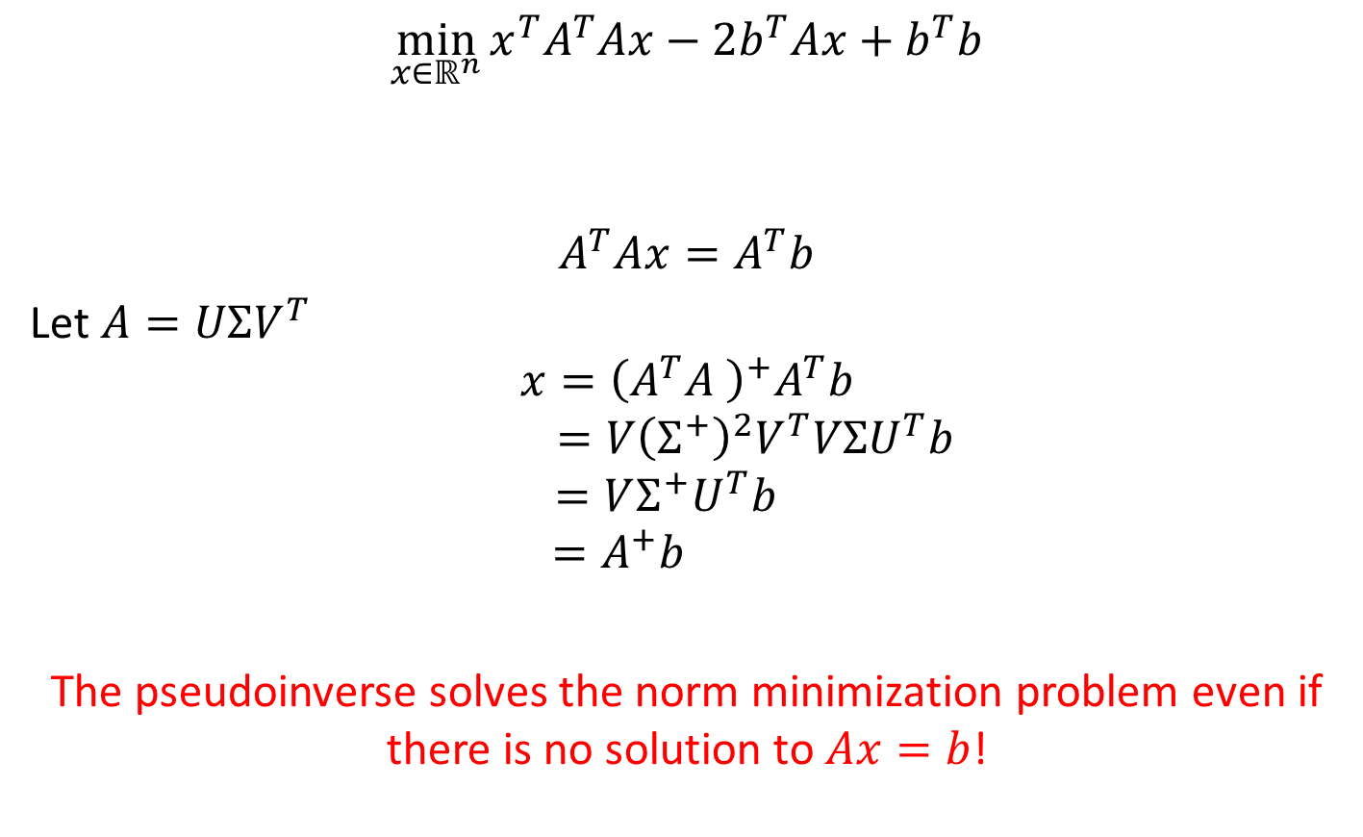
Pseudoinverse
$$\min_{x∈ℝ^{n}}{x^{T}A^{T}Ax−2b^{T}Ax+b^{T}b}$$
$$A^{T}Ax=A^{T}b$$
Let $A=UΣV^{T}$
$$x={\left(A^{T}A \right)}^{+}A^{T}b$$
$$=V{\left(Σ^{+}\right)}^{2}V^{T}VΣU^{T}b$$
$$=VΣ^{+}U^{T}b$$
$$=A^{+}b$$
The pseudoinverse solves the norm minimization problem even if there is no solution to $Ax=b$!

Slide 17

Ex 2: Convex Quadratic Minimization
$$\min_{x∈ℝ^{n}}{\frac{1}{2}x^{T}Qx−s^{T}x}$$
subject to
$$x≥0$$
$$L\left(x,λ\right)=\frac{1}{2}x^{T}Qx−s^{T}x−λ^{T}x$$
$A∈ℝ^{n×n}$ is an arbitrary p.s.d matrix

Slide 18

Ex 2: Convex Quadratic Minimization
$$\min_{x∈ℝ^{n}}{\frac{1}{2}x^{T}Qx−s^{T}x}$$
subject to
$$x≥0$$
$$L\left(x,λ\right)=\frac{1}{2}x^{T}Qx−s^{T}x−λ^{T}x$$
Either
$$Qx=s+λ$$
or
$$\inf_{x}{L\left(x,λ\right)=−∞}$$

Slide 19

Ex 2: Convex Quadratic Minimization
$$\min_{x∈ℝ^{n}}{\frac{1}{2}x^{T}Qx−s^{T}x}$$
subject to
$$x≥0$$
$$L\left(x,λ\right)=\frac{1}{2}x^{T}Qx−s^{T}x−λ^{T}x$$
$$\max_{λ}{\frac{1}{2}\left({\left(s+λ\right)}^{T}Q^{+}QQ^{+}(s+λ)\right)−{\left(s+λ\right)}^{T}Q^{+}(s+λ) }$$
subject to
$$∃x st. Qx=s+λ$$
$$λ≥0$$

Slide 20

Ex 2: Convex Quadratic Minimization
$$\min_{x∈ℝ^{n}}{\frac{1}{2}x^{T}Qx−s^{T}x}$$
subject to
$$x≥0$$
$$L\left(x,λ\right)=\frac{1}{2}x^{T}Qx−s^{T}x−λ^{T}x$$
$$\max_{λ}{−\frac{1}{2}{\left(s+λ\right)}^{T}Q^{+}(s+λ) }$$
subject to
$$∃x st. Qx=s+λ$$
$$λ≥0$$

Slide 21

Ex 2: Convex Quadratic Minimization
$$\min_{x∈ℝ^{n}}{\frac{1}{2}x^{T}Qx−s^{T}x}$$
subject to
$$x≥0$$
$$L\left(x,λ\right)=\frac{1}{2}x^{T}Qx−s^{T}x−λ^{T}x$$
$$\max_{λ}{−\frac{1}{2}{\left(s+λ\right)}^{T}Q^{+}(s+λ) }$$
subject to
$$(s+λ)∈span(eig. vec. of Q with non−zero eigenvalue)$$
$$λ≥0$$

Slide 22


Ex 2: Convex Quadratic Minimization
$$\min_{x∈ℝ^{n}}{\frac{1}{2}x^{T}Qx−s^{T}x}$$
subject to
$$x≥0$$
$$L\left(x,λ\right)=\frac{1}{2}x^{T}Qx−s^{T}x−λ^{T}x$$
$$\max_{λ}{−\frac{1}{2}{\left(s+λ\right)}^{T}Q^{+}(s+λ) }$$
subject to
$$For all i st. μ_{i}=0, {\left(s+λ\right)}^{T}x^{(i)}=0$$
$$λ≥0$$
$$Q=\sum_{i}{μ_{i}x^{(i)}x^{{\left(i\right)}^{T}}}$$

Slide 23
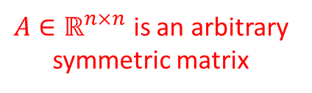

Non-Convex Quadratic Minimization
$$\min_{x∈ℝ^{n}}{x^{T}Ax+2b^{T}x}$$
subject to
$$x^{T}x≤1$$
$A∈ℝ^{n×n}$ is an arbitrary symmetric matrix

Slide 24

Non-Convex Quadratic Minimization
$$\min_{x∈ℝ^{n}}{x^{T}Ax+2b^{T}x}$$
subject to
$$x^{T}x≤1$$
$$L\left(x,y\right)=x^{T}Ax+2b^{T}x+λ\left(x^{T}x−1\right)$$
$$=x^{T}\left(A+λI\right)x+2b^{T}x−λ$$
$A∈ℝ^{n×n}$ is an arbitrary symmetric matrix

Slide 25
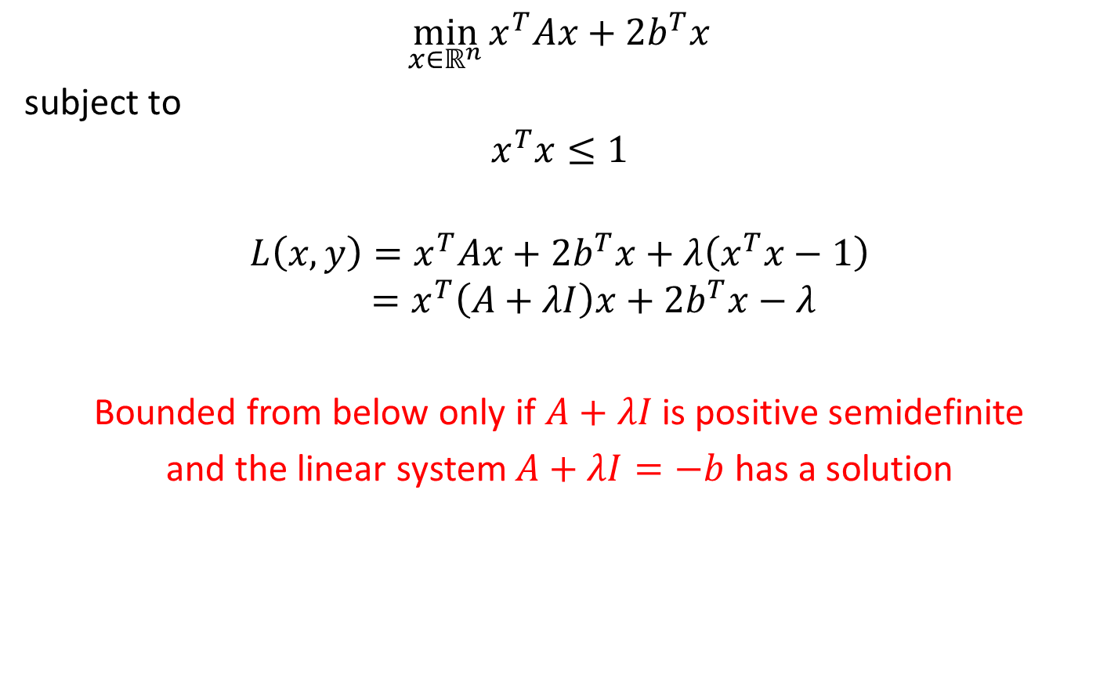
Non-Convex Quadratic Minimization
$$\min_{x∈ℝ^{n}}{x^{T}Ax+2b^{T}x}$$
subject to
$$x^{T}x≤1$$
$$L\left(x,y\right)=x^{T}Ax+2b^{T}x+λ\left(x^{T}x−1\right)$$
$$=x^{T}\left(A+λI\right)x+2b^{T}x−λ$$
Bounded from below only if $A+λI$ is positive semidefinite
and the linear system $A+λI=−b$ has a solution
$A∈ℝ^{n×n}$ is an arbitrary symmetric matrix

Slide 26
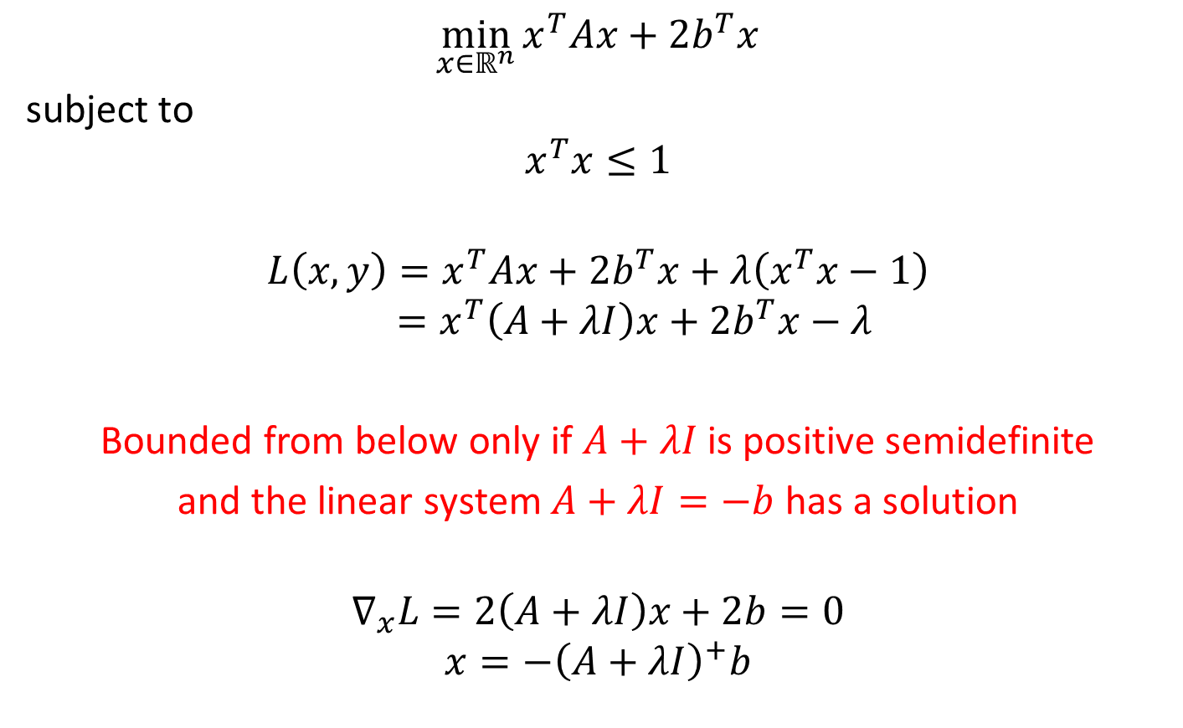
Non-Convex Quadratic Minimization
$$\min_{x∈ℝ^{n}}{x^{T}Ax+2b^{T}x}$$
subject to
$$x^{T}x≤1$$
$$L\left(x,y\right)=x^{T}Ax+2b^{T}x+λ\left(x^{T}x−1\right)$$
$$=x^{T}\left(A+λI\right)x+2b^{T}x−λ$$
Bounded from below only if $A+λI$ is positive semidefinite
and the linear system $A+λI=−b$ has a solution
$$∇_{x}L=2\left(A+λI\right)x+2b=0$$
$$x=−{\left(A+λI\right)}^{+}b$$
$A∈ℝ^{n×n}$ is an arbitrary symmetric matrix

Slide 27
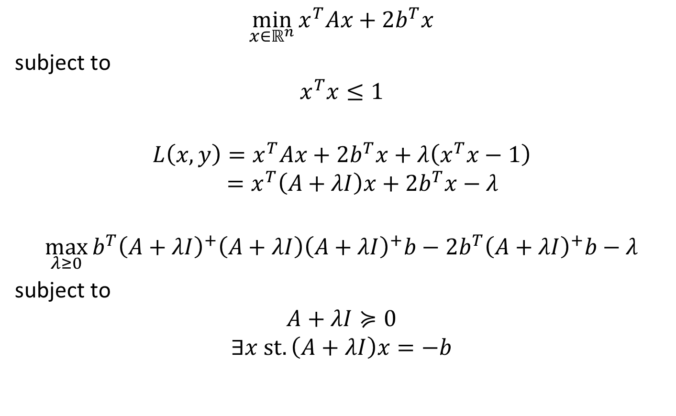
Non-Convex Quadratic Minimization
$$\min_{x∈ℝ^{n}}{x^{T}Ax+2b^{T}x}$$
subject to
$$x^{T}x≤1$$
$$L\left(x,y\right)=x^{T}Ax+2b^{T}x+λ\left(x^{T}x−1\right)$$
$$=x^{T}\left(A+λI\right)x+2b^{T}x−λ$$
$$\max_{λ≥0}{b^{T}{\left(A+λI\right)}^{+}\left(A+λI\right){\left(A+λI\right)}^{+}b−2b^{T}{\left(A+λI\right)}^{+}b−λ}$$
subject to
$$A+λI≽0$$
$$∃x st. \left(A+λI\right)x=−b$$
$A∈ℝ^{n×n}$ is an arbitrary symmetric matrix

Slide 28

Non-Convex Quadratic Minimization
$$\min_{x∈ℝ^{n}}{x^{T}Ax+2b^{T}x}$$
subject to
$$x^{T}x≤1$$
$$L\left(x,y\right)=x^{T}Ax+2b^{T}x+λ\left(x^{T}x−1\right)$$
$$=x^{T}\left(A+λI\right)x+2b^{T}x−λ$$
$$\max_{λ≥0}{−b^{T}{\left(A+λI\right)}^{+}b−λ}$$
subject to
$$A+λI≽0$$
$$∃x st. \left(A+λI\right)x=−b$$
$A∈ℝ^{n×n}$ is an arbitrary symmetric matrix

Slide 29
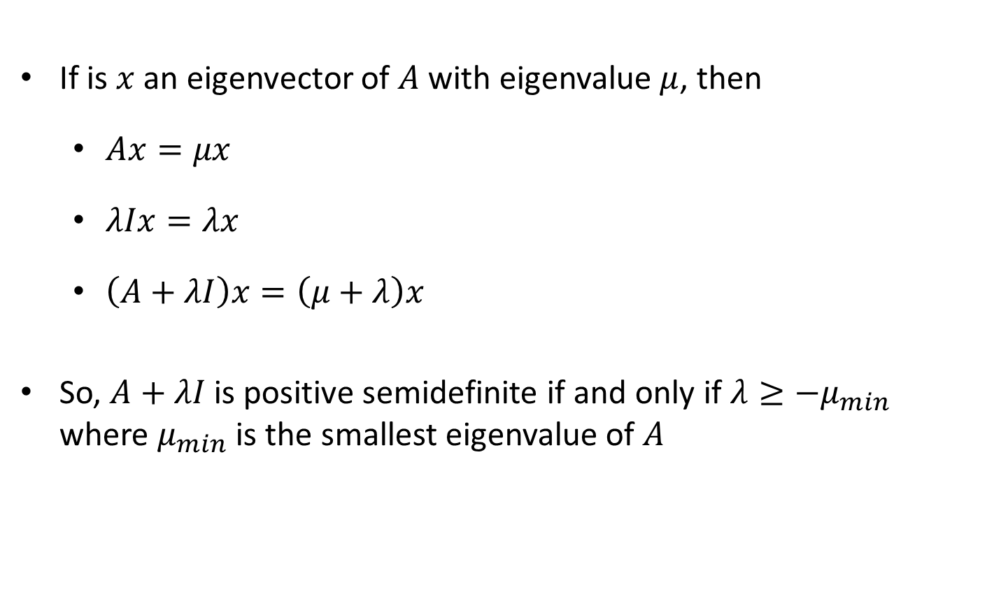

Eigenvectors of $A+λI$
If is $x$ an eigenvector of $A$ with eigenvalue $μ$, then
  $Ax=μx$
  $λIx=λx$
  $\left(A+λI\right)x=\left(μ+λ\right)x$
So, $A+λI$ is positive semidefinite if and only if $λ≥−μ_{min}$ where $μ_{min}$ is the smallest eigenvalue of $A$

Slide 30

Non-Convex Quadratic Minimization
$$\min_{x∈ℝ^{n}}{x^{T}Ax+2b^{T}x}$$
subject to
$$x^{T}x≤1$$
$$L\left(x,y\right)=x^{T}Ax+2b^{T}x+λ\left(x^{T}x−1\right)$$
$$=x^{T}\left(A+λI\right)x+2b^{T}x−λ$$
$$\max_{λ≥0}{−b^{T}{\left(A+λI\right)}^{+}b−λ}$$
subject to
$$λ≥−μ_{min}$$
$$∃x st. \left(A+λI\right)x=−b$$
$A∈ℝ^{n×n}$ is an arbitrary symmetric matrix

Slide 31
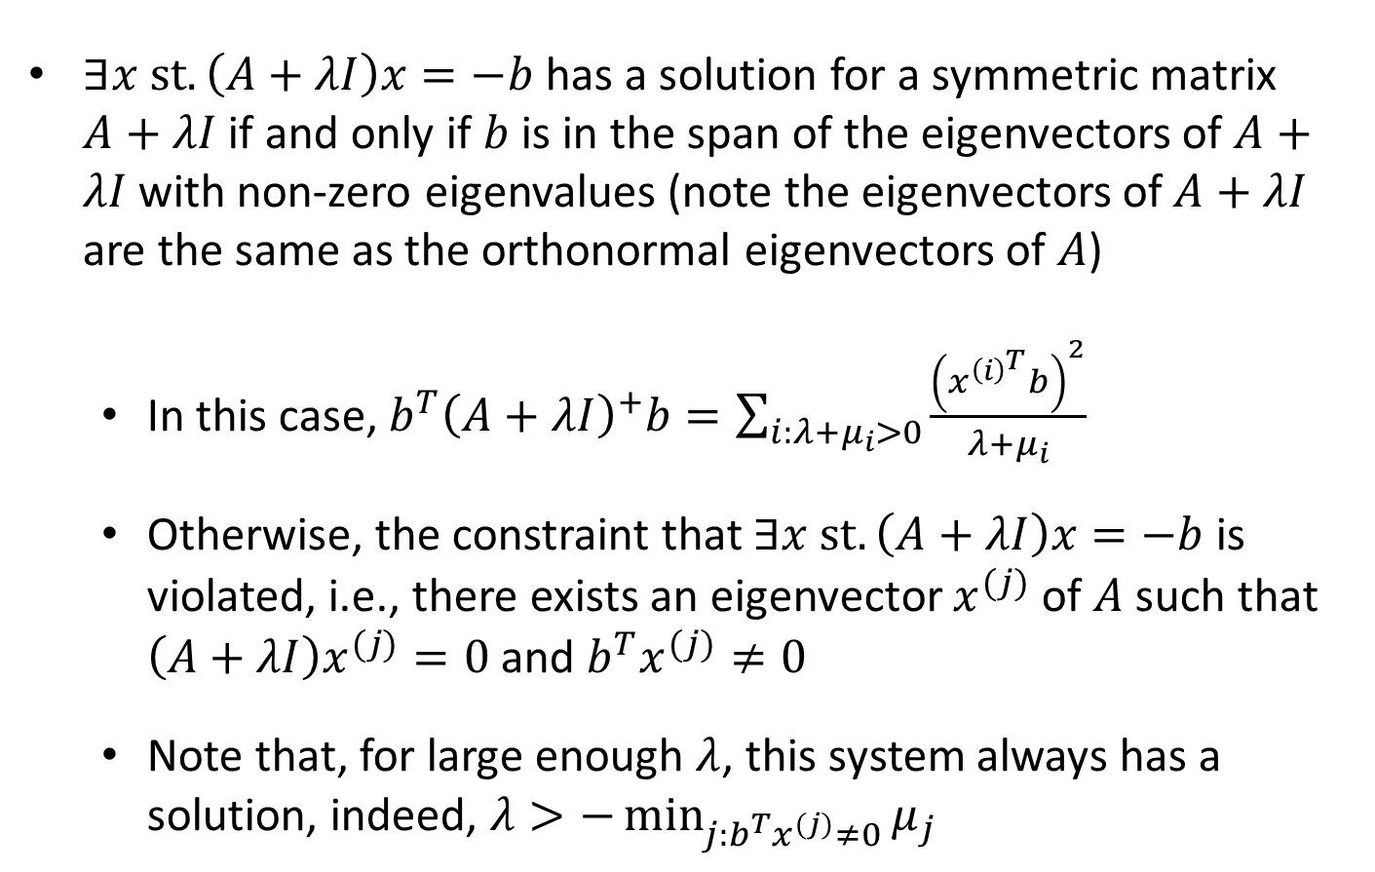
Range of a Matrix
$∃x st. \left(A+λI\right)x=−b$ has a solution for a symmetric matrix $A+λI$ if and only if $b$ is in the span of the eigenvectors of $A+λI$ with non-zero eigenvalues (note the eigenvectors of$A+λI$ are the same as the orthonormal eigenvectors of $A$)
  In this case, $b^{T}{\left(A+λI\right)}^{+}b=\sum_{i:λ+μ_{i}>0}{\frac{{\left(x^{{\left(i\right)}^{T}}b\right)}^{2}}{λ+μ_{i}}}$
  Otherwise, the constraint that $∃x st. \left(A+λI\right)x=−b$ is violated, i.e., there exists an eigenvector $x^{(j)}$ of $A$ such that $\left(A+λI\right)x^{(j)}=0$ and $b^{T}x^{(j)}≠0$
  Note that, for large enough $λ$, this system always has a solution, indeed, $λ>−\min_{j:b^{T}x^{(j)}≠0}{μ_{j}}$

Slide 32

Non-Convex Quadratic Minimization
$$\min_{x∈ℝ^{n}}{x^{T}Ax+2b^{T}x}$$
subject to
$$x^{T}x≤1$$
$$\max_{λ≥0}{−f(λ)−λ}$$
subject to
$$λ≥−μ_{min}$$
where
$$f\left(λ\right)=\left\{\begin{matrix}\begin{matrix} \\ ∞,\end{matrix} & if ∃j st. b^{T}x^{\left(j\right)}≠0 and λ+μ_{j}=0 \\ \left(\sum_{i:λ+μ_{i}>0}{\frac{{\left(x^{{\left(i\right)}^{T}}b\right)}^{2}}{λ+μ_{i}}}\right), & otherwise\end{matrix}\right.$$
$A∈ℝ^{n×n}$ is an arbitrary symmetric matrix

Slide 33
Non-Convex Quadratic Minimization
$$\min_{x∈ℝ^{n}}{x^{T}Ax+2b^{T}x}$$
subject to
$$x^{T}x≤1$$
$$\max_{λ≥0}{−f(λ)−λ}$$
subject to
$$λ≥−μ_{min}$$
where
$$f\left(λ\right)=\left\{\begin{matrix}\begin{matrix} \\ ∞,\end{matrix} & if ∃j st. b^{T}x^{\left(j\right)}≠0 and λ+μ_{j}=0 \\ \left(\sum_{i:λ+μ_{i}>0}{\frac{{\left(x^{{\left(i\right)}^{T}}b\right)}^{2}}{λ+μ_{i}}}\right), & otherwise\end{matrix}\right.$$
$A∈ℝ^{n×n}$ is an arbitrary symmetric matrix
How would you solve this problem?

Slide 34
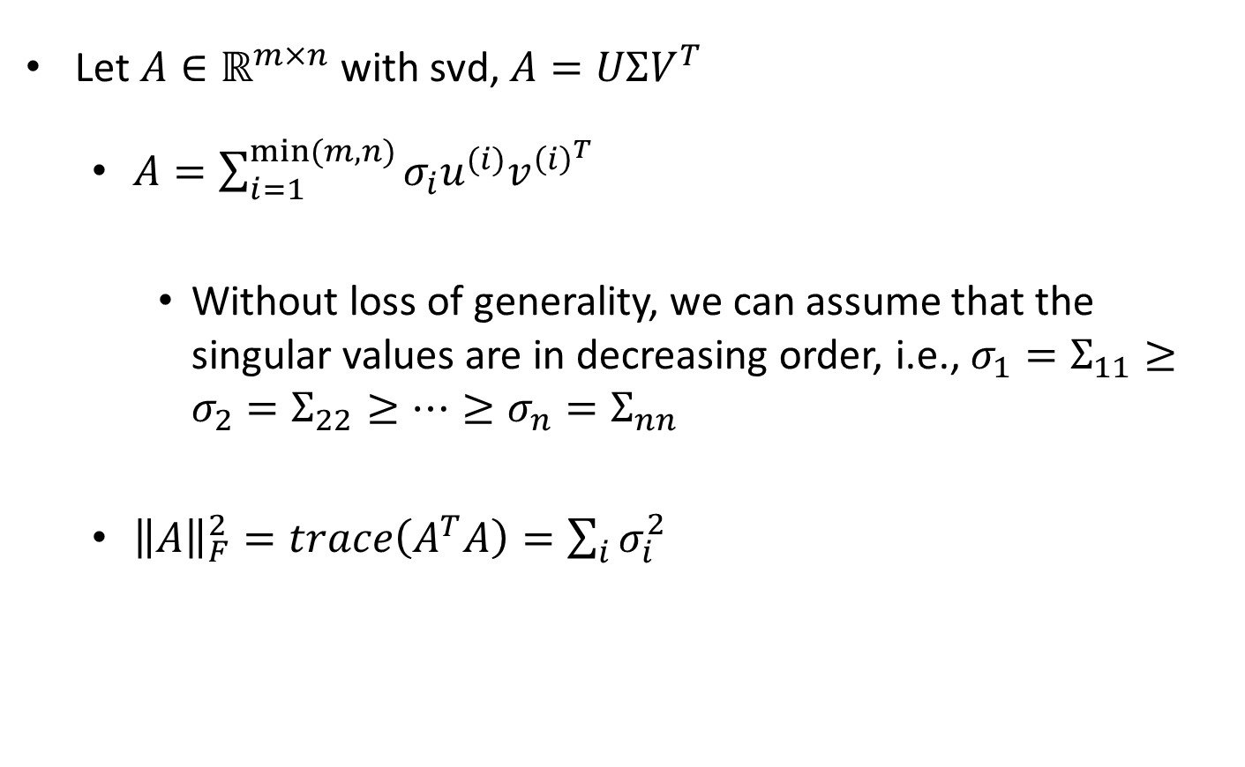
SVD Reformulated
Let $A∈ℝ^{m×n}$ with svd, $A=UΣV^{T}$
  $A=\sum_{i=1}^{min⁡(m,n)}{σ_{i}u^{(i)}v^{{\left(i\right)}^{T}}}$
    Without loss of generality, we can assume that the singular values are in decreasing order, i.e., $σ_{1}=Σ_{11}≥σ_{2}=Σ_{22}≥…≥σ_{n}=Σ_{nn}$
  ${\left\|A\right\|}_{F}^{2}=trace\left(A^{T}A\right)=\sum_{i}{σ_{i}^{2}}$

Slide 35

Applications of SVD: Low Rank Approximations
$$B^{∗}=\arg{\min_{B st. rank\left(B\right)=k}{{\left\|A−B\right\|}_{F}^{2}} }$$
$$A=UΣV^{T}=\sum_{i=1}^{min⁡(m,n)}{σ_{i}u^{(i)}v^{{\left(i\right)}^{T}}}$$
$$B^{∗}=\sum_{i=1}^{k}{σ_{i}u^{(i)}v^{{\left(i\right)}^{T}}}$$
Note: $σ^{′}s$ must be in decreasing order for this!

